Slide 1

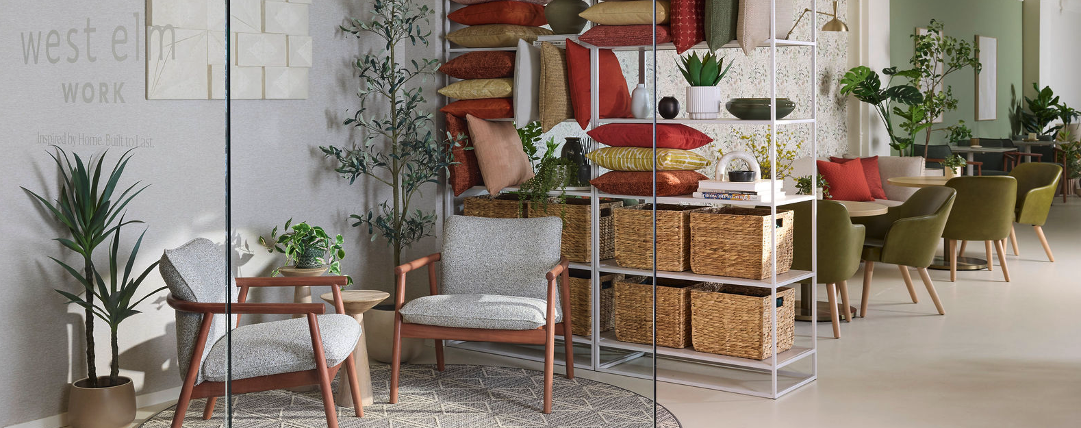
Inspired by home. Built to last. West Elm Work is a collaboration between Steelcase and West Elm to humanize the workplace by creating environments that are both beautiful and durable.
Merchandise Mart
10th Floor
Suite 10-165
Web Experience

Slide 2
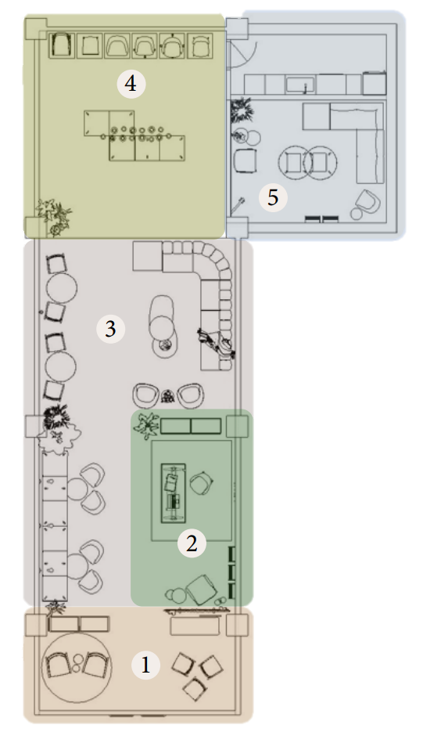
Merchandise Mart Suite 10-165
1 | New Product: Fulton Collection
2 | Private Office + Designtex Collaboration
3 | Lounge Seating + Café
4 | Featured Seating Families
5 | Health Collection

Slide 3
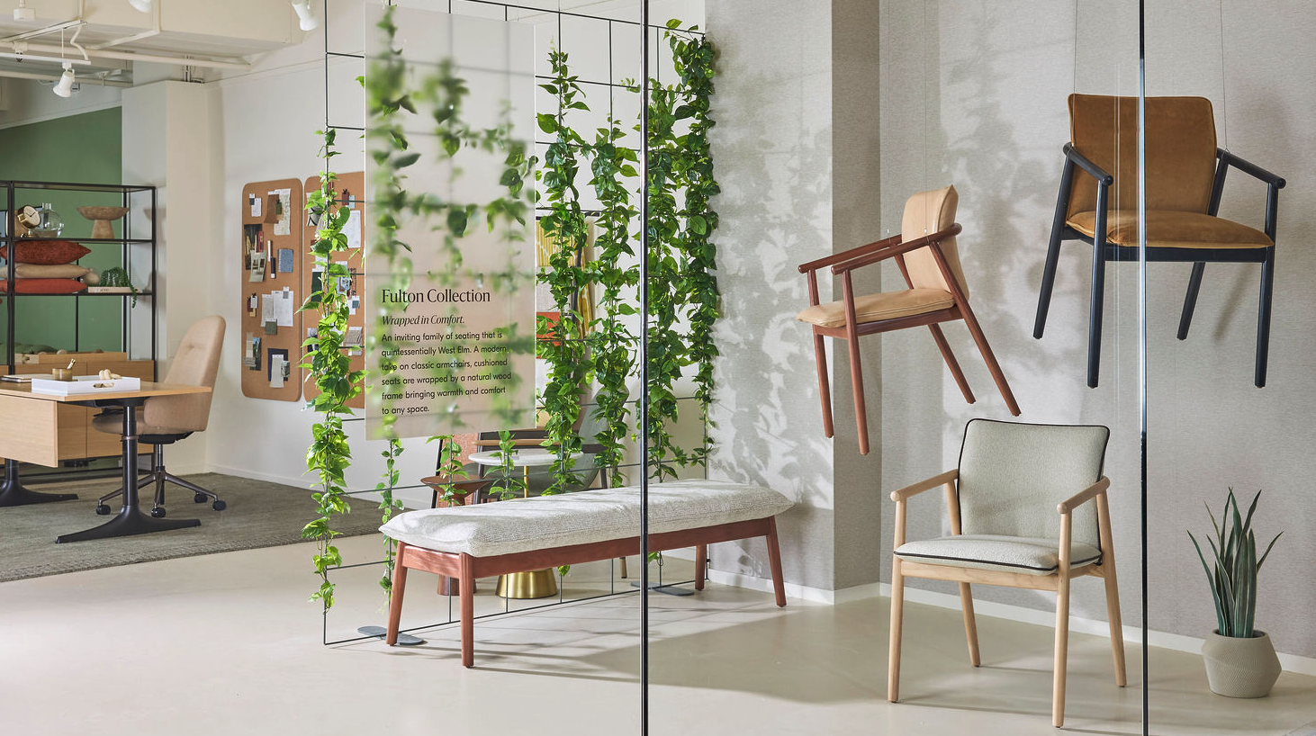
1 | New Product Feature: Fulton Collection
Featured Products
Fulton Guest Chairs
Fulton Bench
Fulton Lounge Chairs
A wood frame available in 5 standard finishes and custom stain program
Upholstery: COMs, COLs, graded-in, Steelcase standards, Designtex + West Elm collection
Optional contrasting cord for pops of color or elegant complementary leathers
Greenpoint Bookcase
Steelcase standard, lux, and accent paints
Standard HPLs and Veneers
Retail/Partner Products
Designtex Pillow Display
Area Rug (Shaw)
Meyer Side Tables (West Elm Retail)
Celebrate our modern take on classic armchairs. Cushioned seats are wrapped by a natural wood frame bringing warmth and comfort to any space. The Fulton Collection includes a guest chair, lounge chair and bench.

Slide 4
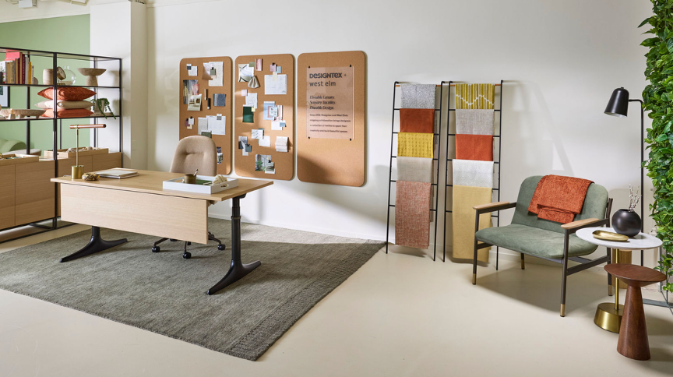
2 | Private Office + Designtex Collaboration
Designtex
7.0 Drop: Coming soon! This collection features 3 new fabric families: Marl, Template and Acre, all bleach cleanable. We have the full range of samples in the health space. Two are bold patterns, and one is a warm new texture.
Wallcoverings:
Blur (front window)
From the digital studio: Liliana (Boardwalk wall), Bloomer (Health showroom) You can change the scale and all colorways to make each design blend seamlessly with your space
Featured Products
West Elm Work
Greenpoint Storage Bookcase
Sutton Height-Adjustable Desk with Modesty Panel
Kent Conference Chair
Brighton Lounge Chair
Maisie Side Table
Retail/Partner Products
NEW Designtex 7.0 Collection
Area Rug (West Elm Retail)
Meyer Side Table (West Elm Retail)
Floor Lamp (West Elm Retail)
Sift through the latest Designtex + West Elm fabric collection. The collaboration combines West Elm’s residential inspiration with Designtex’s deep understanding of the commercial market, delivering designers a textile collection to create beautiful spaces.

Slide 5
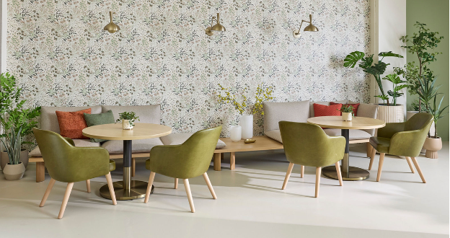
3 | Lounge Seating + Café
Featured Products
West Elm Work
Boardwalk Lounge System
Inspired by Japanese style of pillow seating mixed with ‘California cool’ wood benches
Floating like cushions have a durable molded plywood frame with ‘lived in’ pillow-like upholstery to appear floating while actually securely bolted to the base
1, 2, or 3-seaters
Each seat: no cushion, Single Cushion, cushion with back, or corner cushion
Square, round, rectangle, and oval coffee tables in 2 heights for nesting
Sterling Lounge Chairs
Retail/Partner Products
Designtex Wallcovering, Liliana
Orbit Café Tables (West Elm Retail)
Lighting (West Elm Retail)
Relax and enjoy lounge and café spaces that are inspired by home and built to last. These spaces embody the collaboration between innovative workplace brand Steelcase and global modern furnishings retailer West Elm.

Slide 6
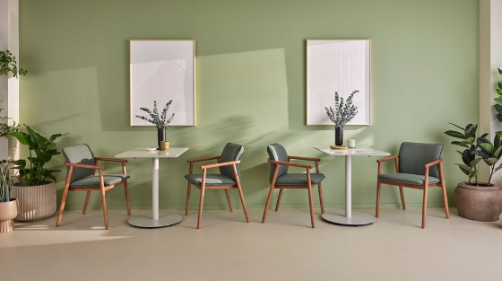
3 | Lounge Seating + Café
Featured Products
West Elm Work
Fulton Guest Chairs
Retail/Partner Products
Chroma Café Tables (West Elm Retail)

Slide 7
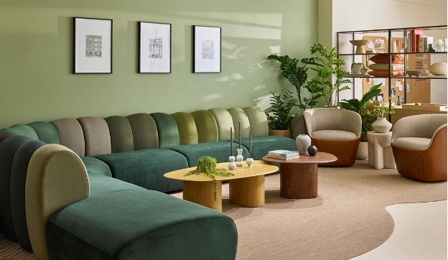
3 | Lounge Seating + Café
Featured Products
West Elm Work
Belle Sofa
Belle is a beauty and a statement piece. Large chunky channels create fun and inspiring color stories with the ability to do contrasting seat, back, and individual channels.
Willow Lounge Chairs
Available in fixed or 360-swivel options, Willow is a classic club chair.
Also sporting contrasting fabrics.
Willow has two back upholstery options, smooth (shown) or soft which gives it a duvet-like backing.
Retail/Partner Products
Organic Modular Tables (West Elm Retail)
Monti Side Table (West Elm Retail)
Lighting (West Elm Retail)
Area Rug (West Elm Retail)

Slide 8
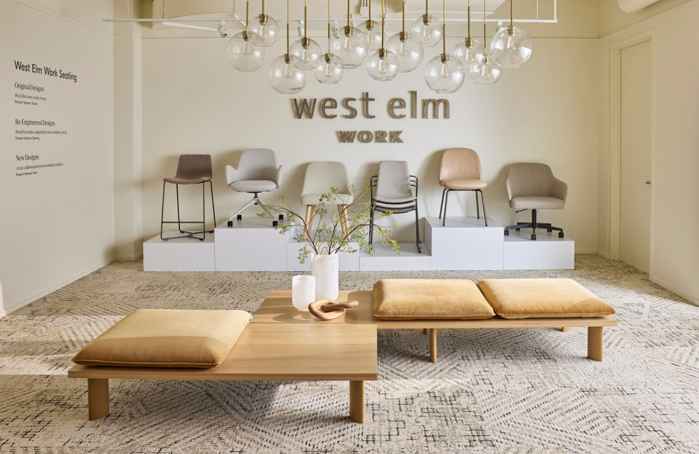
4 | Featured Seating Families
Slope
Slope is a West Elm retail icon, ready to spec with infinite colorways and finish combinations and an expanded statement of line
Slope Stacking Guest Chairs
Slope Stool
Sterling
Sterling is a retail bestseller adapted for the workplace. What started as the “Mid-Century Chair” on the retail side, was re-engineered by Steelcase for a wider sit and an expanded statement. The Sterling chair has quickly become the best-seller in the Work collection too.
Sterling Guest Chair
Sterling Conference Chair
Kent
Kent is a true collaboration between industry leaders. Designed specifically for the contract market with a focus on conference and collaboration, Kent is a juxtaposition to the rectilinear chairs of the mid-century. With no straight lines and all smooth curves, Kent is an inviting sit every time.
Kent Conference Chair
Kent Guest Chair
Boardwalk Lounge System

Slide 9
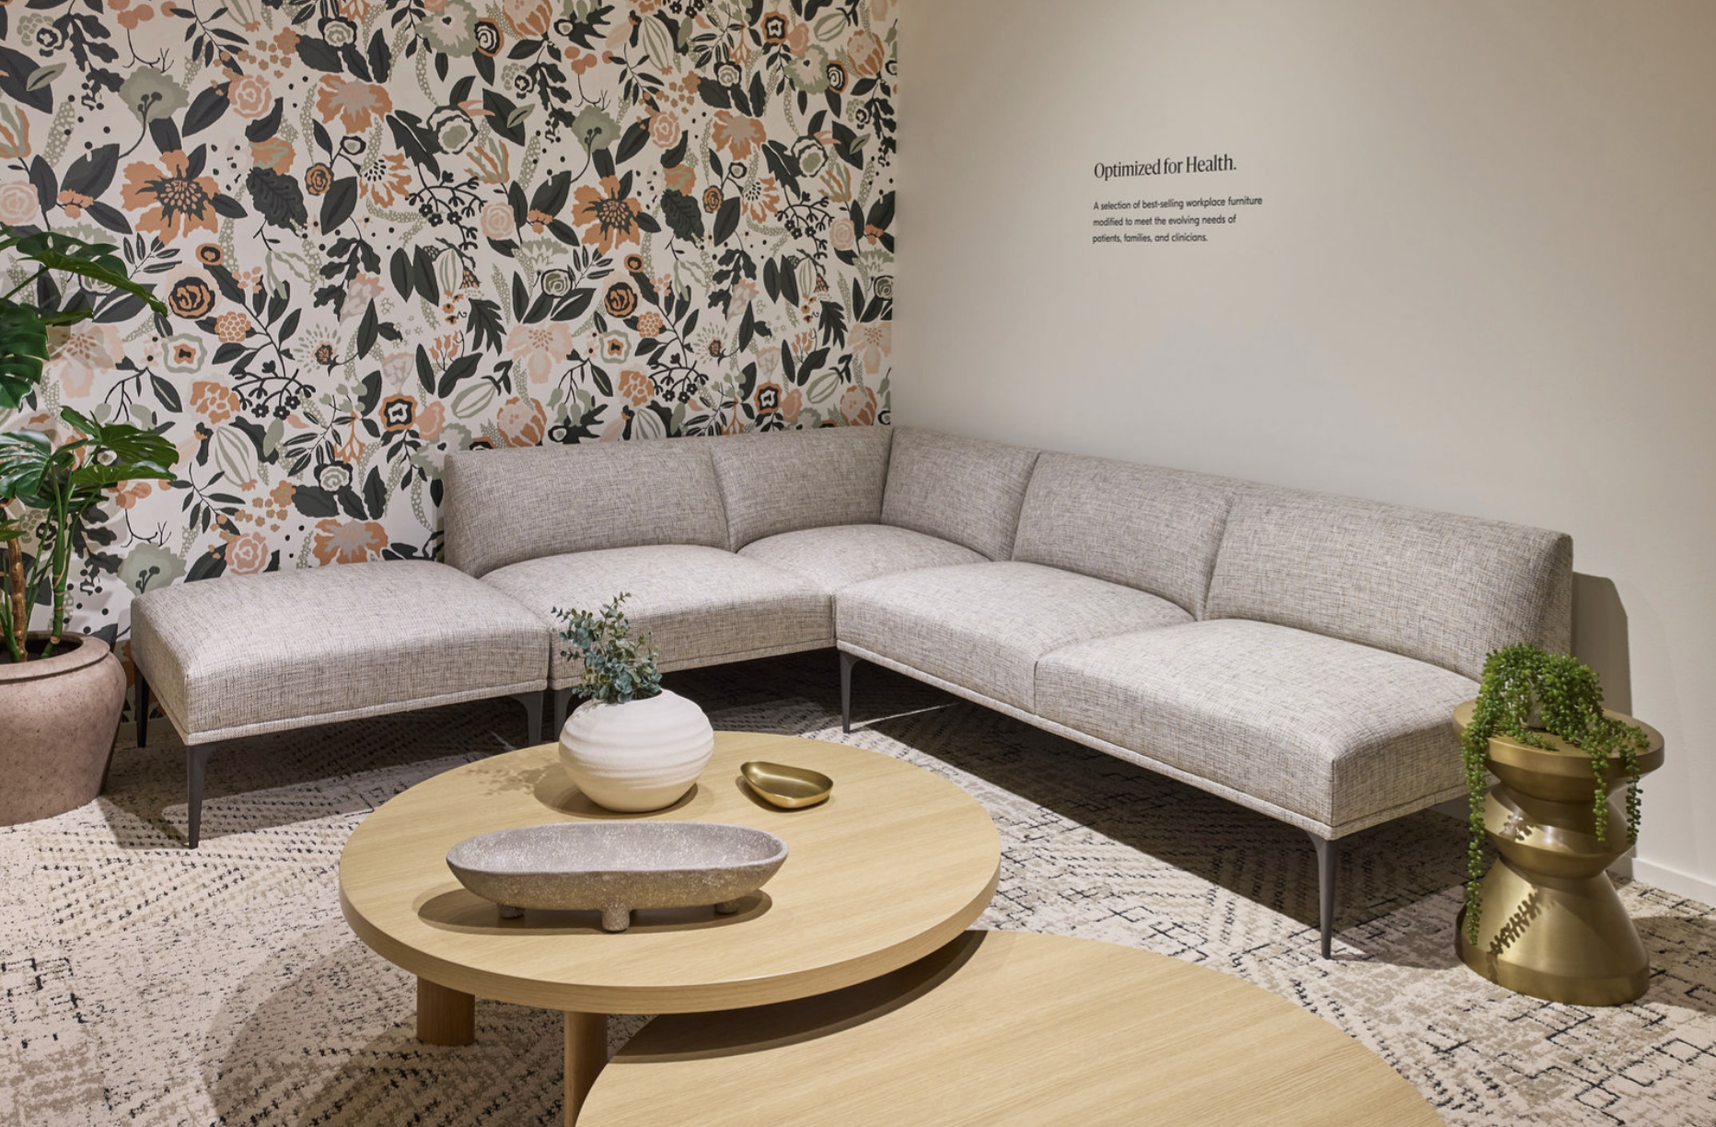
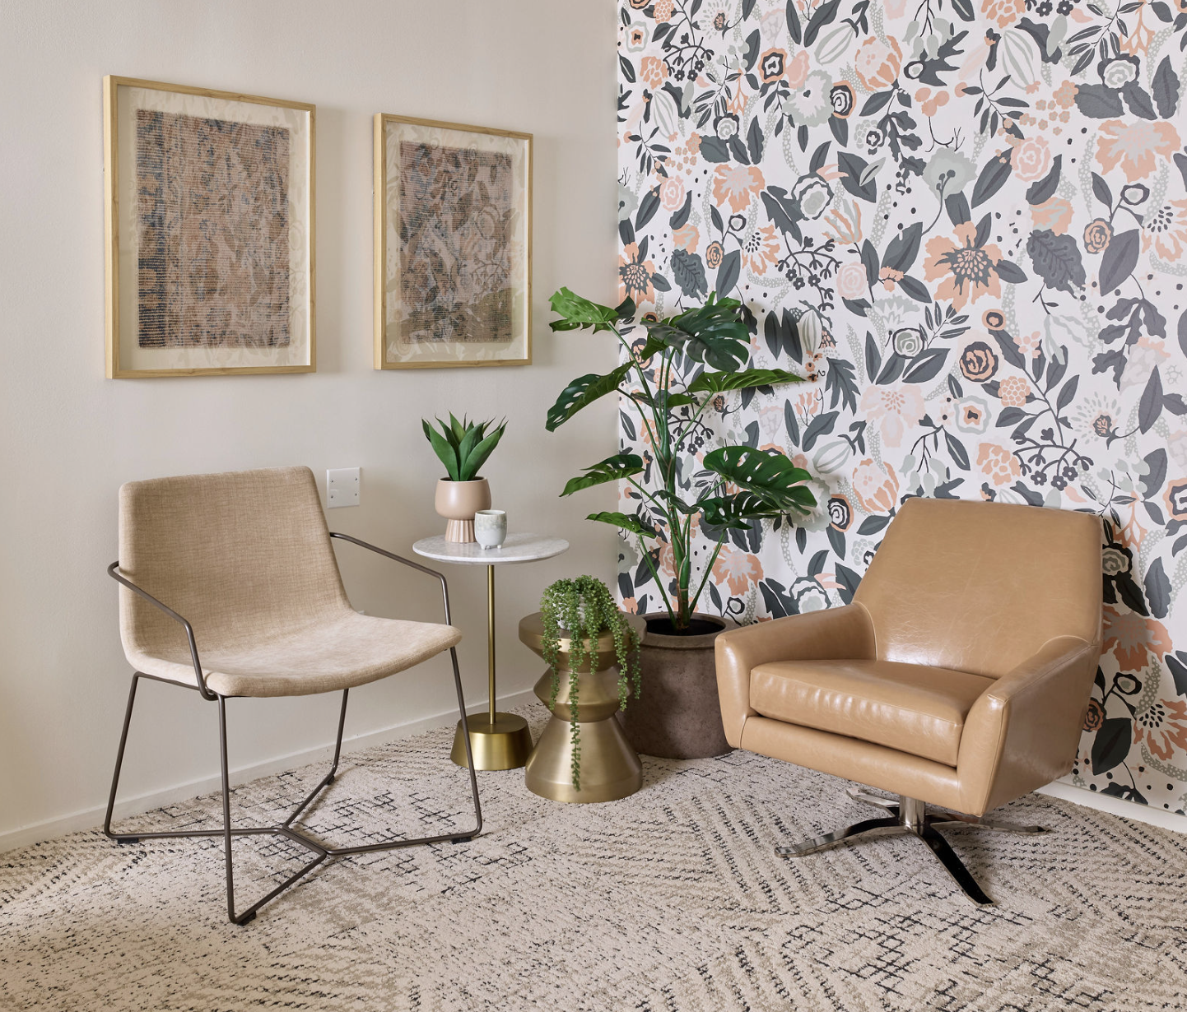
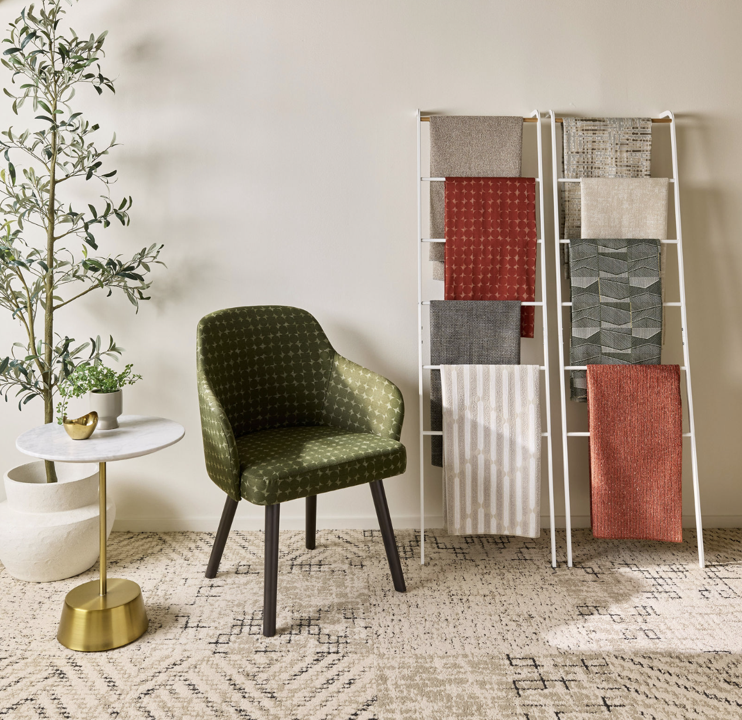
5 | Health Collection
Featured Products
Mesa Health Sectional
Health Modifications to SOL: crumb sweep, tested to BIFMA weight reqs (500+lbs), healthcare appropriate fabric options
Sterling Health Guest Chair
Health modifications to SOL: Crumb sweep, tested to BIFMA weight reqs (300lbs), healthcare appropriate fabrics, Metal leg option, decreased seat recline
Slope Health Bariatric Chair
Health Modifications to SOL: tested to BIFMA weight reqs (Bariatric to 500+ lbs, all others 300lbs), healthcare approved fabric options, decreased recline
Lucas Swivel Lounge Chair
Maisie Side Tables
Boardwalk Coffee Tables
Nolan Side Table
Retail/Partner Products
All Designtex fabrics featured are bleach cleanable
Designtex Wallcovering, Bloomer
Carpet Tiles (Shaw)
Discover a selection of best-selling workplace furniture, modified specifically for healthcare environments to meet the evolving needs of patients, families and clinicians.

Slide 10

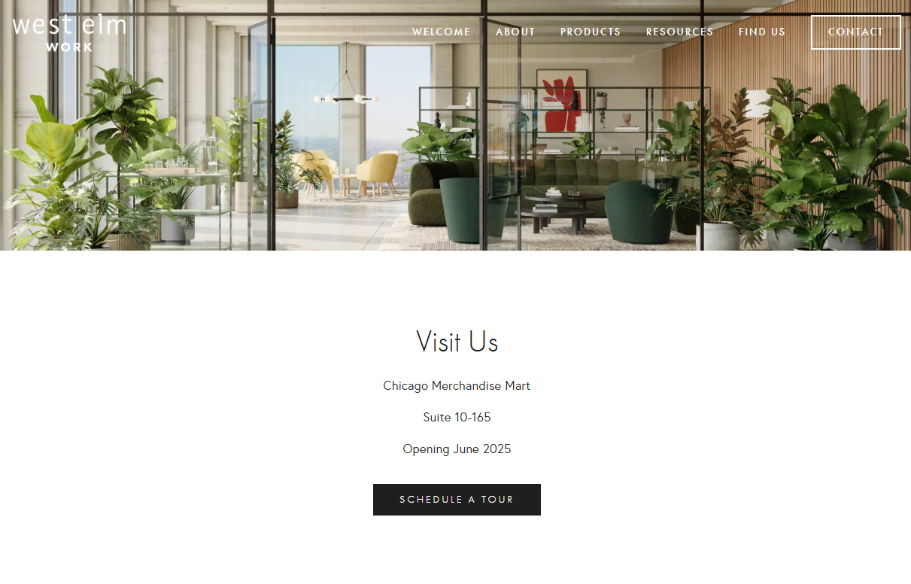
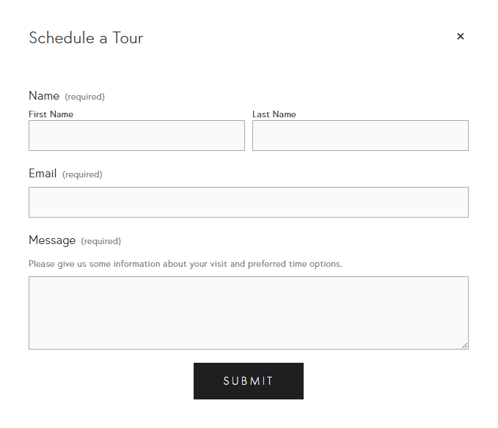
Web Experience | Desktop
Use the form to schedule showroom appointments with clients before, during and after the show.

Slide 11
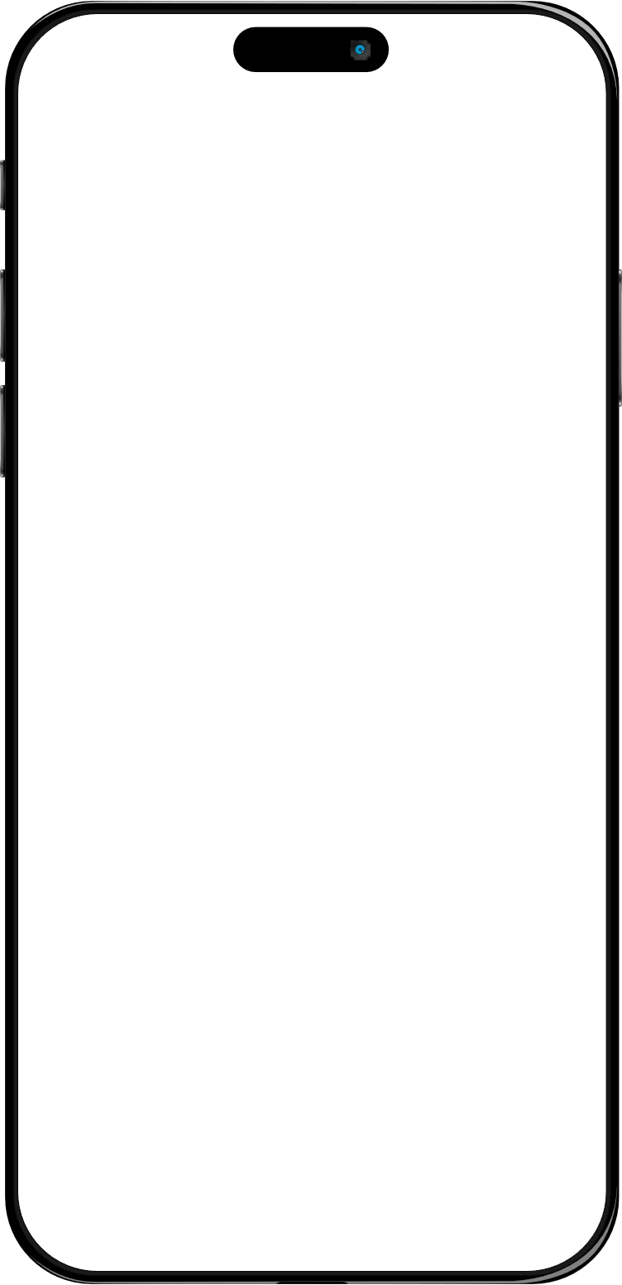
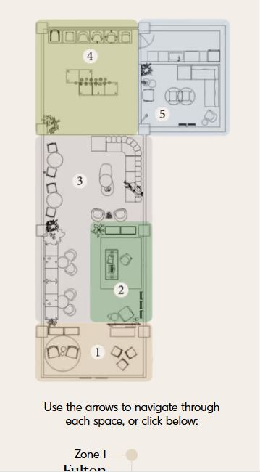
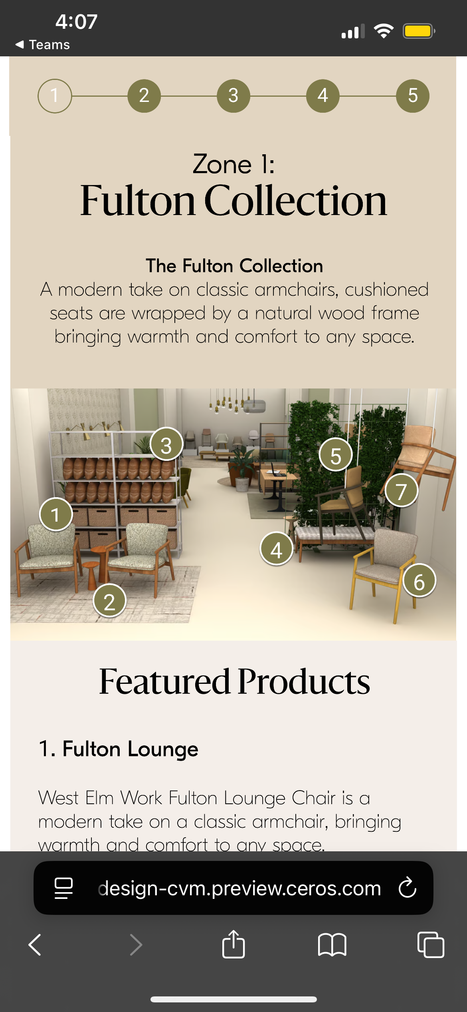
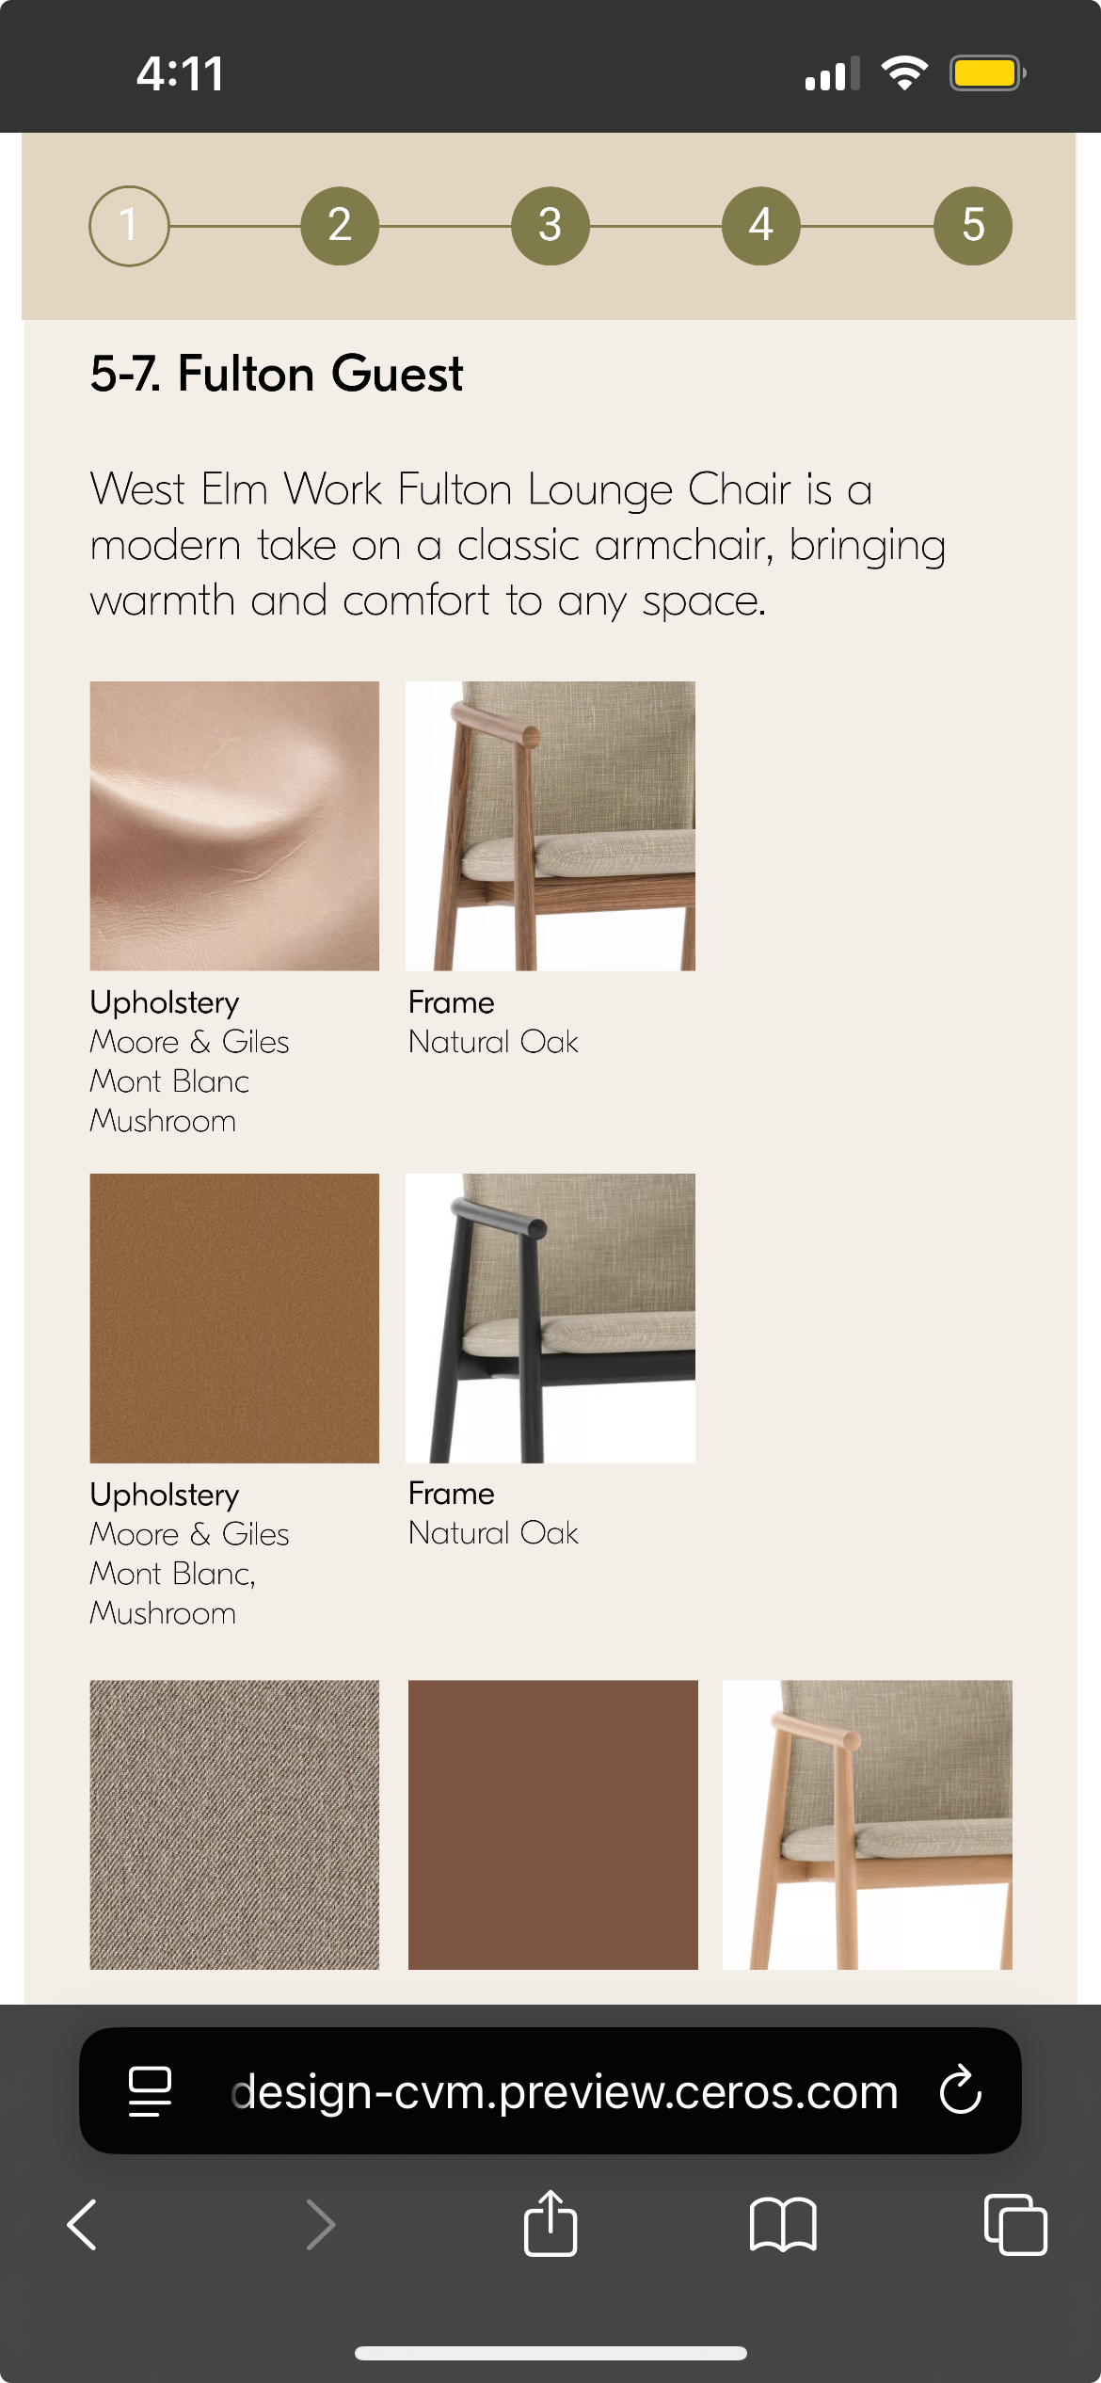
Web Experience | Mobile
Navigate through each zone in the showroom for product and finish information.

Slide 12
Starting List Prices

Slide 13
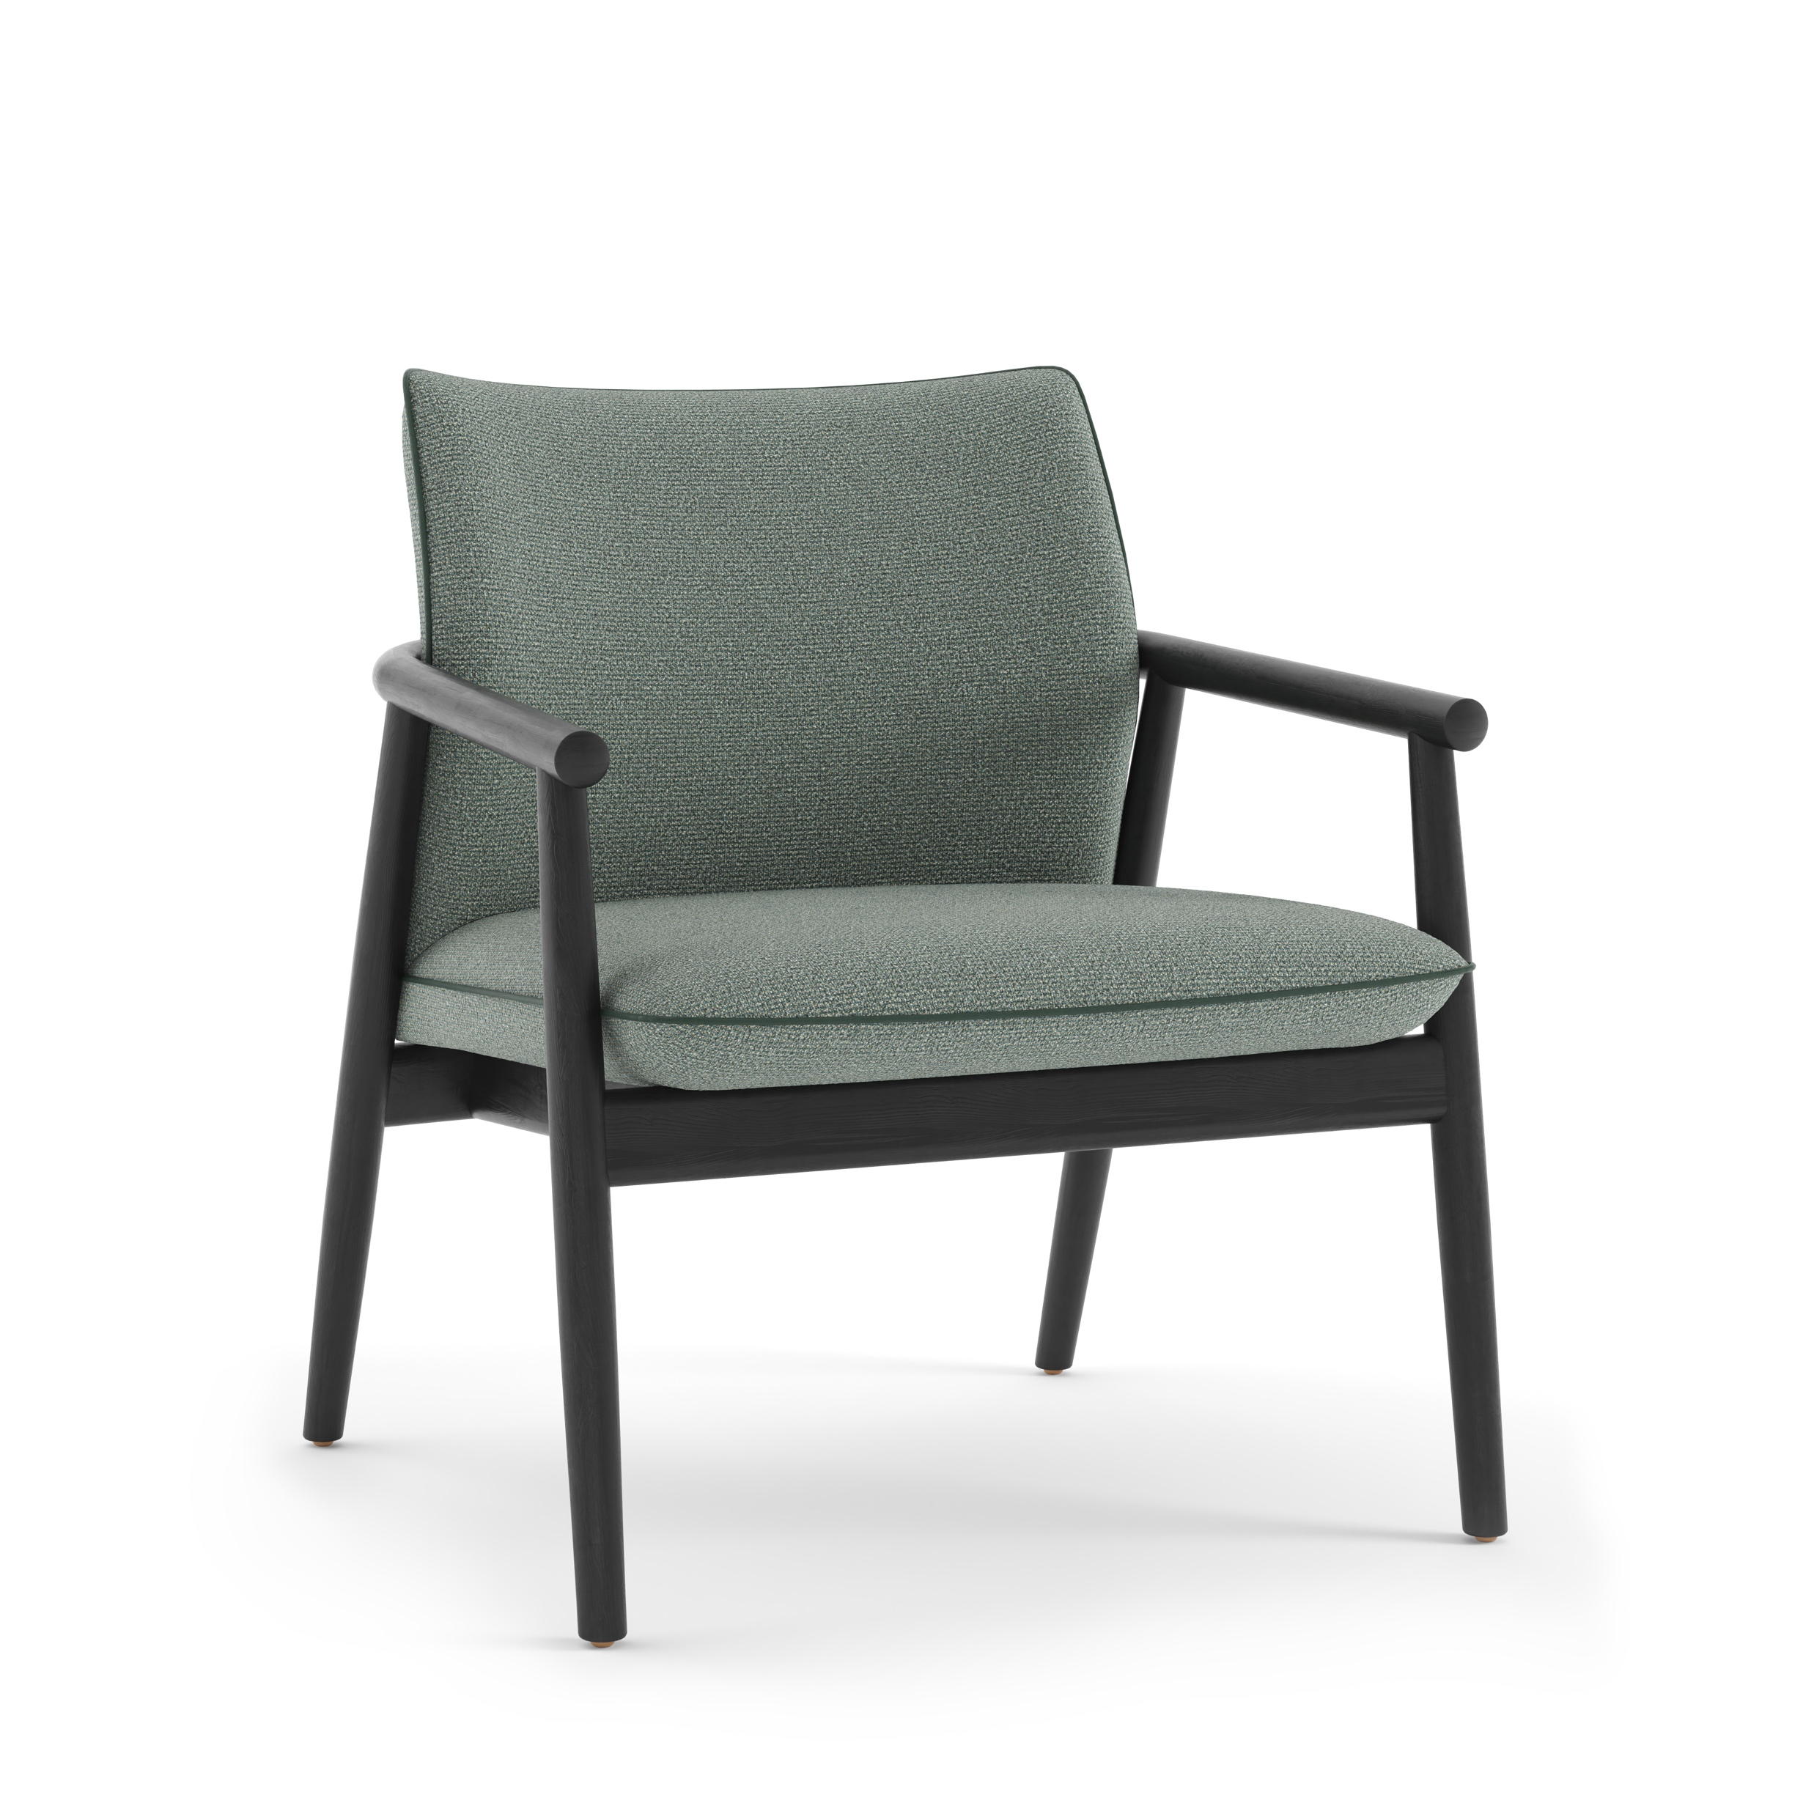
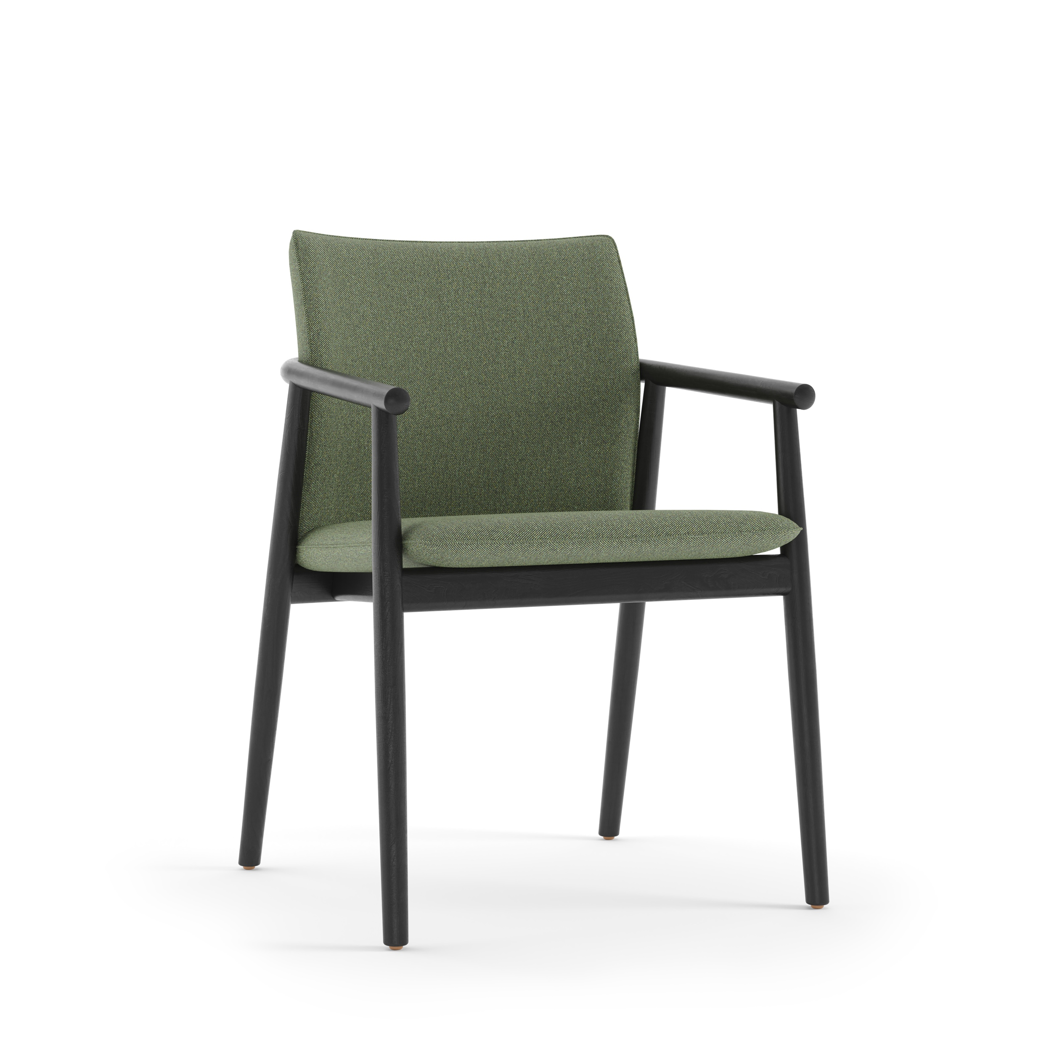
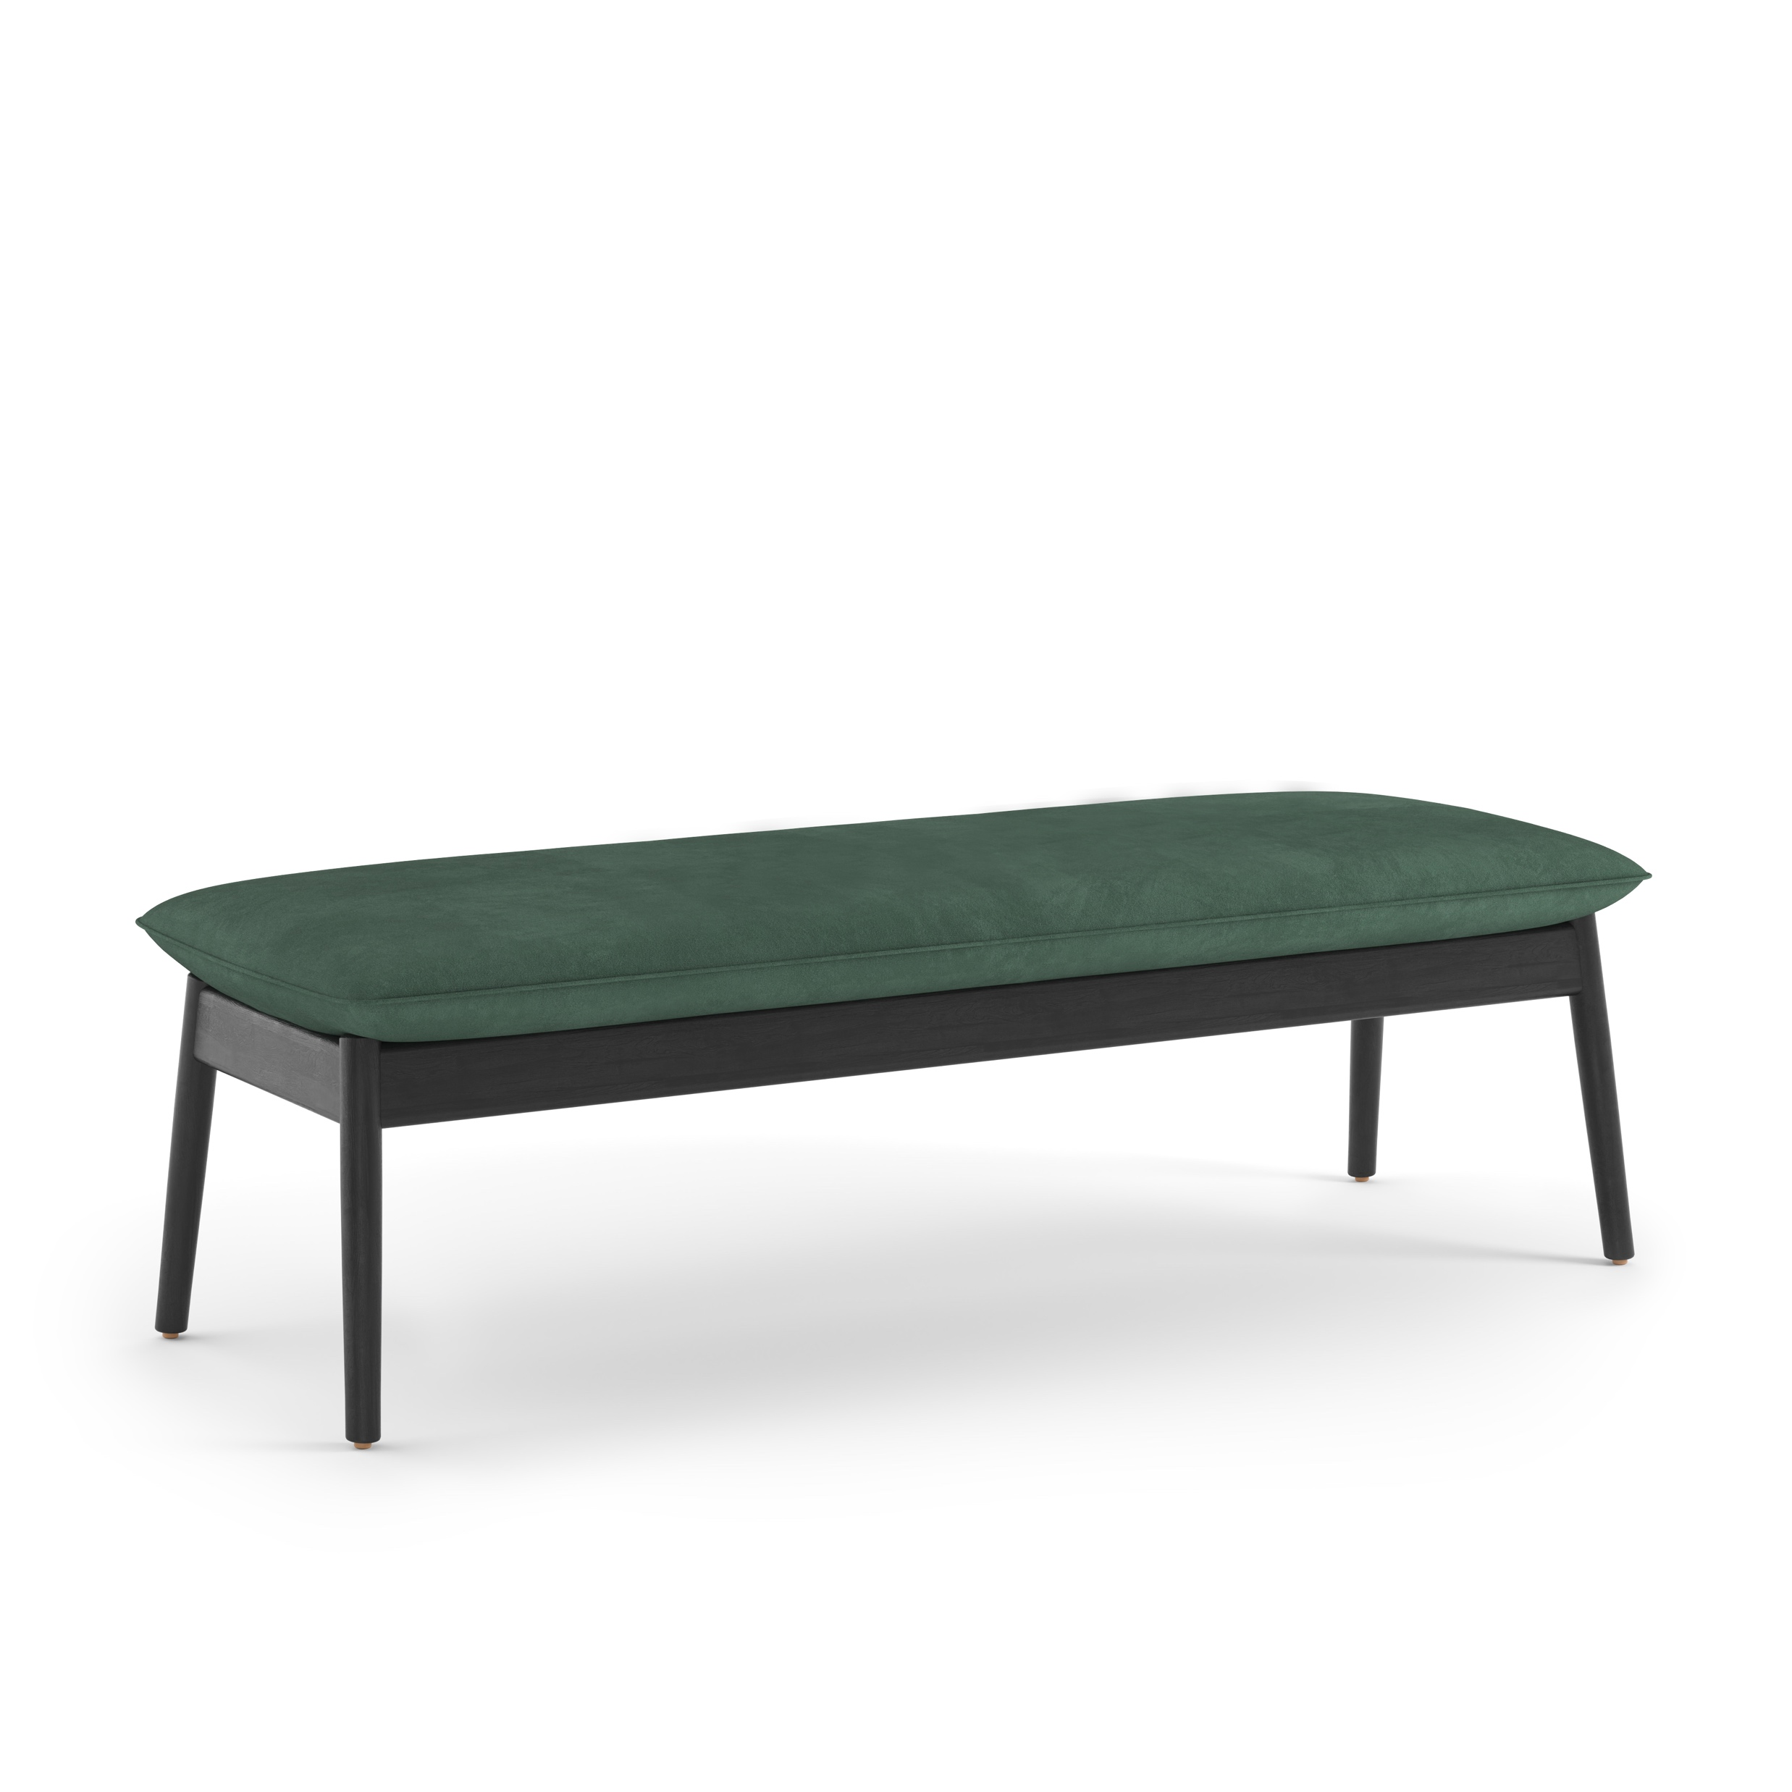
Pricing Guide | Fulton Collection
Fulton Lounge
Fulton Guest
Fulton Bench
Greenpoint Bookcase
$2,600 starting list
$1,800 starting list
$2,100 starting list
$3,600 starting list

Slide 14
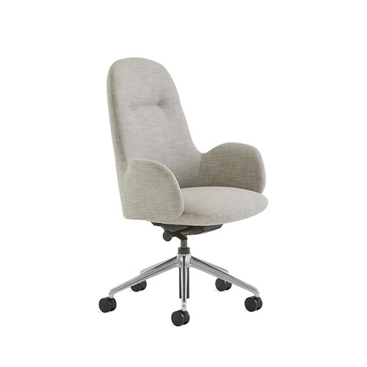
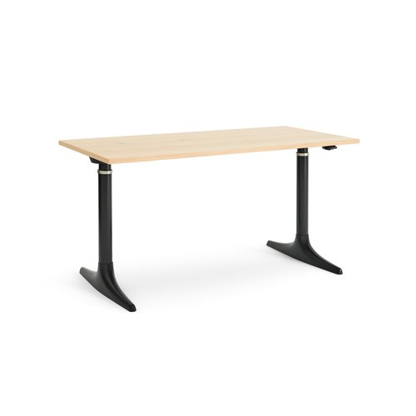
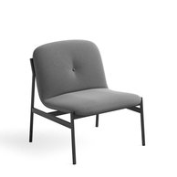
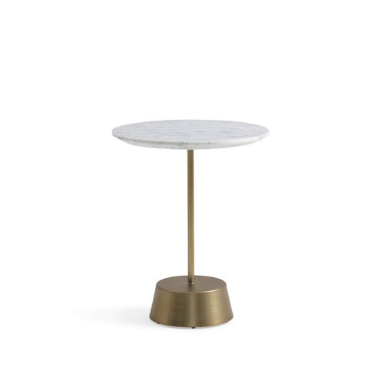
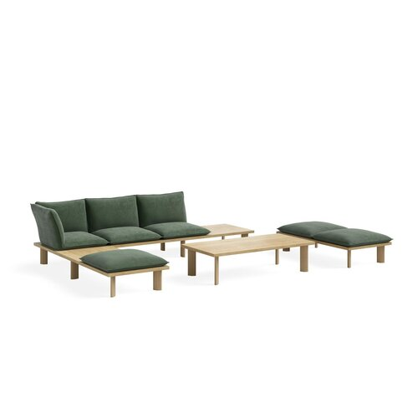
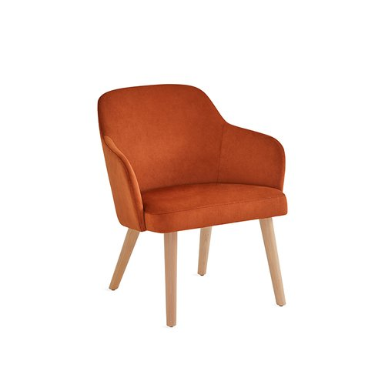
Pricing Guide | Private Office + Lounge
Greenpoint Storage Bookcase
Kent 5-Star Conference Chair
Sutton Height Adjustable Desk
Brighton Lounge Chair
Maisie Side Table
$4,700 starting list
$1,700 starting list
$2,150 starting list
$2,200 starting list
$8,50 starting list
Boardwalk Lounge
Sterling Lounge
$10,710 starting list
$1,200 starting list

Slide 15
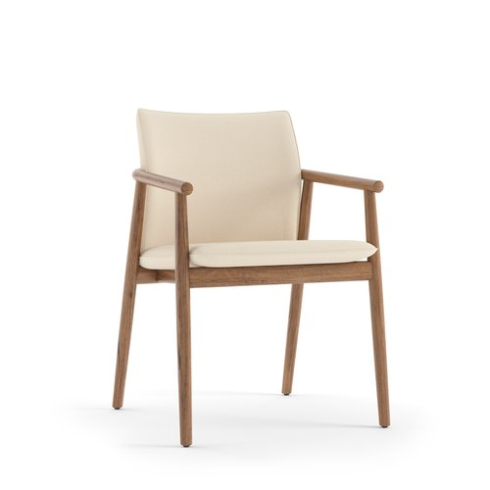
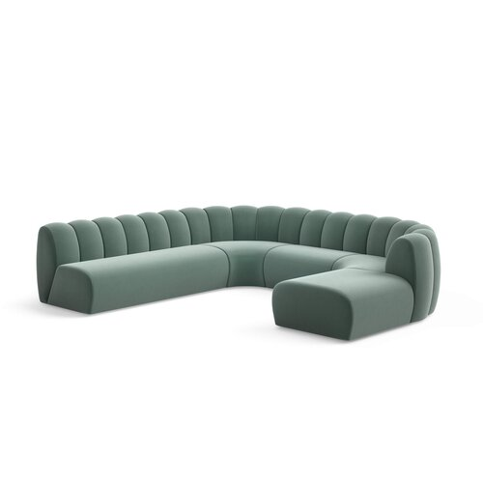
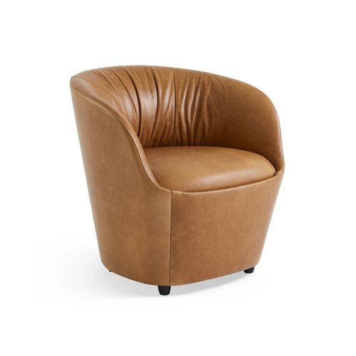
Pricing Guide | Lounge Seating + Café
Fulton Guest
Belle Sectional
Willow Lounge
$1,800 starting list
$19,436 starting list
$2,500 starting list

Slide 16
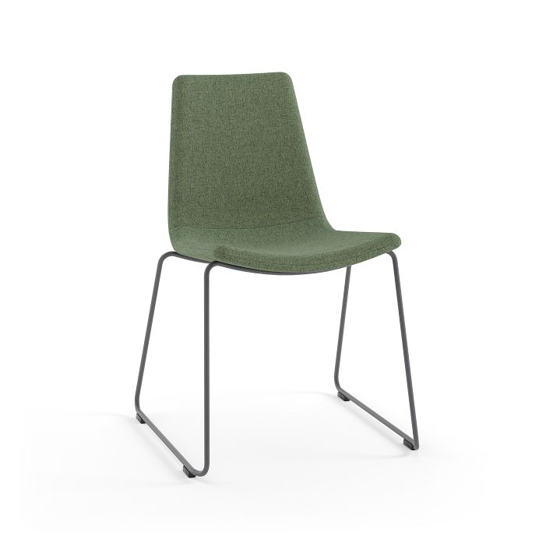
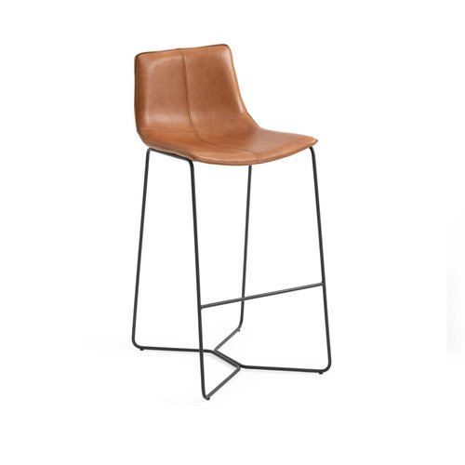
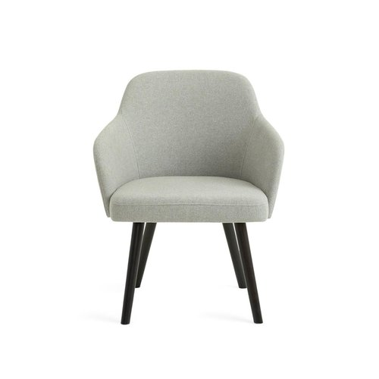
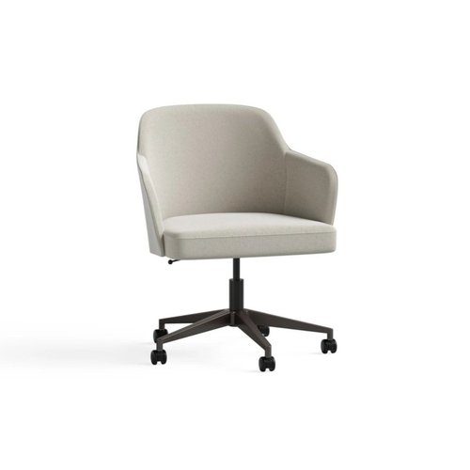
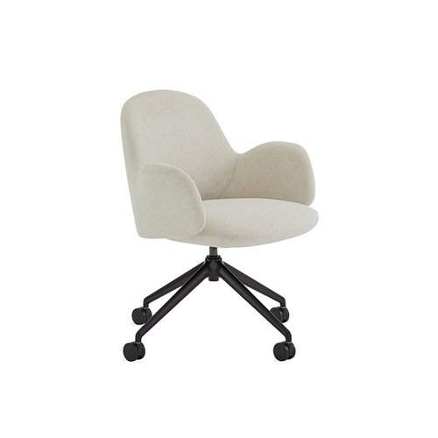
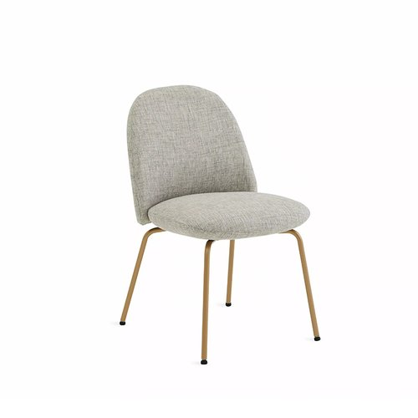
Pricing Guide | Seating Families
Slope Stacker
Slope Stool
Sterling Guest
Sterling Conference
Kent Conference
$890 starting list
$1,100 starting list
$1,200 starting list
$1,400 starting list
$1,700 starting list
Kent Guest
Boardwalk Bench
$1,300 starting list
$5,900 starting list

Slide 17
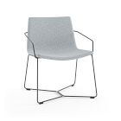
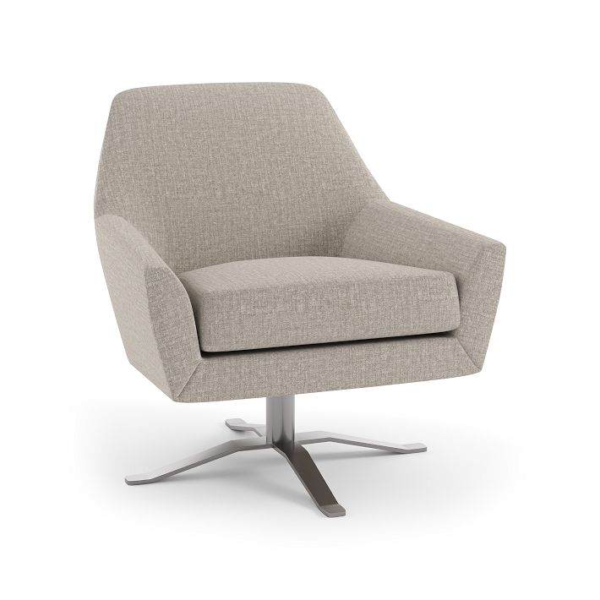
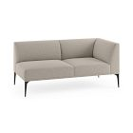
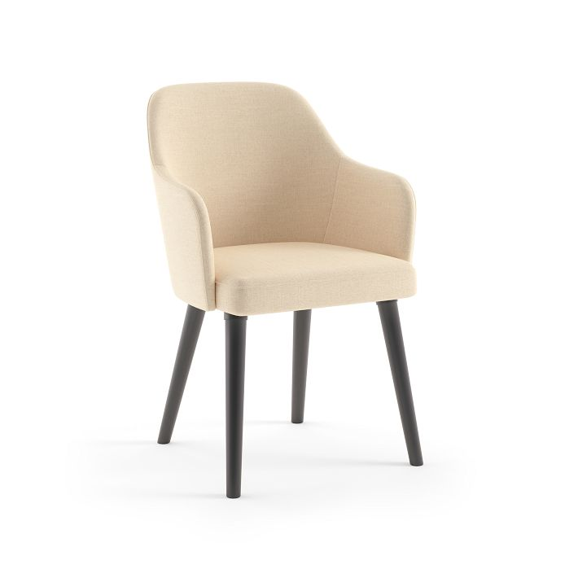
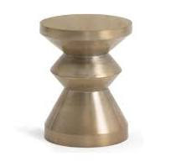
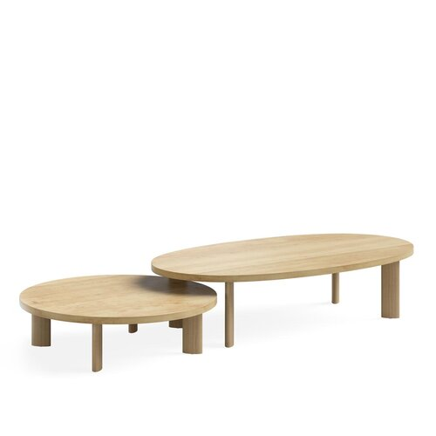
Pricing Guide | Health Collection
Slope Health Bariatric
Maisie Side Table
Lucas Swivel Lounge
Mesa Health Sectional
Sterling Health Guest
$1,200 starting list
$850 starting list
$2,800 starting list
$12,073 starting list
$1,600
Nolan Side Table
Boardwalk Coffee Table
$525 starting list
$1,710 starting list

