Slide 1
Thread
Power Distribution

Slide 2
Learning has changed

Slide 3
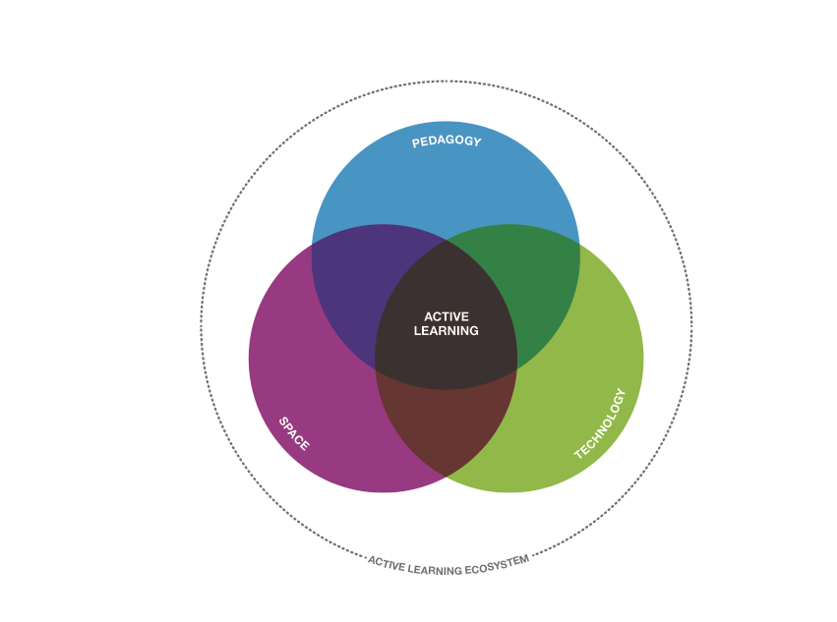
THREAD
Technology
changes learning
Notes:
We have been talking about the intersection between space, pedagogy and technology for a long time, that’s what we’ve spent the last 7 years studying and supporting with products like Node and Verb. We have been predominantly focused on the spatial component but we have always had technology in mind. Technology has a huge influence on learning spaces and the ability of those spaces to support the increase in tech directly relates to that space’s utilization (or under-utiliization).

Slide 4



THREAD
More mobility, devices and power needs
Notes:
Speaker notes:
Learning has become a mobile activity and students are using more devices in more places than ever before.

Slide 5
THREAD
More mobility, devices and power needs
86% own smartphones
Notes:
Speaker notes:
Learning has become a mobile activity and students are using more devices in more places than ever before.

Slide 6
THREAD
More mobility, devices and power needs
86% own smartphones
35% use tablets in class
Notes:
Speaker notes:
Learning has become a mobile activity and students are using more devices in more places than ever before.

Slide 7
THREAD
More mobility, devices and power needs
86% own smartphones
35% use tablets in class
70% use laptops in class
Notes:
Speaker notes:
Learning has become a mobile activity and students are using more devices in more places than ever before.

Slide 8
Students need technology.
Technology needs power.
Notes:
Speaker notes:
Let’s take a look at how mobility, technology and changing learning styles impact physical space.

Slide 9

OBSERVATIONS
Technology and active learning aren't well supported in many of today's classrooms.
Notes:
Note to Presenter:
Based on your knowledge of the audience and their work environment, you may wish to select pain points from this and this and the next nine slides that are most appropriate for your audience. Or present all the slides −audiences typically will identify with all pain points.

Slide 10
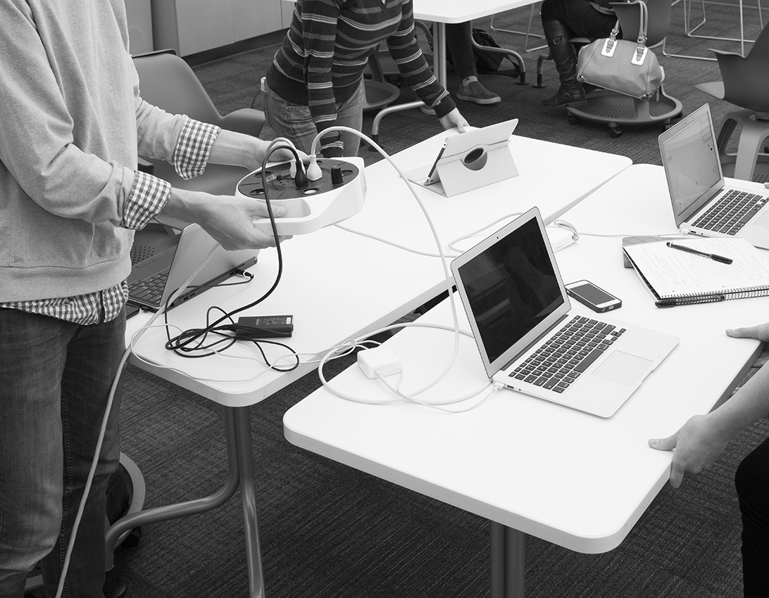
OBSERVATIONS
As instructors work toward providing an active learning environment, technology needs are not being supported in the classroom.
Notes:
Note to Presenter:
Based on your knowledge of the audience and their work environment, you may wish to select pain points from this and this and the next nine slides that are most appropriate for your audience. Or present all the slides −audiences typically will identify with all pain points.

Slide 11

OBSERVATIONS
Students are willing to sacrifice their own needs when using mobile devices in order to access power.
Notes:
Note to Presenter:
Based on your knowledge of the audience and their work environment, you may wish to select pain points from this and this and the next nine slides that are most appropriate for your audience. Or present all the slides −audiences typically will identify with all pain points.

Slide 12
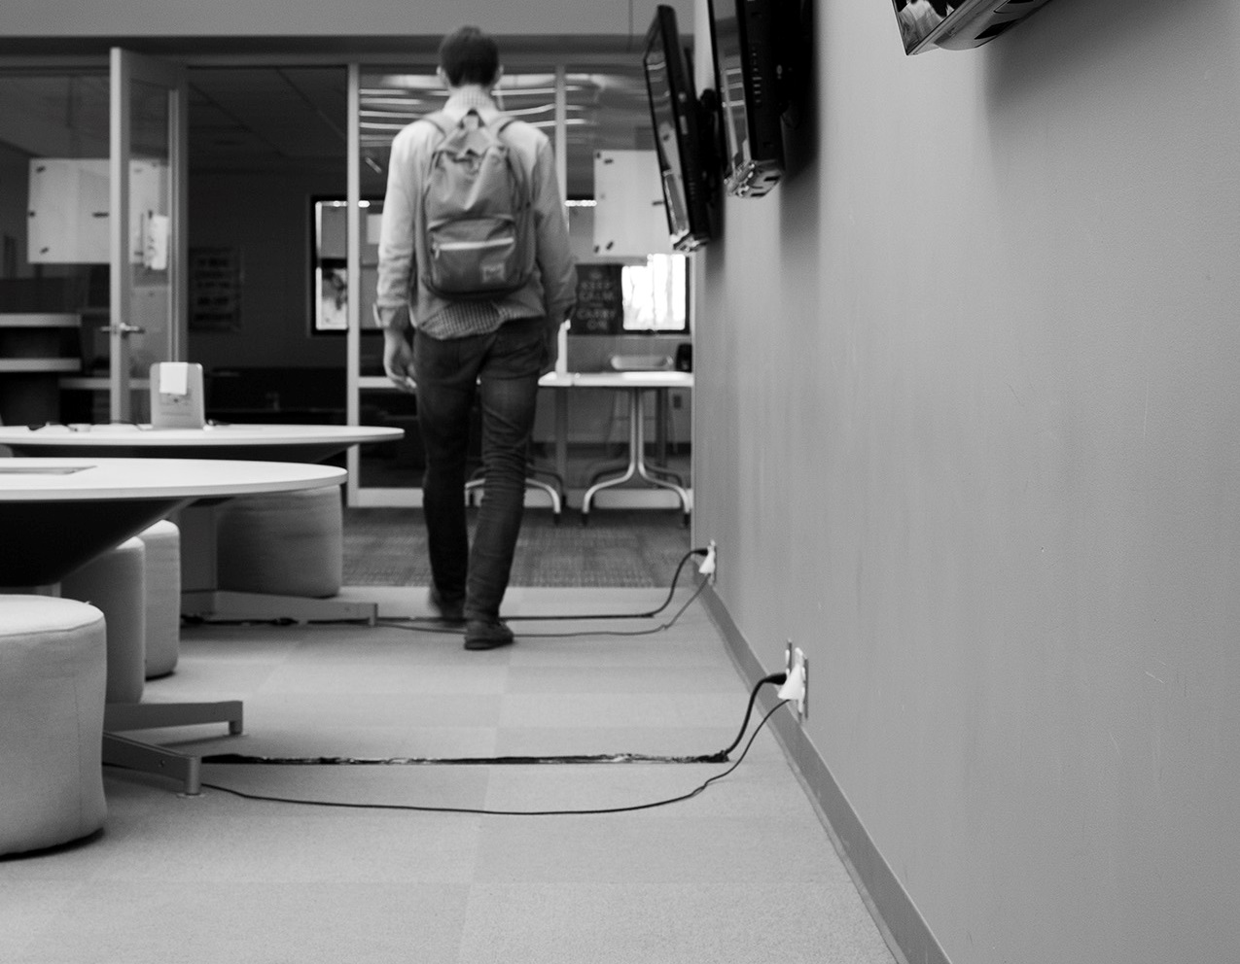
OBSERVATIONS
Furniture with integrated power can’t be placed in the open plan where there isn’t a plug.
Notes:
Note to Presenter:
Based on your knowledge of the audience and their work environment, you may wish to select pain points from this and this and the next nine slides that are most appropriate for your audience. Or present all the slides −audiences typically will identify with all pain points.

Slide 13

OBSERVATIONS
Open spaces typically have little to no access to power. Students crowd near the only available outlets.
Notes:
Note to Presenter:
Based on your knowledge of the audience and their work environment, you may wish to select pain points from this and this and the next nine slides that are most appropriate for your audience. Or present all the slides −audiences typically will identify with all pain points.

Slide 14
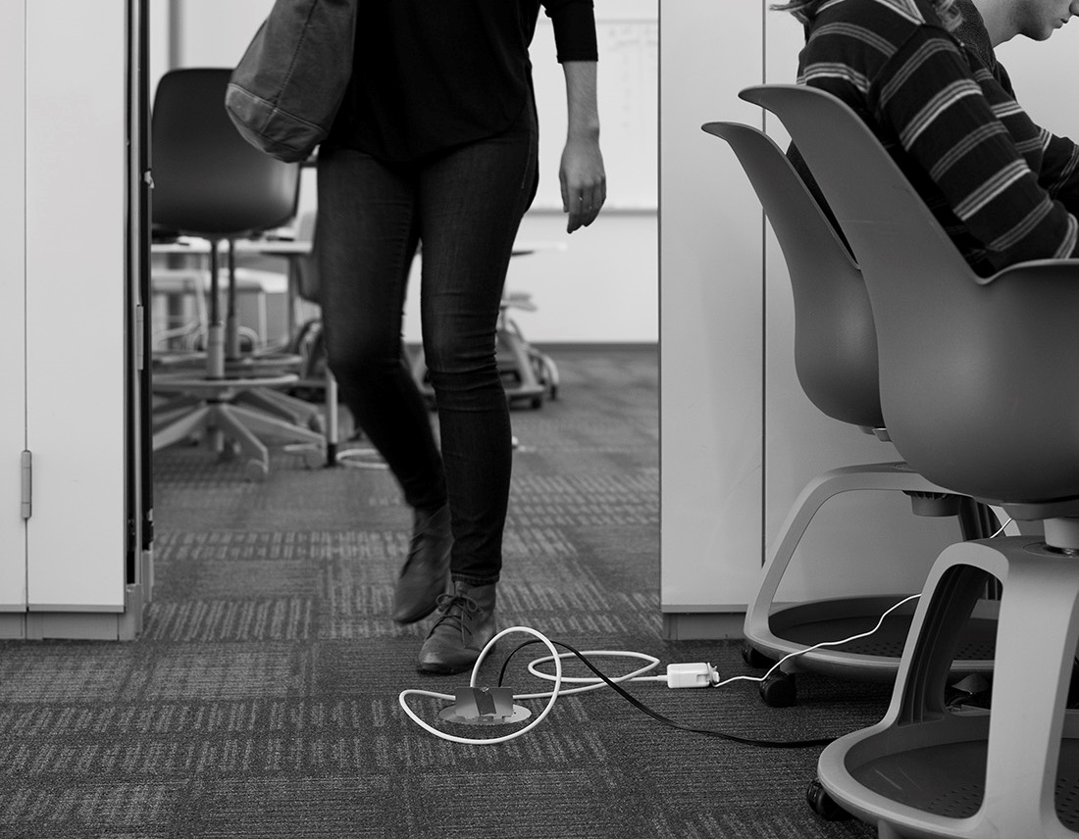
OBSERVATIONS
As classroom configurations change, power on the floor stays the same, becoming a tripping hazard.
Notes:
Note to Presenter:
Based on your knowledge of the audience and their work environment, you may wish to select pain points from this and this and the next nine slides that are most appropriate for your audience. Or present all the slides −audiences typically will identify with all pain points.

Slide 15
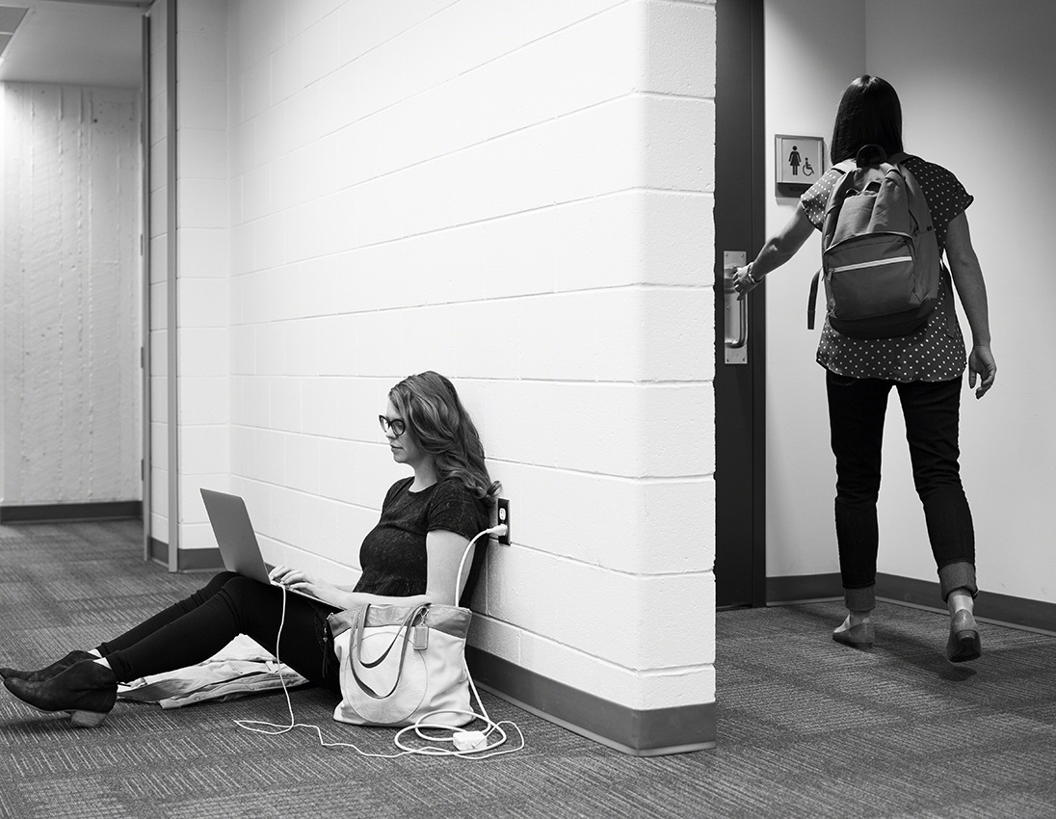
INTRODUCING THREAD
Whether or not furniture is available, students will work wherever there is power.
Notes:
Note to Presenter:
Based on your knowledge of the audience and their work environment, you may wish to select pain points from this and this and the next nine slides that are most appropriate for your audience. Or present all the slides −audiences typically will identify with all pain points.

Slide 16
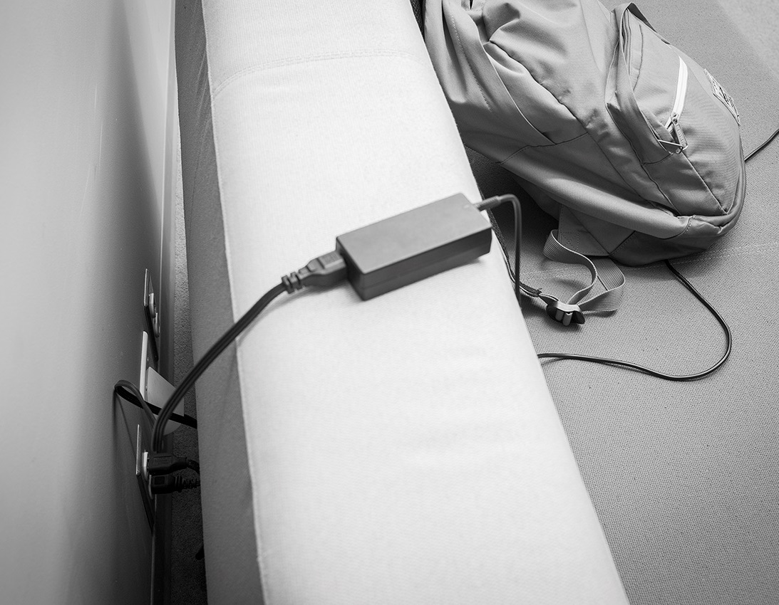
OBSERVATIONS
Open outlets get blocked by furniture systems, forcing students to climb around and over furniture to plug in.
Notes:
Note to Presenter:
Based on your knowledge of the audience and their work environment, you may wish to select pain points from this and this and the next nine slides that are most appropriate for your audience. Or present all the slides −audiences typically will identify with all pain points.

Slide 17
Unfortunately, it isn’t always easy.
Notes:
Speaker notes:
We know that while we need power, it’s not as simple as it could be.

Slide 18

OBSERVATIONS
We need more power, but don't have options.
Notes:
Note to Presenter:
Based on your knowledge of the audience and their work environment, you may wish to select pain points from this and this and the next two slides that are most appropriate for your audience. Or present all the slides −audiences typically will identify with all pain points.
Speaker notes:
We need more power, but don't have options.
Core drilling and trenching are expensive, and damage architecture.
Raised-floor isn't applicable to all spaces.

Slide 19
Thread:
Power made simple.

Slide 20
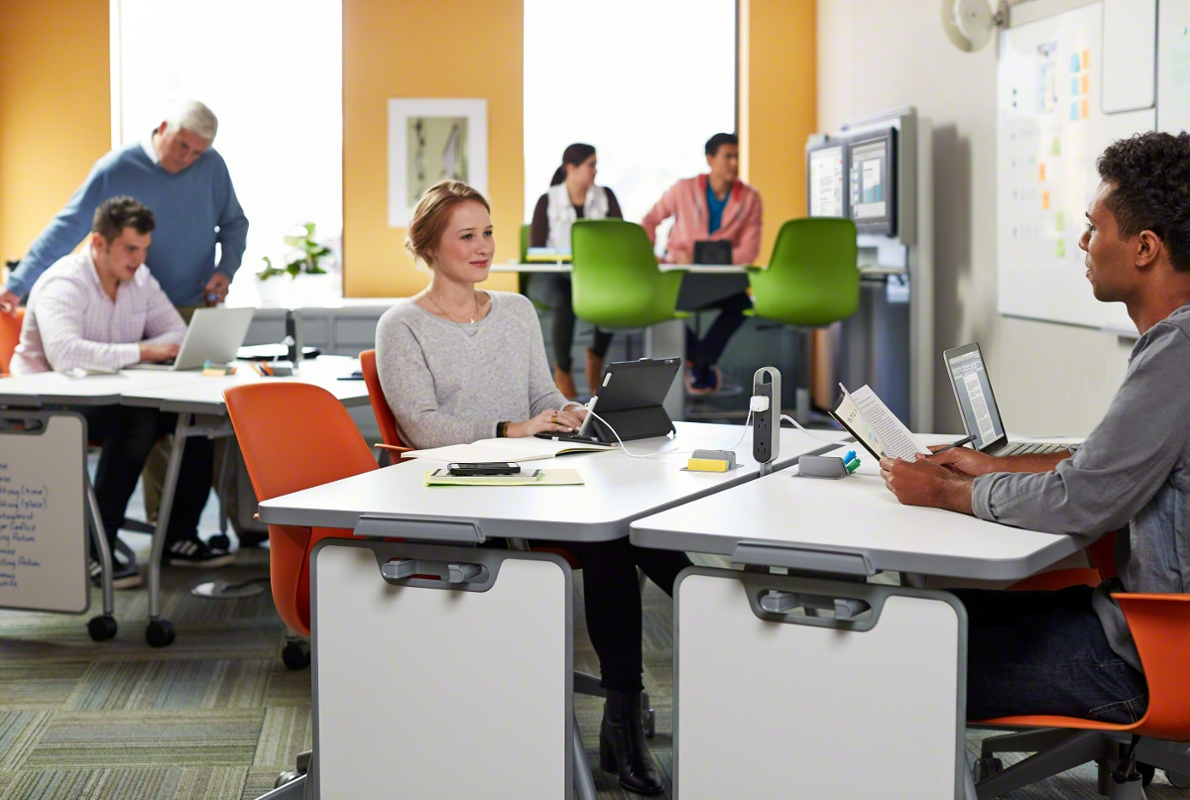
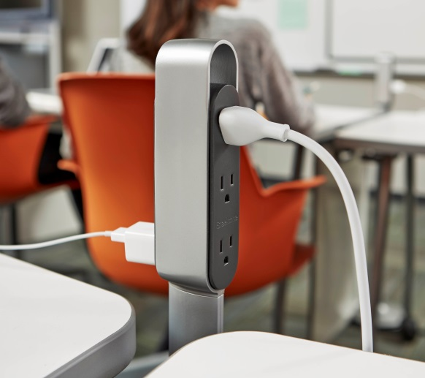
THREAD
Powering active learning.
Notes:
Active learning demands active spaces. Thread's ultra thin design lays underneath the carpet. At a height of just 3/16", it seamlessly integrates into a space empowering active learning.

Slide 21
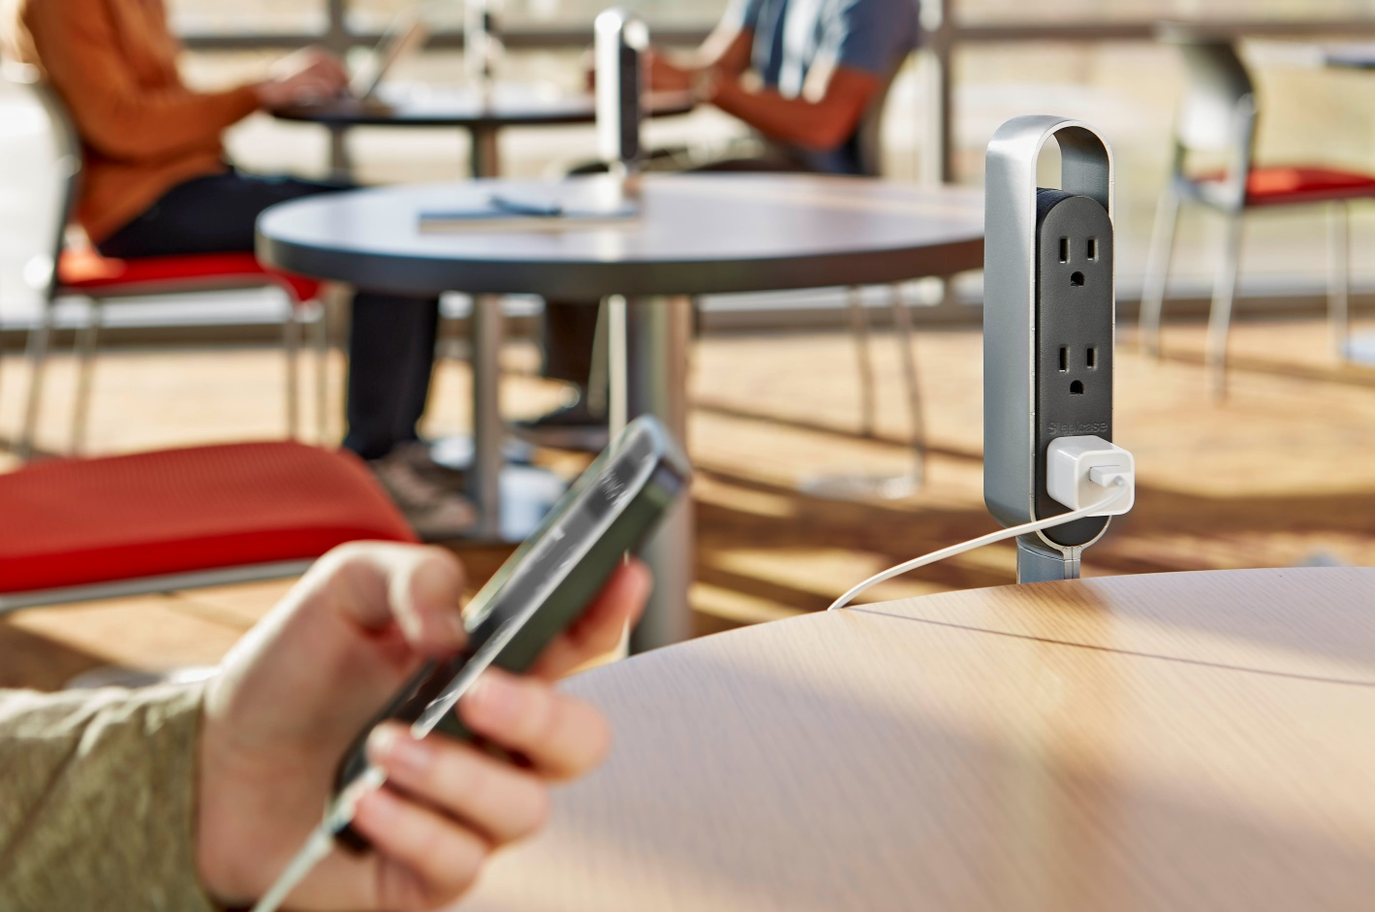
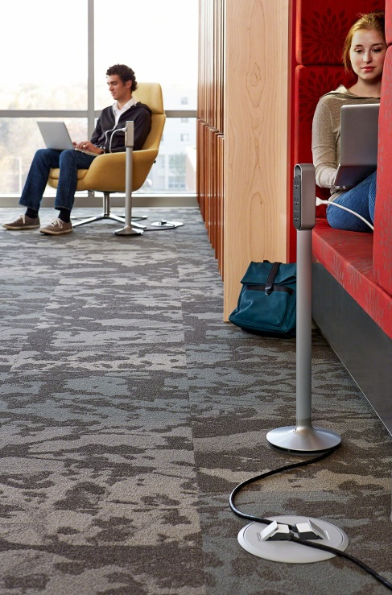
THREAD
Powerfully simple.
Notes:
Thread's simple kit of parts provide power to any space - whether a classroom, library or in-between space - allowing under-utilized real estate to work harder.

Slide 22
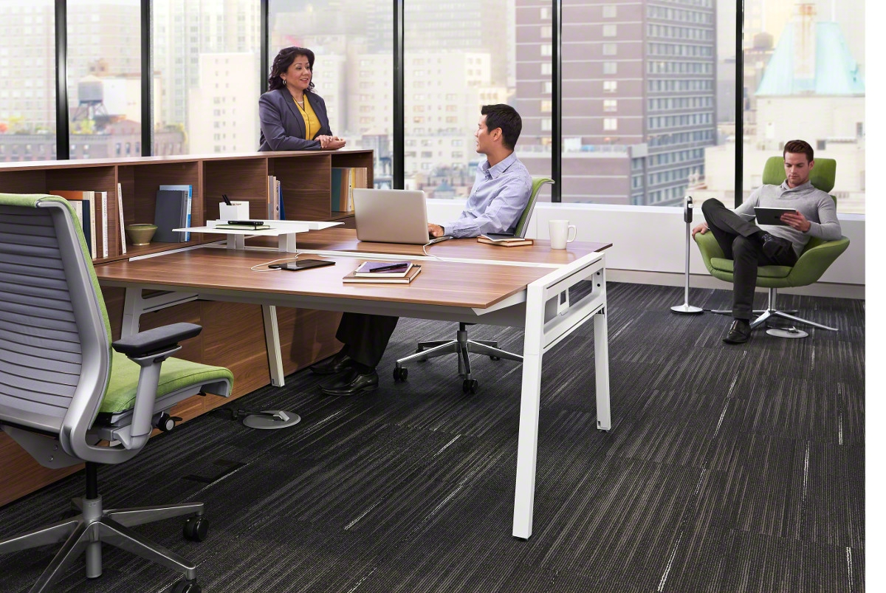
THREAD
More power.
Easy installation.
Notes:
Installing Thread is as easy as laying carpet, with modularity that makes it easy to reconfigure.
Power can easily be added to new construction or retrofitted into existing spaces.
Every square foot of real estate can be optimized with power, revitalizing 'dead' zones.

Slide 23
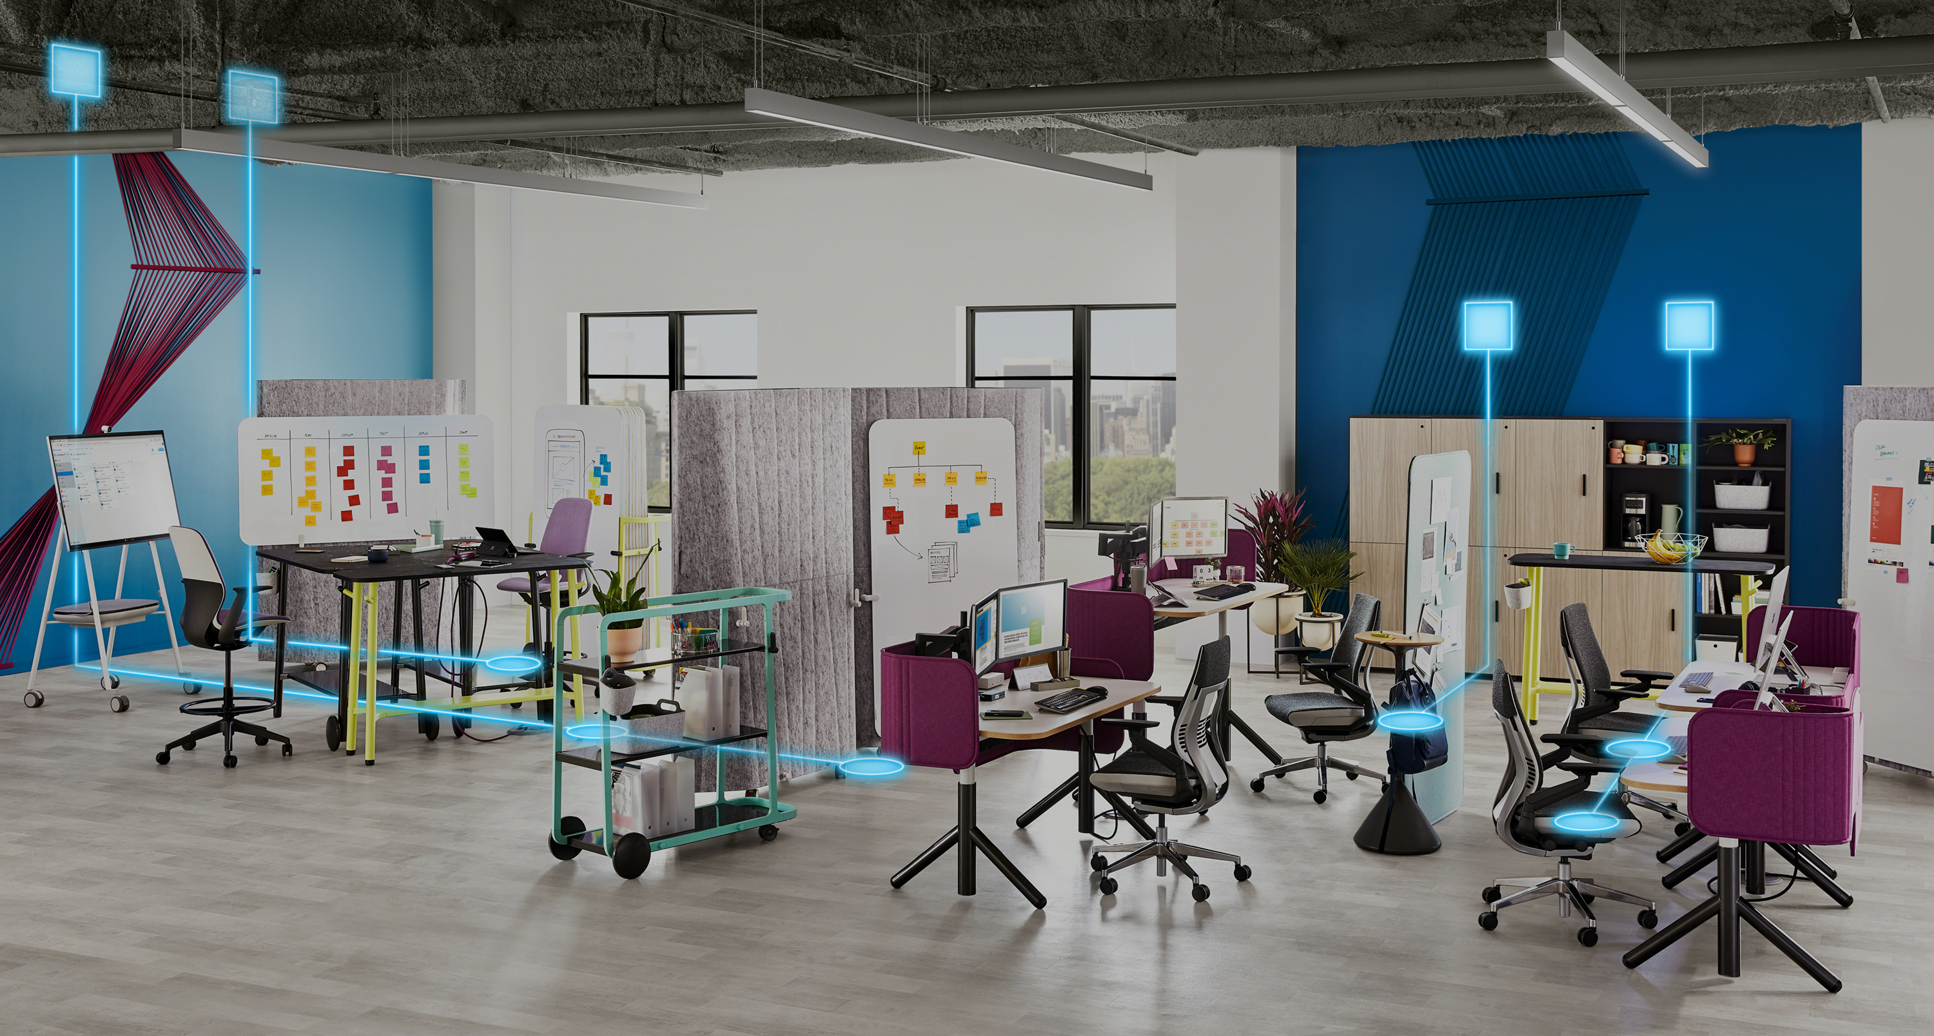
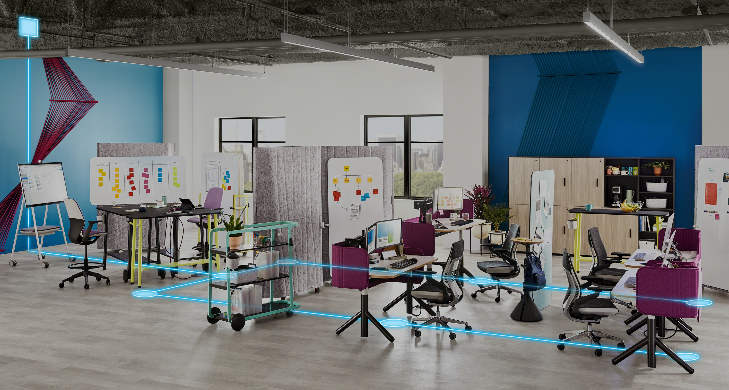
THREAD
Single and Dual Circuit Powered.
Notes:
Thread with single circuit technology shares power from multiple sources, while dual circuit technology supports more power distribution with fewer outlets and cords for a clean aesthetic.
For simpler configurations, and applications that require less power, Single Circuit is ideal. Dual Circuit is best for groups and teams that need to power multiple devices and applications in flexible spaces.

Slide 24
Optimize Real Estate
Notes:
Speaker notes:
We know that without power, many spaces go unused. As technology gives users more freedom and flexibility, users need choice and control over how and where they work.
However, without the tools needed to support learning today, some spaces are overlooked. Thread revitalizes spaces, providing power wherever it is needed.
We know that when students can select the spaces and tools that best fit the tasks at hand, they’re more productive and effective. And now, with flexible dual circuit technology, powering devices in evolving classroom configurations is even easier.

Slide 25




THREAD
Lecture Mode
Group Mode
Discussion Mode

Slide 26

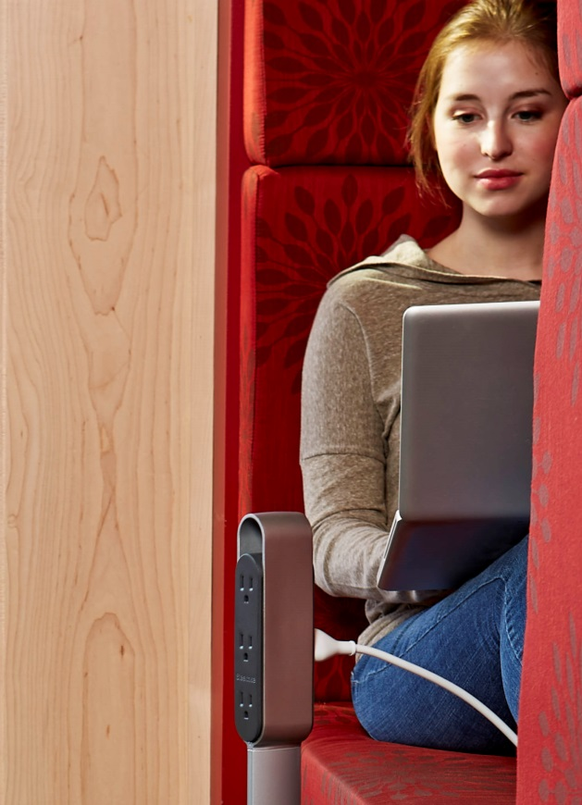
THREAD
Lounge Area
Library
Nest

Slide 27
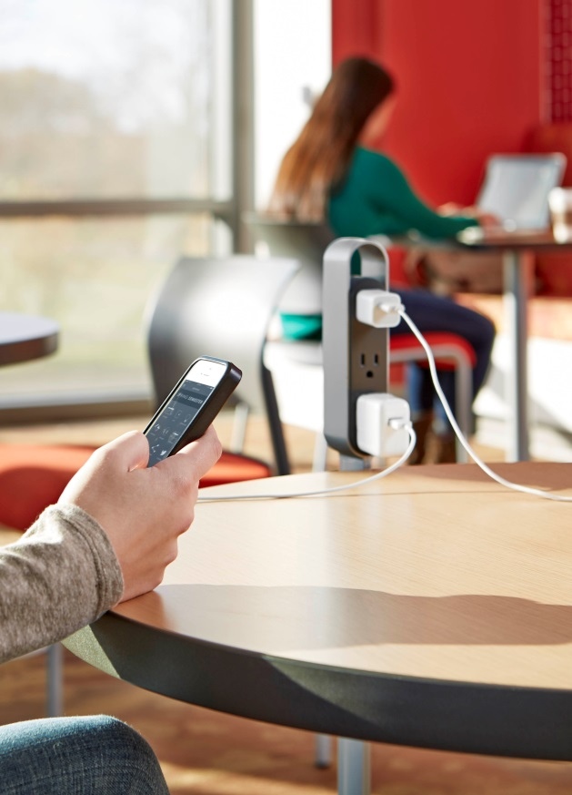
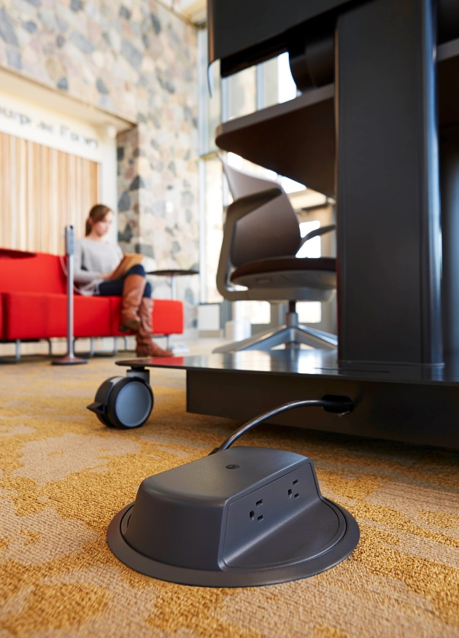

THREAD
Café
Touchdown Space
Collaborative Spaces

Slide 28
Power Made Simple
Notes:
Speaker Notes:
Installing Thread is about as easy as laying carpet tiles, with modularity that makes it easy to
reconfigure. Power can easily be added to new construction or retrofitted into existing spaces.
Utilizing 5 main components Thread is easily assembled and disassembled giving you power
exactly where you need it.

Slide 29
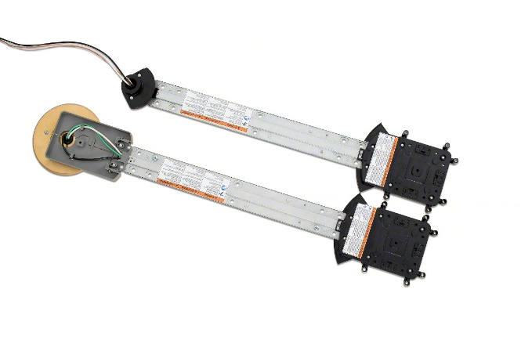
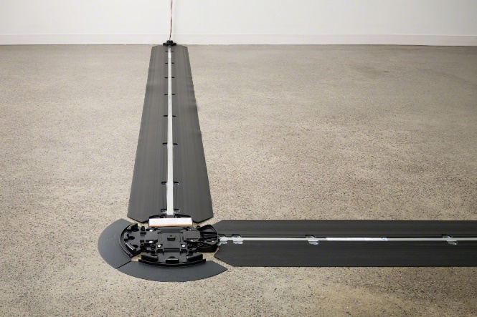
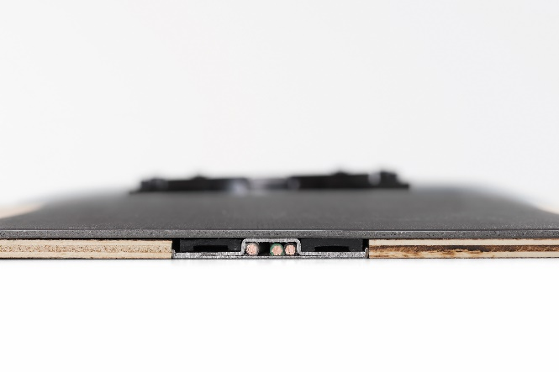
THREAD
Components
Power Track Infeeds
Available as a wall infeed or floor infeed
Power Tracks
Available with ramps for carpeted floorcovering applications or infills for resilient floorcovering applications
Notes:
The Thread system is listed as a 20 amp branch circuit. It
utilizes three standard 12 gauge wires (hot, neutral, ground.)
Thread's dual circuit infeed allows for two circuits to distribute power throughout the room while only requiring one connection point to the building's power.
The Thread power track is capable of connecting to
any standard conduit or other listed product such as
Wiremold or Panduit.
The building electrical supply connection must be performed by a licensed electrician.
Only connect this system to a dedicated 120-127 V~ 60Hz 20A single phase
GFCI protected building power circuit.
Due to voltage drop, the National Electric Code (NEC) recommends that the distance between the building circuit box and the user access point not exceed 75-150 feet (depending on gauge or wires running from the building circuit box to the Thread infeed junction.) Thread branches longer than
70 feet may risk contributing to voltage drop exceeding acceptable levels.
Listing categories: Thread power track is listed as a multiple-outlet assembly and is considered a
20 amp branch circuit, which means it meets the same requirements as the hard wire outlets in the
wall. The power hub is listed as a relocatable power tap (RPT, the listing as a typical power strip).
The plug adapter is listed as an accessory to the Thread system.
The Power Track and Power Track infeed are available in lengths starting at 2’ – 12’, in one foot increments. The Power Track infeed is just 3/4” tall. The track, which consists of steel sheets riveted together, is just 3/16” tall. Durable ramps ease the transition in height from the subfloor to the top of the track.

Slide 30
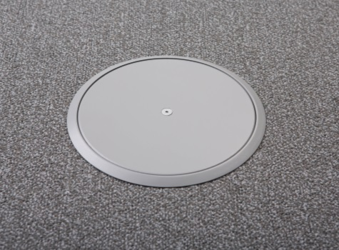
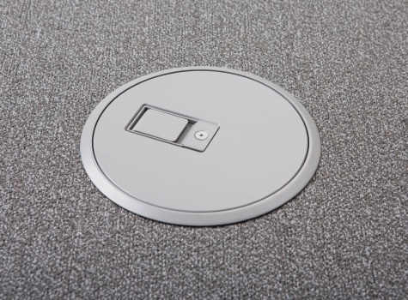
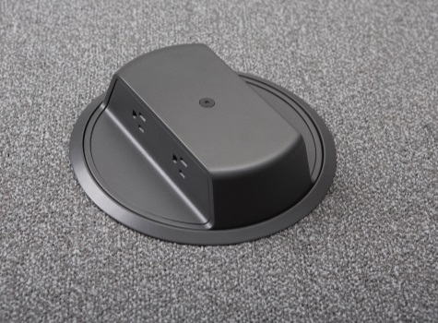
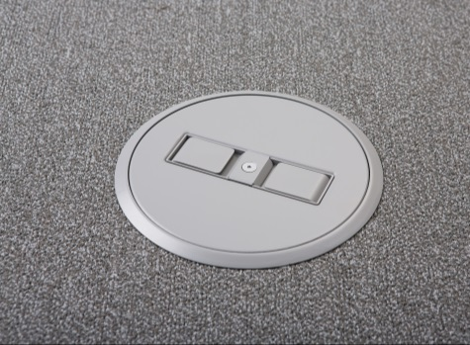
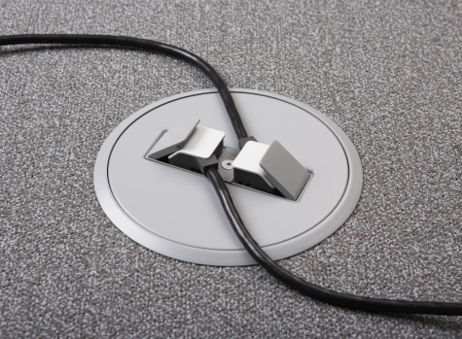
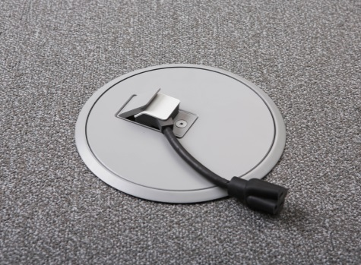
THREAD
Components
Blank Low-Profile Connector
One-Door Low-Profile Connector
Two-Door Low-Profile
Connector
Two-Door Low-Profile Connector
One-Door Low-Profile
Connector with Proprietary Plug
NEMA Monument Connector* *Optional tamper-resistant receptacles available
Notes:
We intentionally kept the kit of parts simple. There are 4 connector types: 3 low profile (blank, 1 door and 2 door) and 1 monument.
Speakers note: Extra detail provided below, should you need it.
The low profile connectors utilize a proprietary plug design to minimize the profile and ensure ADA compatibility. The low profile connectors are only 3/8” above the carpet, which means they don’t impact foot traffic and don’t require ramping for ADA compliance.
The blank cover is utilized for X configurations and the 2 door cover can only be utilized in I configurations or at end of run. The monument provides 4 standard 3-prong NEMA receptacles but stands approximately 2.5” off the ground and is only meant for areas that would not be considered egress or aisle ways.
The plug adapter was designed to convert a low profile connection to a standard NEMA 5-15 connection.

Slide 31
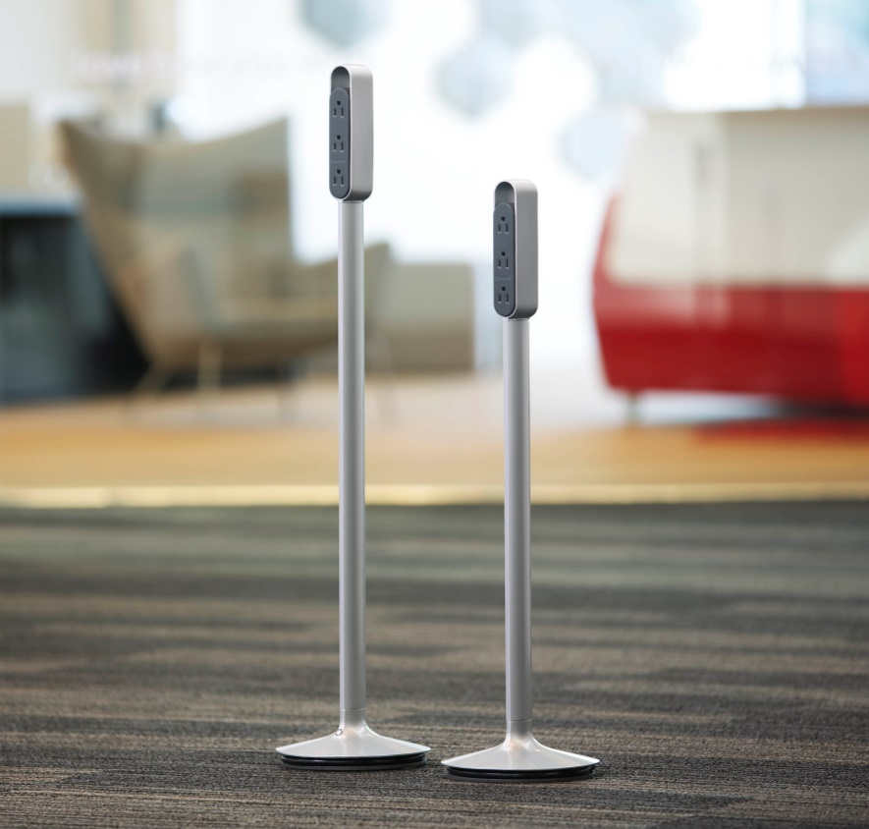
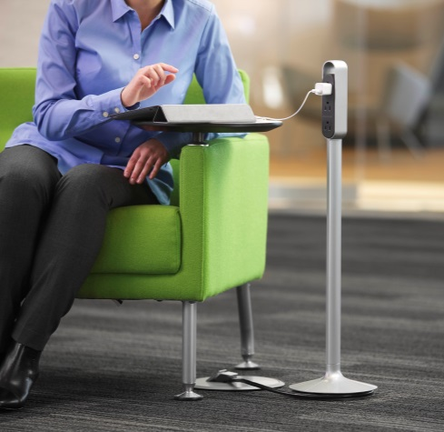
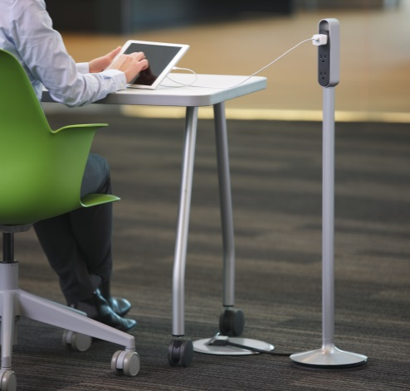
THREAD
Power Hubs
Lounge-Height
Desk-Height
Notes:
The Power Hub comes in 2 heights, either desk height or lounge height. It offers 6 standard 3-prong (NEMA 5-15) receptacles and features a 5’ cord, allowing flexibility to move the hub as a space is reconfigured.
It is also available with either our proprietary plug or a standard 3 prong plug (NEMA 5-15. A Power Hub with a standard 3-prong plug can be used on its own, apart from the rest of the Thread system. It offers 6 standard 3-prong (NEMA 5-15) receptacles and has a 5’ cord, allowing the flexibility to move the hub as the space is reconfigured.
The power hub has a circuit breaker in the base that is intended
to trip should excessive power draw occur. If the total draw from
all the receptacles on a hub exceeds 15 amps, the breaker will
trip and a black button will pop out of the base where it meets
the stalk. Pressing the button back in will reset the circuit.

Slide 32
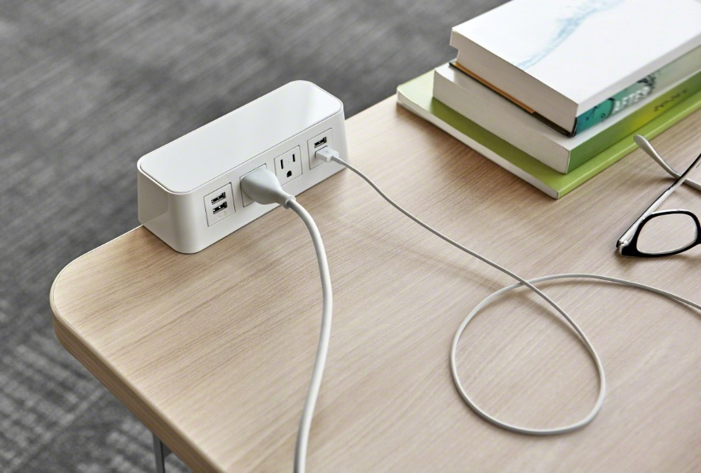
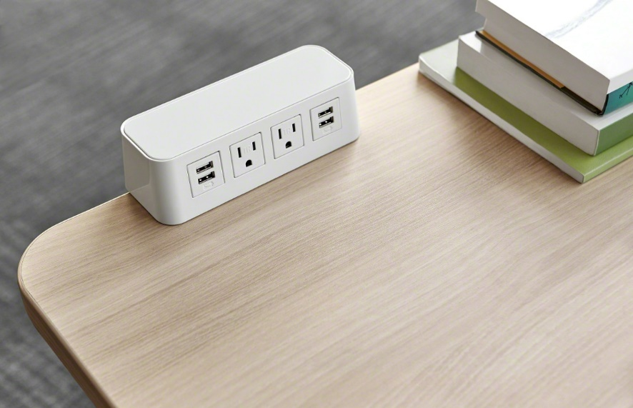
THREAD
Power Strip
Notes:
Available with:
• Thread low profile plug or NEMA plug
• Freestanding or clamp-on mount
• 1 USB/3 Power schematic or 1 USB/2
Power/1 USB schematic
• 6’ or 10’ cord
• Tamper-resistant or Non Tamper-resistant
power receptacles
Standard includes:
• Freestanding mount
• Low profile plug
• 1 USB/3 Power schematic
• 6’ Cord
• Non Tamper-resistant power receptacles

Slide 33
THREAD
Cost Comparisons
900 sq ft room, 36 students, 3 circuits, 9 floor boxes
Notes:
Competitive Price Comparison
Solution: Installed customer cost (includes labor):
Raised Floor $14,000 - $16,000
Trenching $7,200 - $25,000
Coring $6,000 - $22,000
Connectrac $7,000 - $9,000
Thread $5,145 (includes Power Hubs)
Thread cost includes hubs, all others are floor box access only

Slide 34
THREAD
Cost Comparisons
900 sq ft room, 36 students, 3 circuits, 9 floor boxes
Raised Floor Trenching Core Drilling Thread w/ Power Hubs
Notes:
Competitive Price Comparison
Solution: Installed customer cost (includes labor):
Raised Floor $14,000 - $16,000
Trenching $7,200 - $25,000
Coring $6,000 - $22,000
Connectrac $7,000 - $9,000
Thread $5,145 (includes Power Hubs)
Thread cost includes hubs, all others are floor box access only

Slide 35
THREAD
Cost Comparisons
900 sq ft room, 36 students, 3 circuits, 9 floor boxes
Raised Floor Core Drilling
Notes:
Competitive Price Comparison
Solution: Installed customer cost (includes labor):
Raised Floor $14,000 - $16,000
Trenching $7,200 - $25,000
Coring $6,000 - $22,000
Connectrac $7,000 - $9,000
Thread $5,145 (includes Power Hubs)
Thread cost includes hubs, all others are floor box access only

Slide 36
THREAD
Cost Comparisons
900 sq ft room, 36 students, 3 circuits, 9 floor boxes
Raised Floor Core Drilling Trenching Thread w/ Power Hubs
Notes:
Competitive Price Comparison
Solution: Installed customer cost (includes labor):
Raised Floor $14,000 - $16,000
Trenching $7,200 - $25,000
Coring $6,000 - $22,000
Connectrac $7,000 - $9,000
Thread $5,145 (includes Power Hubs)
Thread cost includes hubs, all others are floor box access only

Slide 37
THREAD
Cost Comparisons
900 sq ft room, 36 students, 3 circuits, 9 floor boxes
Raised Floor Core Drilling Trenching Thread
Notes:
Competitive Price Comparison
Solution: Installed customer cost (includes labor):
Raised Floor $14,000 - $16,000
Trenching $7,200 - $25,000
Coring $6,000 - $22,000
Connectrac $7,000 - $9,000
Thread $5,145 (includes Power Hubs)
Thread cost includes hubs, all others are floor box access only

Slide 38
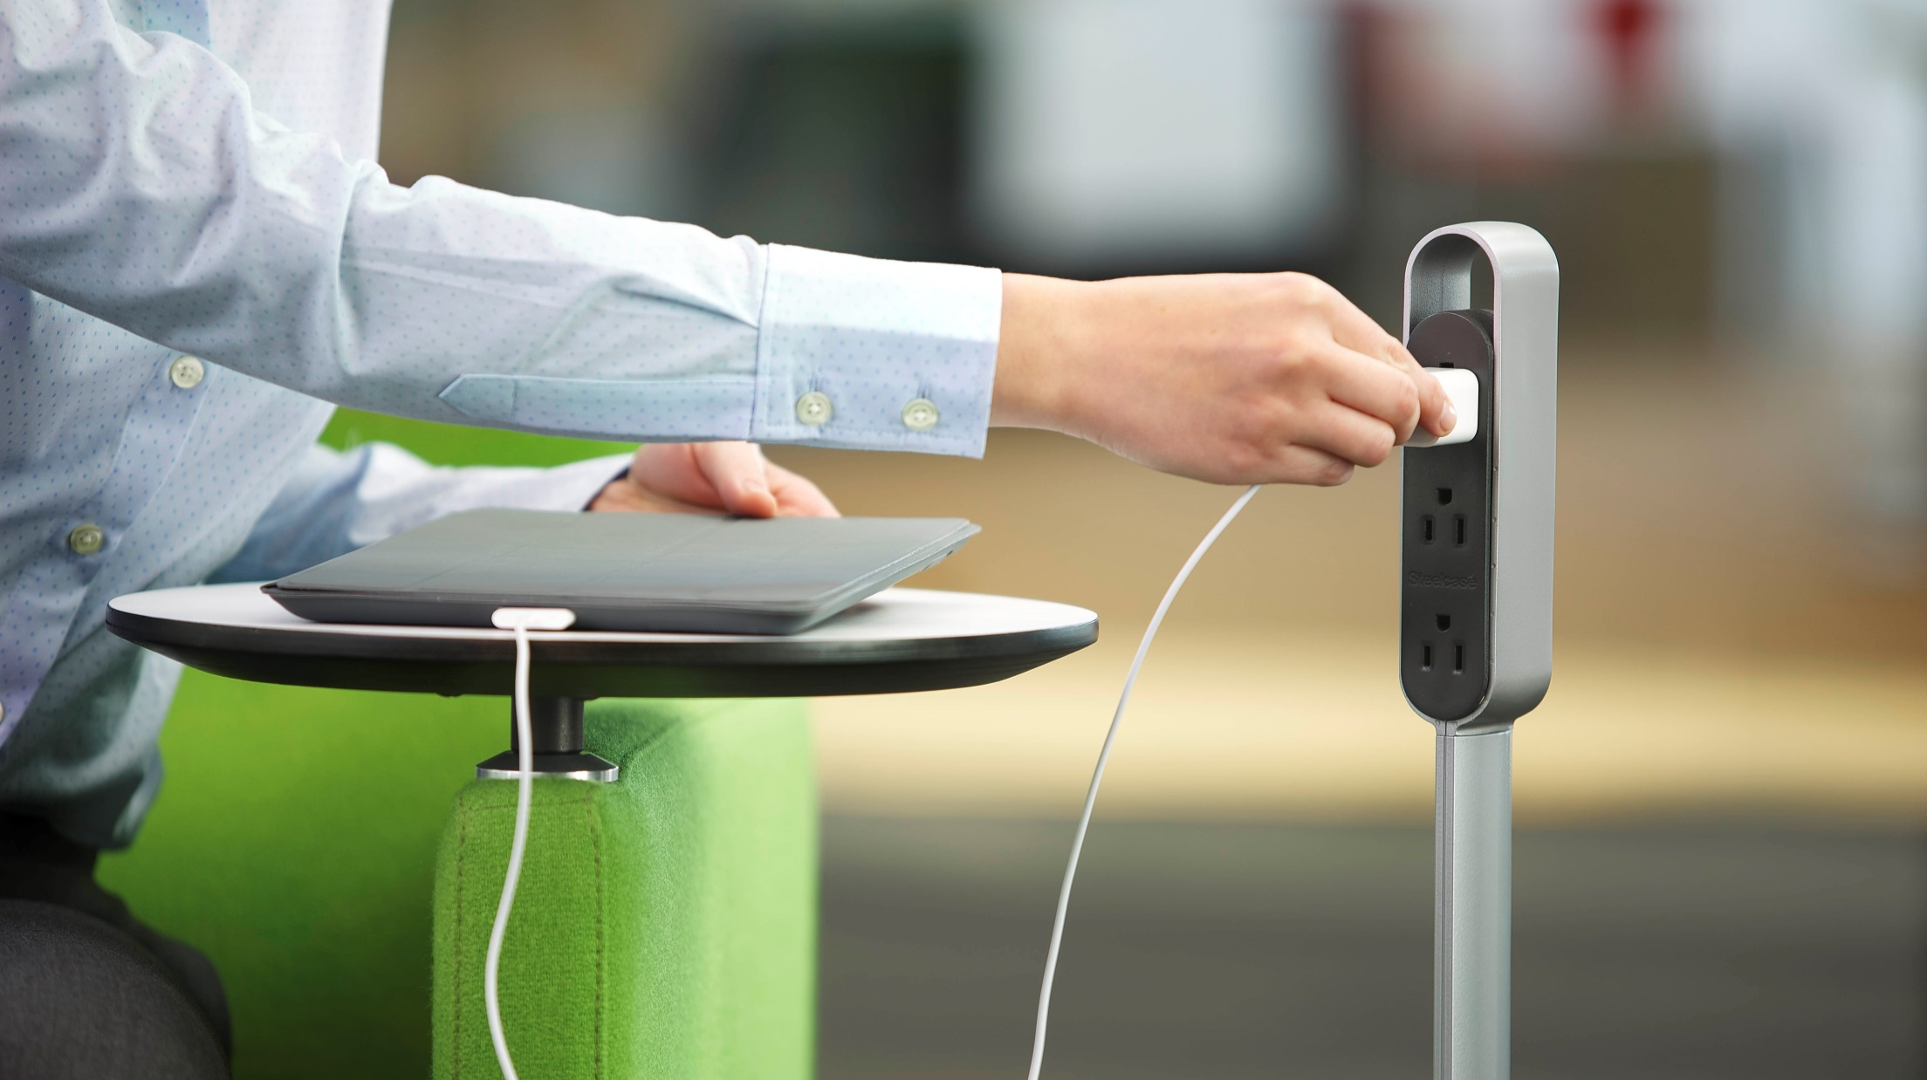
Thread
Power made simple.

