Slide 1
The Ocular Collection in Healthcare
A collection of thought starters

Slide 2
Consultation Space In-person
Ocular in Health

Slide 3
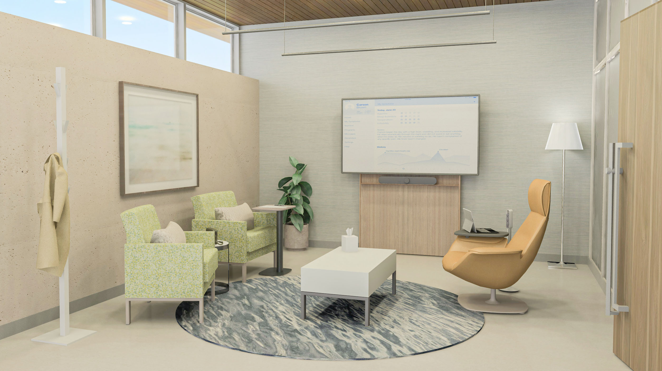
Consultation Space In-person
Ocular Collection:
Ocular Frame – 71” Height
Steelcase + Steelcase Health:
Leela Lounge chair + table
Apprise personal table
Coalesse Massaud Lounge seating
Viccarbe Window rack
Designtex performance textiles
4
1
2
3
5
Coat racks are a welcome addition to any consultation space because they offer a dedicated place for coats, purses or backpacks.
Leela seating provides a simple, classic aesthetic with a comfortable and cleanable seat for guests while meeting the rigorous demands needed for seating in a healthcare environment.
The Apprise Personal table is portable and can be easily pulled up by a user for a convenient writing surface when needed.
Technology plays an important role in the consultation space. A monitor is an essential tool for both teaching and learning, and it should be easily viewable by both clinicians and patients.
The Massaud chair with a tablet arm supports both work and rest in a comfortable lounge posture, enabling eye‑to‑eye conversation and treatment between clinicians and patients.

Slide 5
Virtual Consultation in a Waiting Space
Ocular in Health

Slide 6
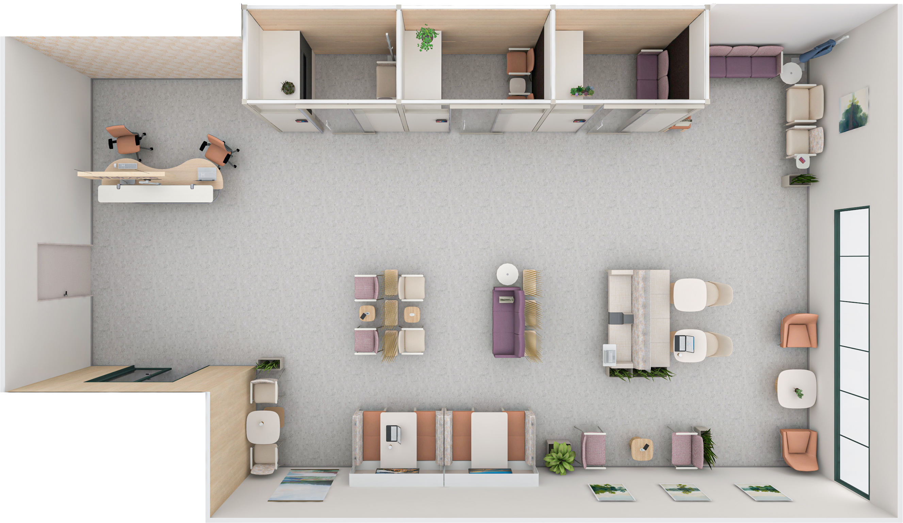
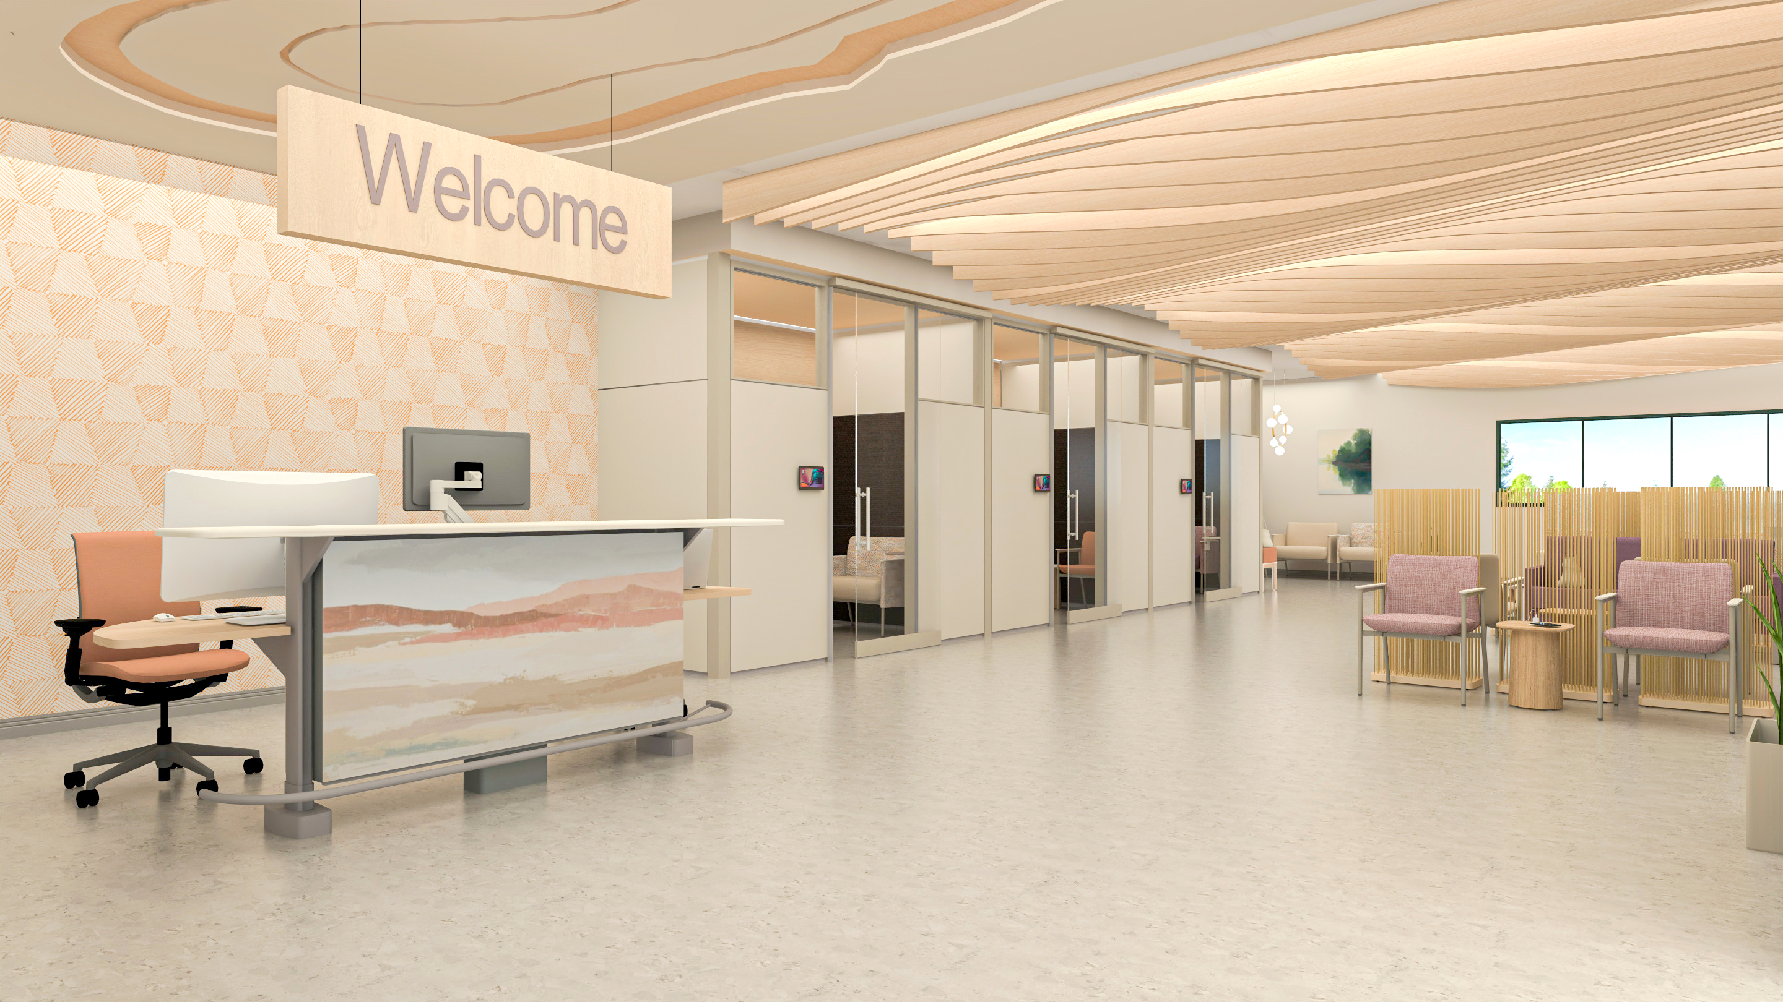
Virtual Consultation in a Waiting Space
Ocular Collection:
Ocular View
Steelcase + Steelcase Health:
Sync Double-Sided base
Apprise Guest & Lounge seating + side table
Leela Lounge seating
Everwall Modular Walls
Think Task chair
Extremis Sticks
Designtex performance textiles
1
2
3
Ocular View delivers an immersive extended‑reality consultation experience, designed to foster a natural, personal, and authentic face‑to‑face connection—even when clinicians and patients are miles apart. Its intuitive setup helps create a seamless virtual care interaction that feels grounded, human, and clinically supportive.
This information desk provides a place for visitors to approach staff with any questions, either upon entering the space or at any time during their visit.
Extremis Sticks incorporates a biophilic element and adds visual interest to the space while acting as space division between user groups.

Slide 8
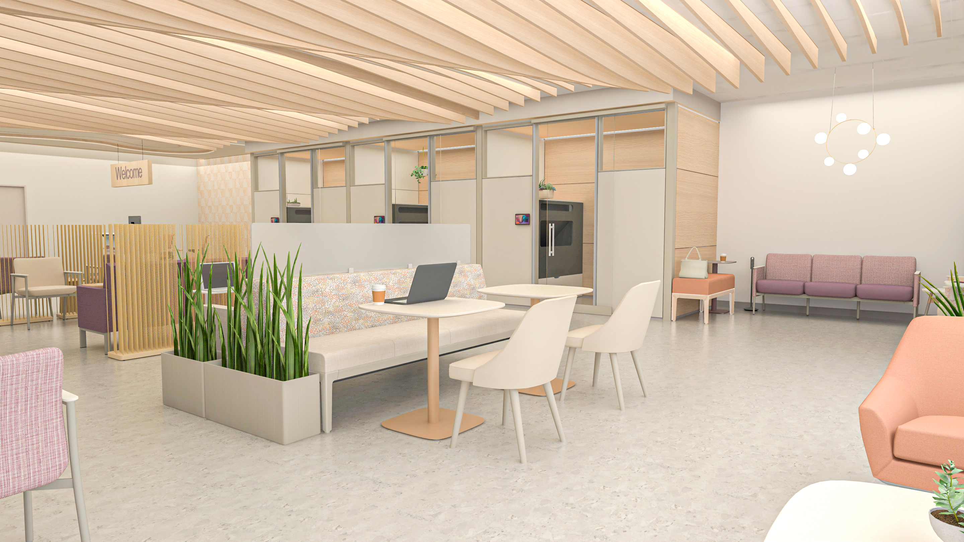
Virtual Consultation in a Waiting Space
Ocular collection:
Ocular View
Steelcase + Steelcase Health:
Apprise Guest & Lounge seating + work-table
Regard seating + planter
West Elm for Health Sterling
West Elm Lucas
Everwall Modular Walls
Extremis Sticks
Designtex performance textiles
3
1
4
2
Regard privacy screens provides an additional element of protection between users that are seated back-to-back.
The Apprise Work-Table offers a convenient surface for working, reading, or enjoying a quick meal, supporting comfort and productivity while waiting.
Ocular View delivers an immersive extended‑reality consultation experience, designed to foster a natural, personal, and authentic face‑to‑face connection—even when clinicians and patients are miles apart. Its intuitive setup helps create a seamless virtual care interaction that feels grounded, human, and clinically supportive.
Apprise Lounge seating brings a warm, residential aesthetic to waiting areas while meeting the performance needs of healthcare environments. Its healthcare‑appropriate finishes, compliant seat heights, and integrated crumb sweep support cleanability, durability, and long‑term maintenance in high‑use clinical spaces.

Slide 10
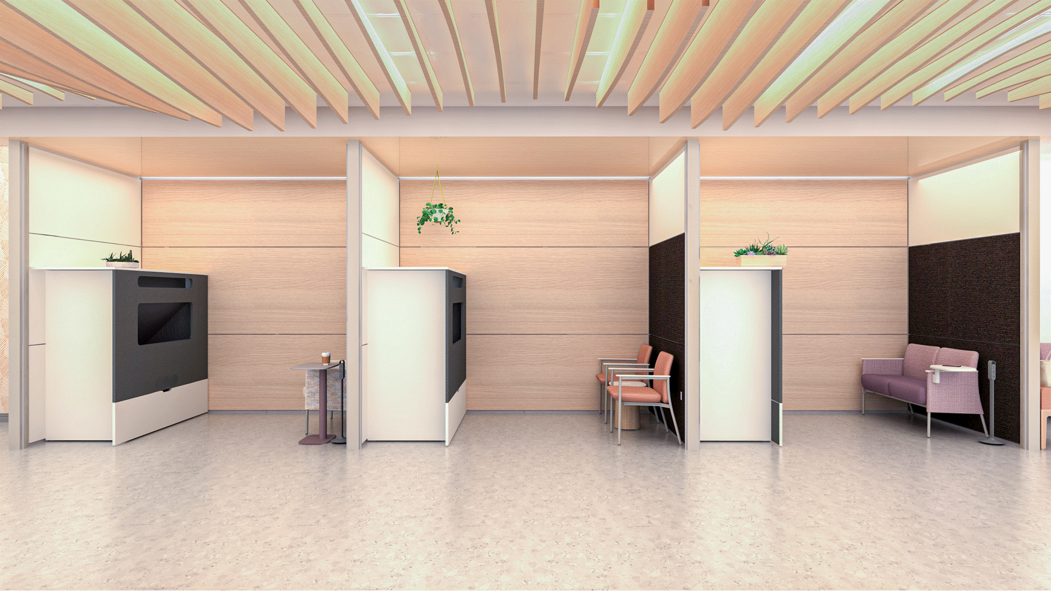
Virtual Consultation in a Waiting Space
Ocular Collection:
Ocular View
Steelcase + Steelcase Health:
Apprise Guest & Lounge seating + personal & side tables
Everwall Modular Walls
Thread Power Hub
Designtex performance textiles
4
1
2
Ocular View delivers an immersive extended‑reality consultation experience, designed to foster a natural, personal, and authentic face‑to‑face connection—even when clinicians and patients are miles apart. Its intuitive setup helps create a seamless virtual care interaction that feels grounded, human, and clinically supportive.
A room scheduler supports efficient scheduling by giving clinicians and patients real‑time visibility into space availability, reducing confusion and improving flow within the consultation area.
Apprise Lounge seating with a tablet surface provides comfortable seating for the patient or care partner, along with a convenient place for personal items or note‑taking during a consultation.
Everwall modular walls create a sense of visual and acoustic privacy essential for meaningful clinician–patient conversations. They are designed to support both single‑user and two‑user lounge configurations, offering flexible options that adapt to a variety of consultation needs.
3

Slide 12
Conference Room
Ocular in Health

Slide 13
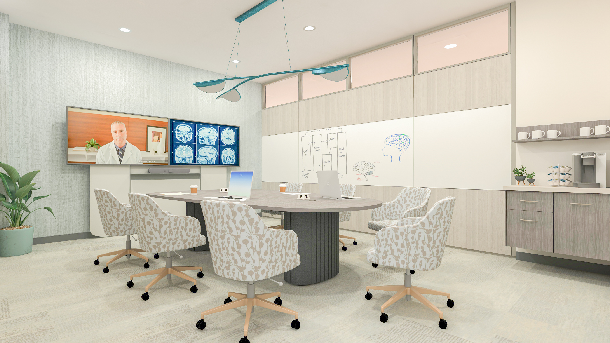
Conference Room
Ocular Collection:
Ocular Sightline table
Ocular Frame – 71” Height
Steelcase + Steelcase Health:
Convey Modular Casework
West Elm for Health Sterling
V.I.A Modular Walls
Flos Almendra Light
Designtex performance textiles
1
4
3
2
Technology plays an important role in the space. The Ocular Frame, seen with double displays, is a tool used for both teaching and learning and should be able to be easily viewed by all users within this space.
The Sightline table is strategically positioned to optimize visibility, support seamless hybrid collaboration, and elevate the overall meeting experience within the conference room.
Integrated whiteboards within V.I.A Wall skins encourage active analog sharing, transforming the wall into a dynamic, collaborative surface that supports real‑time brainstorming and team engagement.
Convey Modular Casework creates a welcoming setting for conversation and refreshment, bringing a hospitality‑inspired aesthetic that elevates the overall feel of the space.

Slide 15
Private Office
Ocular in Health

Slide 16
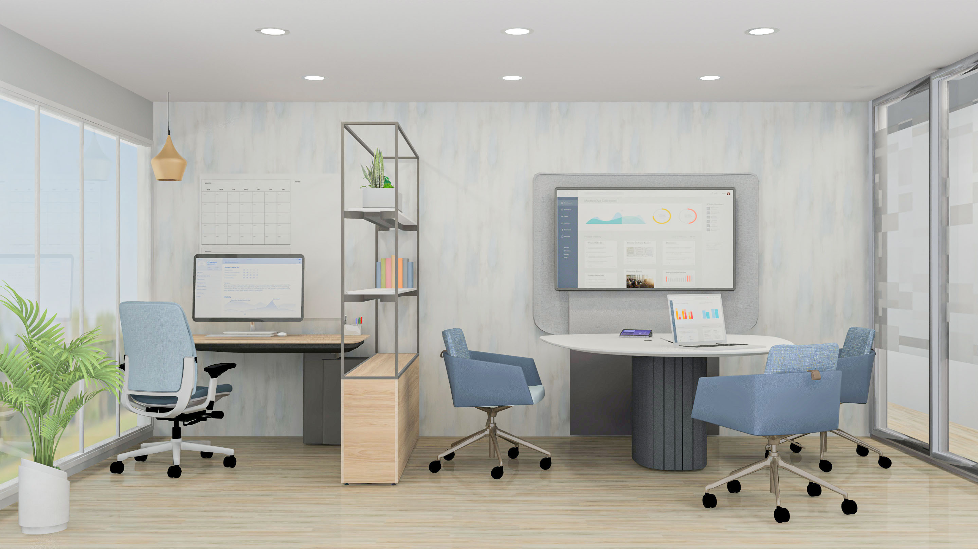
Private Office
Ocular Collection:
Ocular Coupe Tower
Steelcase + Steelcase Health:
Amia task chair
Mackinac
V.I.A Modular Walls
Polyvision Whiteboard
Coalesse Marien 152 chair
Designtex performance textiles
1
2
The Ocular Coupe Tower with a monitor transforms the private office into an efficient space for quick collaboration, with seamless connectivity to technology through the worksurface aperture.
Mackinac surfaces and storage create a definition of space between heads down work and consultation work.
The Amia is an ergonomic task chair that brings a refined style to any space, enhanced by precise manual adjustments, two back options and responsive support.
3

Slide 18
Academic Medical / Ed Med Space
Ocular in Health

Slide 19
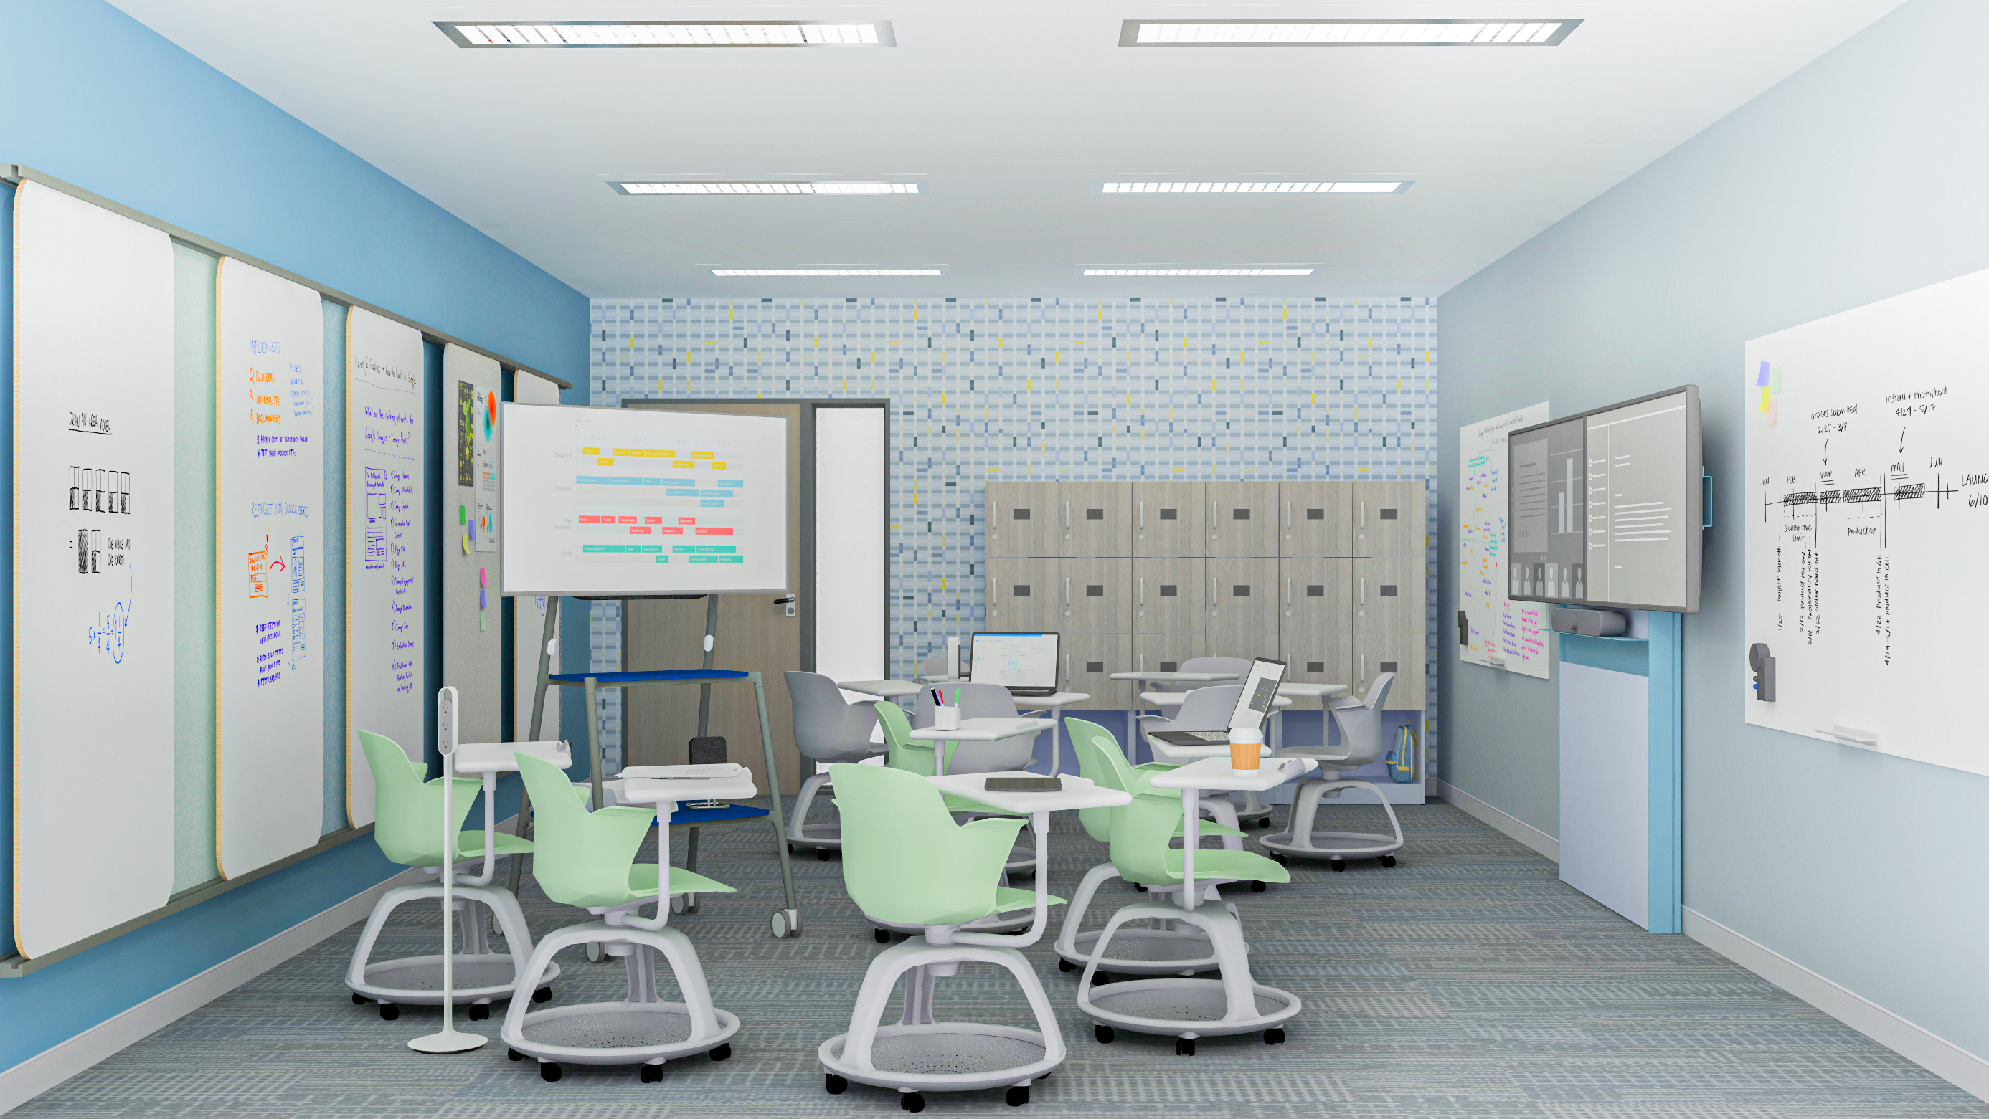
Academic Medical / Ed Med - Small Classroom
Ocular collection:
Ocular Frame – 71” Height
Steelcase + Steelcase Health:
Node chair
WorkValet lockers
Flex Media Cart + Markerboard
Thread Power Hub
Premium Whiteboards
4
1
2
Ocular Frame is a tool used for both teaching and learning and should be able to be easily viewed by all users within this space, with easy accessibility to power and technology inside of the technology door.
WorkValet offer a broad range of possible configurations and aesthetic options to support the desired look and function of any organization’s storage.
The Node chair is mobile and supports all the ways students learn. It’s designed for quick, easy transitions in the classroom, and to support learning modes across the campus.
Lightweight markerboards and mountable wall rails allow students to surround themselves with information and keep everyone in the loop.
3

Slide 21
Training Room / Classroom
Ocular in Health

Slide 22
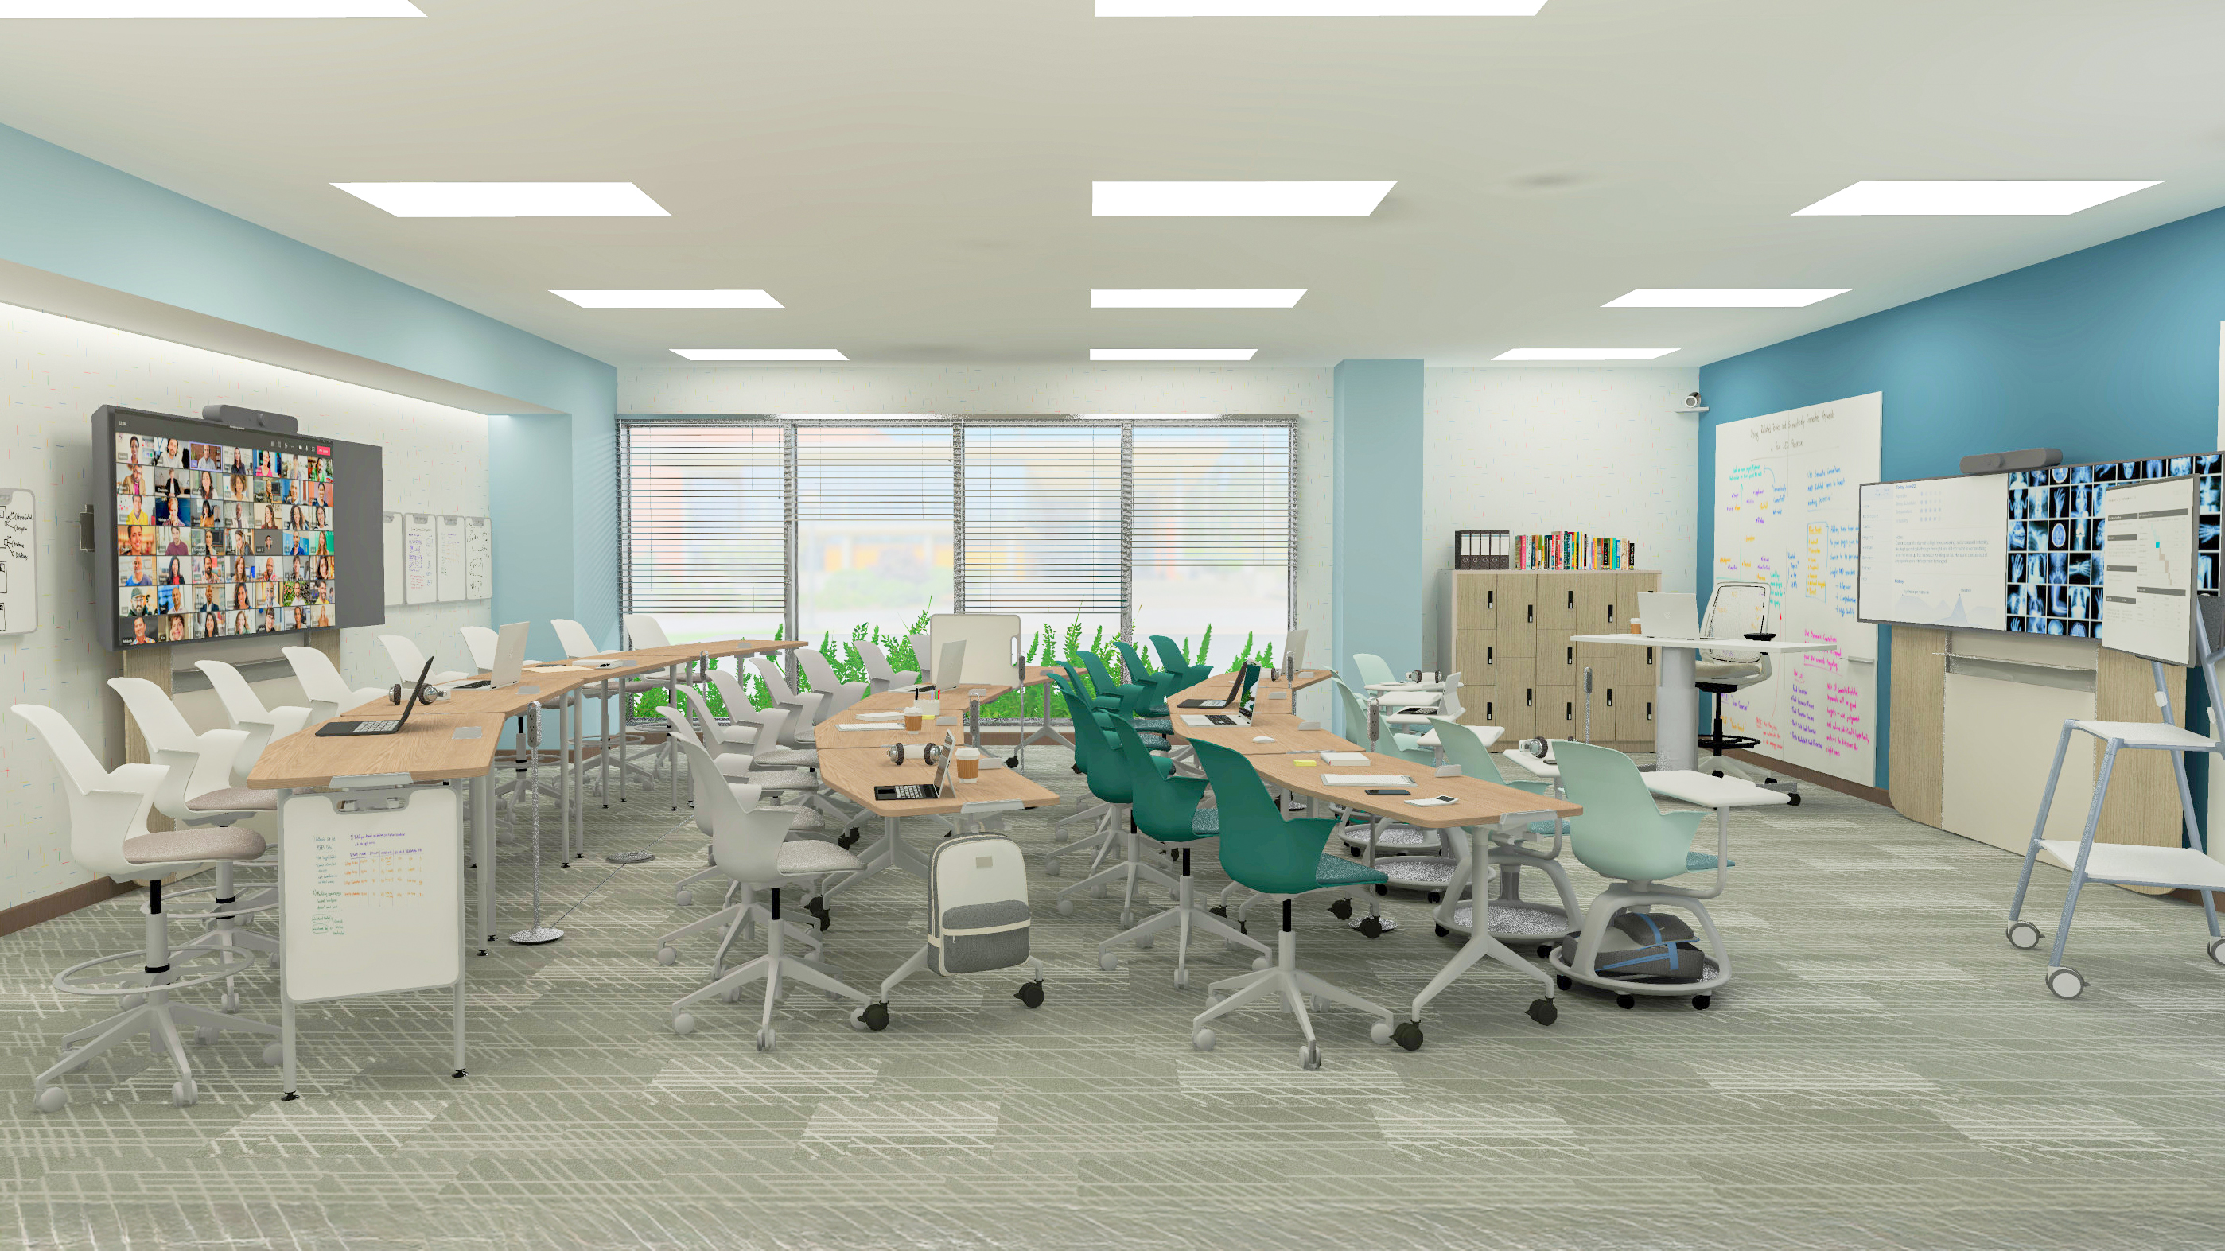
Training Room / Classroom
Ocular collection:
Ocular Frame – Dual Monitor + Single Monitor Pana 105
Steelcase + Steelcase Health:
Node chair
Series 2 stool
Universal Worksurface
WorkValet lockers
Flex Media Cart
Thread Power Hub
Verb Flip Top Table + Personal Whiteboards
Premium Whiteboards
1
2
4
Ocular Frame with a Pana 105 monitor supports both virtual and on‑site trainings for medical students, providing a flexible and immersive learning environment that enhances collaboration and improves the overall training experience.
Ocular Frame supports both teaching and learning by ensuring content is easily visible to everyone in the room. It’s also designed for fast, simple installation—typically completed in under an hour.
Verb Flip Top Chevron Table provide a space that is easy to rearrange, since you can reconfigure the space or nest it for demonstrations in the center.
Markerboard surfaces support analog content sharing, helping facilitate teaching and learning opportunities.
3

Slide 24
Team Huddle
Ocular in Health

Slide 25
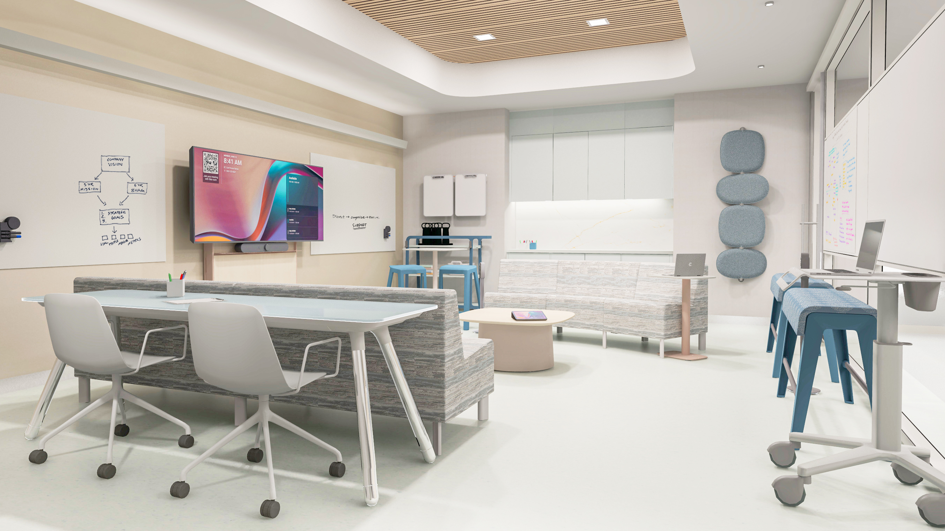
Team Huddle
Ocular collection:
Ocular Frame- Single Monitor Pana 81
Steelcase + Steelcase Health:
Convey Modular Casework
Apprise Personal + Occasional table
Pocket Cart
Simple stool
B-Free bench
1
4
Verb Personal Whiteboards
Premium Whiteboards
Marteen chair
Potrero 415 table
2
3
Ocular Frame, combined with whiteboards, supports both analog and virtual sharing to enhance collaboration in this team huddle space.
Convey modular casework provides necessary storage space and a surface in the room where references and supplies can be placed.
An Apprise Personal Table provides an additional surface to set personal belongings and a laptop for a best posture when needed.
Snowsound acoustic panels enhance overall sound absorption, contributing to a more controlled acoustic environment. Their sculptural forms and varied finishes also allow them to function as artwork, adding visual interest while performing acoustically.

Slide 27
Clinician Collaboration
Ocular in Health

Slide 28
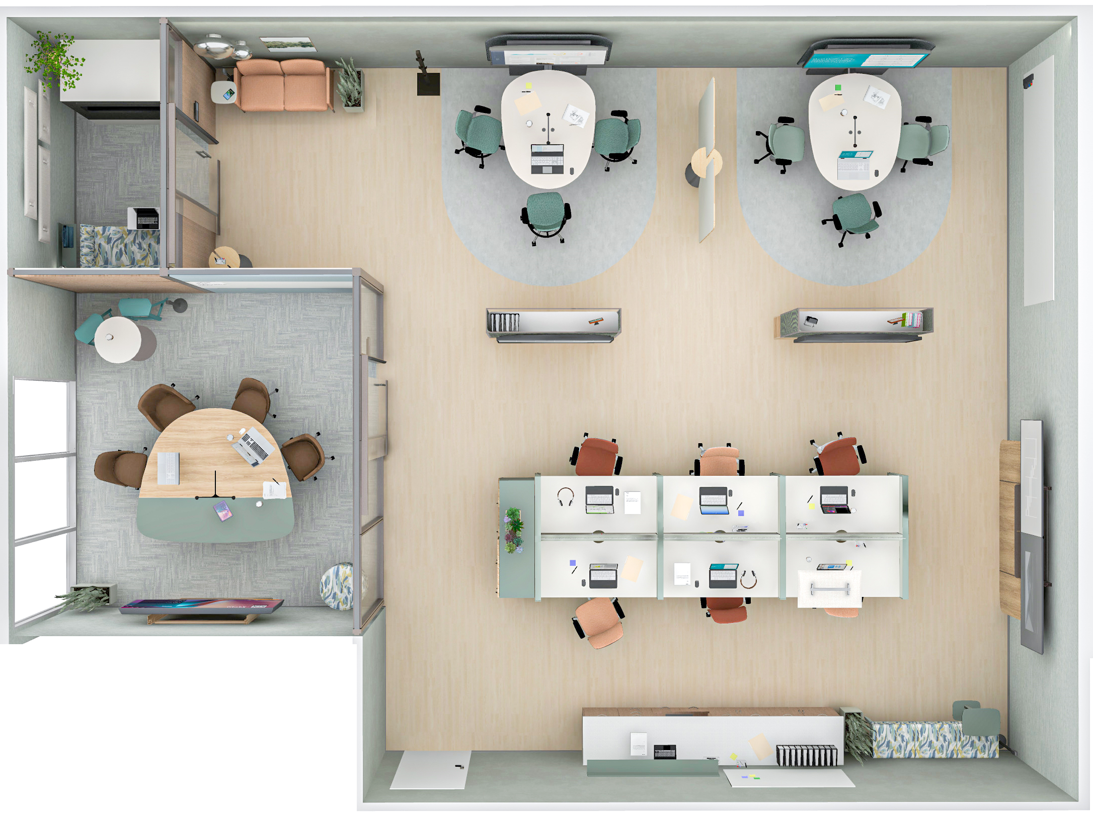
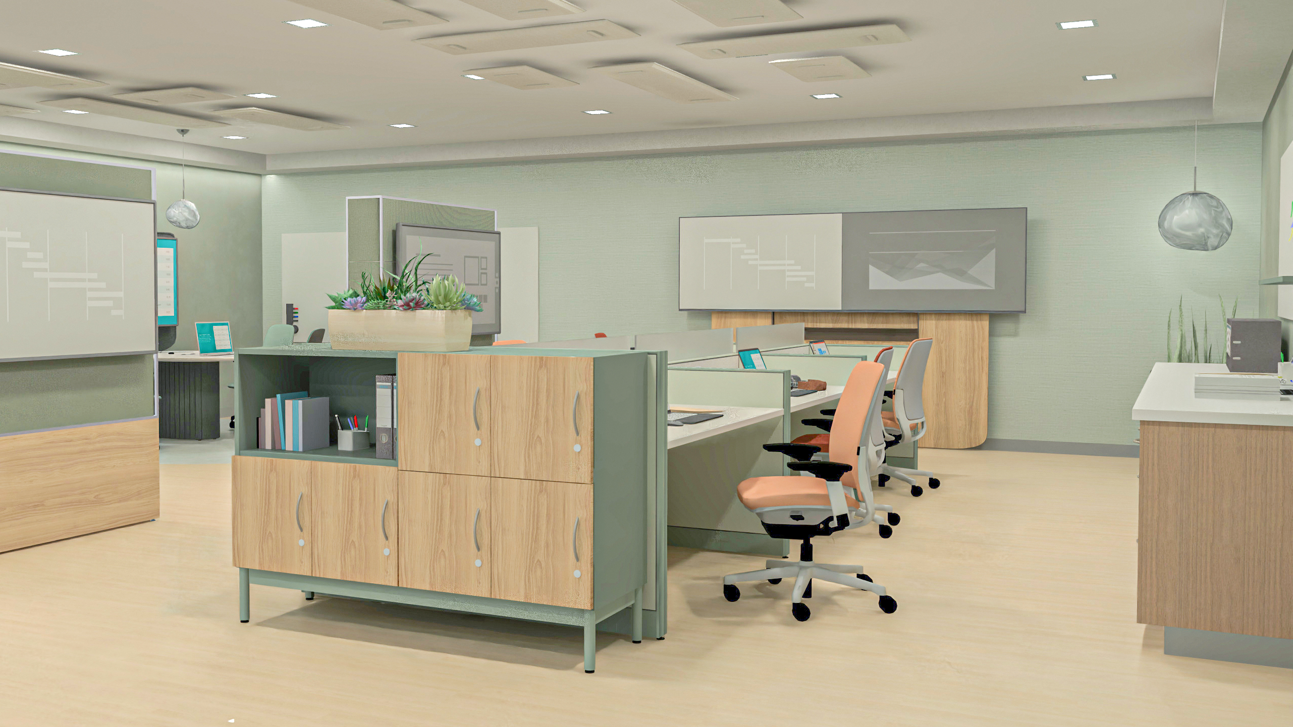
Clinician Collaboration Areas
Ocular Collection:
Ocular Frame- Dual Monitor
Steelcase + Steelcase Health:
Convey Modular Casework
Answer Panels
WorkValet lockers
Amia Task chair
Foundation and Tower
2
Melt Pendant
Snowsound Acoustic panels
Designtex performance textiles
1
3
Ocular Frame integrates technology, accessibility, and ergonomic design to support a variety of collaborative activities—from brainstorming and content sharing to formal presentations and team meetings at this open bench plan.
Mackinac foundation tower allows clinicians to have a space to store important shared references while also acting as a division of space.
WorkValet offer a broad range of possible configurations and aesthetic options to support the desired look and function of any organization’s storage.
Convey Modular Casework provide additional storage space for administrative files and supplies, as well as a dedicated place for a printer.
4

Slide 30
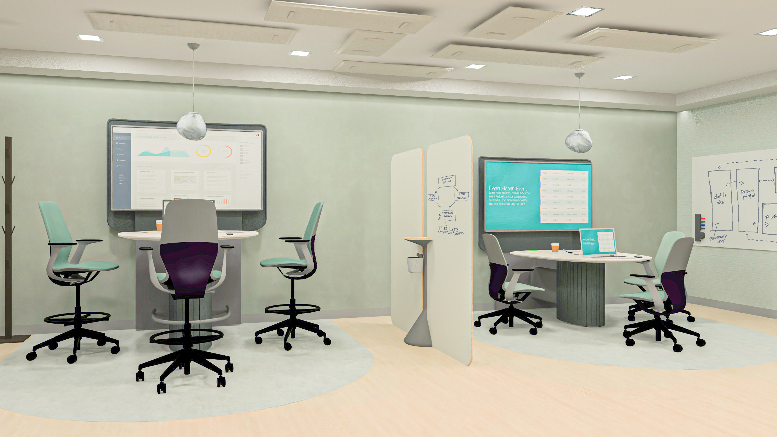
Clinician Collaboration Areas
2
Ocular Collection:
Ocular Coupe Tower
Steelcase + Steelcase Health:
Silq Task chair
Flex Markerboard
Viccarbe Window rack
Premium Whiteboards
Melt Pendant
Snowsound Acoustic panels
Designtex performance textiles
1
3
The Ocular Coupe Tower with a monitor creates an efficient space for quick collaboration, offering both standing and seated heights to support different clinician postures.
Snowsound acoustic panels in an open space enhance overall sound absorption, contributing to a more controlled acoustic environment.
Flex markerboards provide a surface to jot down thoughts and key discussion points among clinicians. It also helps define space, creating a boundary between work areas.

Slide 32
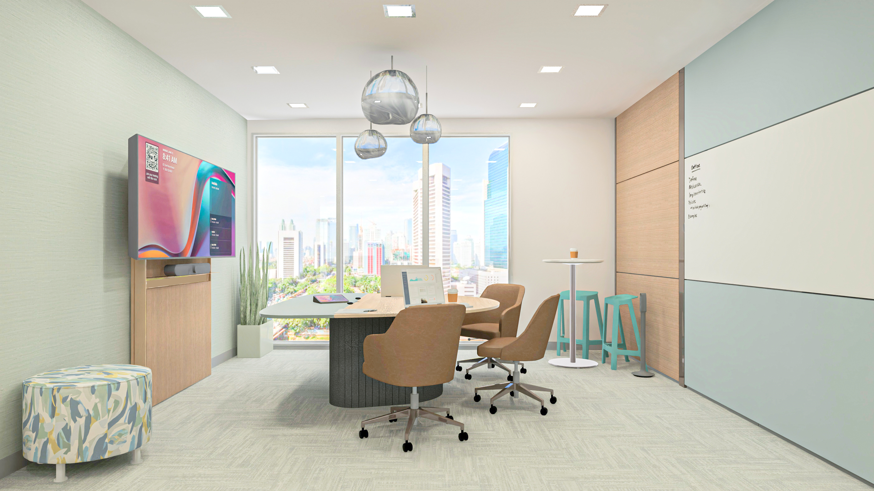
Clinician Collaboration Areas
Ocular Collection:
Ocular Frame- Single Monitor Pana 81
Ocular Coupe Table
Steelcase + Steelcase Health:
West Elm for Health Sterling chair
Everwall Modular Walls
Flex Perch stool
Alight ottoman
1
Coalesse Montara 650 table
Melt Pendant
Designtex performance textiles
5
4
Ocular Frame paired with a Jupiter Pana 81" ultra-wide display creates a high-performance, private meeting or focus space optimized for hybrid collaboration.
The Coupe table is designed to support natural collaboration and conversation, with everyone having a clear view of each other, the screen, and the camera.
West Elm Sterling provides a comfortable and ergonomic sit with a residential aesthetic that supports clinicians while they work.
A standing height table provides a different setting and supports different postures to this collaboration area.
A whiteboard on the back of the Ocular Coupe table supports analog content sharing and encourages collaboration.
2
3

Slide 34
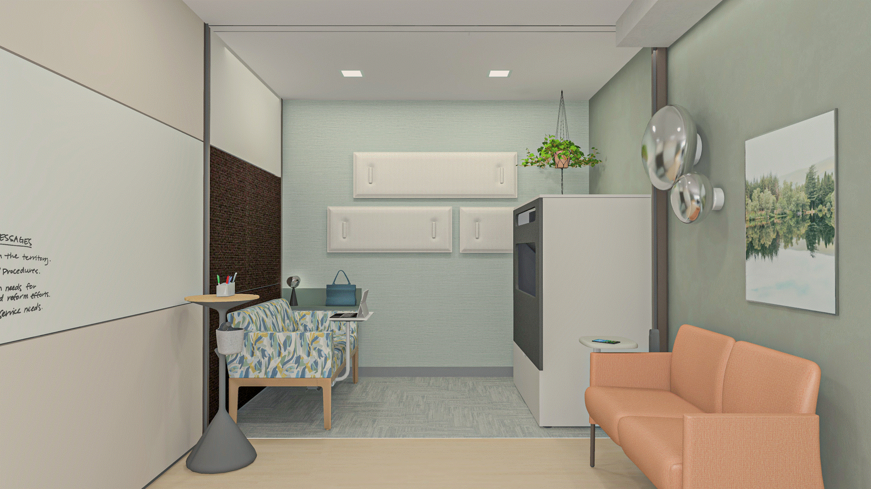
Clinician Collaboration Areas
Ocular collection:
Ocular View
Steelcase + Steelcase Health:
Surround Lounge seating
Apprise Lounge seating
Everwall Modular Walls
EE Floating shelf
Thread Power Hub
Melt Wall lamps
Snowsound Acoustic panels
Designtex performance textiles
3
1
Ocular View integrates digital technology seamlessly into the physical work environment, creating a more natural and intuitive interaction experience. By supporting clear communication and more personal connections, it helps strengthen team cohesion and reduce feelings of isolation often associated with hybrid clinical workflows.
Surround seating with a mobile tablet surface offers comfortable seating, as well as a place for their personal items or note-taking during their meeting.
Snowsound acoustic panels in a closed space significantly improve overall sound absorption, contributing to a more controlled and comfortable acoustic environment.
A comfortable lounge area for casual meetings or rejuvenation is provided for clinicians to sit and relax or work.
2
4

