Slide 1
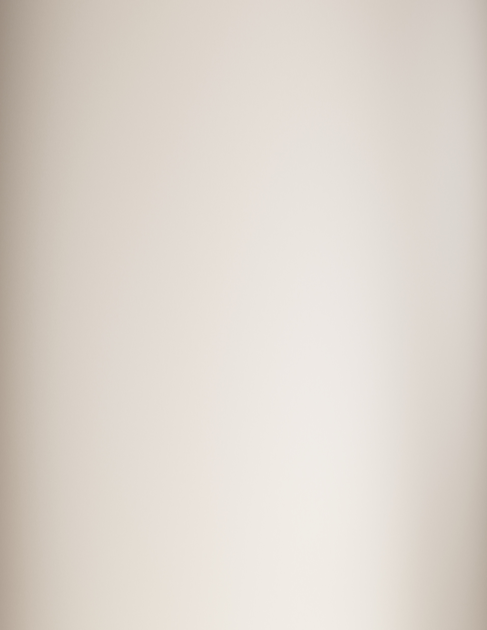
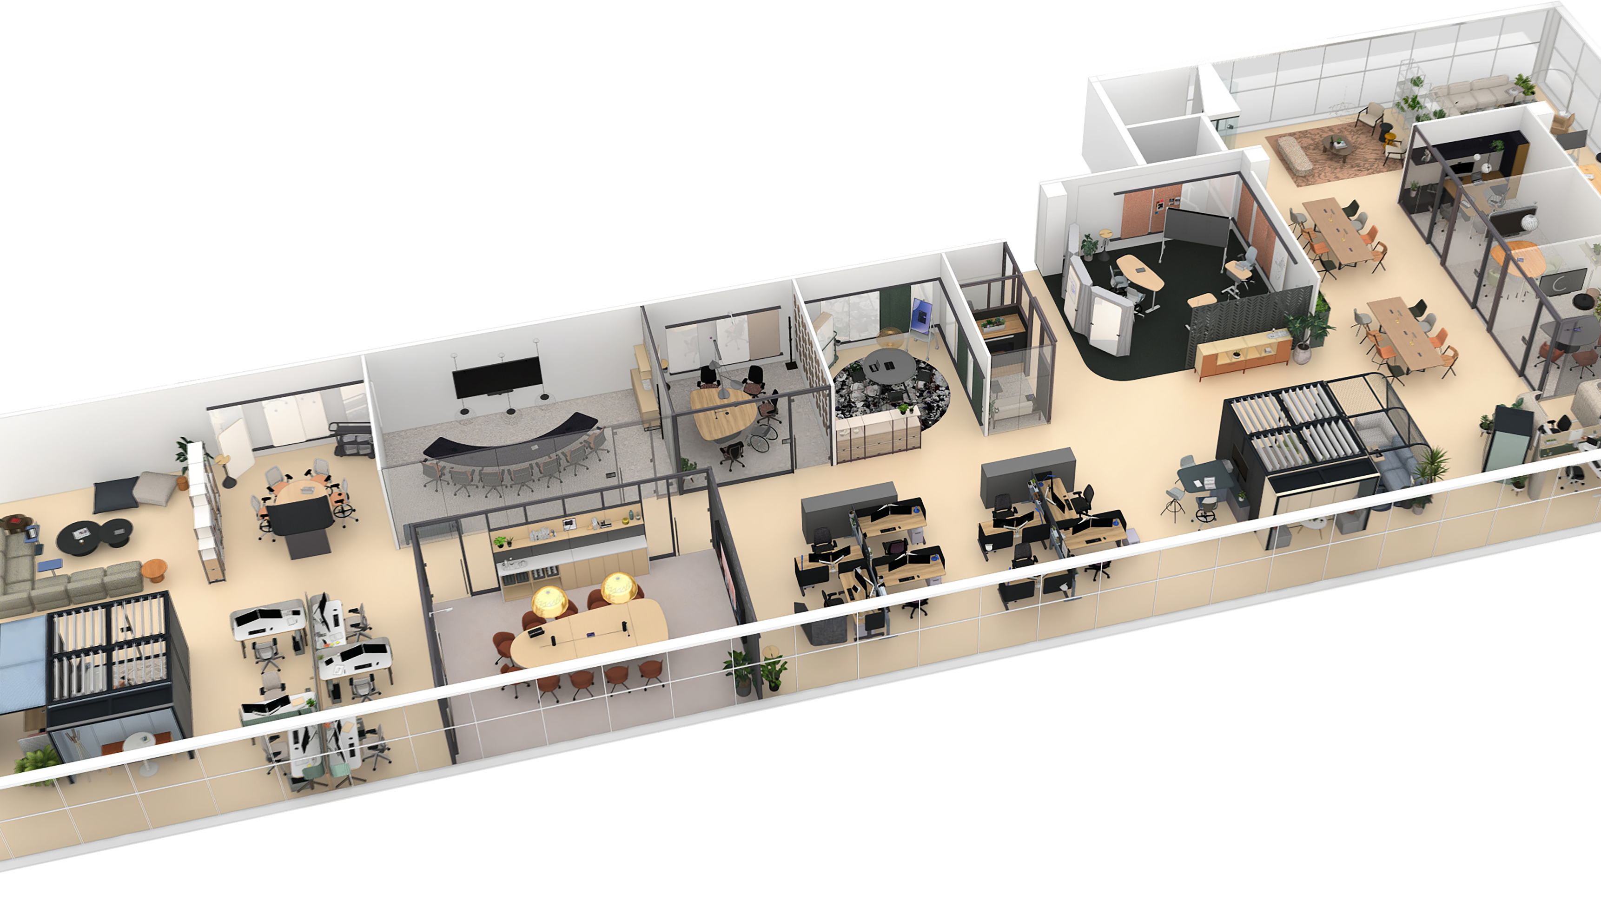

Ocular
Collection
Across The Floorplan
Notes:
Insert dealer partner logo where noted on the slide.

Slide 2
The Ocular Collection
is a range of products designed
to create more engaging, equitable,
and empowering experiences for
people across the hybrid workplace.

Slide 3
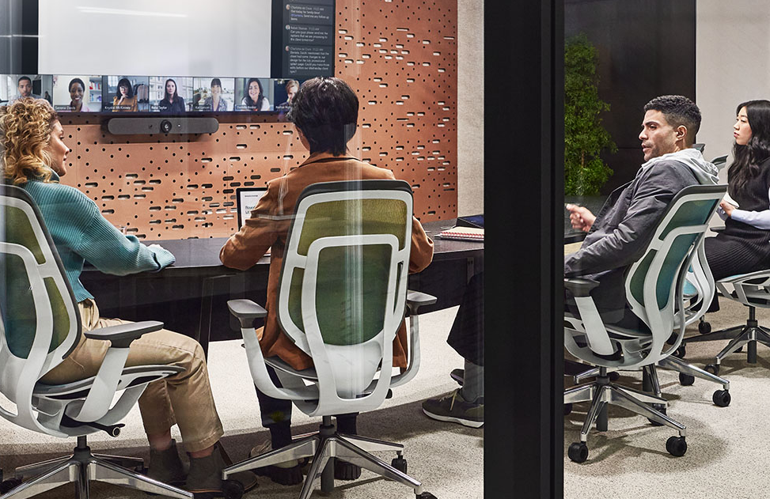
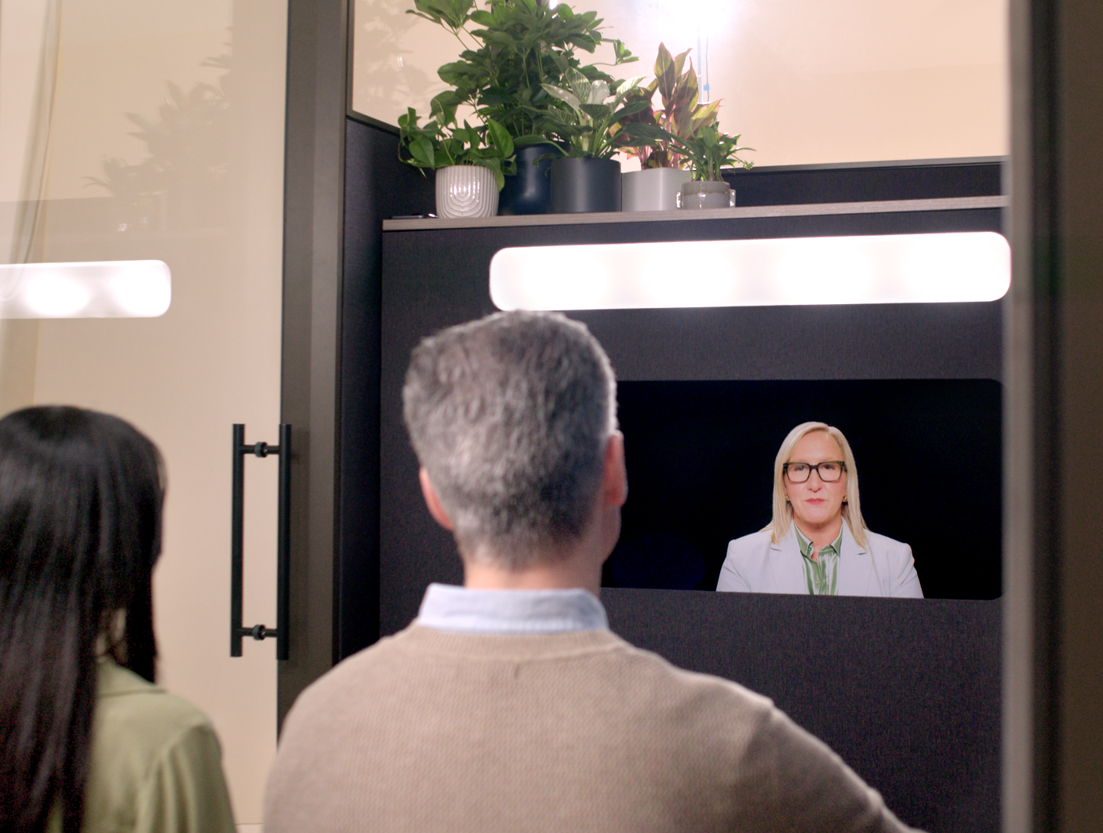
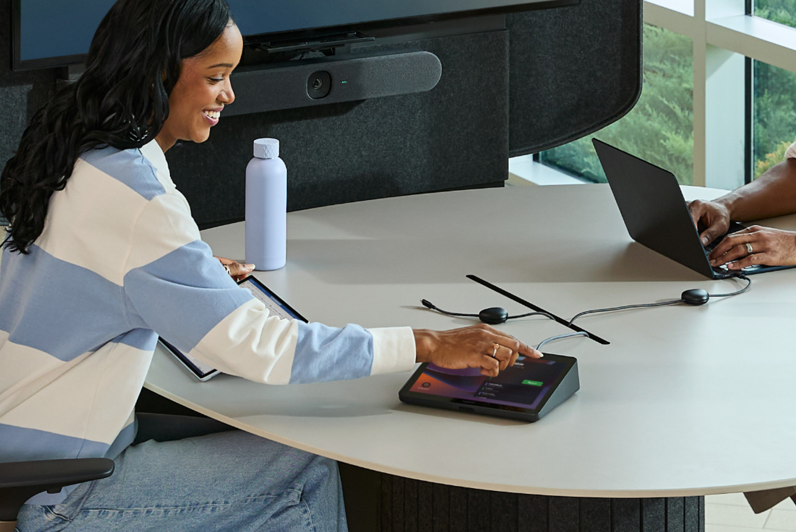
Ocular Design Pillars
Grounded In Research
Shaped by research and real-world insights, the Ocular Collection reimagines hybrid work with solutions that improve how people see, hear, and connect.
Inspired By The Future
Designed For Everyone
Steelcase has partnered with tech leaders to deliver collaboration solutions that enhance today’s hybrid workspace, while prototyping, iterating, and evolving for the future.
The Ocular Collection curates meaningful interactions on both sides of the screen, ensuring everyone feels focused, and motivated to perform at their best.
Notes:
The Ocular Collection has three common design pillars that are core to the product line.

Slide 4
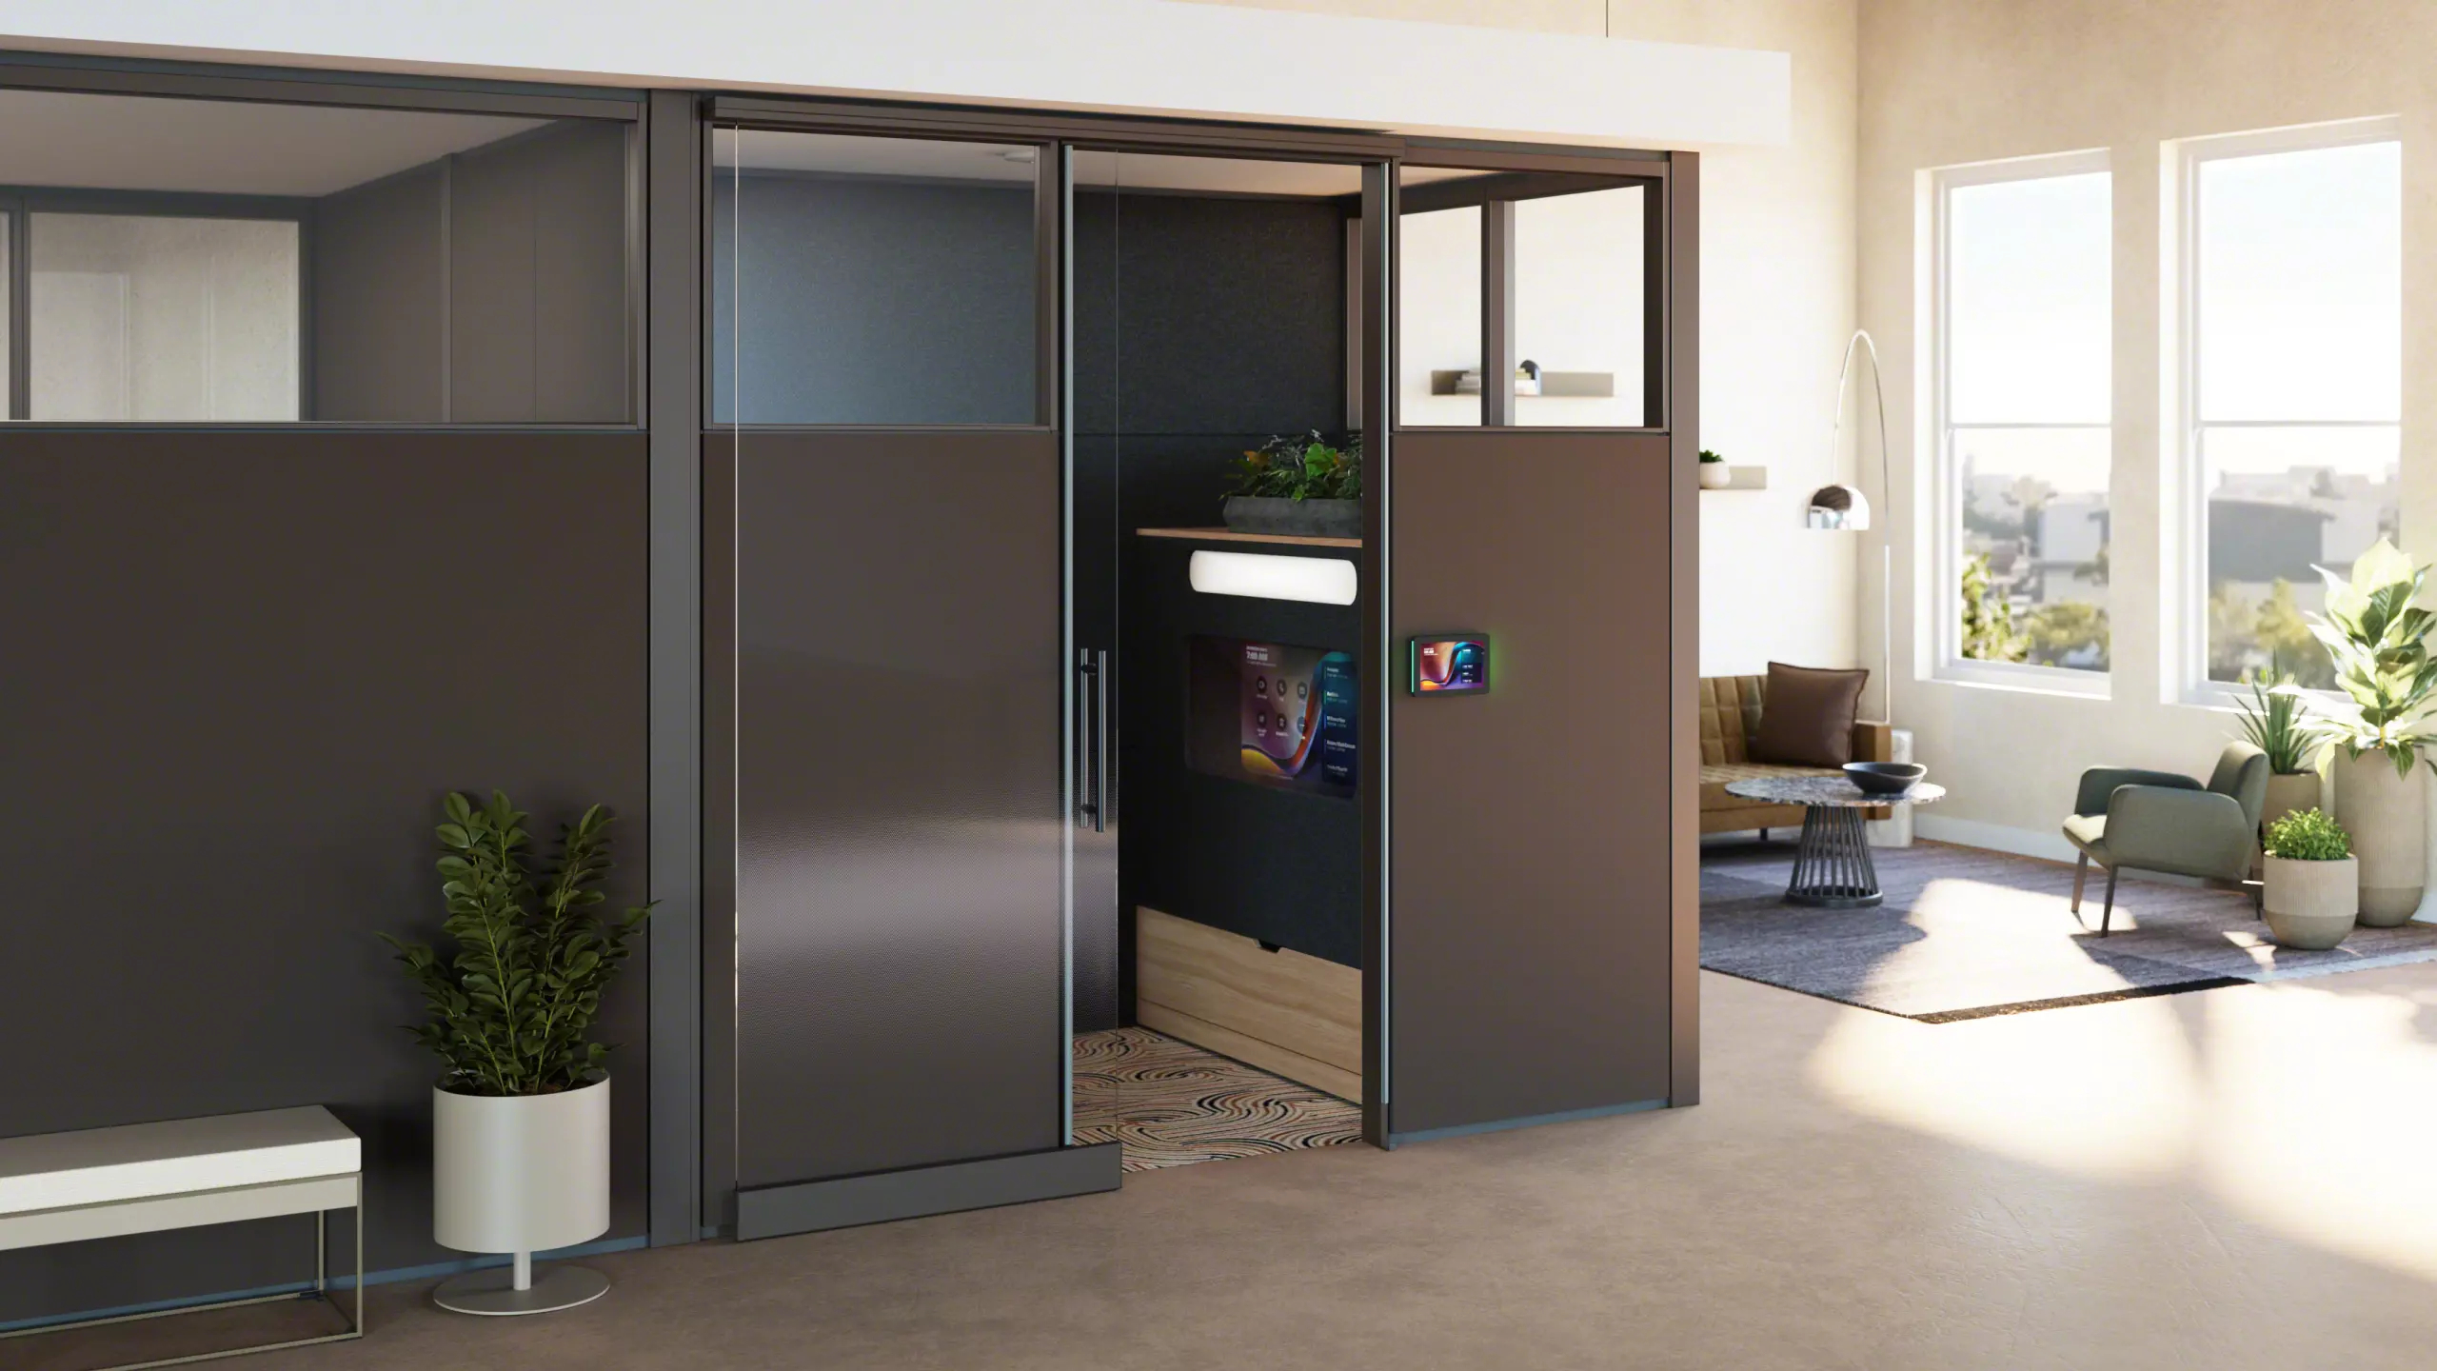
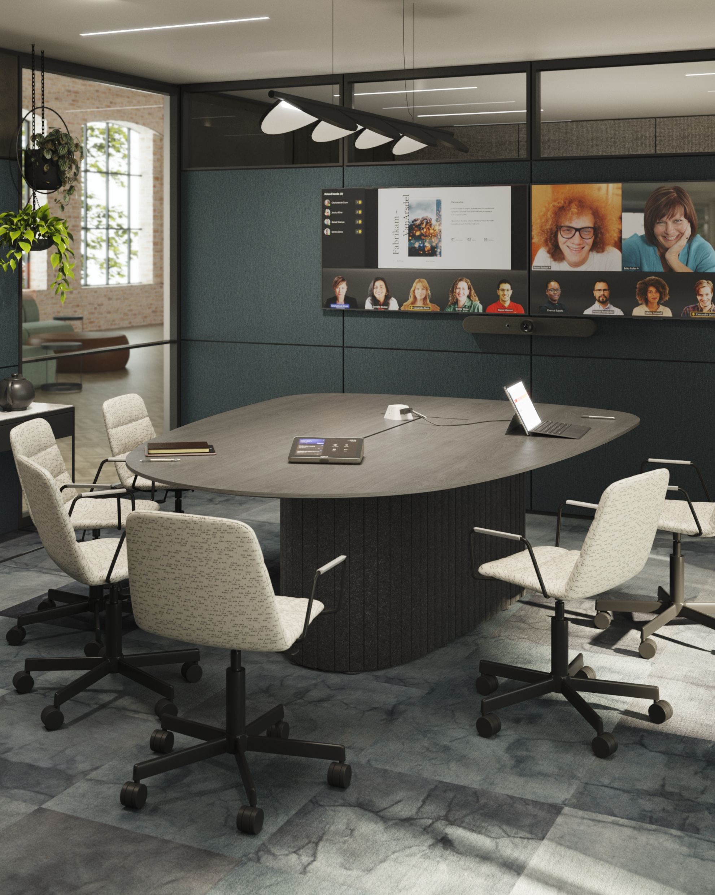
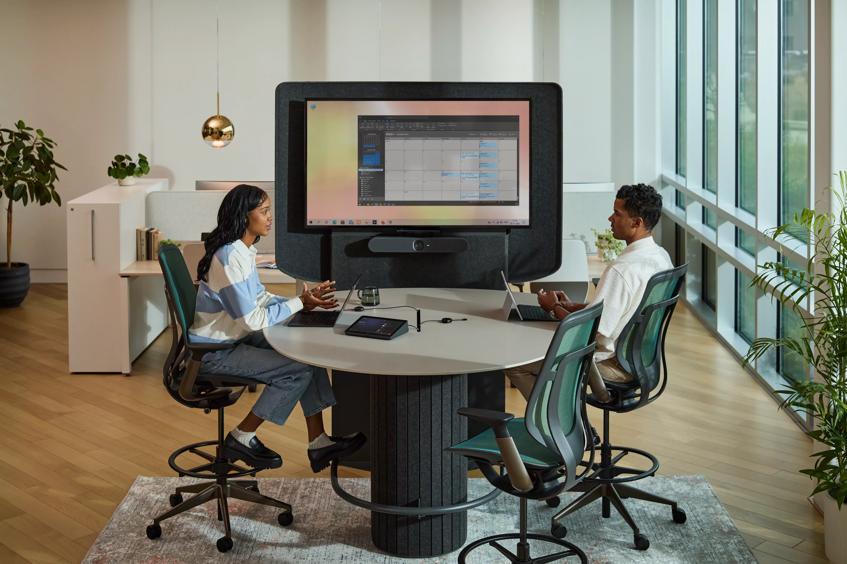
Innovative solutions for connecting in
the new workplace.

Slide 5
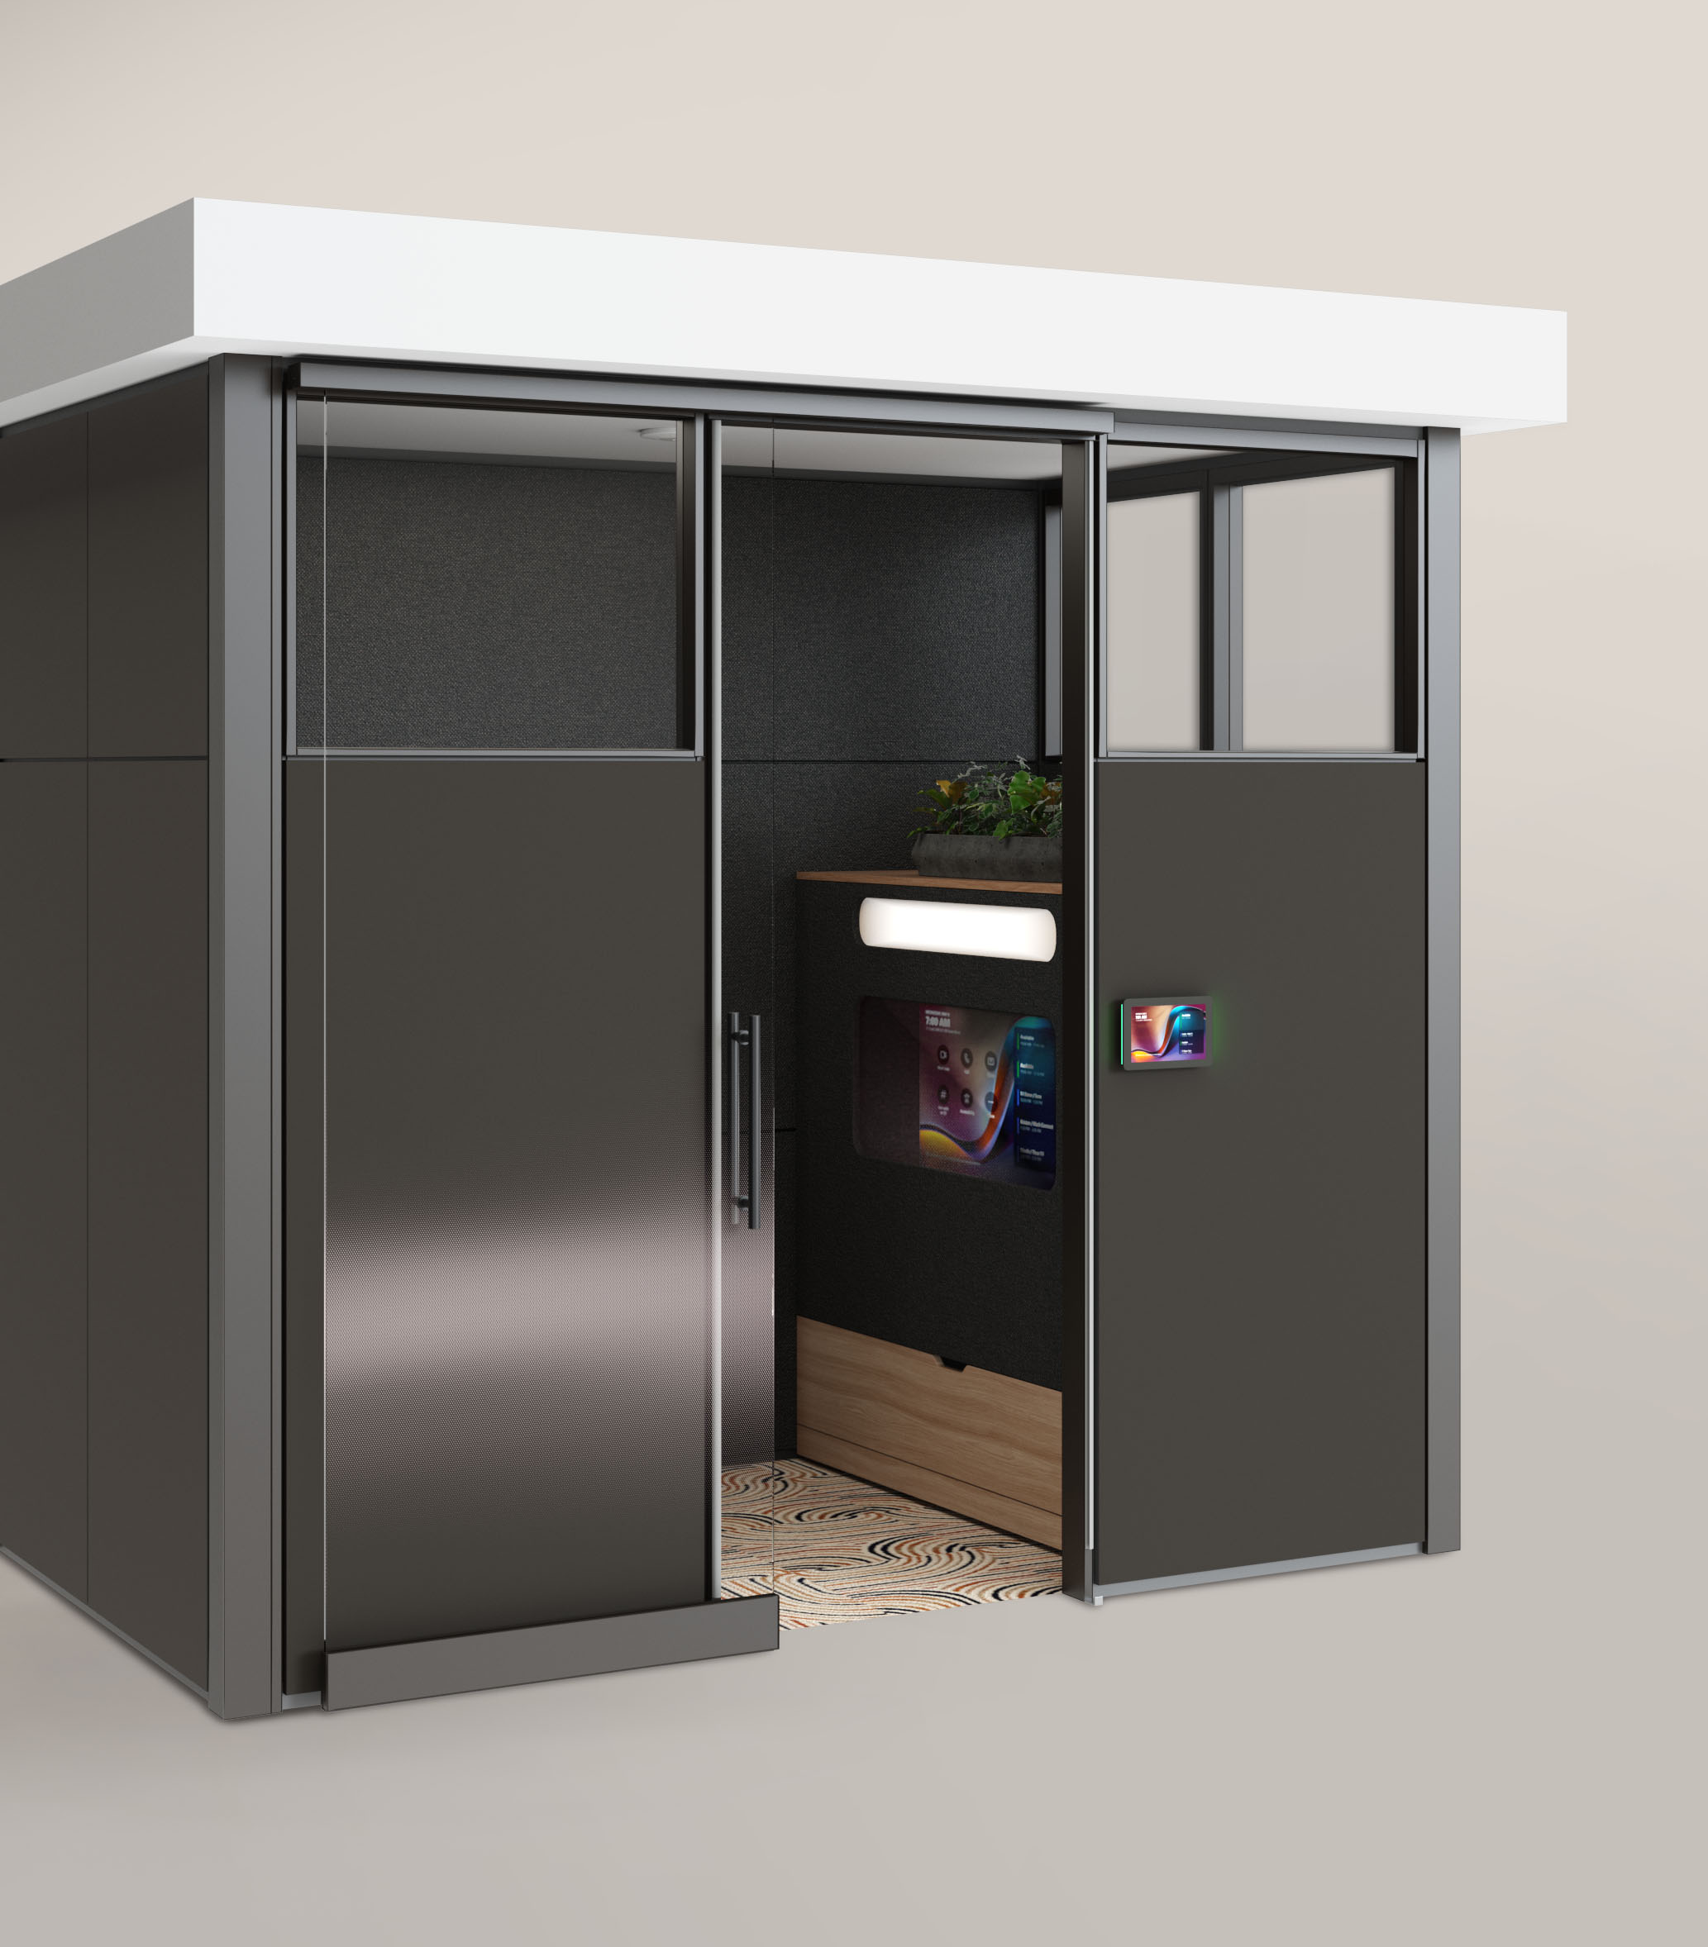
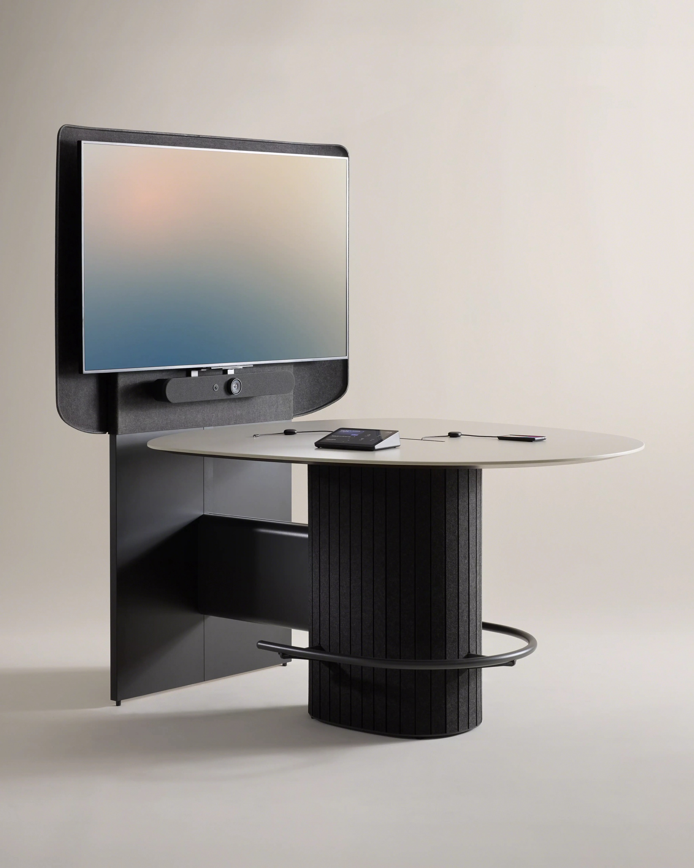
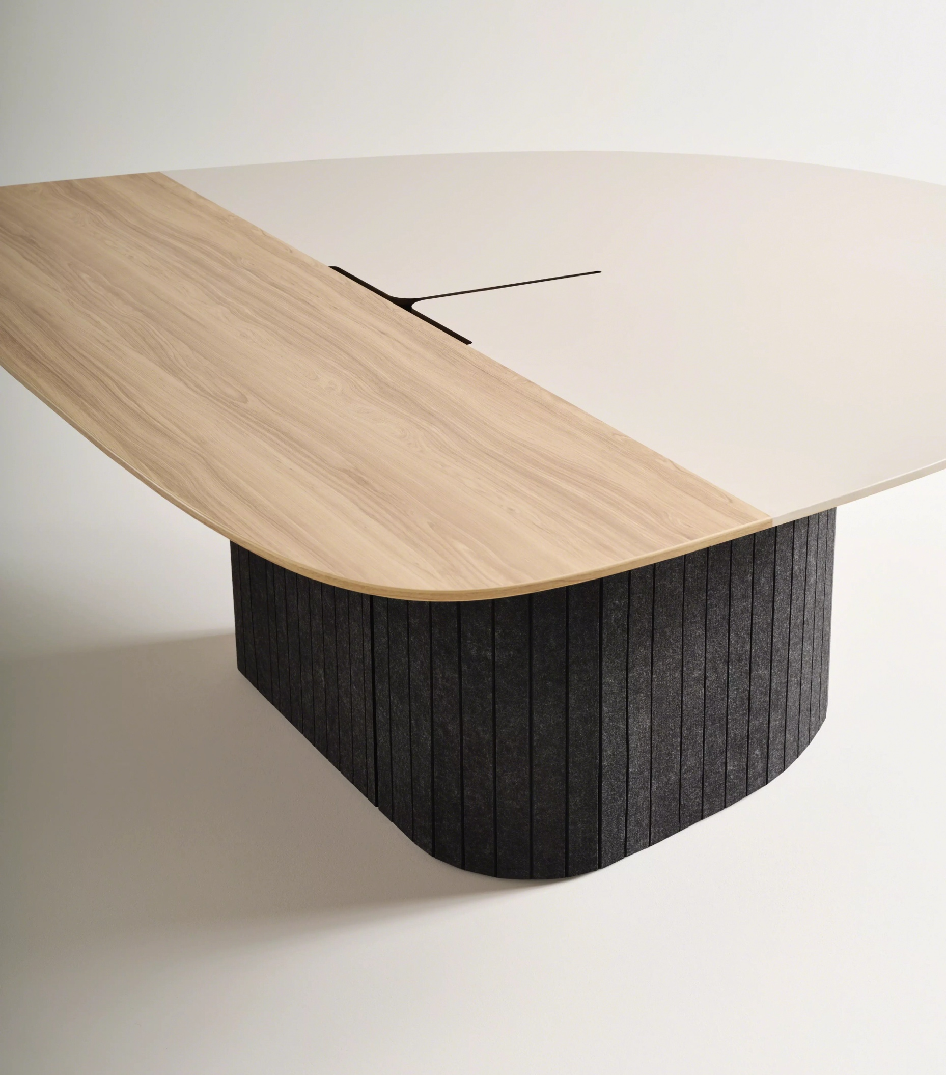
Meet the
Collection
Ocular Tables
A range of organic shaped tables designed for hybrid work, setting the stage for better meeting experiences in huddle spaces to large meeting rooms.
Ocular Tower
Ocular View
Seated and standing height solution with fully integrated technology supports huddle or in between spaces across the open plan.
A realistic, extended-reality meeting experience that creates a more personal and immersive face-to-face connection.

Slide 6
Ocular Collection
Across the Floorplan

Slide 7
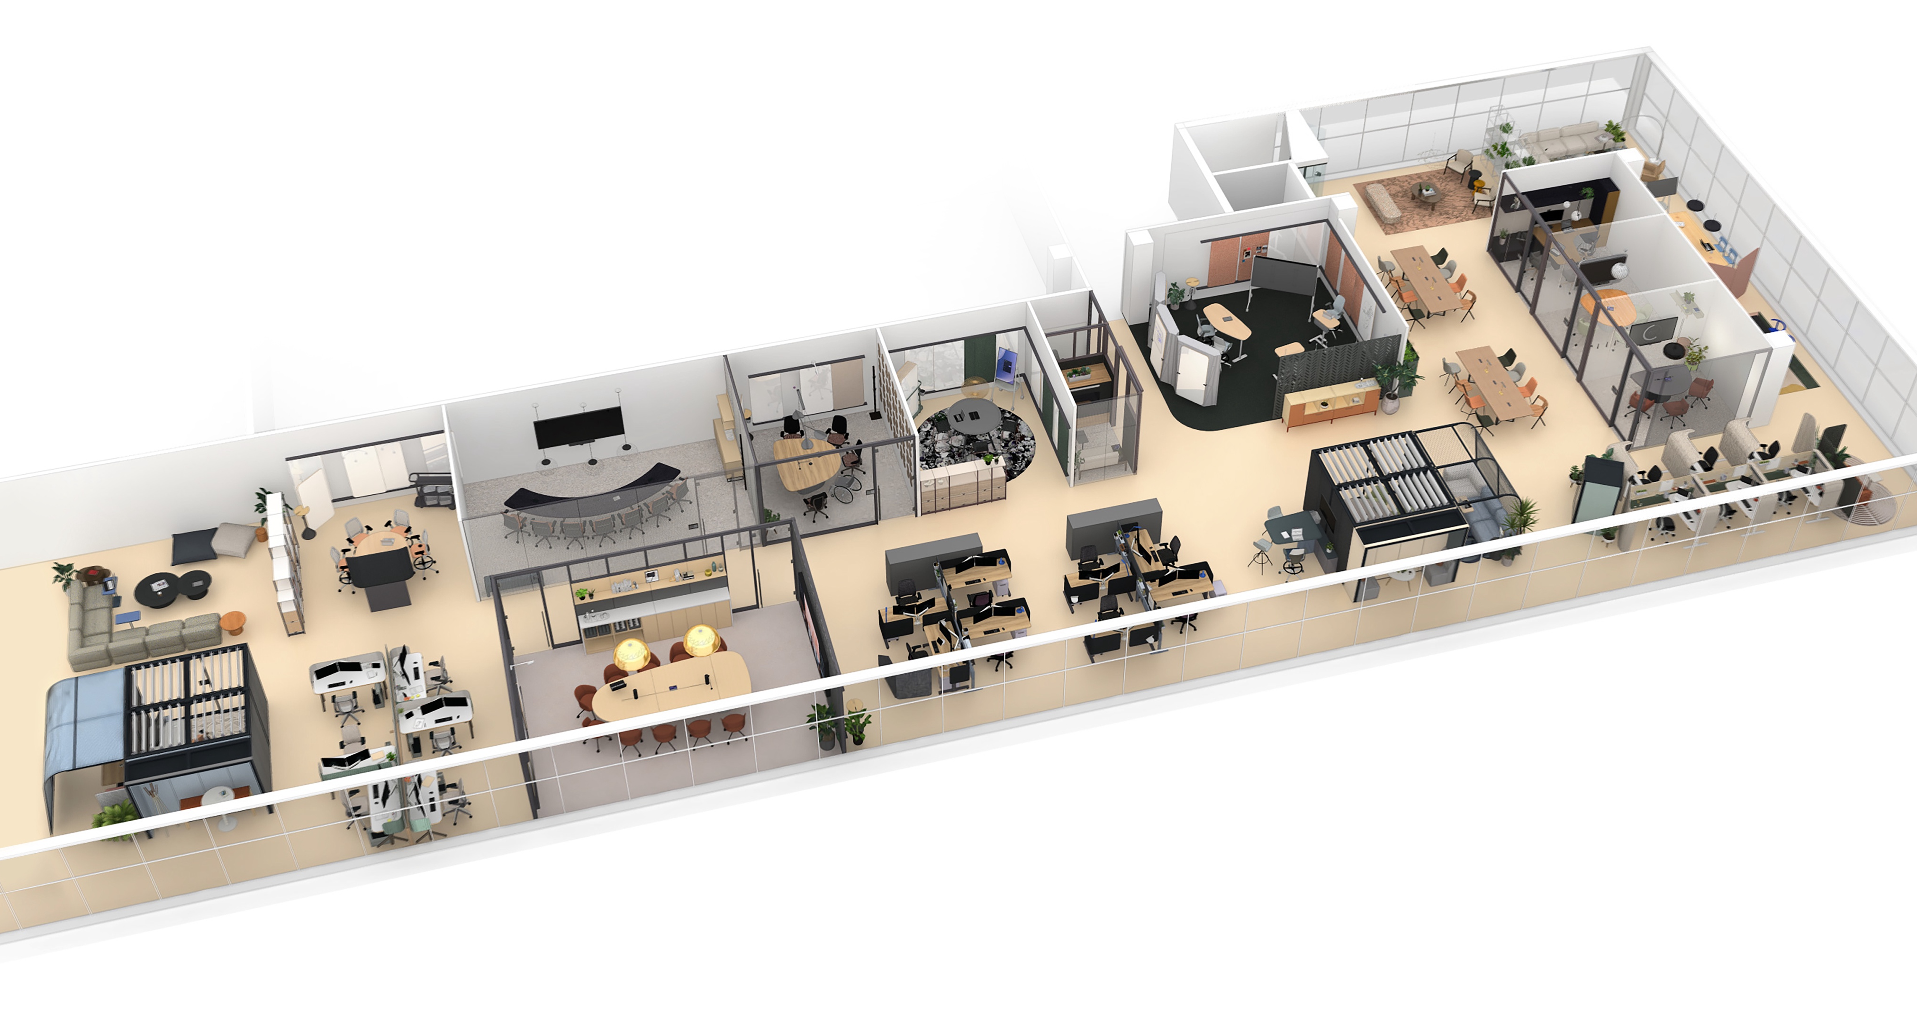
Ocular Across the Floorplan
The Ocular Collection fits seamlessly throughout the evolving workplace, offering spaces for people to meet, share, and collaborate that spark creativity and innovation.

Slide 8
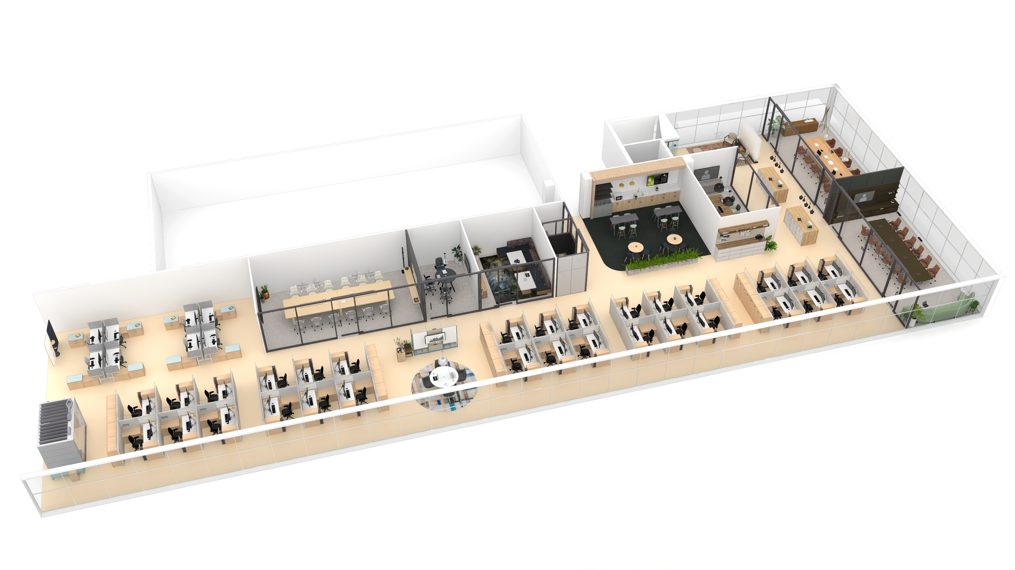
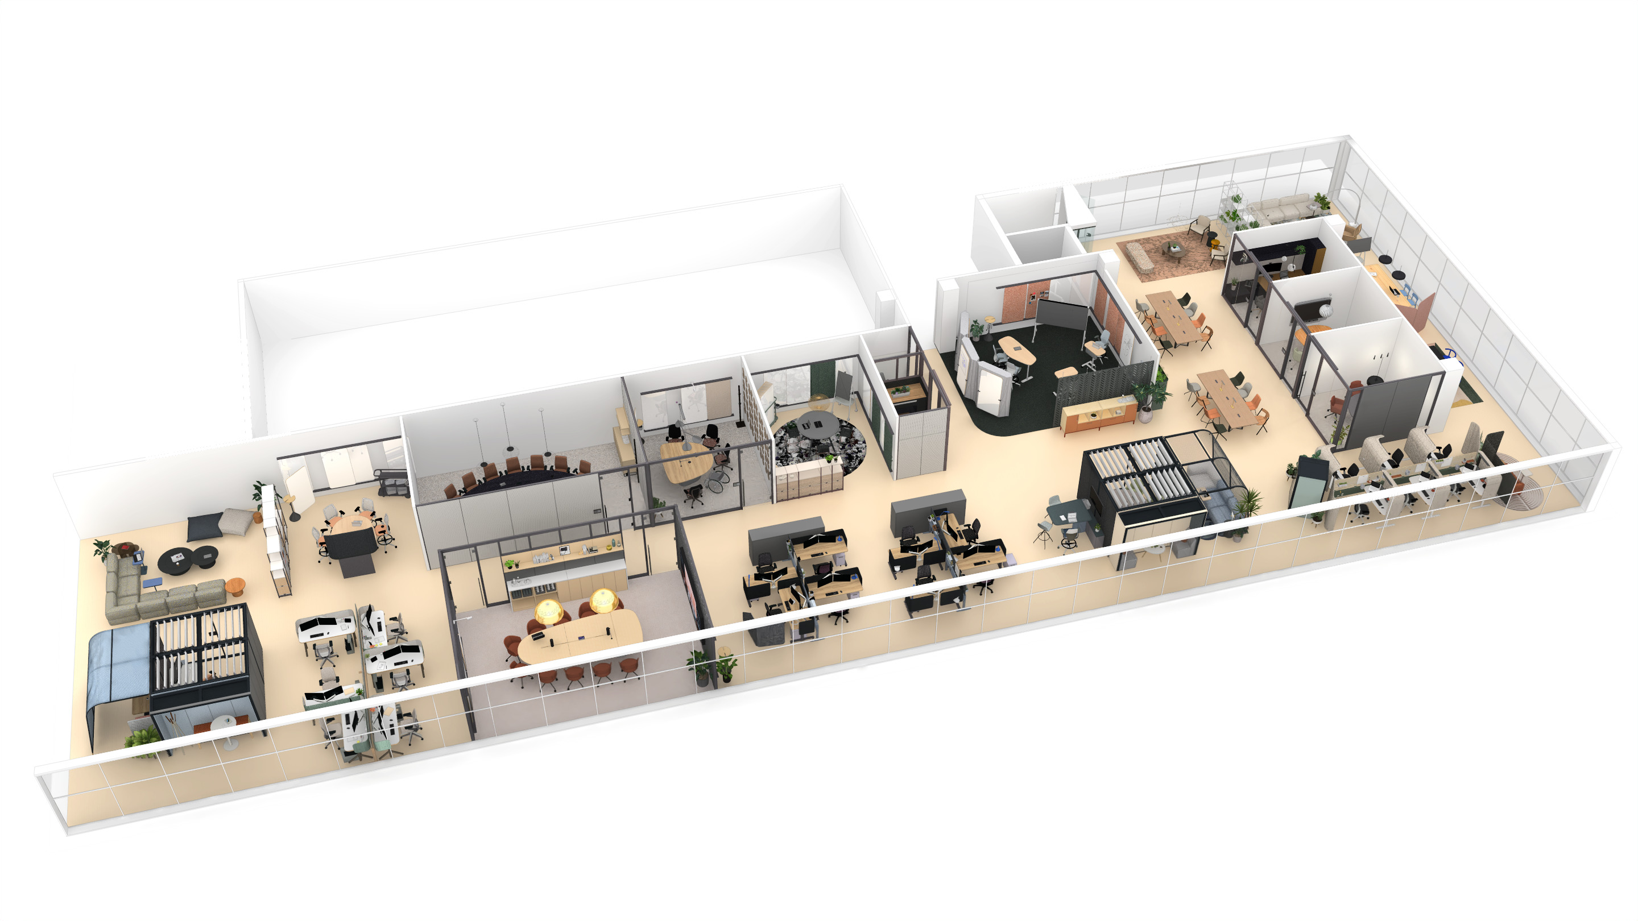
Ocular Across the Floorplan
Before
After
Floorplan Details
Single-purpose areas
One-size fits all
Repeating patterns
Few Large-scale and underutilized meeting rooms
Meeting Seats
Workstations + Individual Enclaves 41 seats
Enclosed Meeting Spaces 56 seats, 6 rooms
Semi-enclosed Meeting Spaces 16 seats
Open Meeting Spaces 4 seats
Total 76 seats
Floorplan Details
Purposefully mixed-use
Diversity of spaces
Offers choice + control
Multiple meeting rooms accommodate a range of group sizes and collaboration styles
Meeting Seats
Workstations + Individual Enclaves 22 seats
Enclosed Meeting Spaces 36 seats, 8 rooms
Semi-enclosed Meeting Spaces 33 seats
Open Meeting Spaces 18 seats
Total 87 seats

Slide 9
Ocular Across the Floorplan
4
6
2
1
5
3

Slide 10
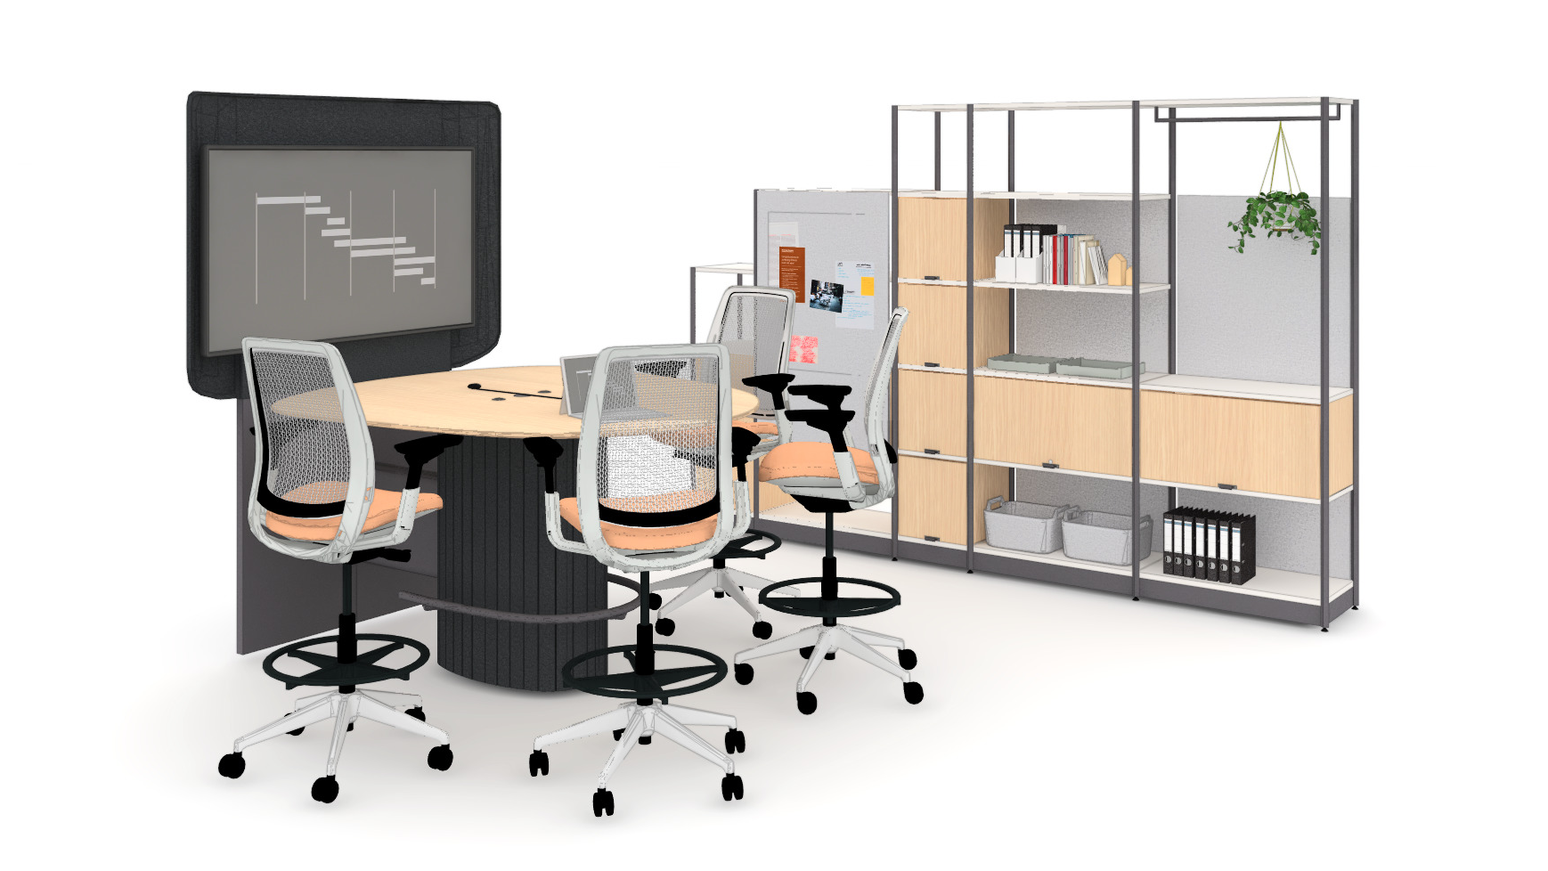
Ocular Across the Floorplan
1
Open Plan Touchpoints
Ocular Coupe Tower
An open touchdown space with integrated technology enables content sharing and collaboration with in-person colleagues.
4
6
2
1
5
3

Slide 11
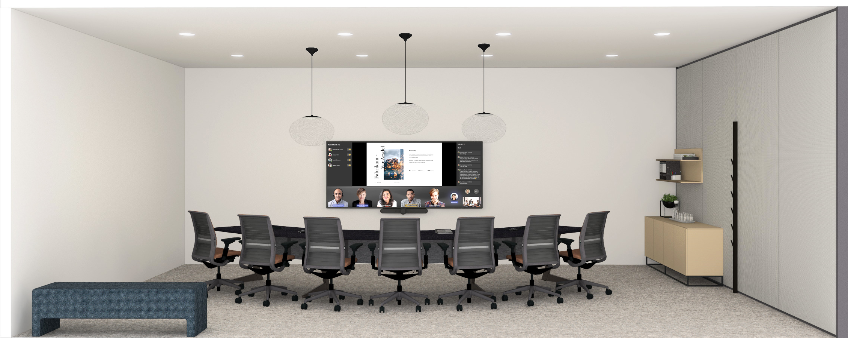
Ocular Across the Floorplan
2
Informative Presentations
Ocular Arc7
This space supports Microsoft Teams
Front Row on an ultra-wide display, ensuring
seamless interaction between remote and
in-room participants, with a curved Ocular
Arc table for optimal visibility.
4
6
2
1
5
3

Slide 12
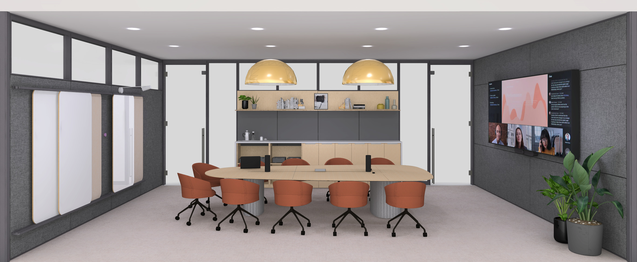
Ocular Across the Floorplan
3
Large Team Reviews
Ocular Sightline
This boardroom provides a more formal setting to support presentations, hosting,
and hybrid meetings for up to 10 people,
with improved sightlines for all participants.
4
6
2
1
5
3

Slide 13
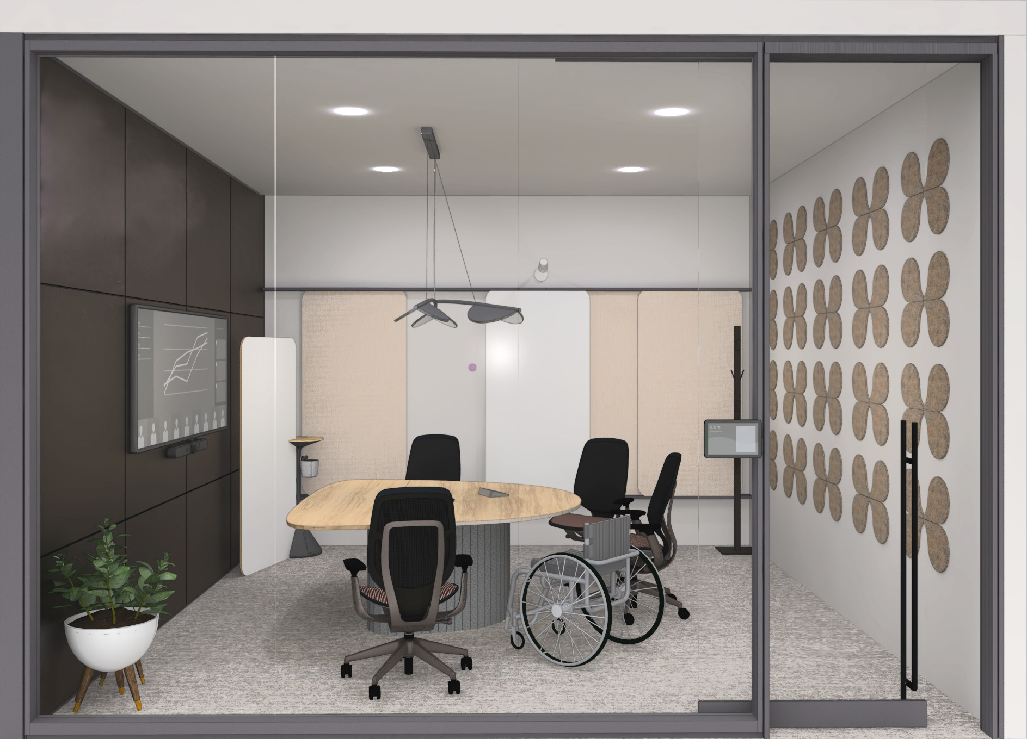
Ocular Across the Floorplan
4
Generative Workshops
Ocular Coupe5
This medium sized huddle room accommodates up to five in-person participants, offering space for teams
to share content and work collaboratively with teammates in-person and remote.
4
6
2
1
5
3

Slide 14
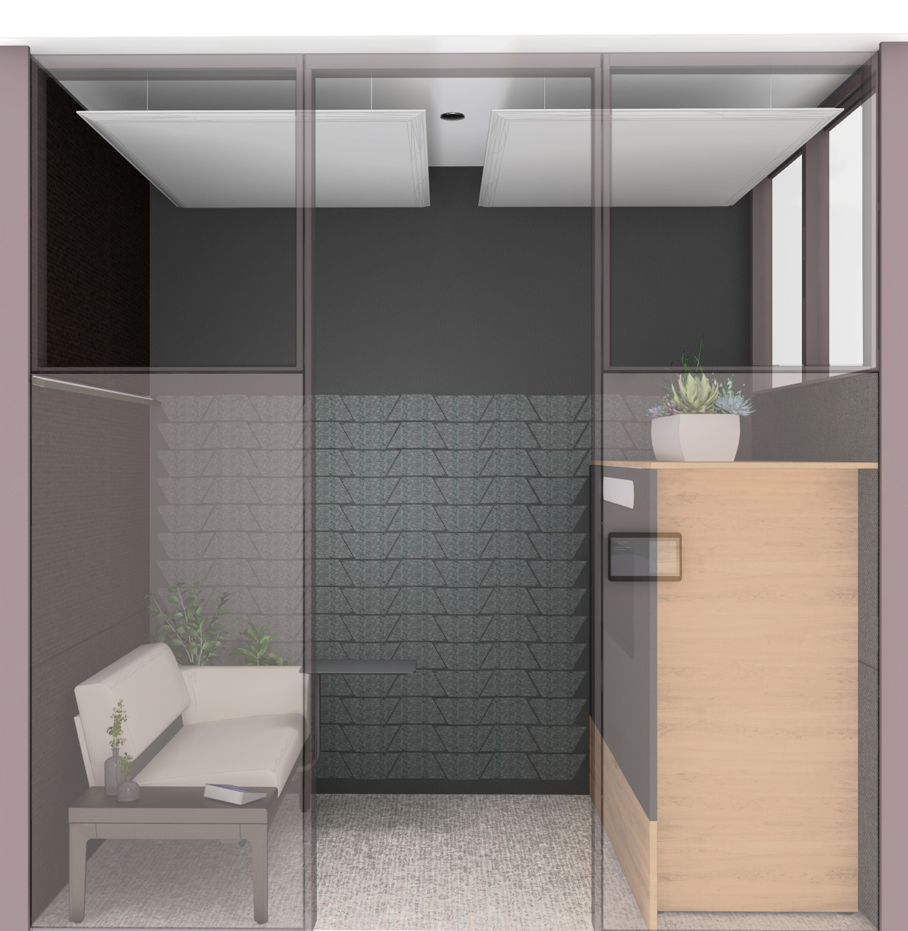
5
Immersive Connections
Ocular View
Ocular View creates an authentic and immersive experience for one-on-one virtual meetings which fosters engagement and nurtures relationships.
4
6
2
1
5
3

Slide 15
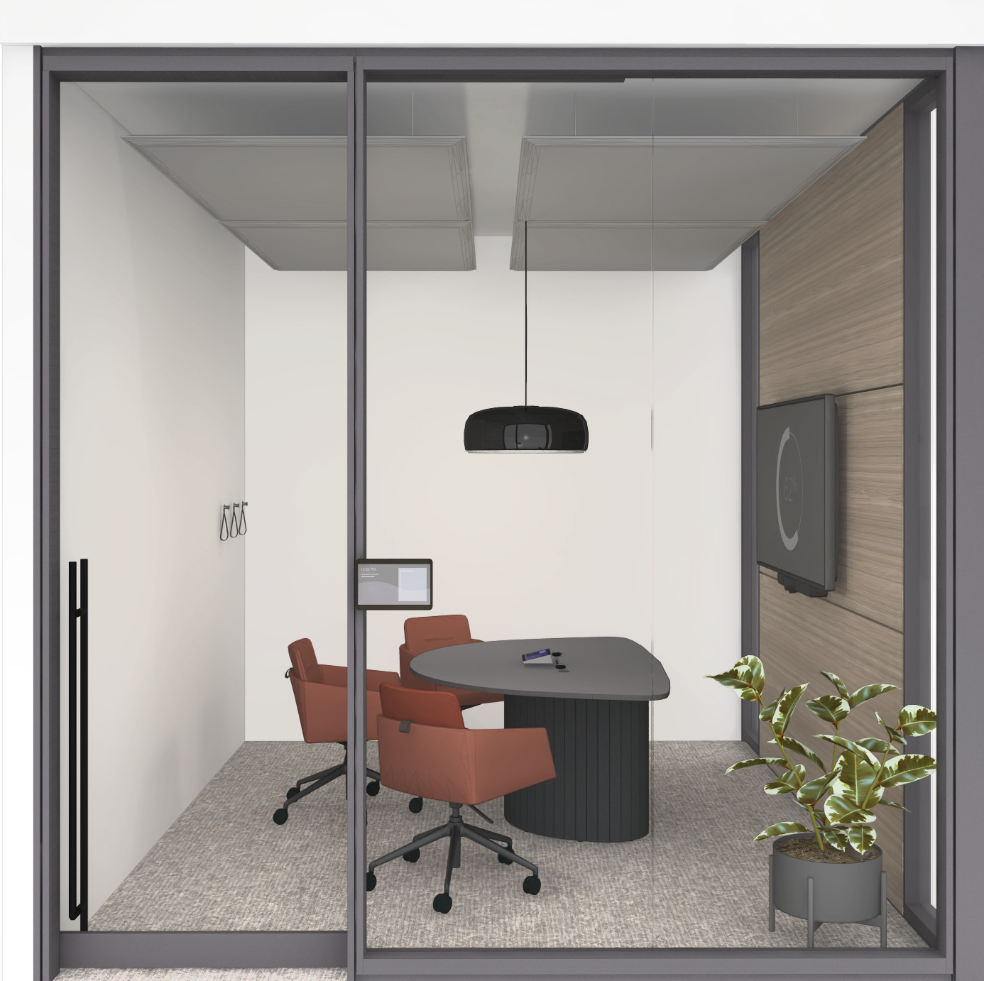
6
Small Team Huddles
Ocular Coupe3
This small huddle room accommodates up to three in-person participants, offering space for individuals or small teams engage in quick touchpoints
and day to day connections.
4
6
2
1
5
3

Slide 16
Ocular Collection
Design Considerations

Slide 17
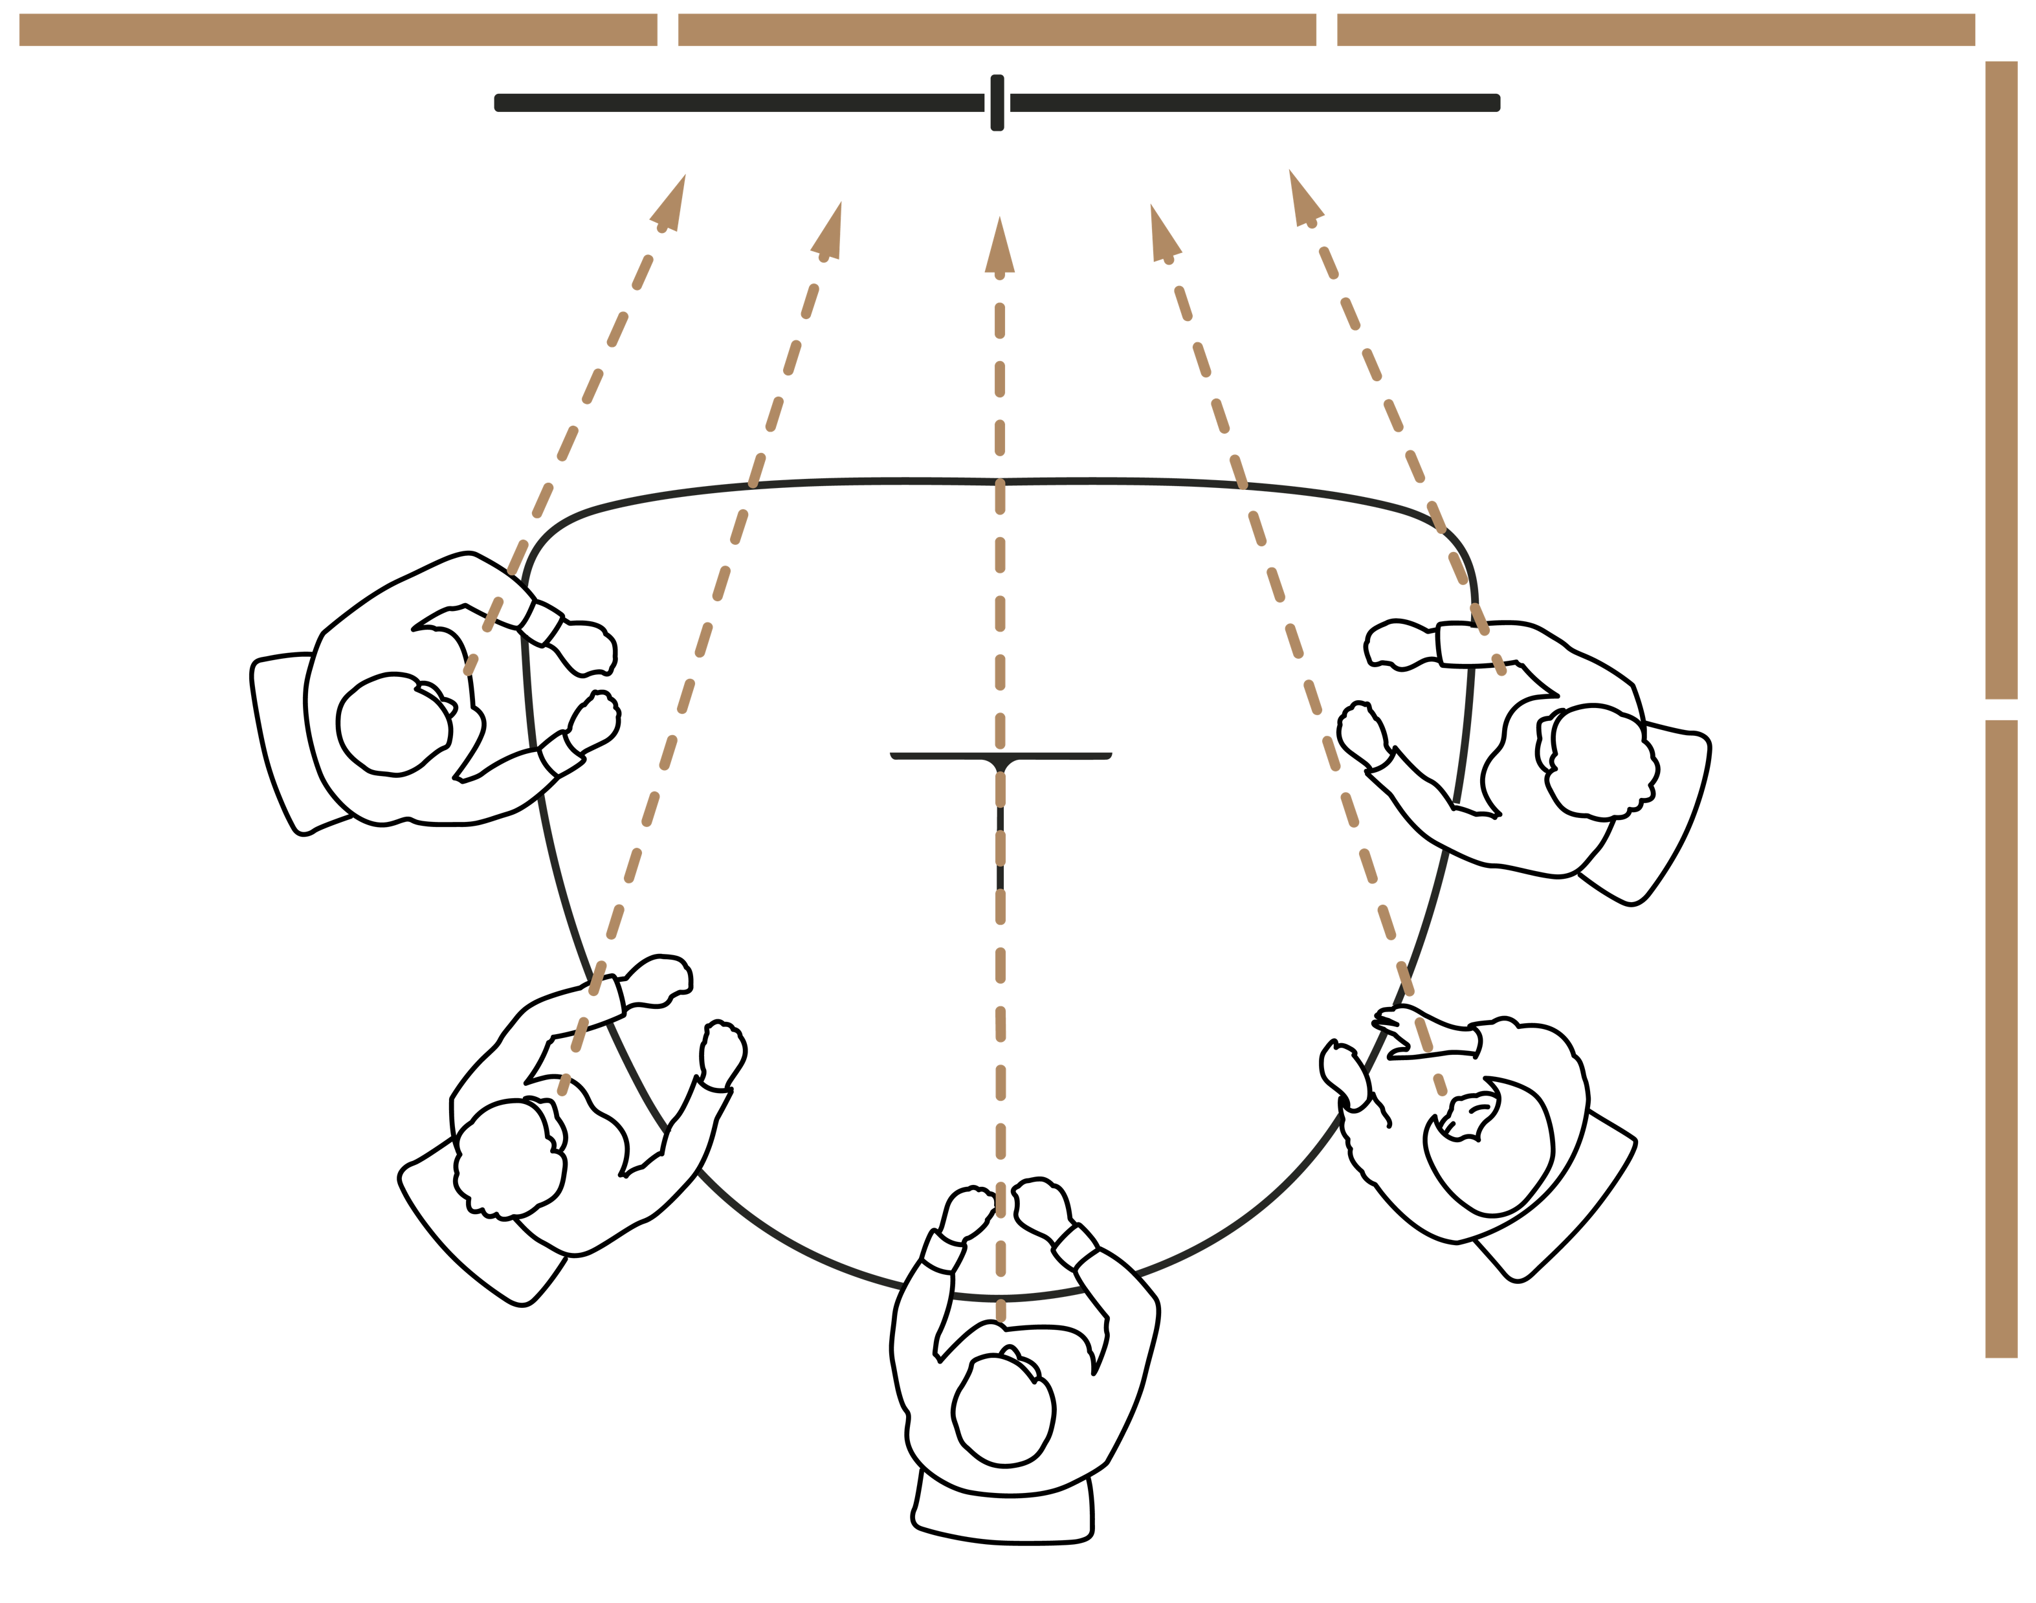
Successful hybrid meetings depend on high quality acoustic performance.
Acoustic Recommendations
“Soft” surfaces like acoustic walls help absorb sound before it bounces back into the room.
The front of the space is an effective place to apply sound absorbing materials, like acoustic panels.
Additional acoustic panel placement
is most effective on adjacent surfaces.
Notes:
Ocular Meeting Room Acoustics
Successful hybrid meetings depend on high quality acoustic performance within the space. Too much sound reverberation can make voices difficult to understand, both for the remote participants and for those in the room. Reducing the reverberation can improve the communication and even the users’ wellbeing within the space.
”Soft” surfaces like curtains, fabric seats, and acoustic walls and ceiling panels can help absorb sound before it bounces back into the room.
In Ocular meeting rooms, users are directed towards the front of the room, making the front of the space an effective place to apply sound absorbing materials, like acoustic panels.
Additional acoustic panel placement is most effective on adjacent surfaces either from wall to adjacent wall or from wall to ceiling.
Recommended Products:
Steelcase Flex Rail with Acoustic Boundary
Steelcase Flex Boundary Screens

Slide 18
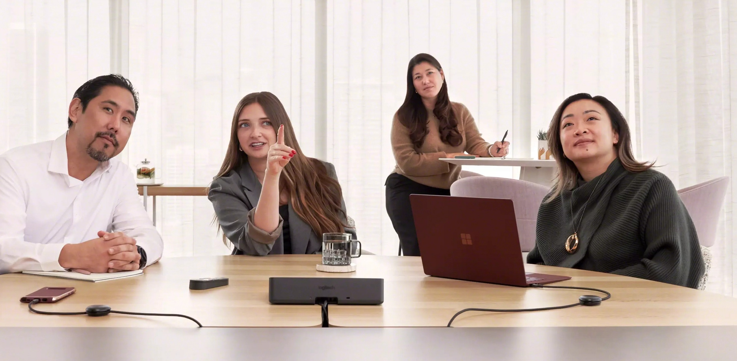
Unified, neutral backgrounds help meeting participants look their best on-camera.
Version 02
Background Recommendations
Unified Background
Making the materiality of the wall opposite the meeting room camera uniform in color and brightness helps meeting room cameras adjust to the in-room lighting conditions.
Neutral Background
Using backgrounds with lower color saturations help meeting room cameras provide more
true-to-life representation of skin tones and
help prevent under-exposure.
Notes:
Ocular Meeting Room Acoustics
Successful hybrid meetings depend on high quality acoustic performance within the space. Too much sound reverberation can make voices difficult to understand, both for the remote participants and for those in the room. Reducing the reverberation can improve the communication and even the users’ wellbeing within the space.
”Soft” surfaces like curtains, fabric seats, and acoustic walls and ceiling panels can help absorb sound before it bounces back into the room.
In Ocular meeting rooms, users are directed towards the front of the room, making the front of the space an effective place to apply sound absorbing materials, like acoustic panels.
Additional acoustic panel placement is most effective on adjacent surfaces either from wall to adjacent wall or from wall to ceiling.
Recommended Products:
Steelcase Flex Rail with Acoustic Boundary
Steelcase Flex Boundary Screens

Slide 19
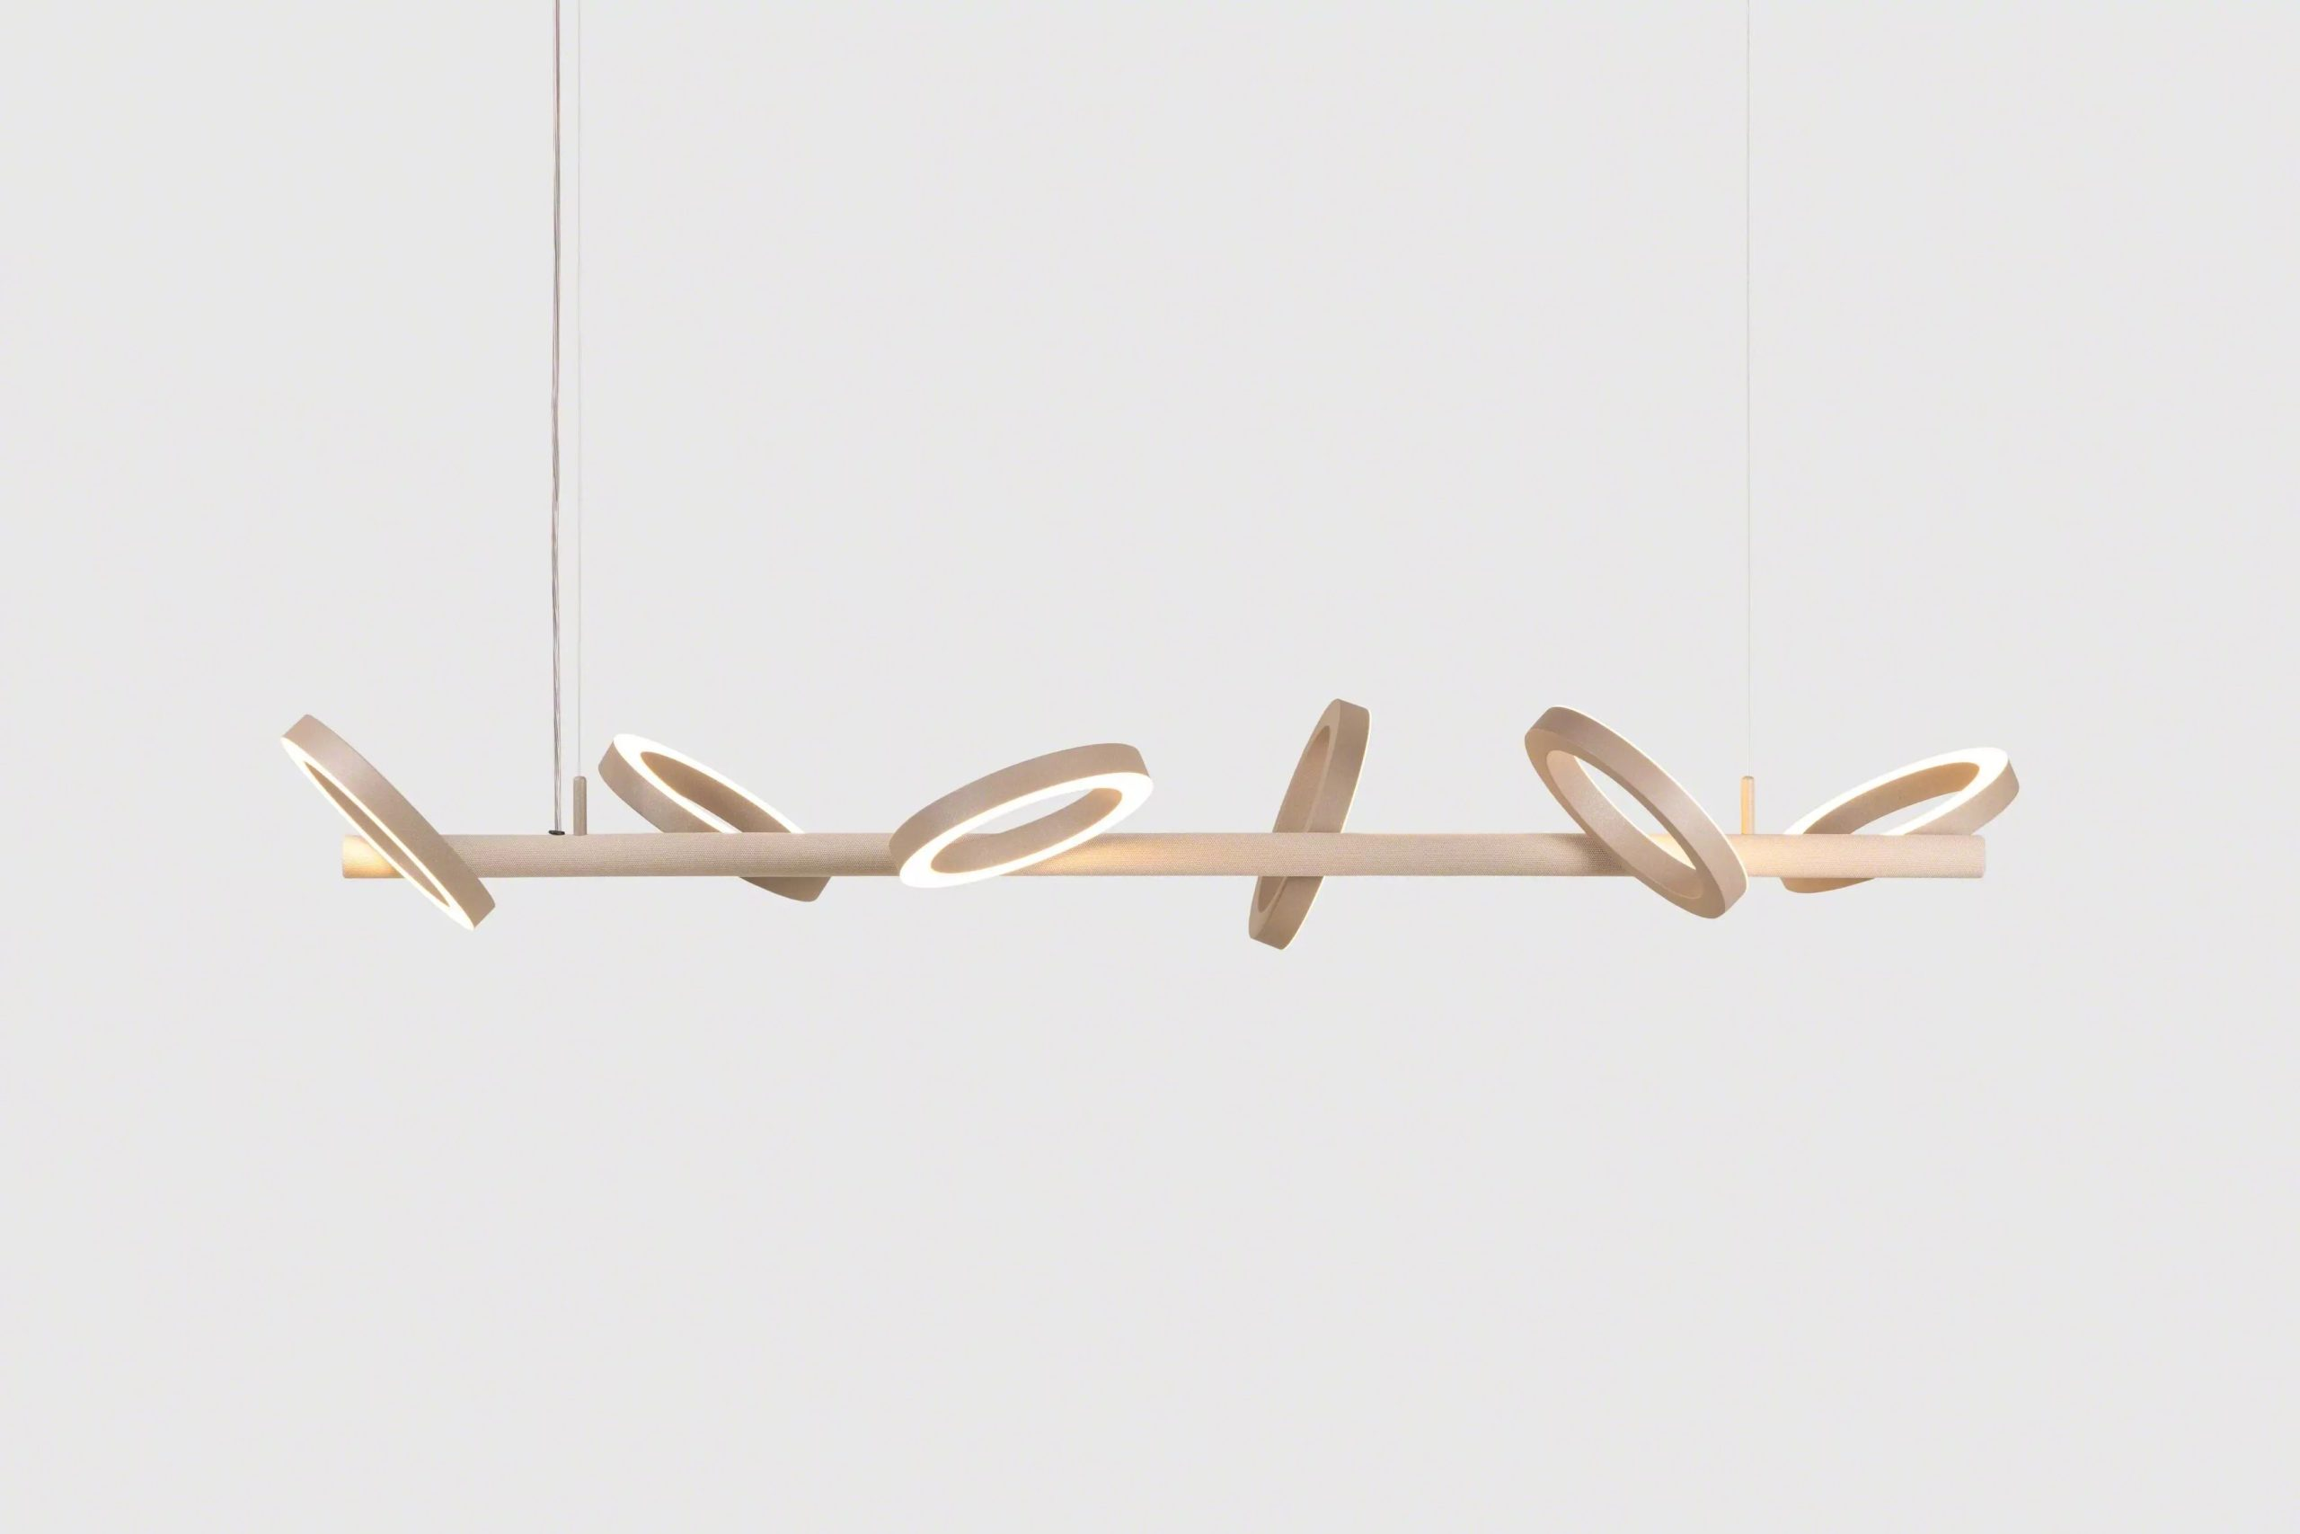
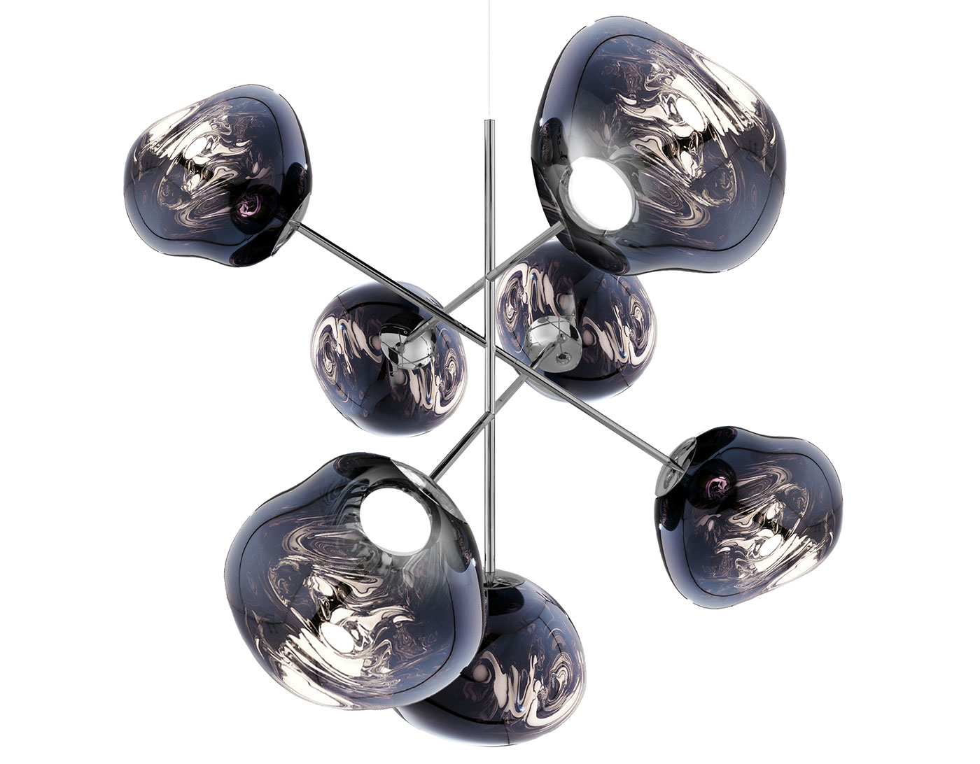
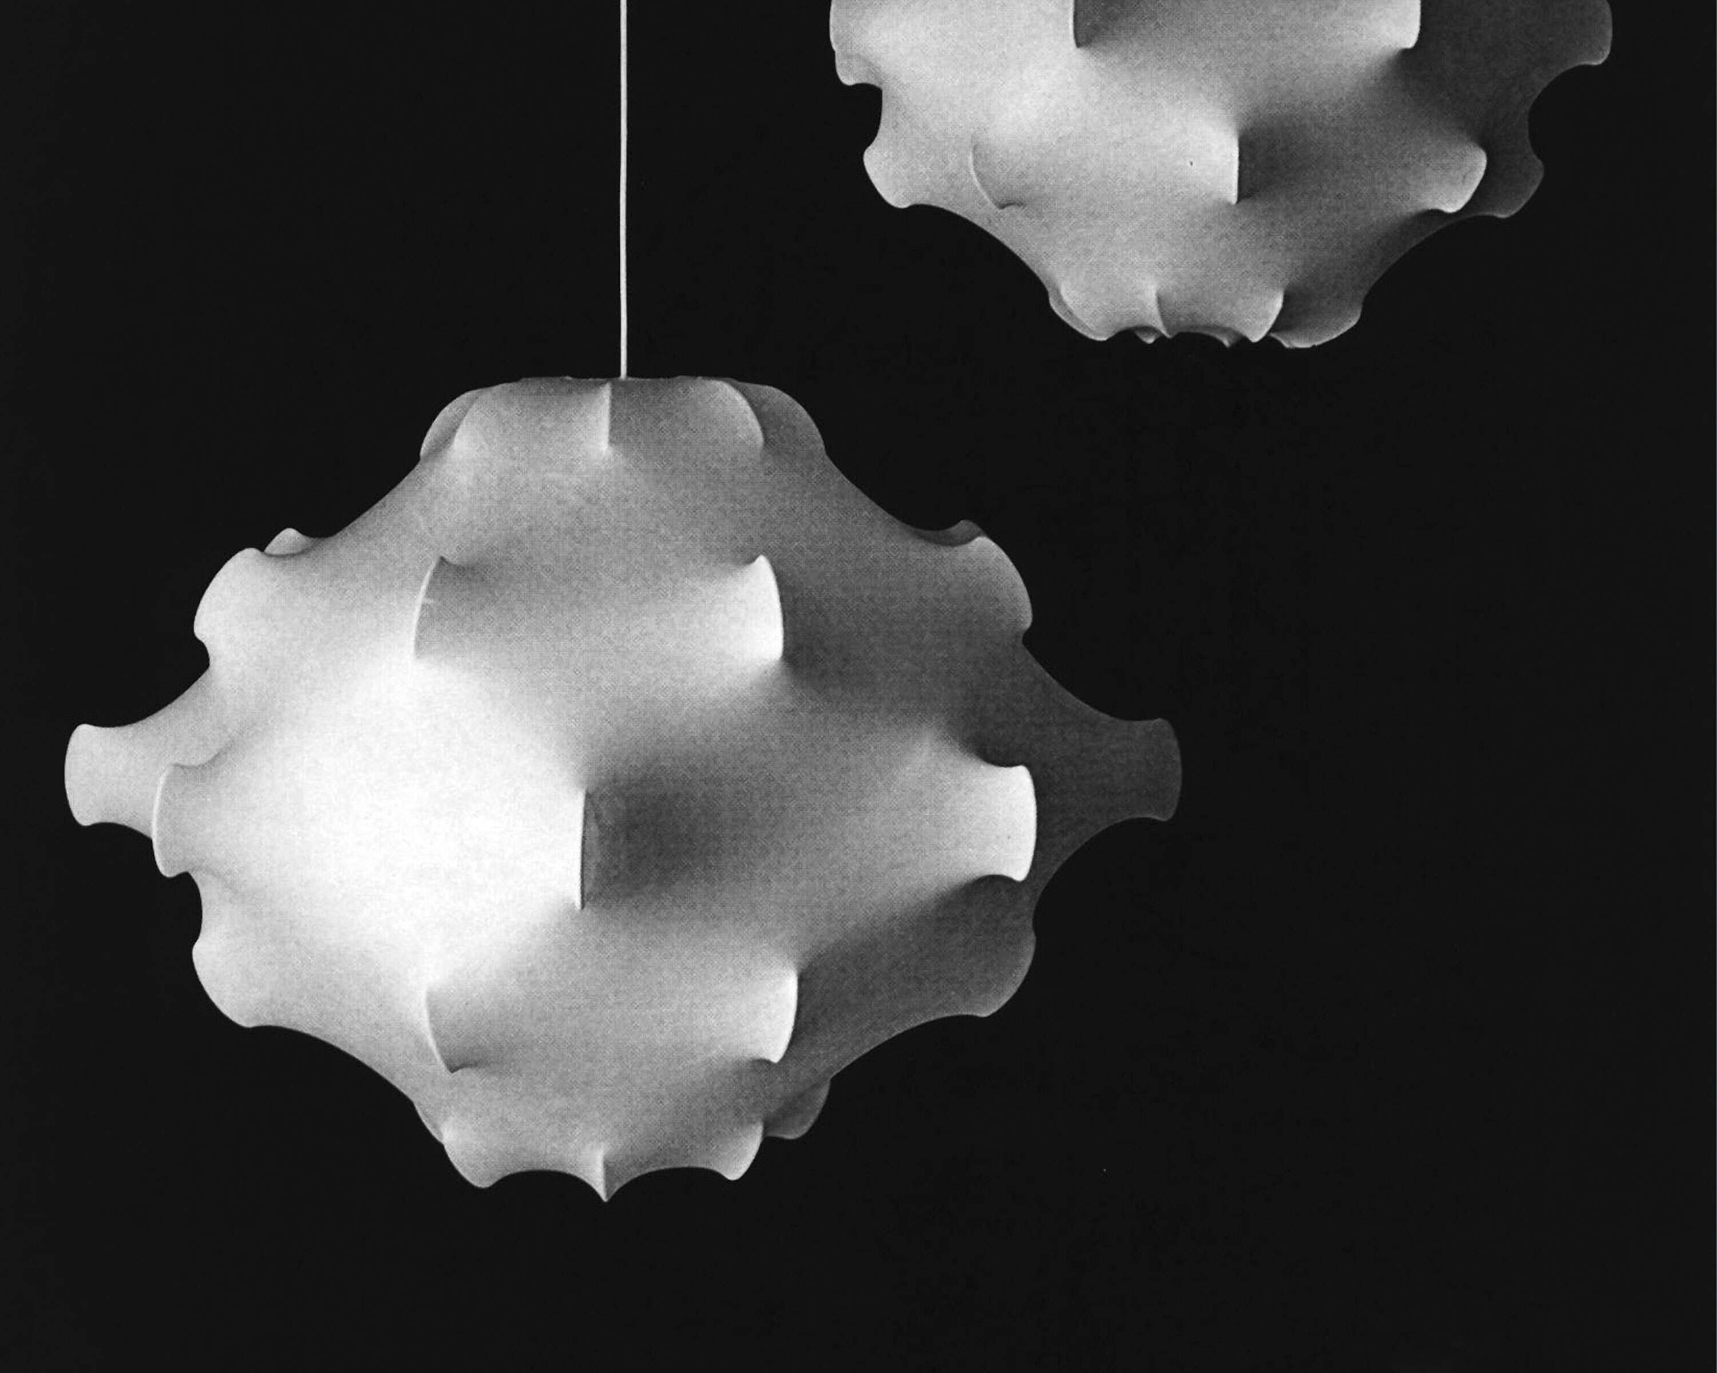
Lighting affects the experience for both in-person and remote meeting participants.
Lighting Recommendations
Pallana by Moooi
Tom Dixon Melt Chandelier
Optimal lighting conditions improve meeting camera adjustments for exposure, contrast, and color.
Dispersed lighting helps prevent harsh shadows and reduce glare in the eyes of in-room participants.
Flos Taraxacum 1 & 2
Notes:
Lighting Recommendations
It’s important to consider how lighting affects the experience for both in-person and remote meeting participants. Modern meeting camera systems can correct for a participant’s exposure, contrast, and color, but this is eased and enhanced with better lighting conditions from the start.
Lighting designs should feature approximately 30 foot-candles of asymmetrical, low UGR lighting.
Most dispersed lighting will help to prevent harsh shadows on faces that make it difficult to read expressions while also reducing glare in the eyes of in-room participants. Steelcase offers solutions from Moooi, Flos, and Tom Dixon which support this better lighting experience.

