Slide 1
PHOTO VIDEO LIBRARY METADATA TEMPLATE
Visualization Team
2018

Slide 2
October Monthly Shared Spaces + Ancillary Webinar
Usage | Applies to all assets in collection
Link to collection
Instructions:
Highlight appropriate fields (identified in blue text)
Fill in fields (identified in red highlight)
This section will apply to all assets in creation / retouching, so you will only need to fill this out once.
Owner: (Asset Requested By or Asset Created on behalf of / Project Leader) Type here: Brian Shapland
Are model used?
Yes - Steelcase models only
Yes - Outside models used
No
Legal Rights:
Steelcase Owned - unlimited use (no talent)
Driven by talent or creative agreements:
Steelcase Owned - 3 years unlimited use
Steelcase Owned - 5 years unlimited use
Steelcase Owned - Limited use (no fixed outdoor signage)
Not usable by third party, including dealers and vendors
Not for advertising use
Is stock Imagery used?
Yes | No
(hidden) If yes: Resource + Asset Number:
Creative Resources (Photographer / Videographer / Renderer):
Please don’t fill in NA, we need information regarding who produced the asset.
Type here: Cisco Webex
This image is approved for use in the following regions:
Americas | Global | EMEA | APAC
Release date:
Type here: 10/24/19
Audience/Security/Permissions:
Public (AM) | EMEA Global | APAC | Employees Only | Dealers Only | Admin Only

Slide 3
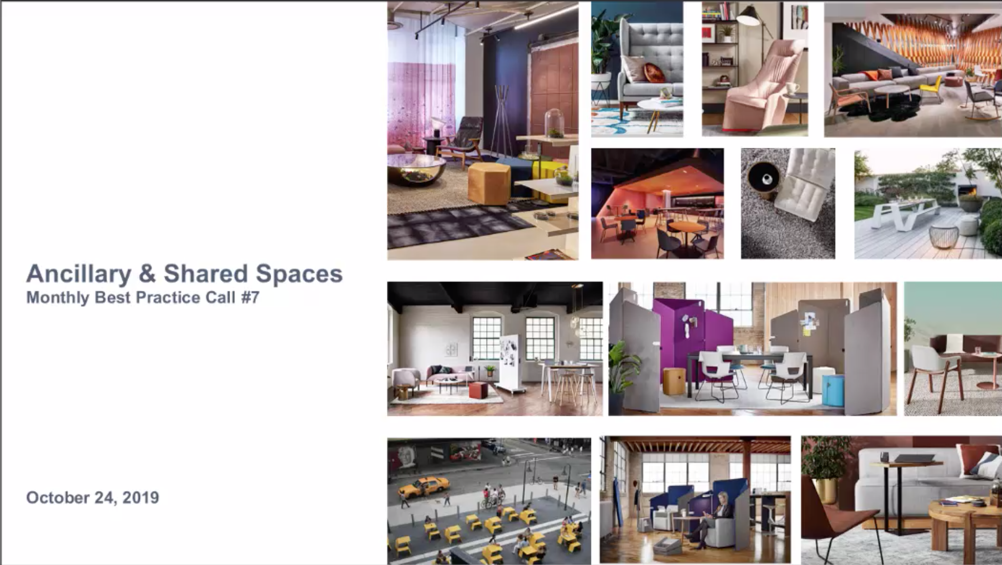
October Monthly Shared Spaces + Ancillary Webinar
Individual Image Details
Link to collection | 19-0130287
Name: Naming follows one of the two conventions outlined below.
Name (Environment) Region** + Work Culture Descriptor (ie. space name / typology / behavior)
(ie. 4W Neighborhood Agile Studio; Circa Lounge System; etc.)
Name (Isolated Product) Region** + Product Name
(ie. Steelcase Series 1)
Type here: October, 24 2019 Shared Spaces & Ancillary Monthly Best Practice Call
Tags: Product name(s), product category, behaviors (these are search terms you may use to look up an image)
Ie. Agile, Ampersand, 4W, IT, Business District, Meeting, Collaboration
Type here: Shared spaces, ancillary, partners, West Elm Work, Bolia, BluDot, FLOS, Michell Gold + Bob Williams, Moooi, Uhuru, Ancillary Best Practices, Events Roadmap
Description: Product Detail Information + Surface Materials shown in image
(Steelcase and Partner Product specifications only. DO NOT include information for items that are not Steelcase or Partner products / accessories)
Steelcase Series 1 (Seat Upholstery: Designtex Building Blocks Red 3821-302; Back Upholstery: 3D Knit Nickel 5093; Frame: Seagull 6053; Base: Platinum Solid 6249 Plastic; Finish: Arctic White 7241 Paint)
SW_1 Table (Top: Oak Light; Substructure: Milk; Base: Aluminum Matte Polished)
Webinar Agenda:
Grand Rapids Campus Refresh
Brand Spotlights (Moooi, Uhuru)
Tools to Make it Easy to Win
New w/ West Elm Work: Photography, CET and order entry, West Elm Work finish boxes
Brand Book
Ancillary Portfolio
Banners
Tale of a Few Cities: Salt Lake City, San Francisco
What’s working and winning business?
Products we love
Our favorite applications
Sales calls that work
Can’t miss training
Winning in CET

