Slide 1
Occasional Tables
Product Portfolio Overview

Slide 2
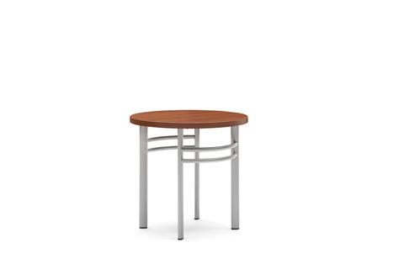
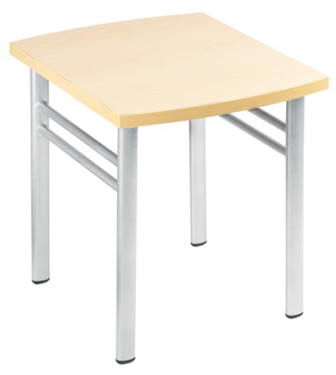
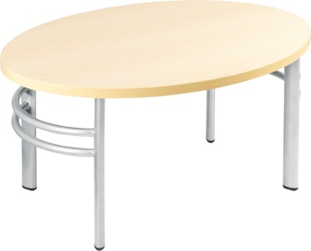
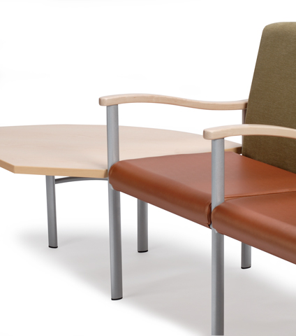
Aspekt Freestanding and Ganging Tables
Features:
Versatile and durable for patient and waiting environments
Available in a variety of shapes to coordinate with Aspekt seating
High-pressure laminate tabletop with 3mm plastic edge
Powder coated steel legs
Black nylon glides
Powder coated black or silver ganging brackets
Available With:
Freestanding tables in oval, bow, and round shapes
Ganging tables are available as in-line, end, 90°, and corner tables

Slide 3
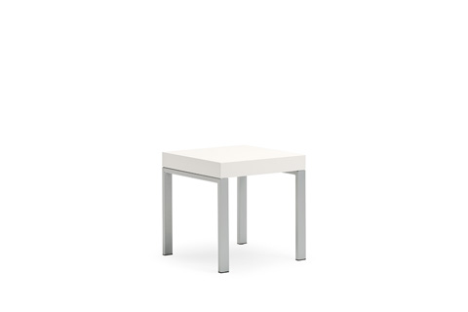
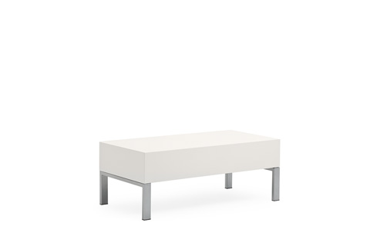
Leela Freestanding Tables
Features:
Modern design with clean lines to bring a sense of home to any healthcare waiting area
Durable to withstand the rigors of healthcare environments
Complements Leela lounge seating collection
Powder coated metal legs for durability
Available With:
Square and rectilinear shapes for side and coffee table applications
Powder coated metal or solid surface tops

Slide 4
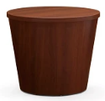
Mitra Freestanding Tables
Features:
Design that works in a multitude of healthcare waiting environments
Comprehensive selection of styles to complement the Mitra family of seating products
High-pressure laminate top with 3mm plastic edge
Solid maple curved wood legs
Available With:
Classic leg style design
Drum table available in HPL or veneer
Round, oval, square or rectangular shapes

Slide 5
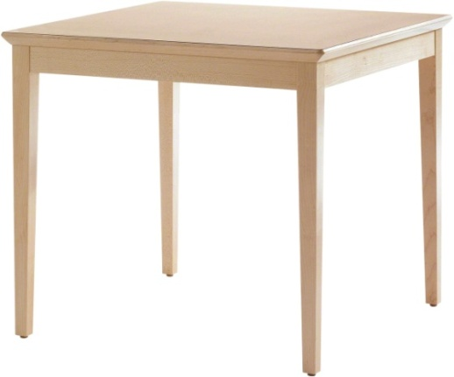
Sieste Freestanding Tables
Features:
  Clean design is home in a variety of healthcare settings
  Complements the extensive Sieste seating line
  Maple hardwood frame and legs
  Square shape
  Maple wood edge band
Nylon glides
Available With:
Laminate or wood top
Two heights for side or coffee table applications

Slide 6
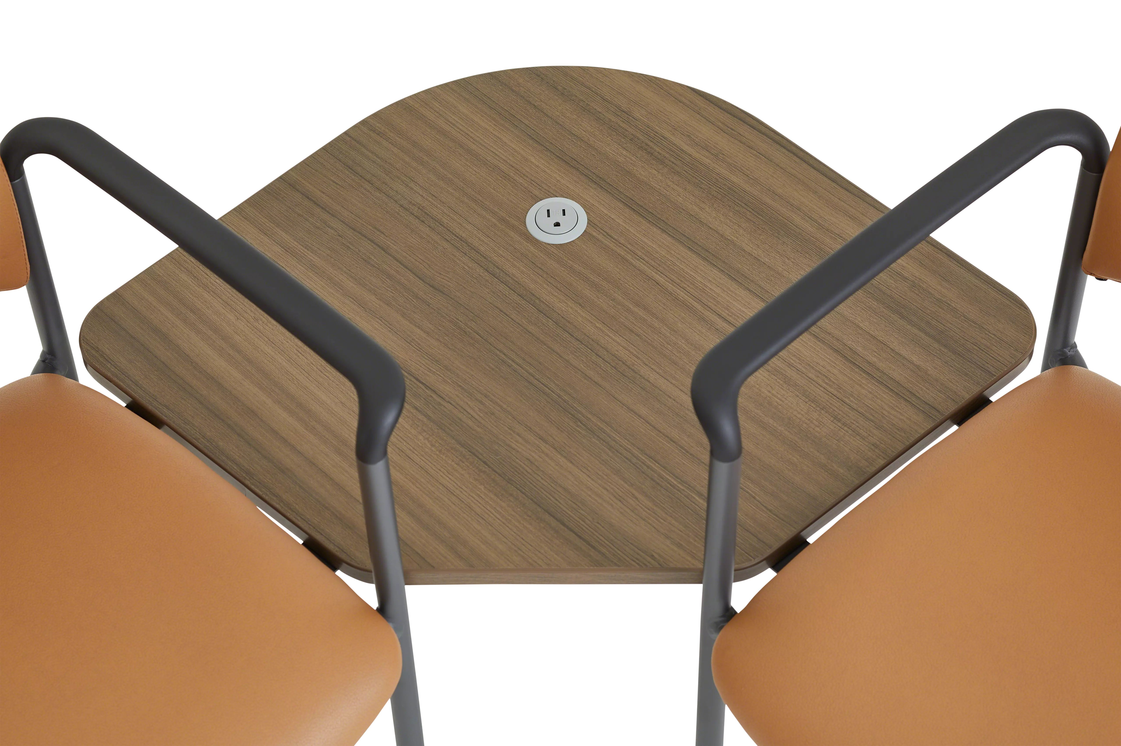
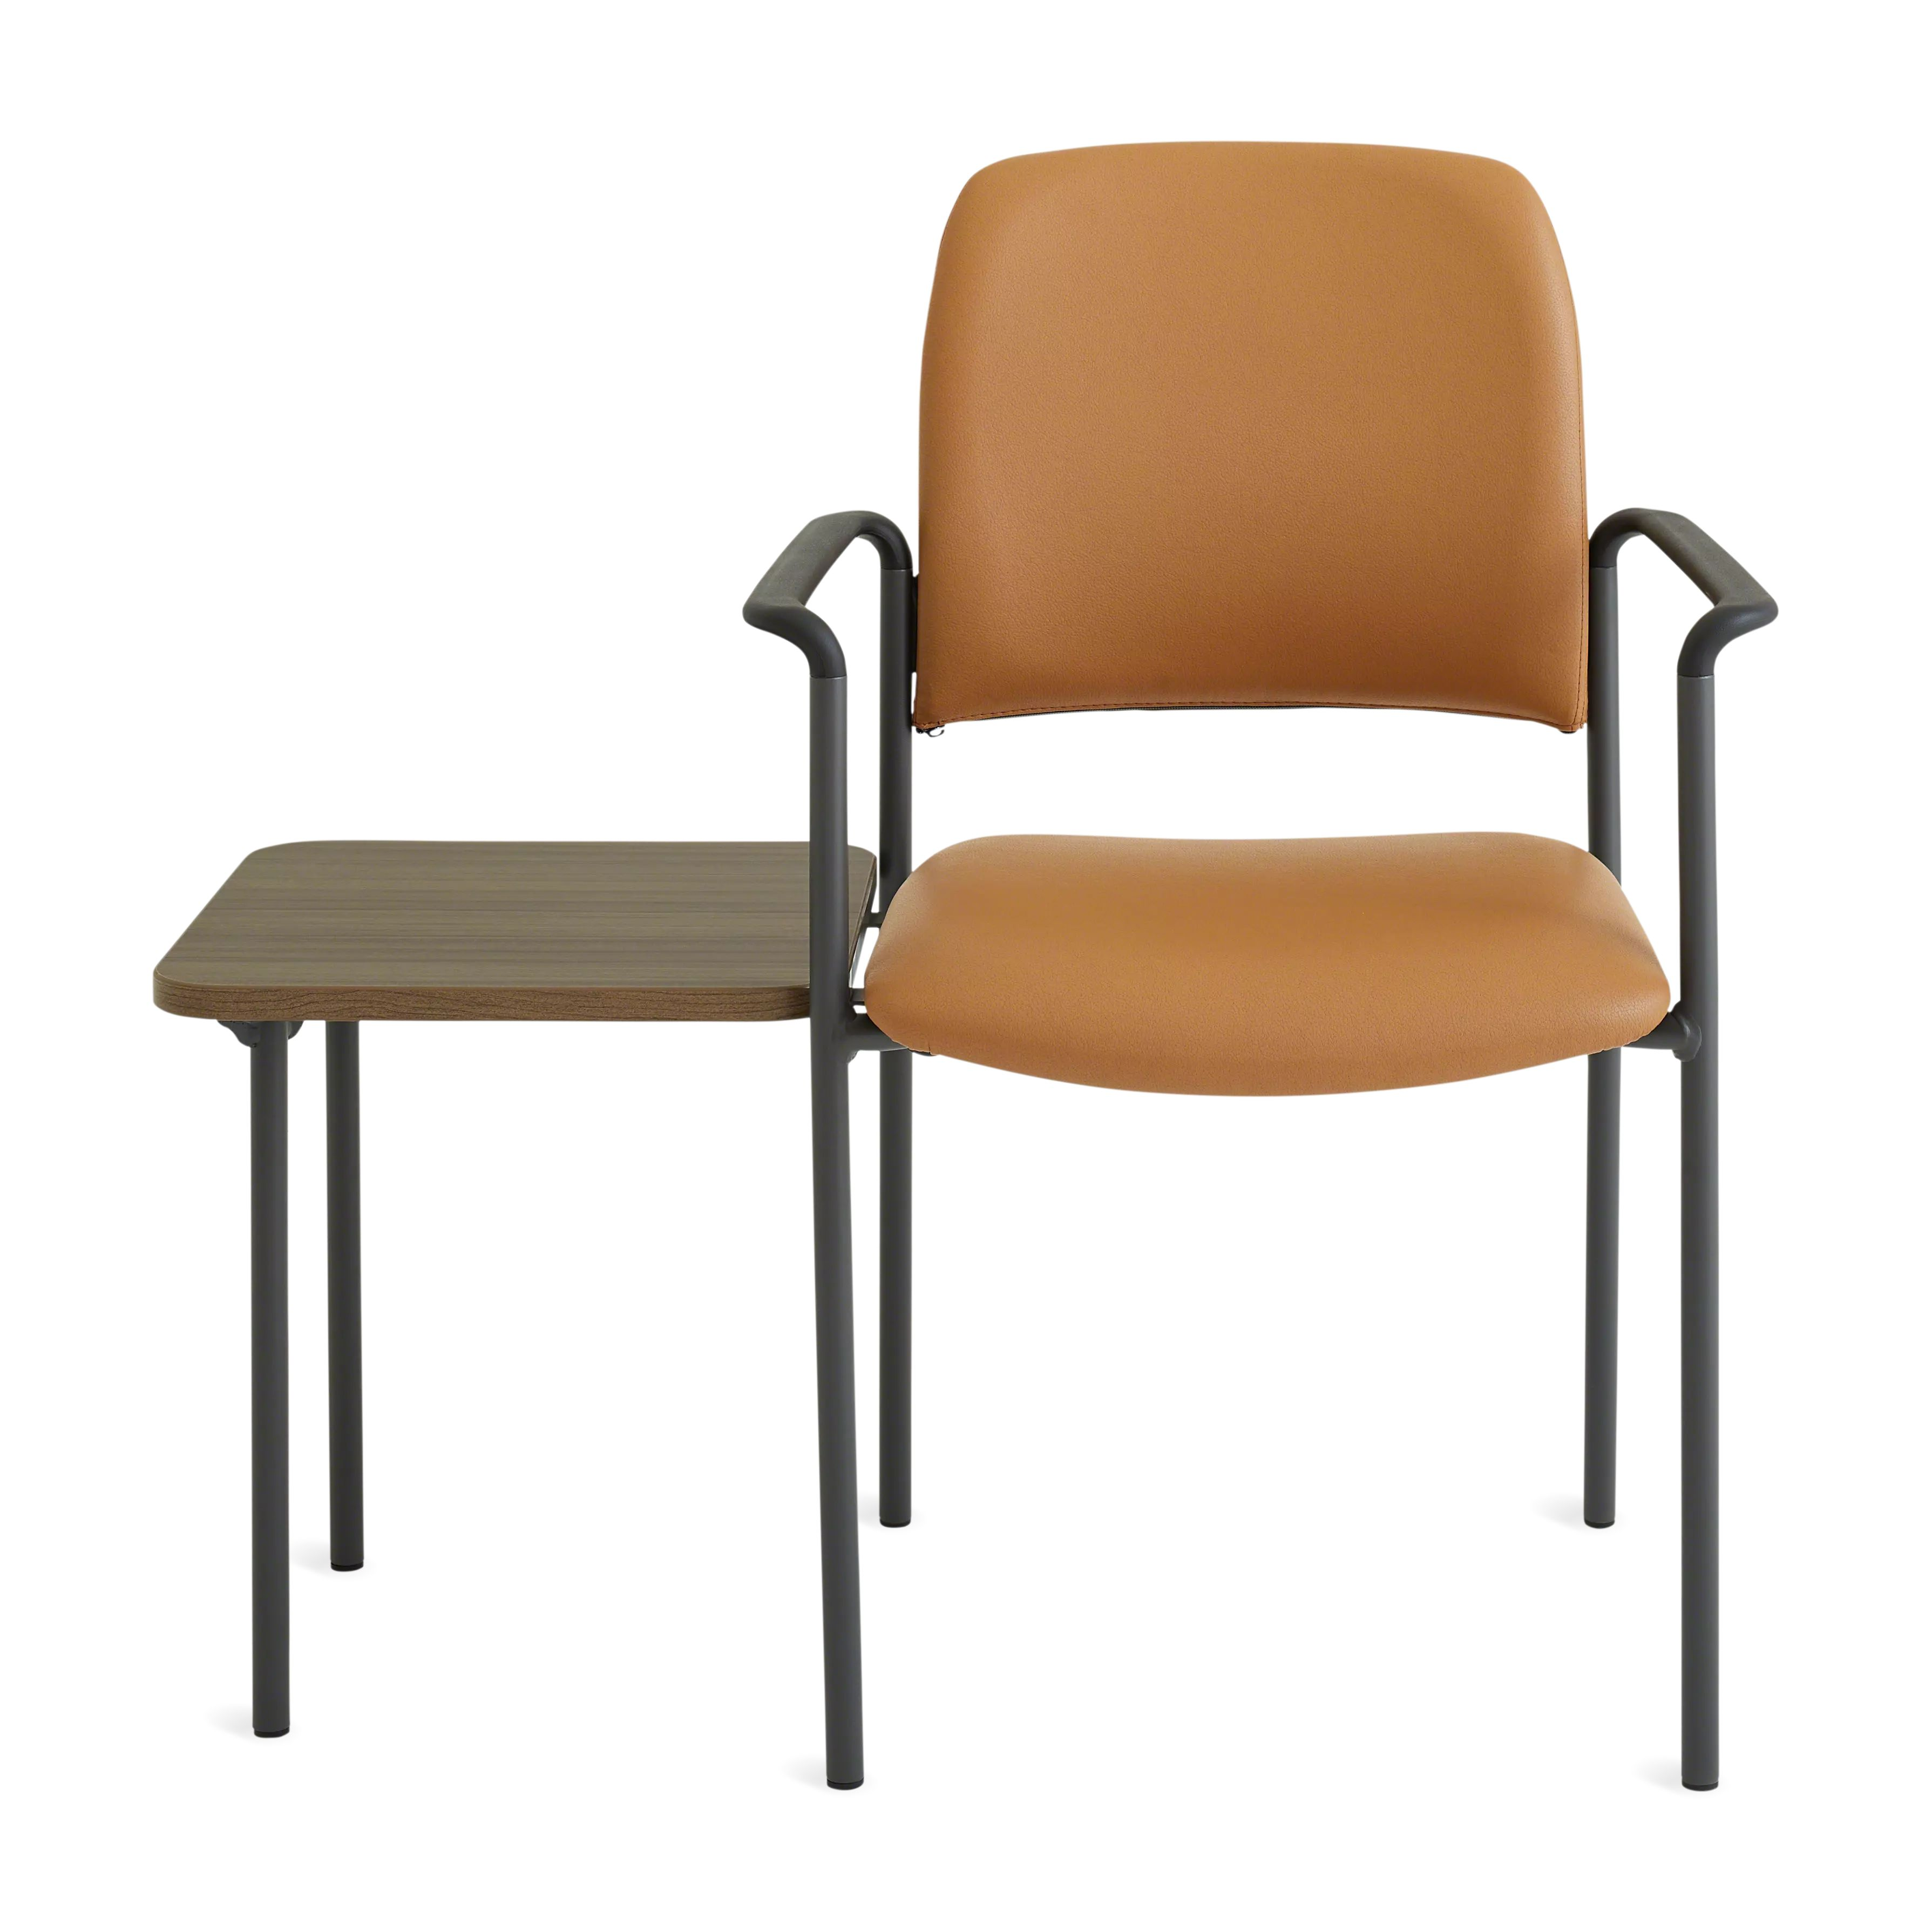
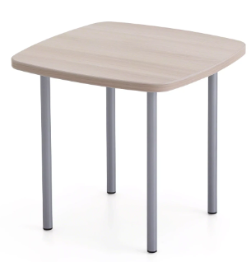
Sorrel Tables
Features:
  Designed for applications with minimal floor space in patient and waiting areas
  Light-scale design to match Sorrel seating
  Freestanding and ganging tables available
Available With:
Multiple heights available (16”, 18”)
Ganging tables include in-line table, left-hand table, right-hand table, and corner table
Black, Merle, and Platinum Metallic painted round, steel legs

Slide 7
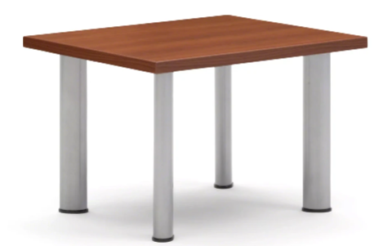
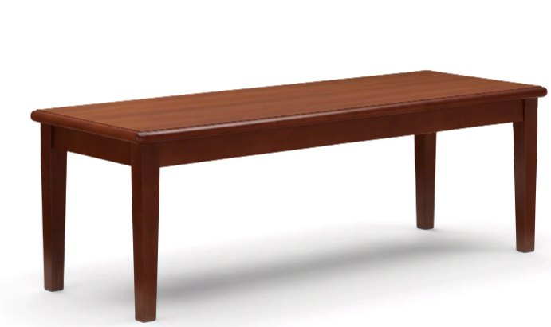
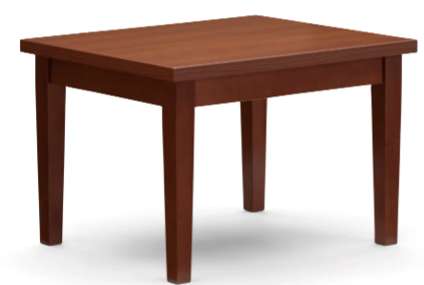
Outlook Tables
Features:
  Outlook tables are available to coordinate with multiple seating lines and settings
  Legs are available in metal or wood
  Drum table is included in collection
Available With:
Wood or plastic edge
Square, rectangular or round table styles

Slide 8
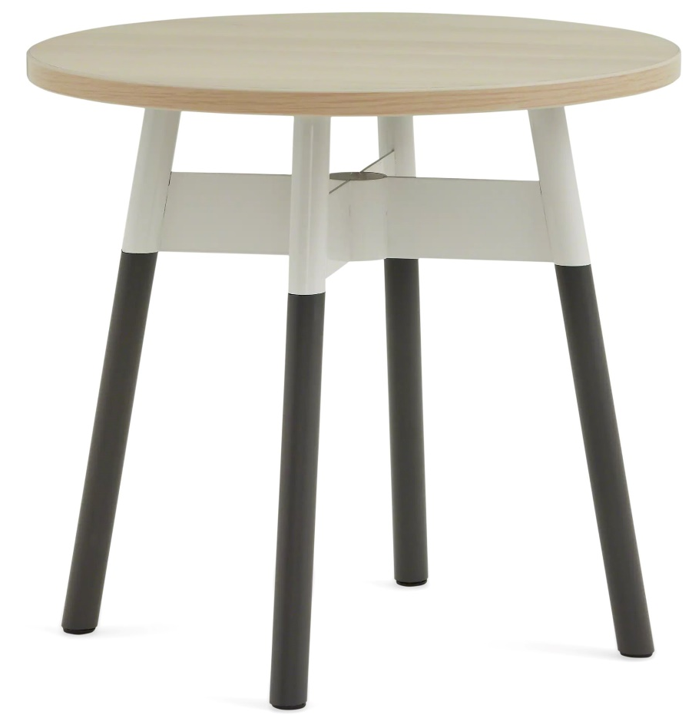
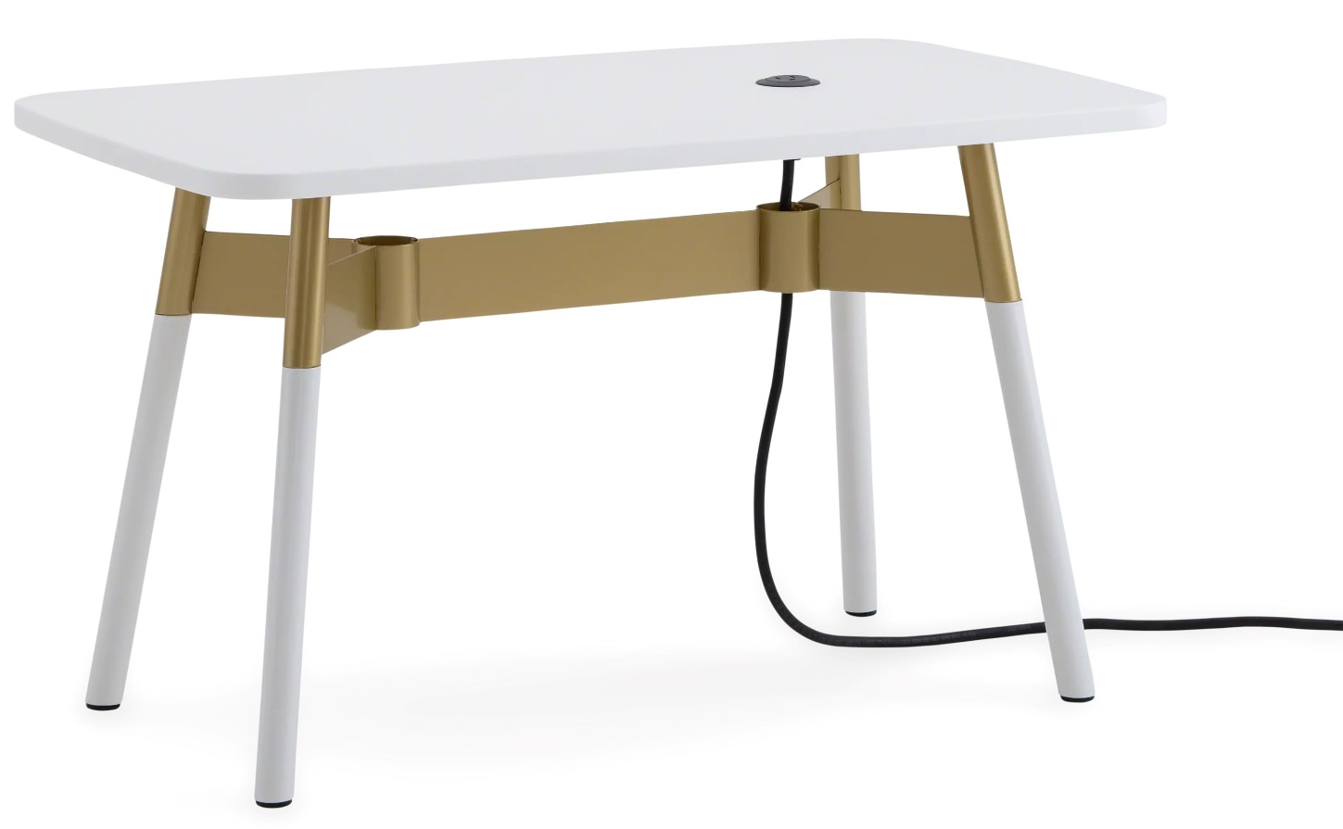
Embold Tables
Features:
  Available in three styles to coordinate with Embold seating: circular, racetrack, and rounded rectangle
  Legs are available in metal, solid maple, solid oak, or solid walnut wood
  Welcoming aesthetic can be used in healthcare spaces and beyond
Available With:
Power options include standard outlet or USB
High pressure laminate or solid surface tops available on all tables
Solid wood (oak, maple, walnut) table tops available on circular tables, but not recommended for clinical settings
Decorative braided power cord covers are available and recommended for non-clinical settings

Slide 9
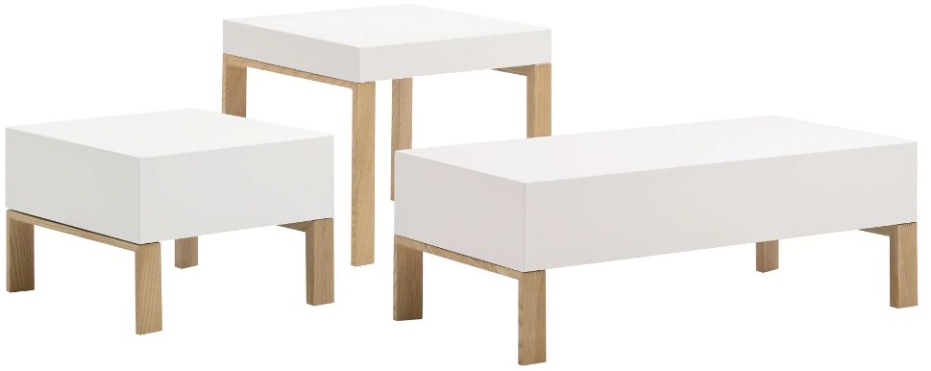
Tava Tables
Features:
  Coordinate with the Tava family of seating line
  Freestanding side and coffee tables are available
  Legs include mitered joints with internal steel reinforcement
Available With:
Multiple widths available (16”, 18”)
Highly cleanable powercoated steel available in several finishes
Crafted ash legs are offered in an array of finishes

Slide 10
Warranty
Steelcase Inc. warrants that Steelcase Health brand products are free from defects in materials and workmanship for the life of the product, except as set forth below. This warranty is valid from the date of shipment, regardless of shift usage, and covers the original purchaser for products delivered in the United States, Canada, Mexico, Latin America and the Caribbean.
Exceptions to the lifetime warranty:
12 years
Glides, laminate, wood veneer and solid surface, RTF Steelcase Health casegoods
5 years
Paint colorfastness, Steelcase Health wood finish
*Visit Steelcase.com for complete warranty details and information on specific fabric warranties

