Slide 1
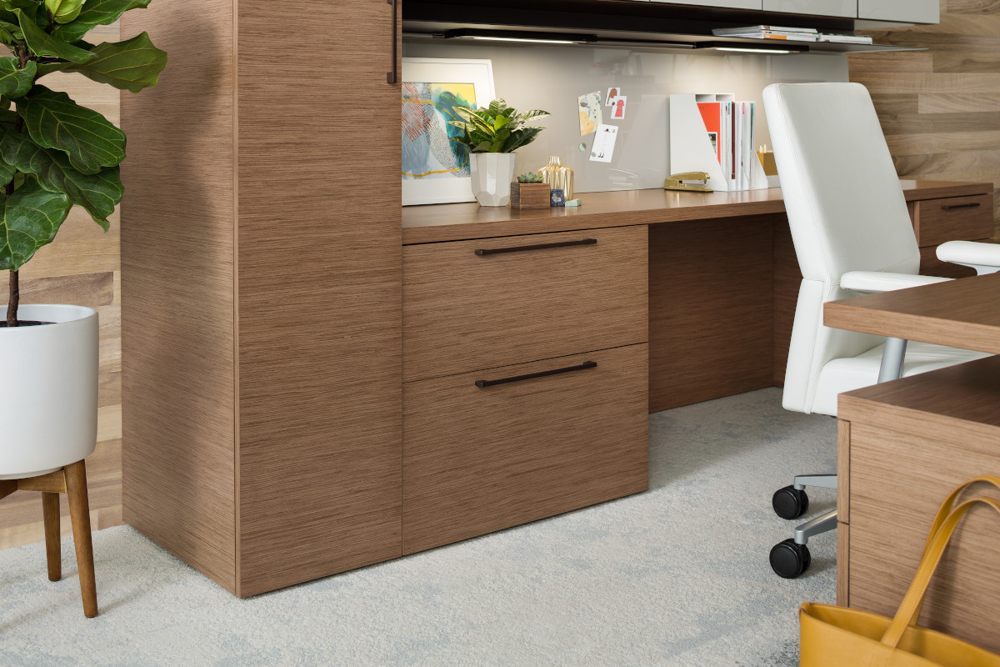
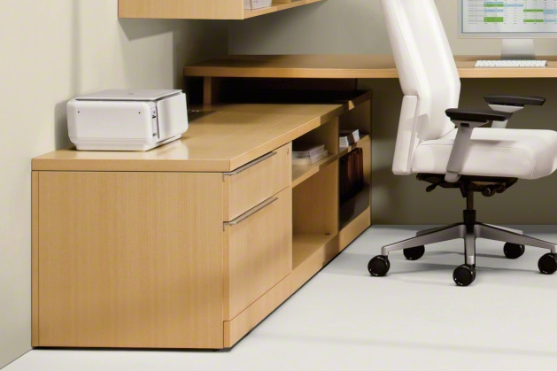
Elective Elements Full Front Headsets Now Available
effective June 19, 2023
Full Front
previously a special called “omit toe kick”
now available as a standard option, specify: FRONT OPTIONS > FULL FRONT
order this option for new customers or for customers who had previous “omit toe kick” specials
bottom drawer front extents to the floor
Toe Kick
previously the standard solution
now an option, specify: FRONT OPTIONS > TOE KICK
order this option to match existing customer standards
an additional finished trim piece which is flush to bottom drawer front
also referred to as an “expressed” toe kick (WorkValet)
NOTE: WorkValet offers an additional option of recessed toe kick, this has not been a feature of Elective Elements.

