Slide 1
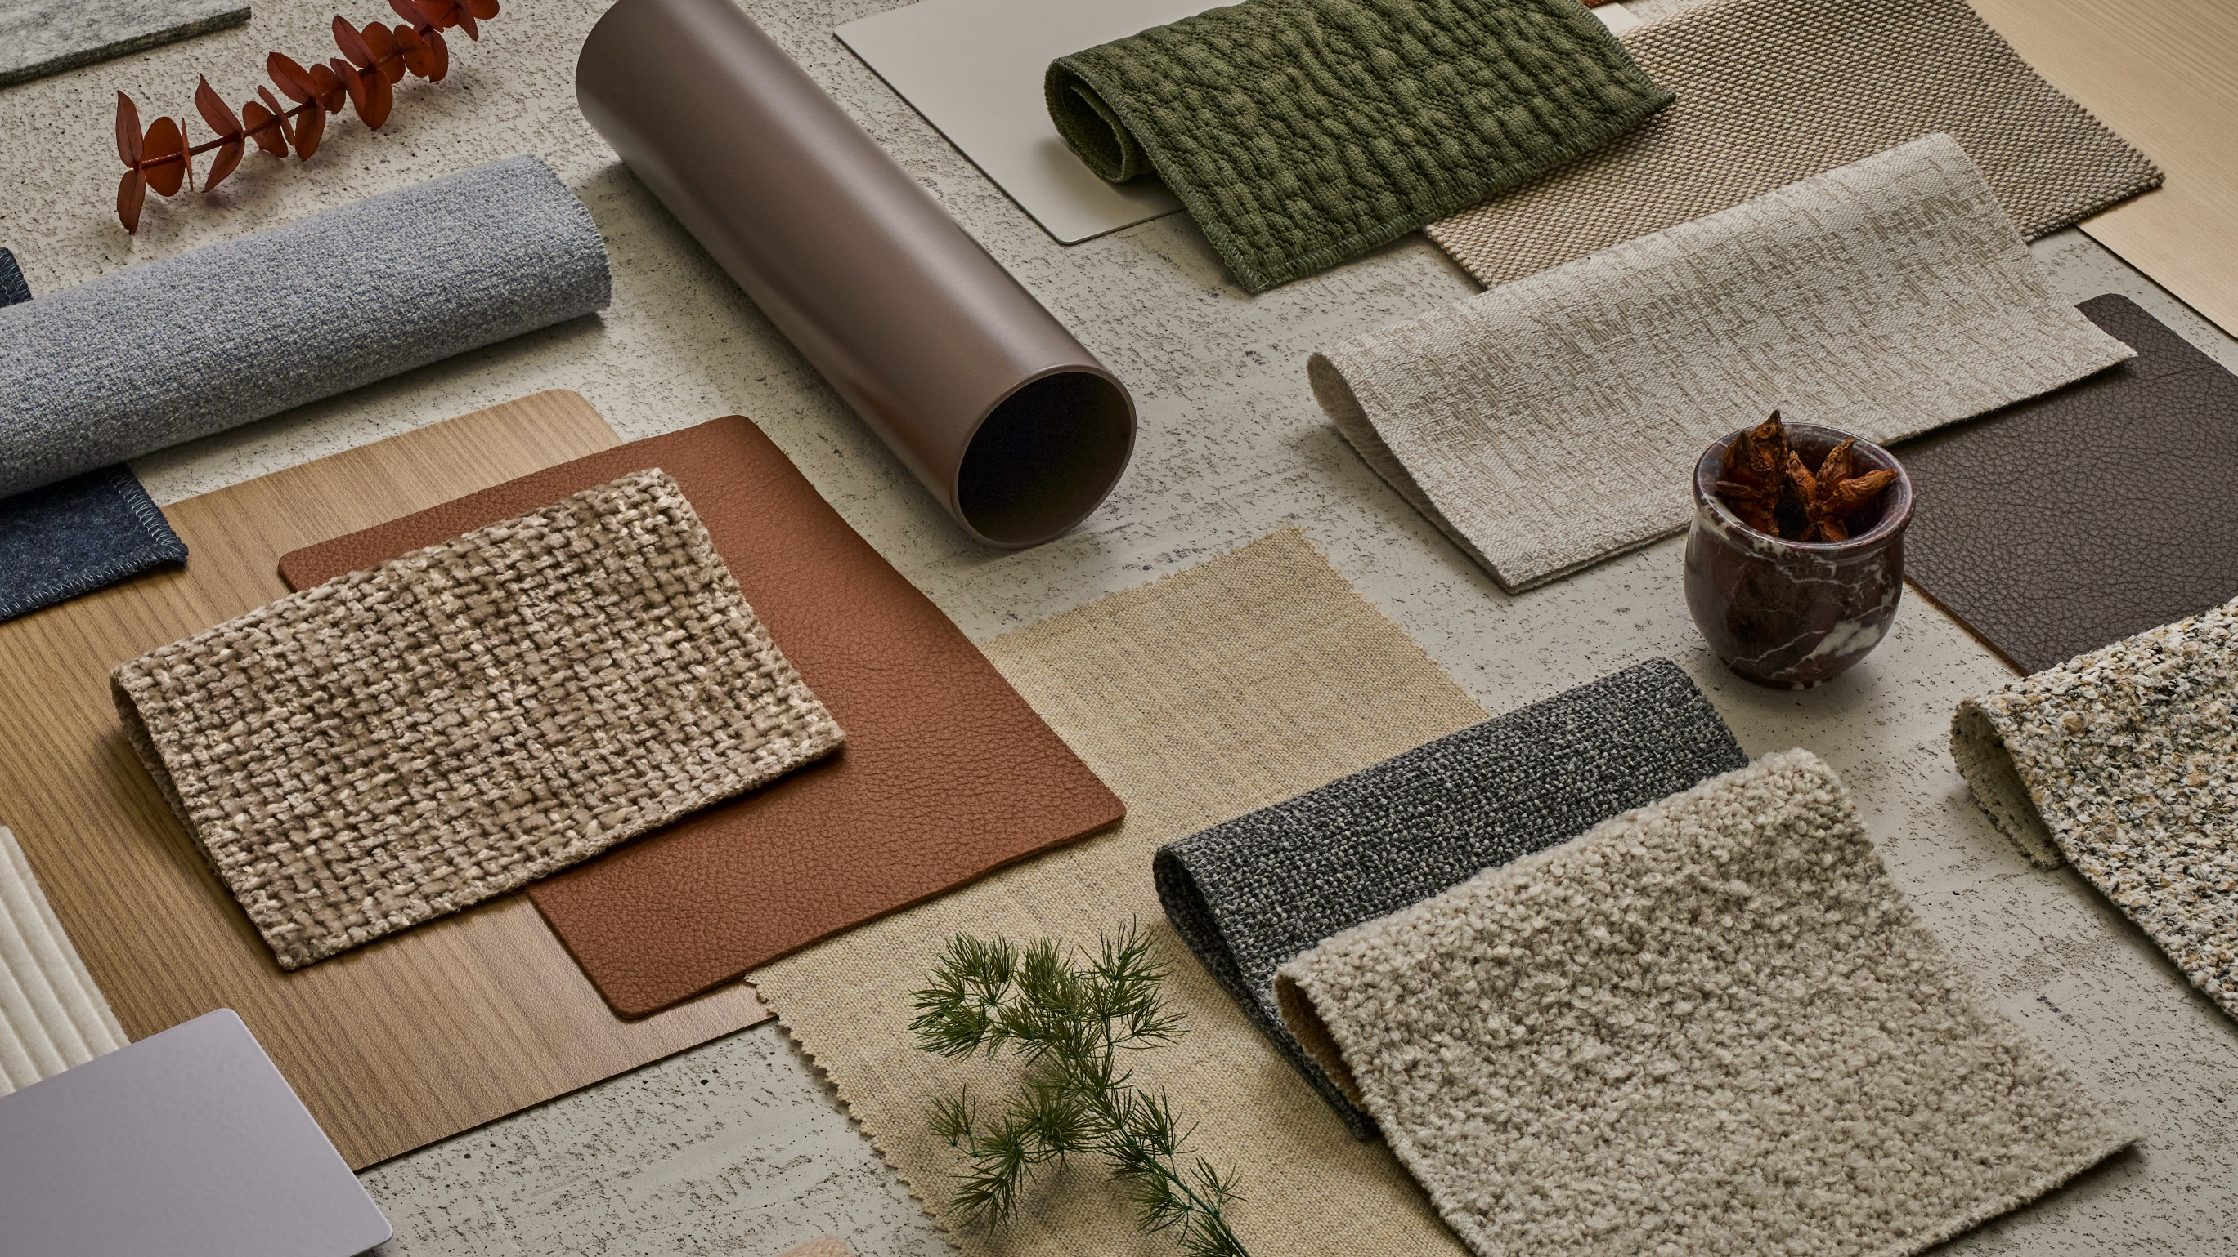

Color Works.
Palette to Product
Surface Materials
September 2025
Notes:
KG

Slide 2
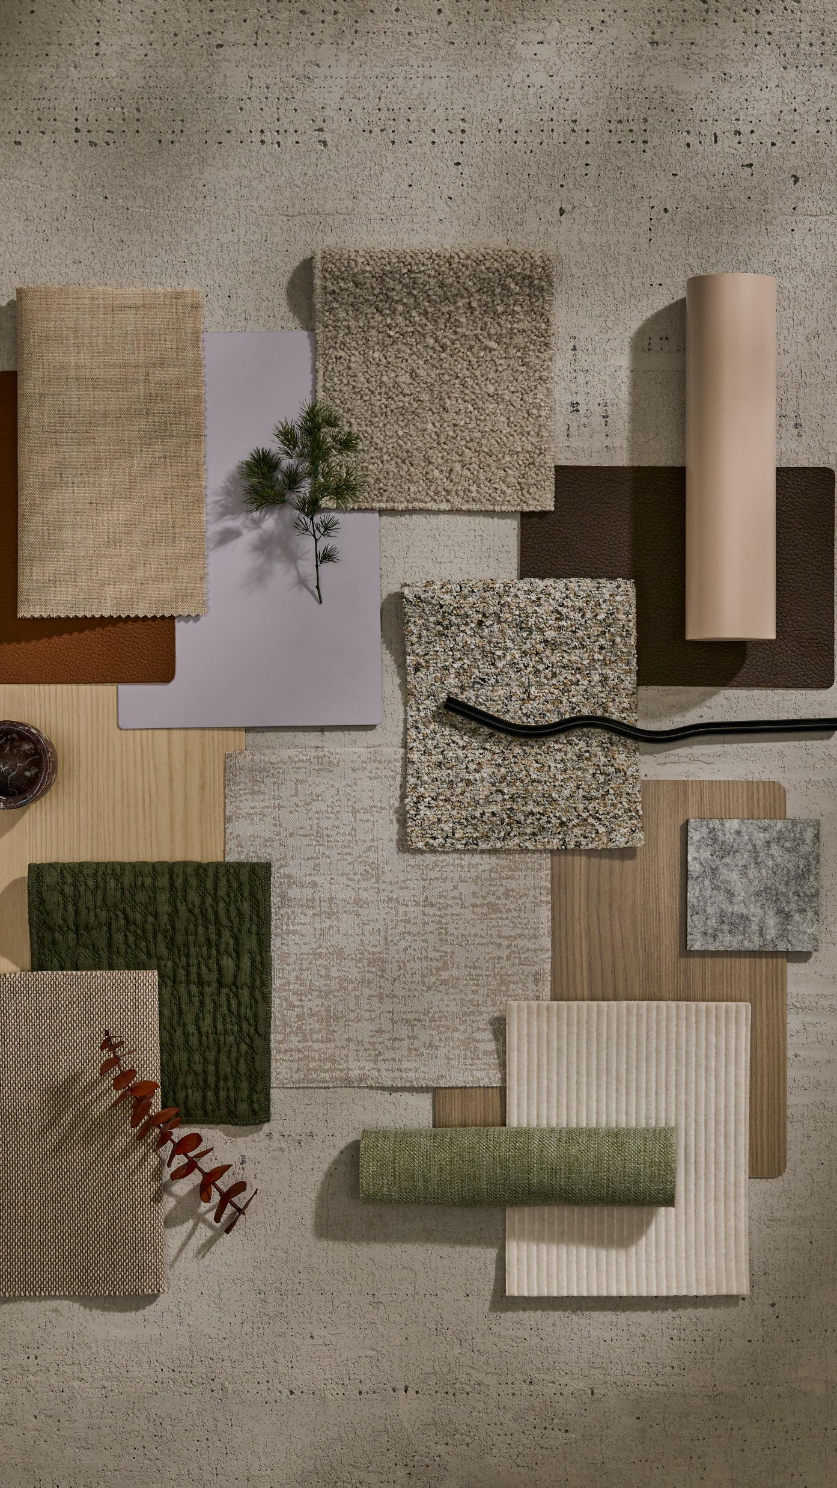
Color Works.
Palette to Product
Color Works: Palette to Product is a color application guide that highlights how Color isn’t just visual – it’s emotional. This guide explores the importance of color and relevant material introductions to meet real needs, featuring spaces for focus, collaboration and transition.
In addition to the guide, there are material callouts within the new & notable card deck and planning ideas available for download.
Links to these touchpoints can be found on the Surface Materials landing page on Steelcase dotcom.

Slide 3
Color Works.
Palette to Product
Color Chapter
Five color themes.
Palette to Product
Color Chapter
Palette and Application
Display Guide
How to create a Color Works display to best suite your needs.
Notes:
KG

Slide 4
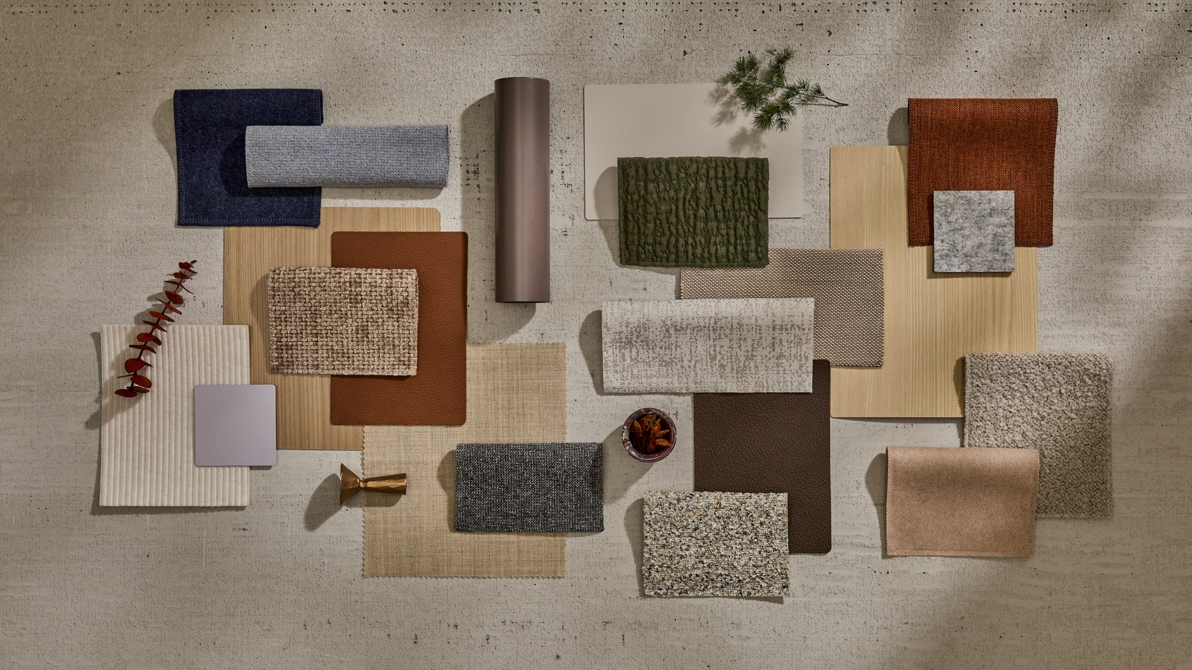

Slide 5
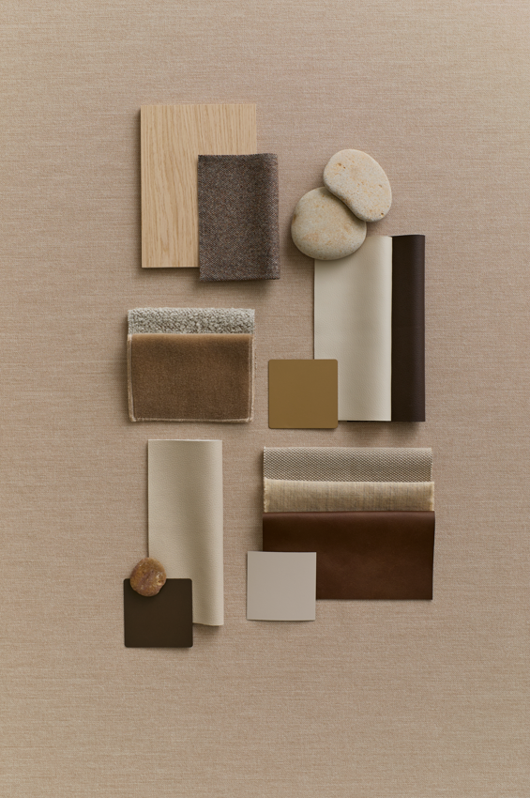
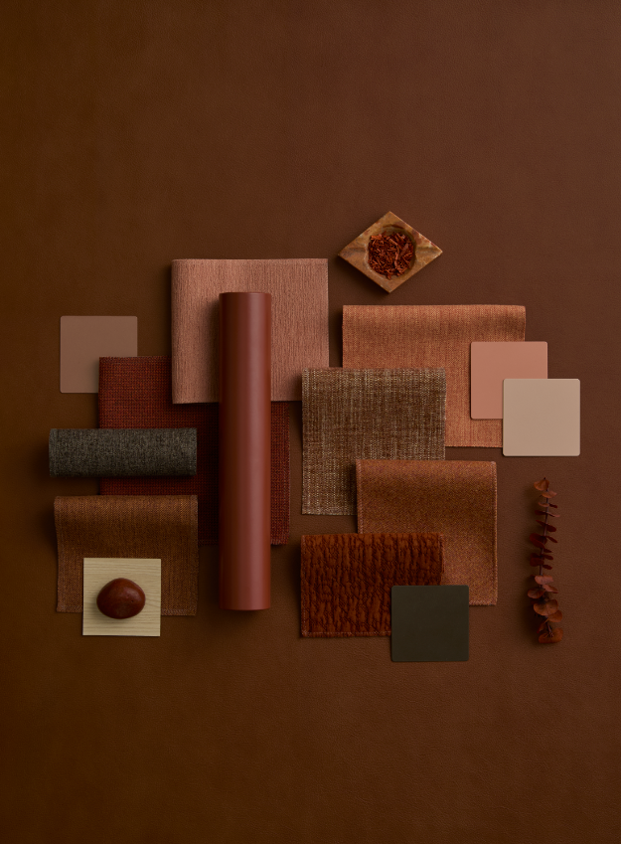
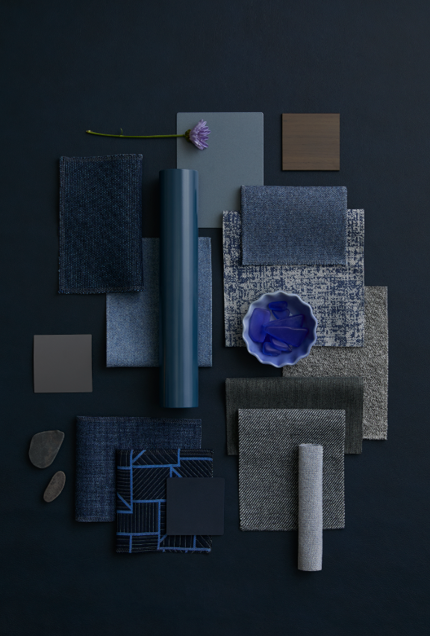
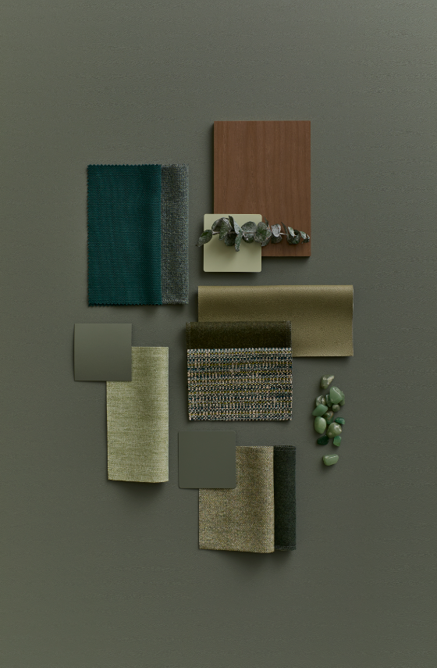
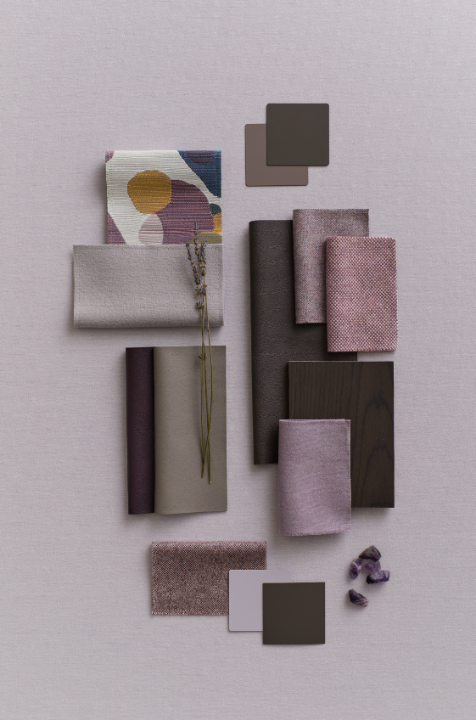
Color Chapters
Introducing five color themes, each designed to evoke emotion, inspire creativity, and guide application across diverse environments. Together, they form a harmonious story grounded in nature, emotion, and design versatility.
Grounding Neutrals
Sunbaked Layers
Twilight Tones
Rooted In Nature
Peaceful Energy
Notes:
AU

Slide 6
Grounding Neutrals
Warm and soft tones often resemble places of comfort. These neutrals can act as a foundation or be layered together in tone-on-tone combinations.
Notes:
KG
Call out how the portfolio work highlighted that Warm White existing within one of the color targets. We pulled the color back into Active status and remarketed as a new neutral.

Slide 7
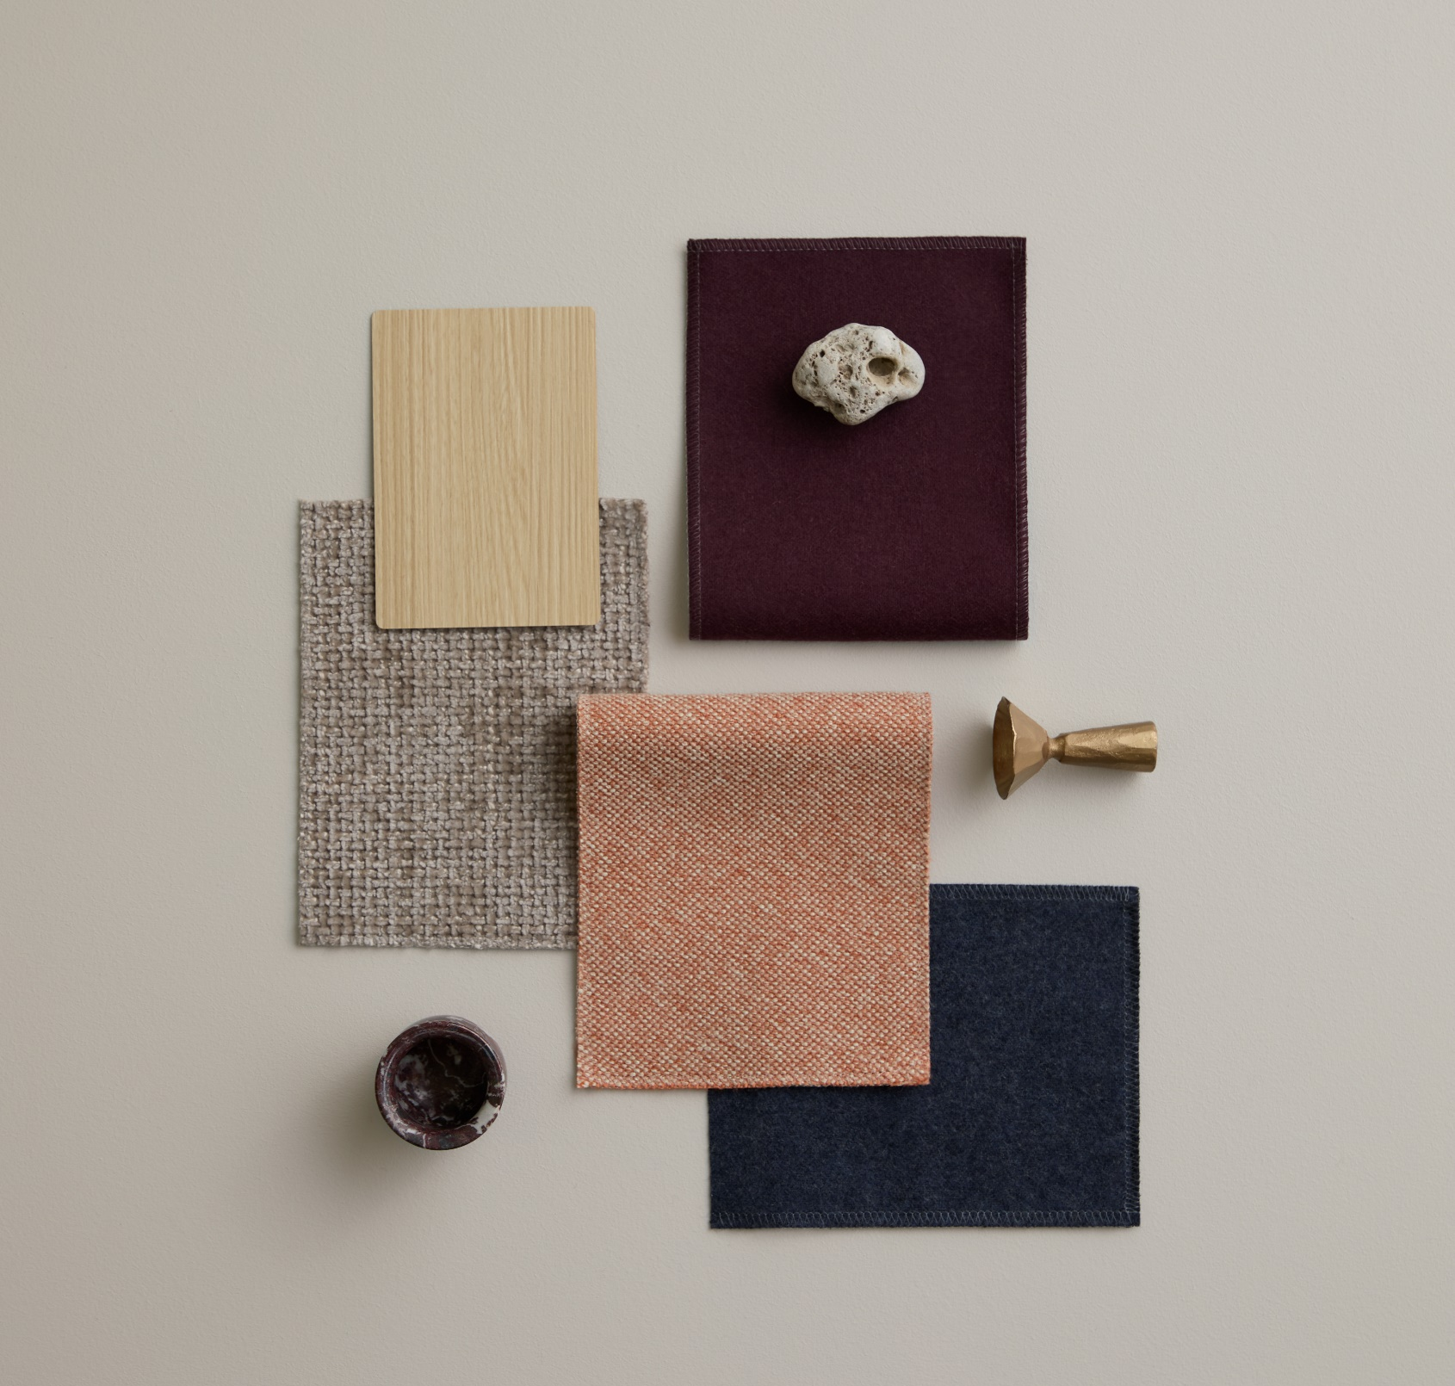
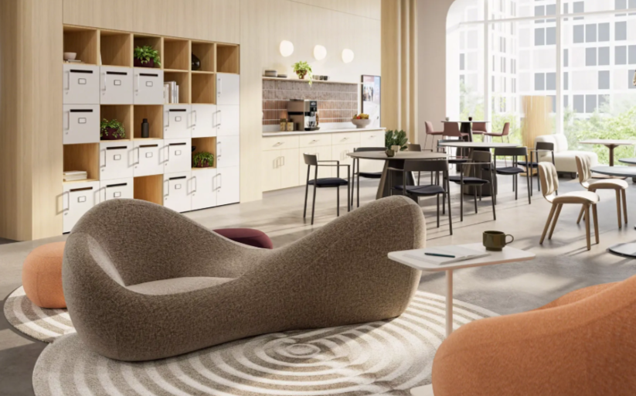
Connected Comfort
Connected Comfort builds on Grounding Neutrals by blending natural woodgrains, rich textiles, and refined accents to create a built-in, welcoming environment. It supports personal storage, casual lounging, and social connection within a small work café setting—balancing comfort, clarity, and a sense of belonging.

Slide 8
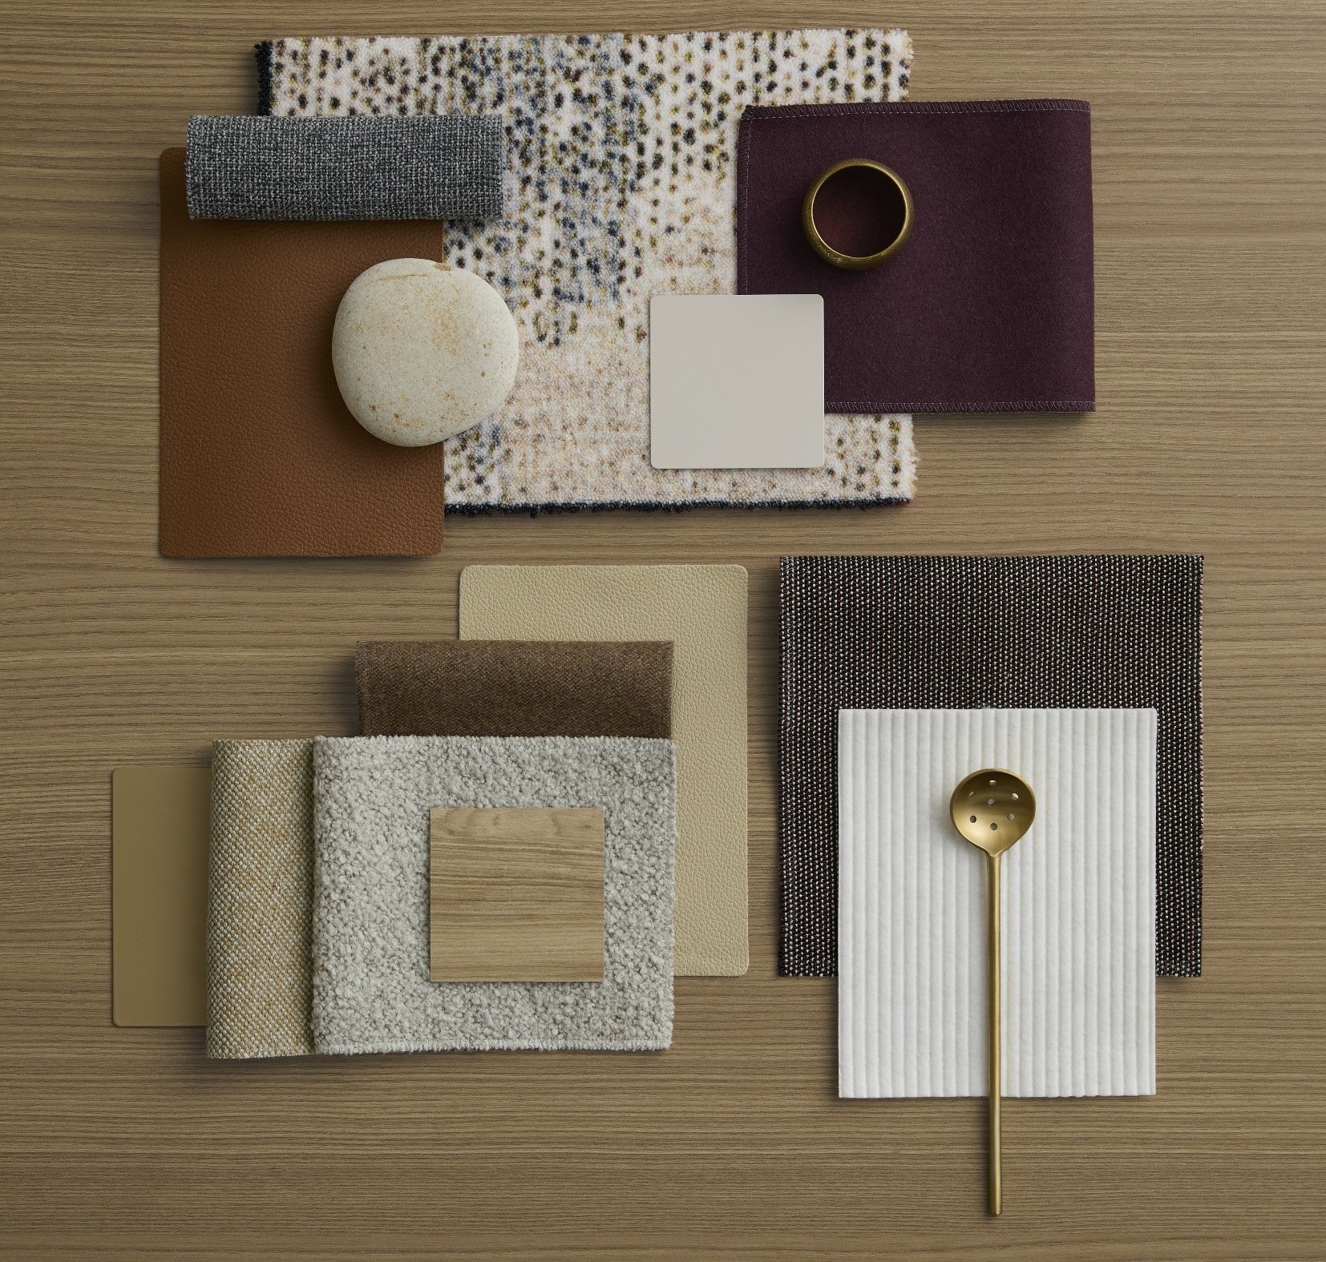
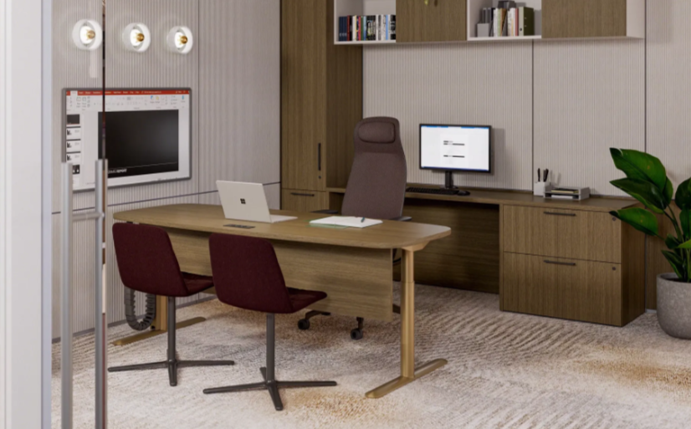
Welcoming Focus
Echoing Grounding Neutrals, Welcoming Focus is a warm, tactile blend of earthy neutrals, soft textures, and natural materials that supports both focused work and spontaneous interaction in a welcoming, well-organized environment. Ideal for multifunctional zones that transition seamlessly from heads-down productivity to casual conversation and guest engagement.

Slide 9
Sunbaked Layers
Earthy, tactile, and inviting tones add a refined warmth that is visually cohesive and emotionally resonant — creating a sense of comfort and understated sophistication.
Notes:
KG
Call out how the portfolio work highlighted that Warm White existing within one of the color targets. We pulled the color back into Active status and remarketed as a new neutral.

Slide 10
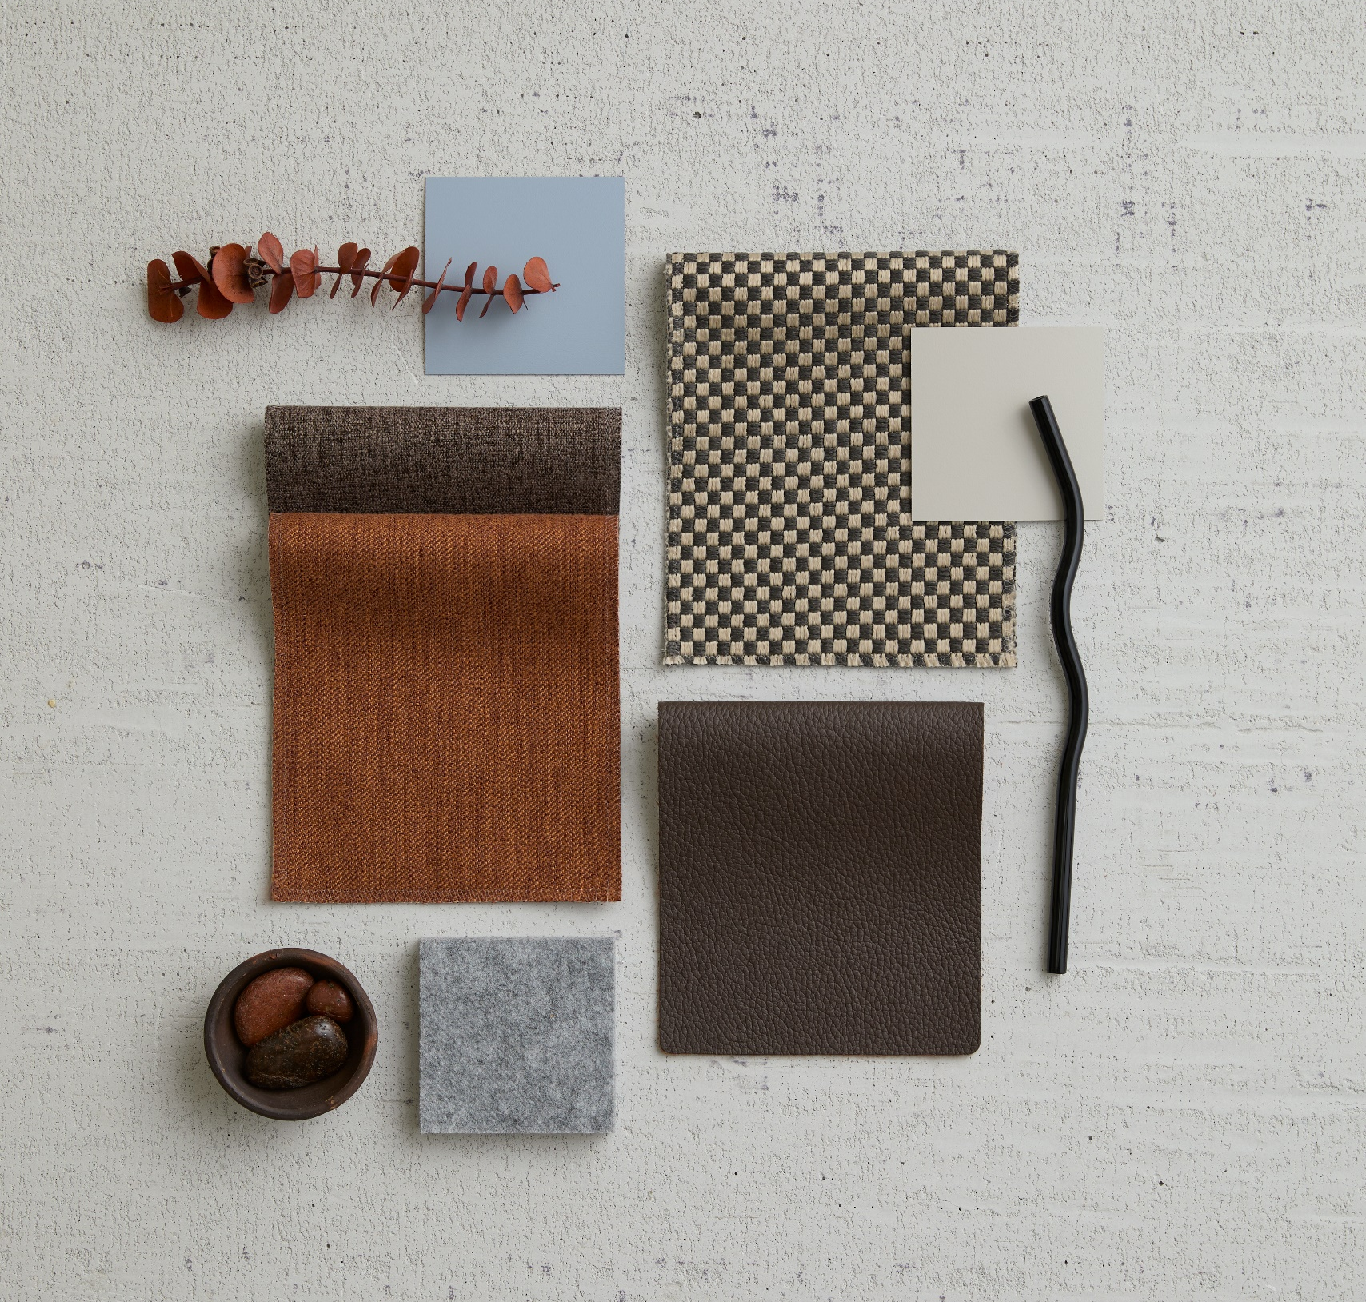
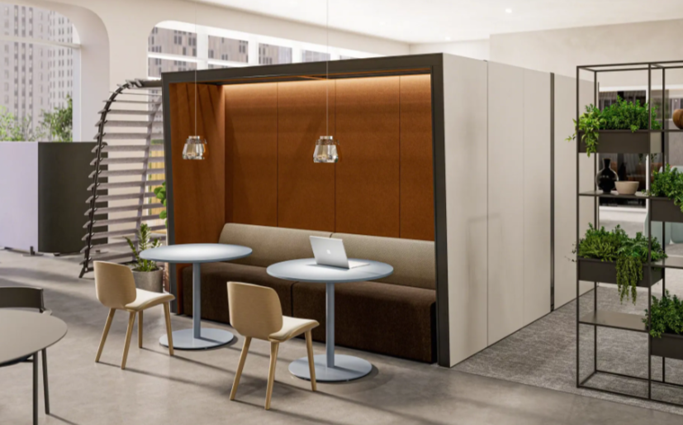
Quiet Shelter
Building off Sunbaked Layers, this is a warm, textured blend of earthy browns, soft greys, and muted blues that evokes a sense of cozy retreat and grounded functionality. Quiet Shelter feels inviting, layered, and thoughtfully grounded, perfect for a space that transitions between group gatherings and personal moments.

Slide 11
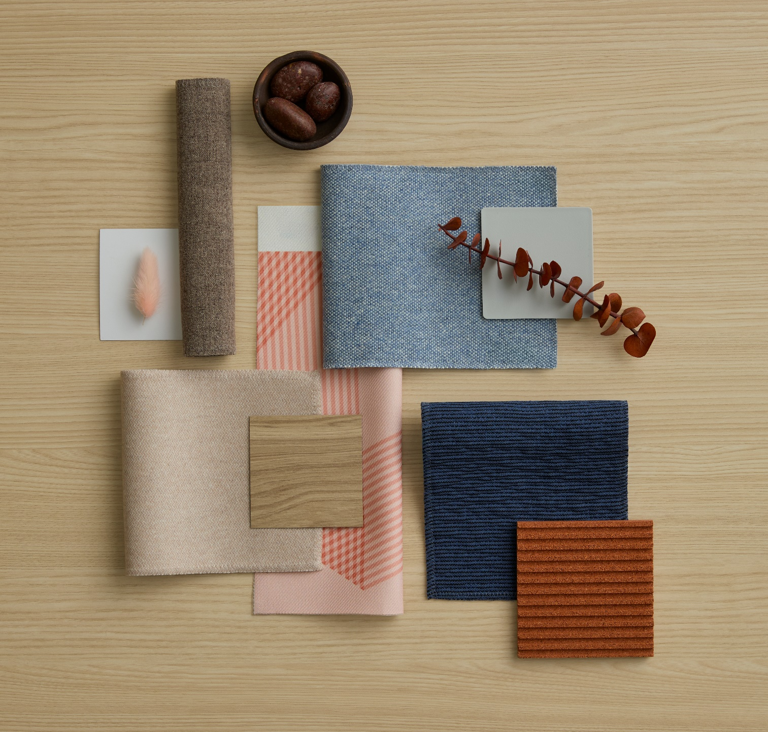
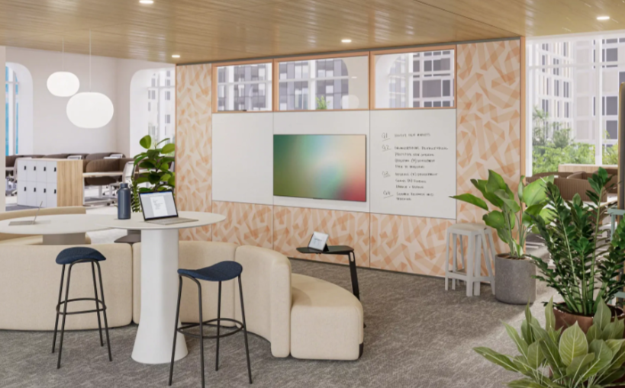
Soft Sync
Resonating with the warmth and tactility of Sunbaked Layers, Soft Sync feels modern yet inviting, with a subtle interplay of digital sophistication and tactile comfort—perfect for spaces that support both team huddles and solo work, while encouraging spontaneous interaction.

Slide 12
Twilight Tones
A serene, minimal, and quietly expressive palette, with a cool-toned sophistication that could suit both modern and nature-inspired design contexts.
Notes:
KG
Call out how the portfolio work highlighted that Warm White existing within one of the color targets. We pulled the color back into Active status and remarketed as a new neutral.

Slide 13
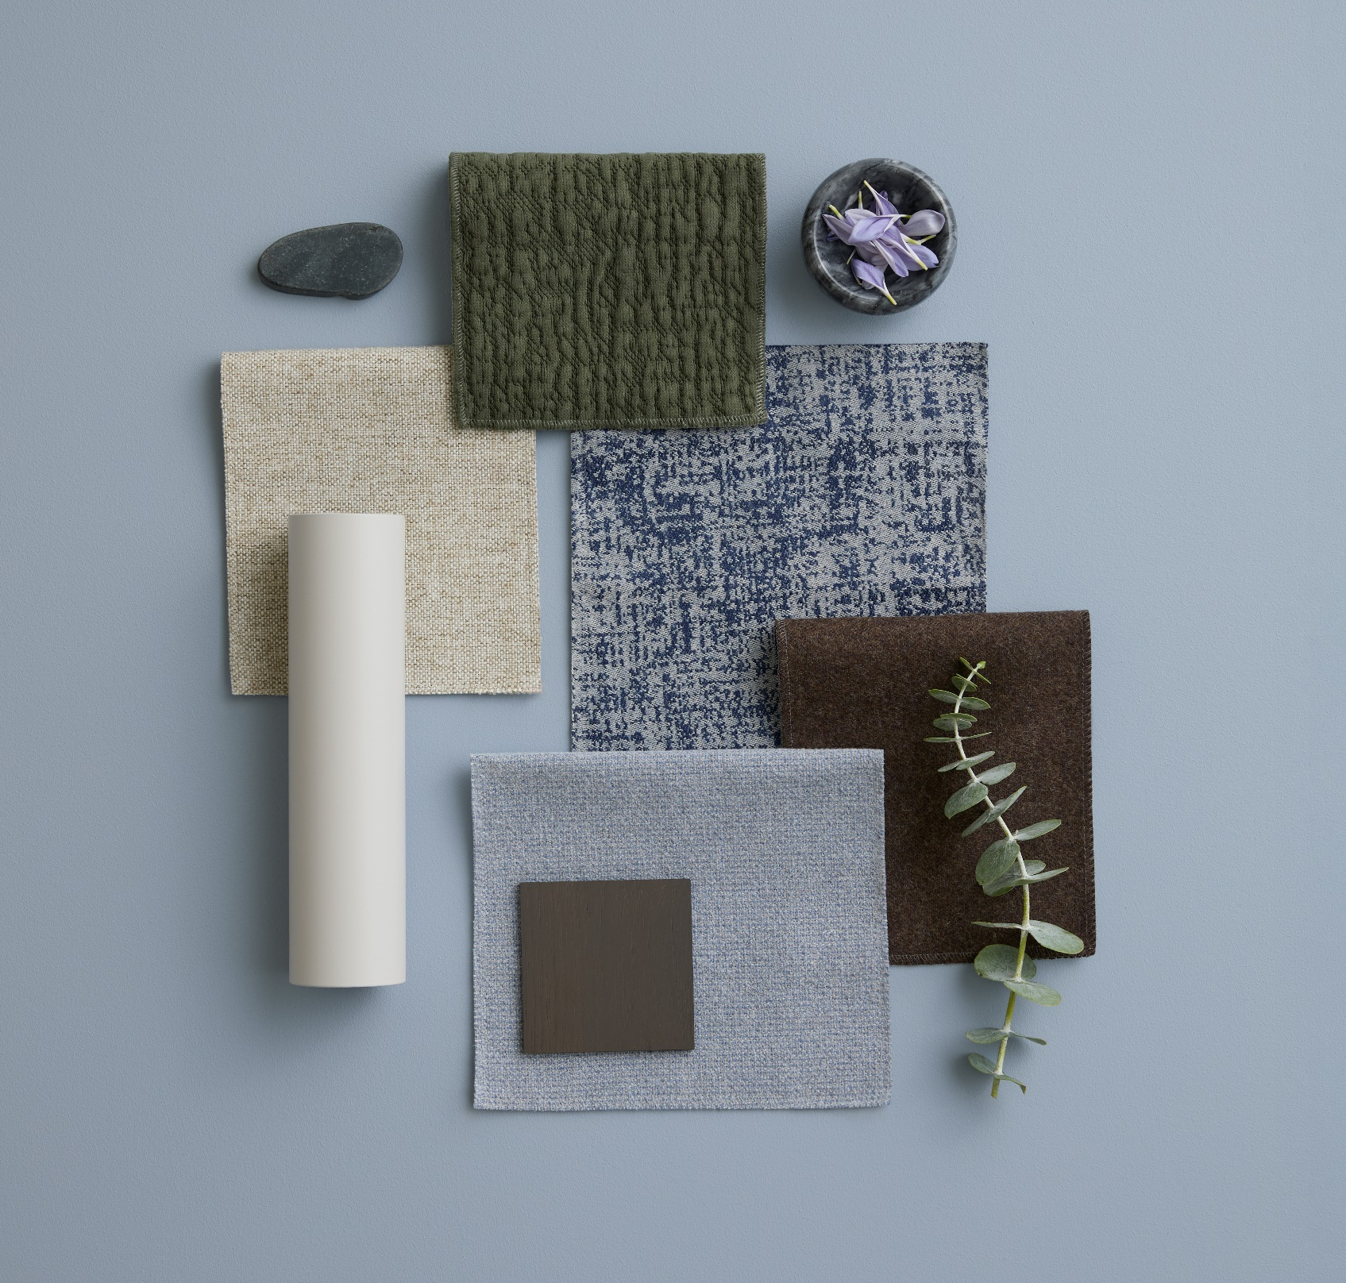
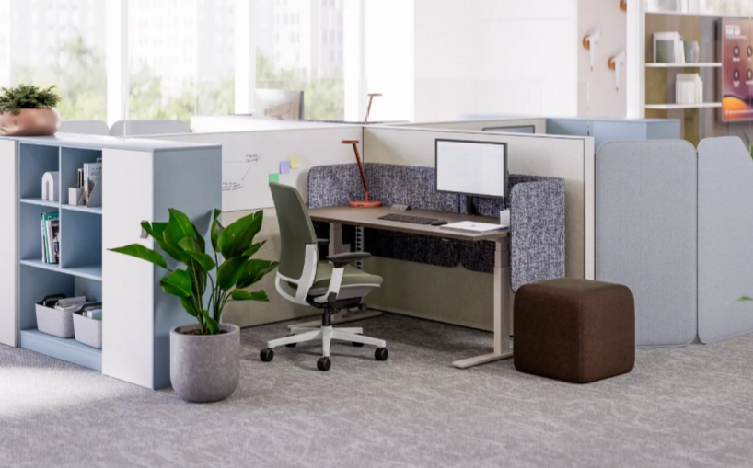
Soft Focus
Soft Focus supports Twilight Tones by maintaining a nature-infused, calming palette. The palette feels balanced, adaptable, and thoughtfully composed, perfect for environments that blend privacy, personalization, and team functionality—from pinwheel-configured workstations to shared lockers and flexible seating.

Slide 14
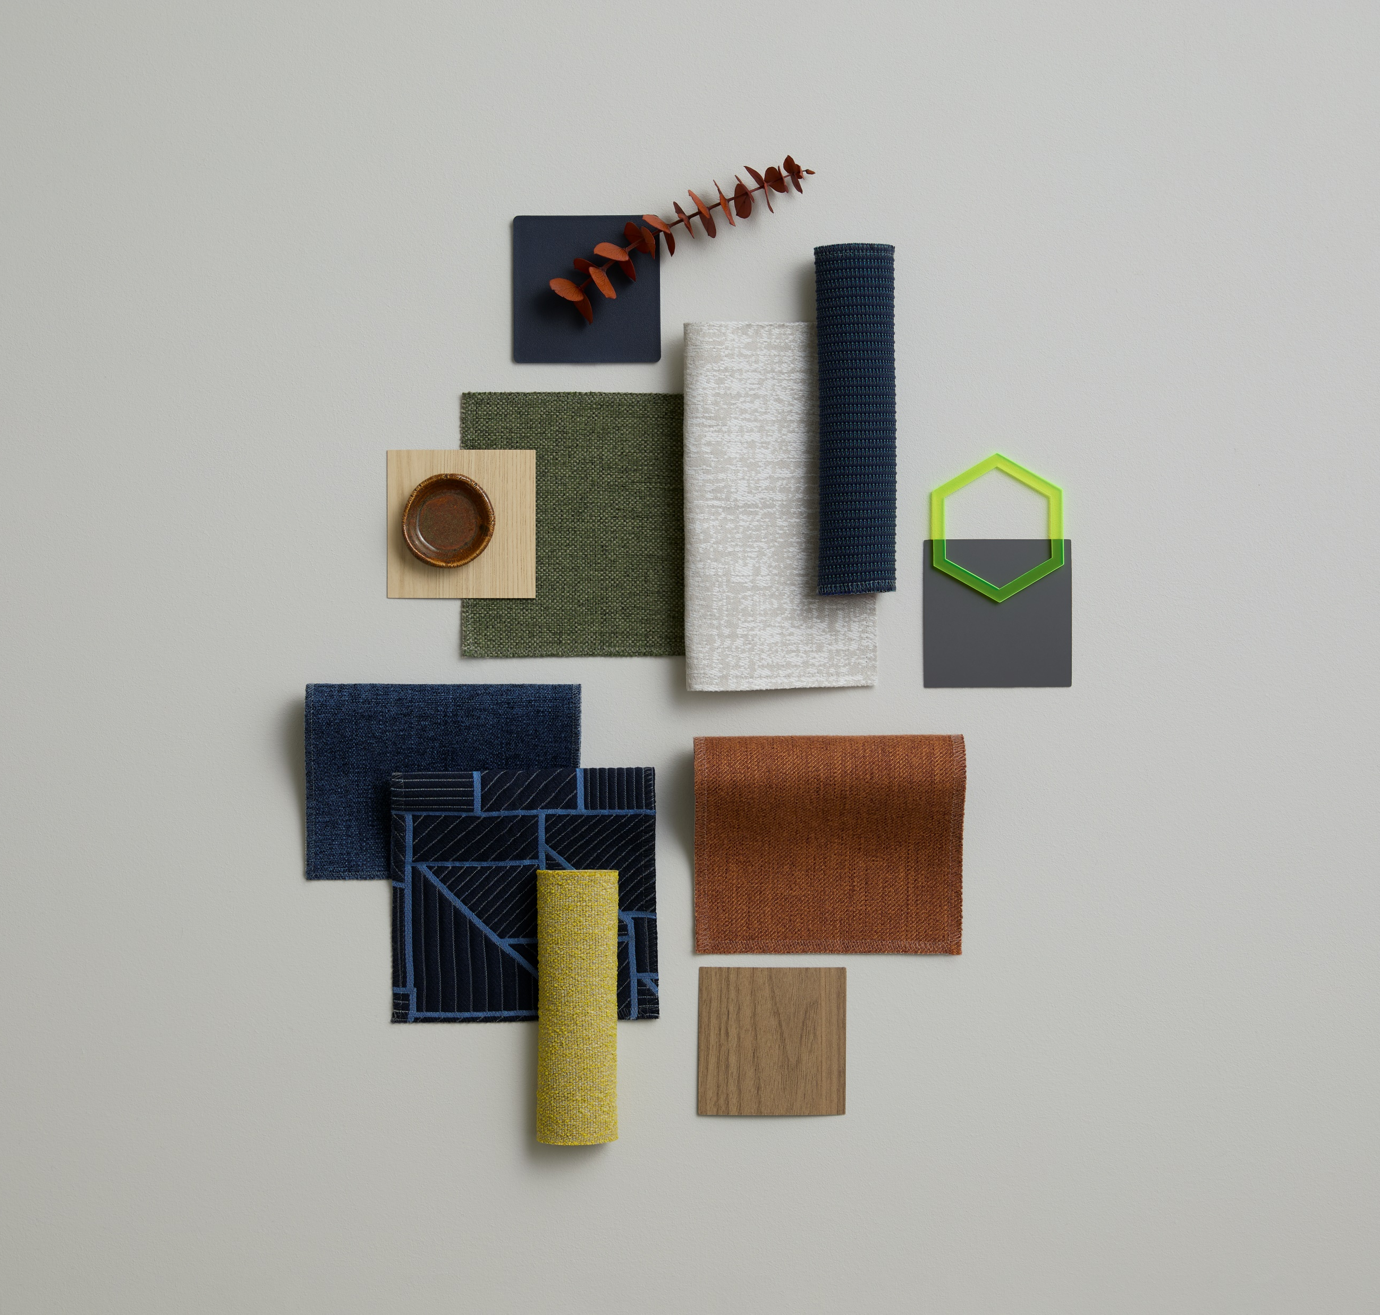
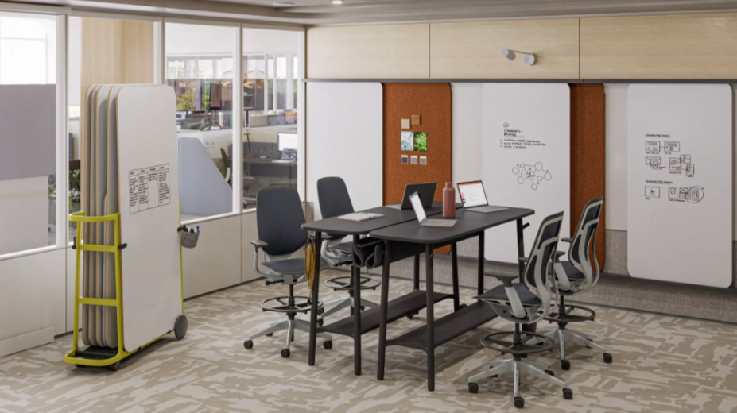
Interactive Energy
Interactive Energy complements Twilight Tones by introducing vibrant, yet balanced hues. A versatile mix of blue, yellow, and green, the palette feels active and adaptable, perfect for environments that encourage spontaneous interaction.

Slide 15
Rooted In Nature
Inspired by nature, these lush tones create serenity indoors. A natural meadow is filled with layers of green, these finishes are meant to replicate layered tones with grounding elements..
Notes:
KG
Call out how the portfolio work highlighted that Warm White existing within one of the color targets. We pulled the color back into Active status and remarketed as a new neutral.

Slide 16
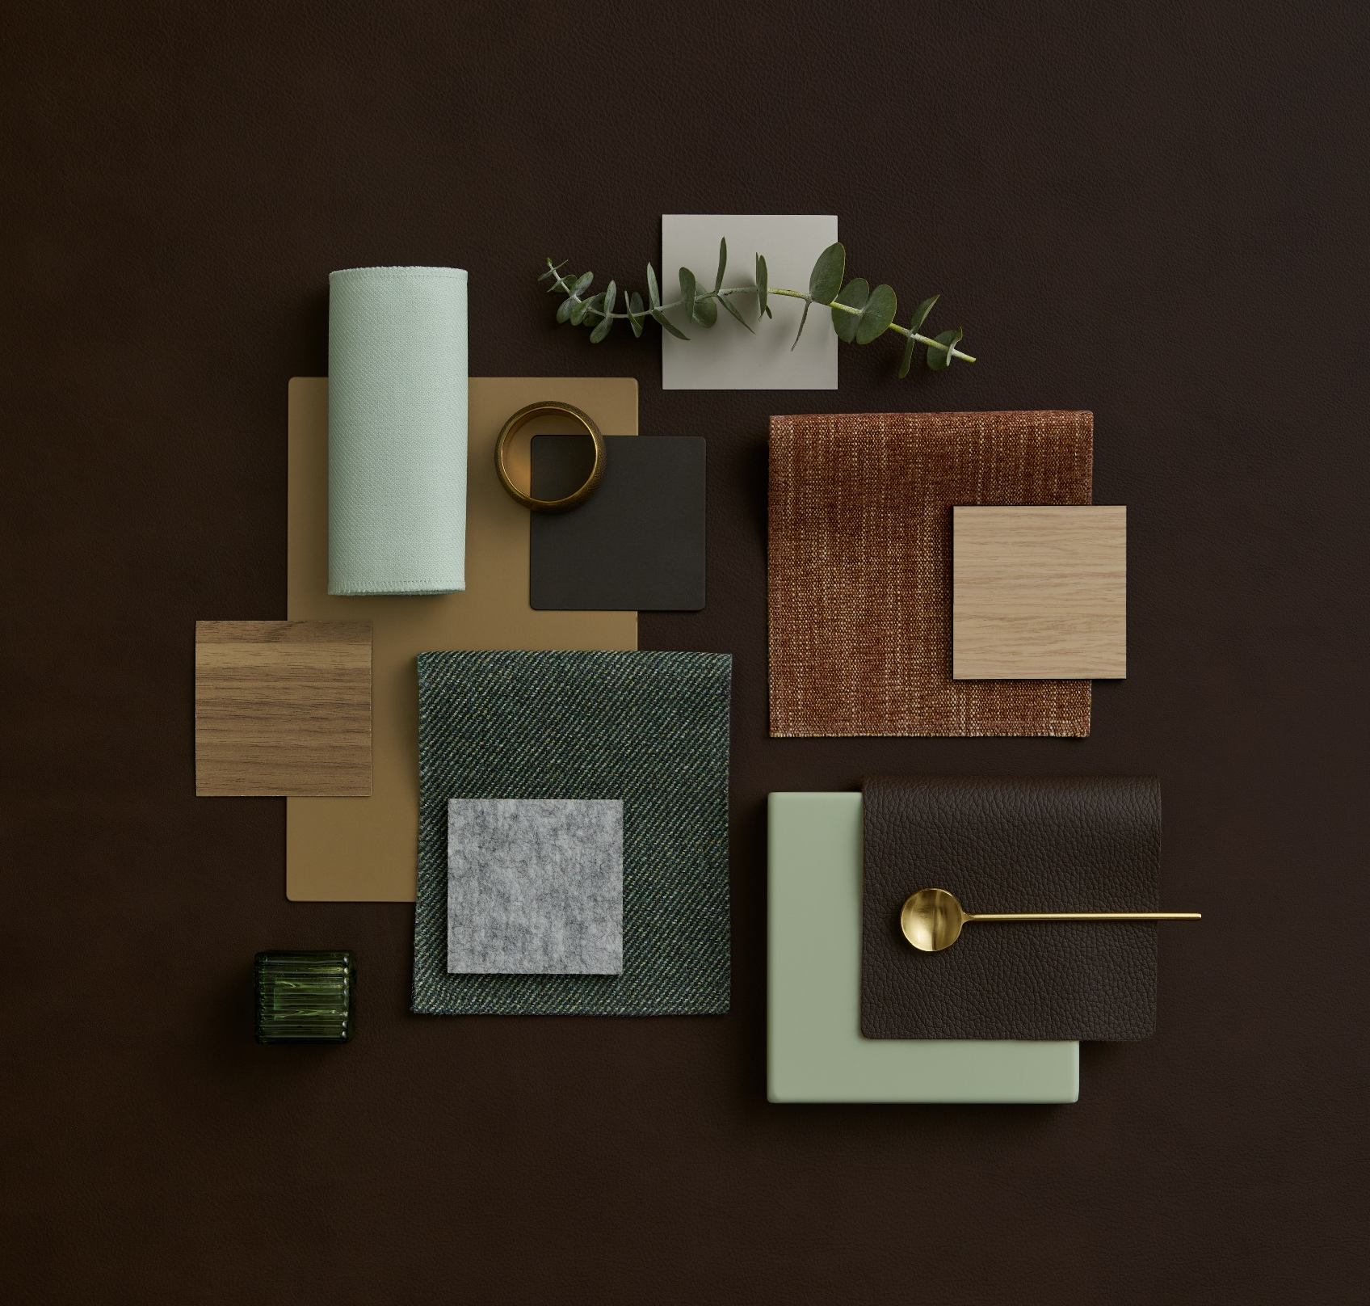
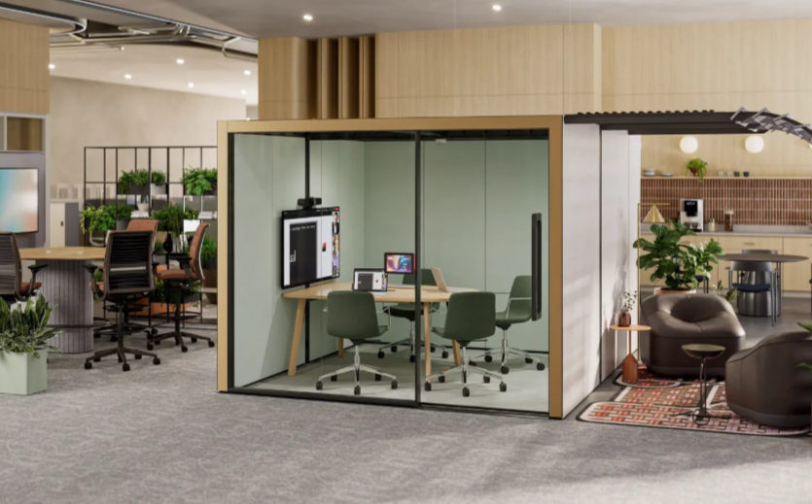
Quiet Grove
Quiet Grove supports Rooted in Nature by maintaining a rich, earthy palette—greens, browns, greys, and wood tones—while introducing subtle metallics and biophilic accents. Perfect for environments that blend digital tools with natural comfort, and support both group interaction and personal retreat.

Slide 17
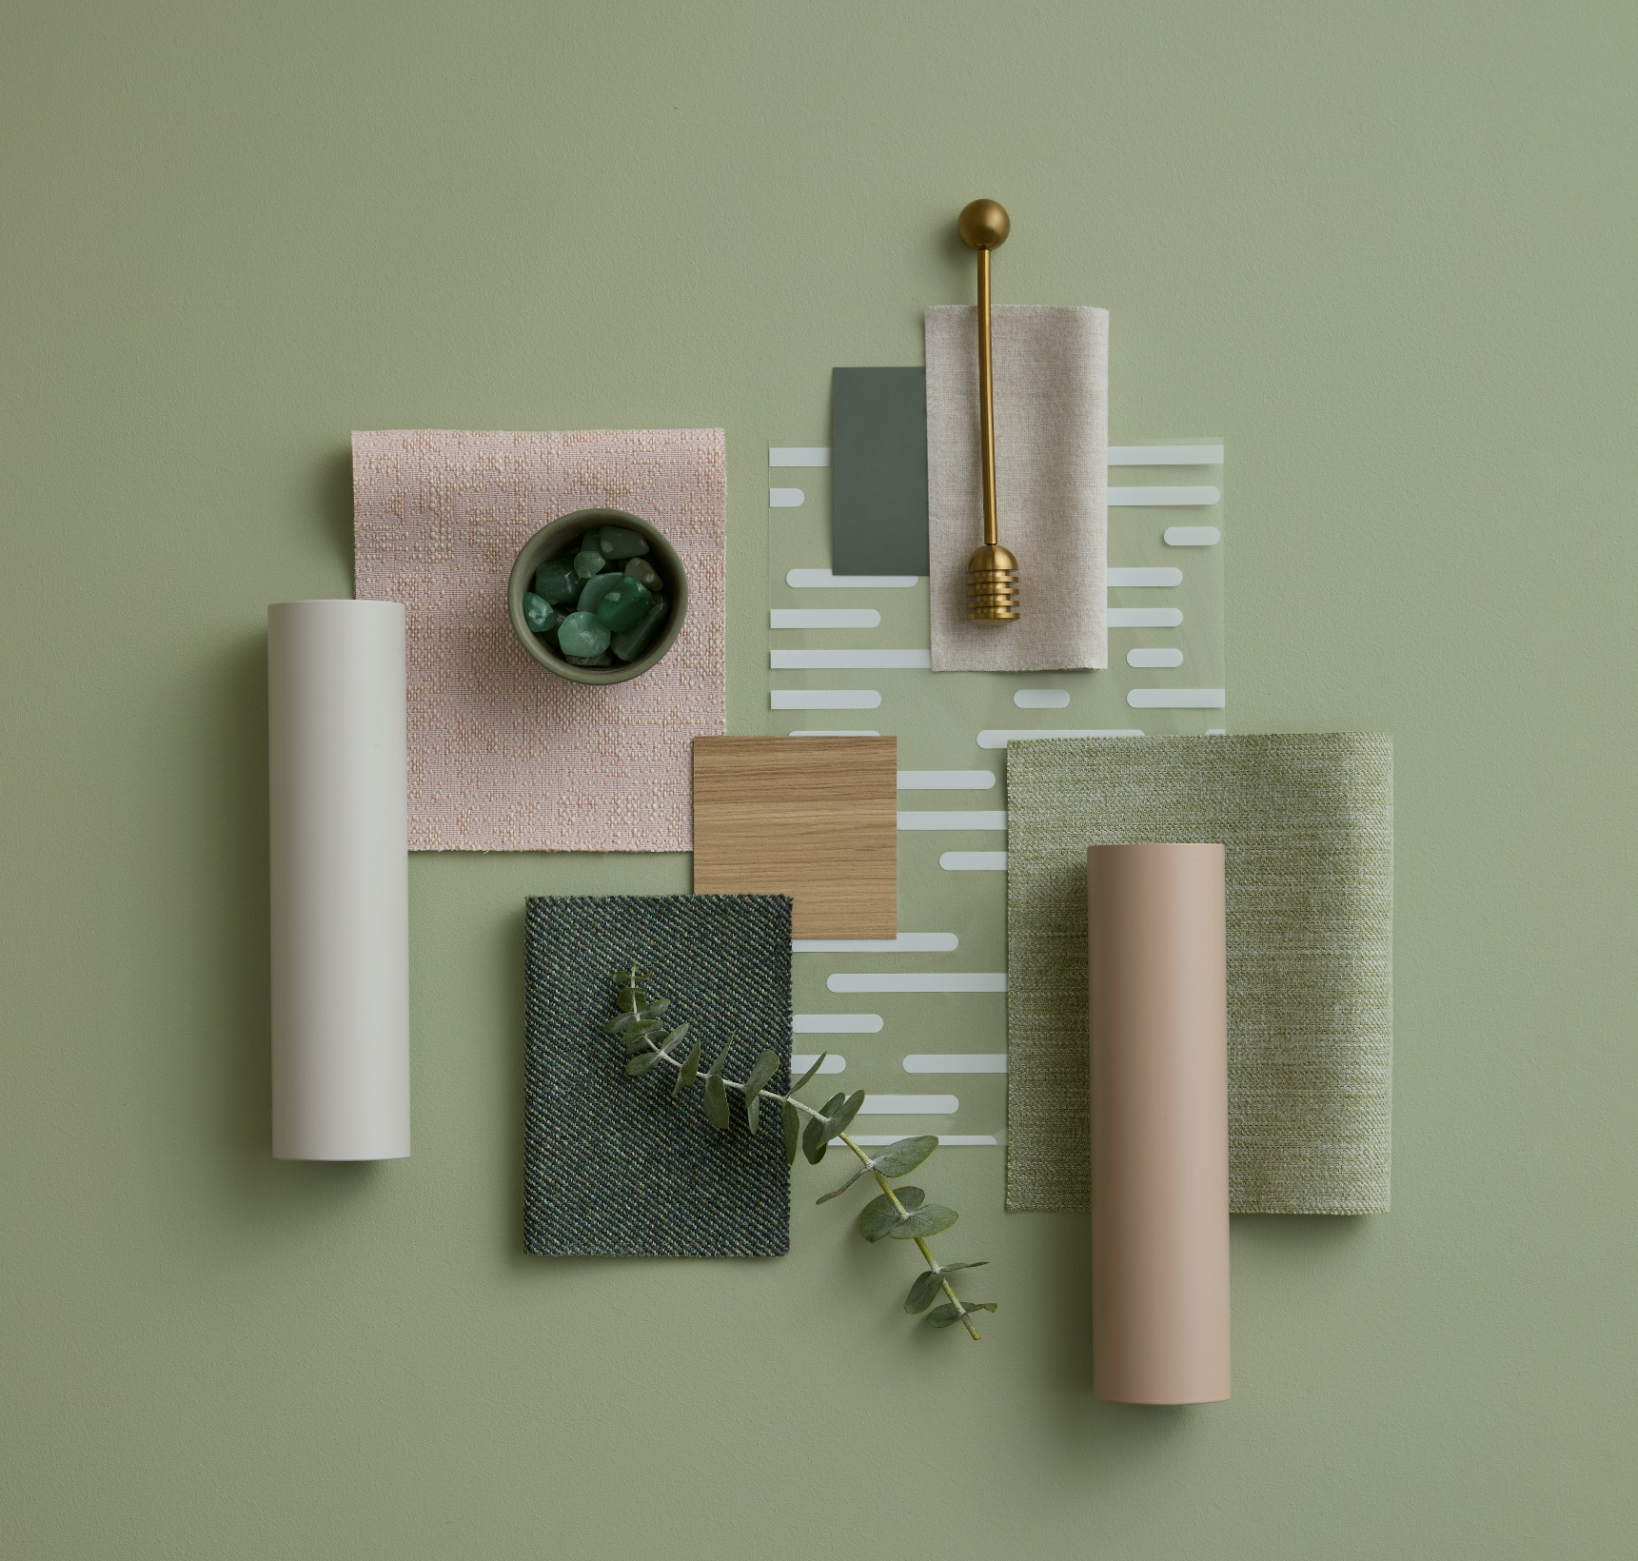
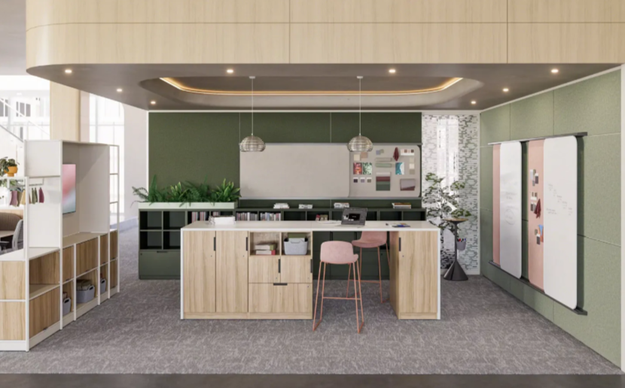
Curated Calm
Curated Calm complements Rooted in Nature by softening the palette into chalky neutrals, muted greens, and light pinks, while retaining natural wood tones. The palette feels organized, approachable, and quietly expressive, ideal for a material library that encourages conversation, creativity, and clarity through thoughtful design.

Slide 18
Peaceful Energy
These soft colors balanced by grounding elements create an atmosphere ready for creativity and imagination.
Notes:
KG
Call out how the portfolio work highlighted that Warm White existing within one of the color targets. We pulled the color back into Active status and remarketed as a new neutral.

Slide 19
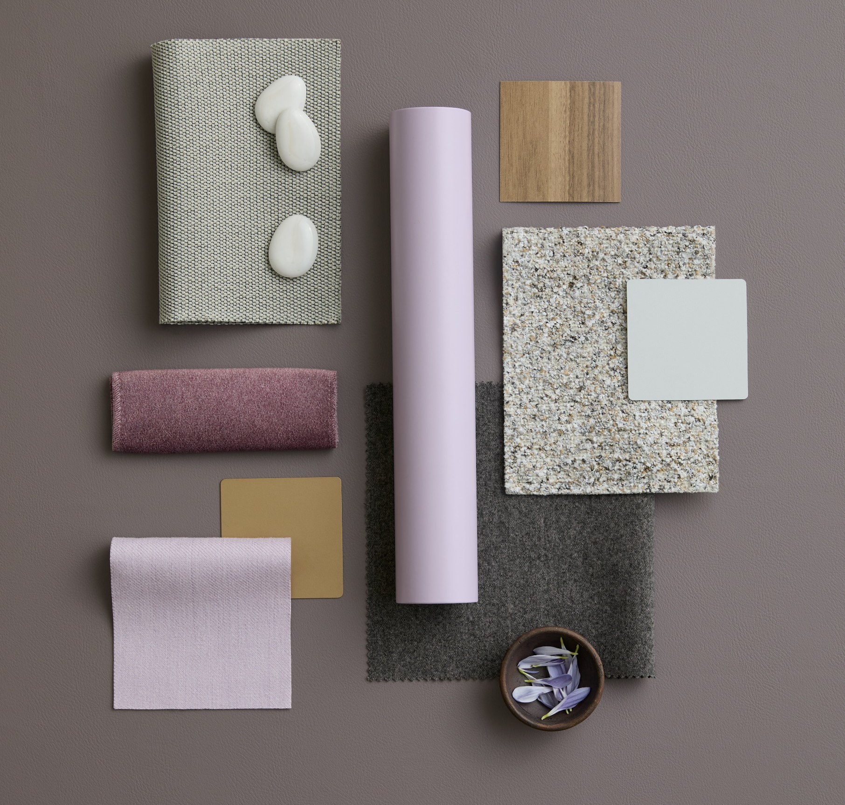
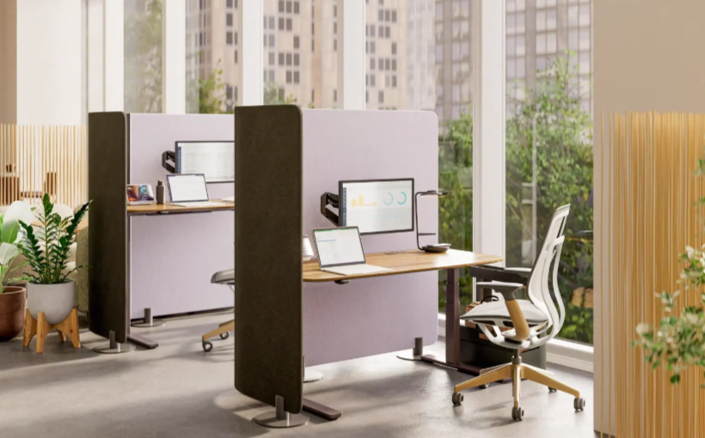
Grounded Clarity
With muted earth tones and tactile materials, Grounded Clarity reduces visual noise and cognitive fatigue, making it ideal for focused workspaces, long work sessions, and adaptable task zones. It translates the emotional calm of Peaceful Energy into visual simplicity and functional support.

Slide 20
Display Detail

Slide 21

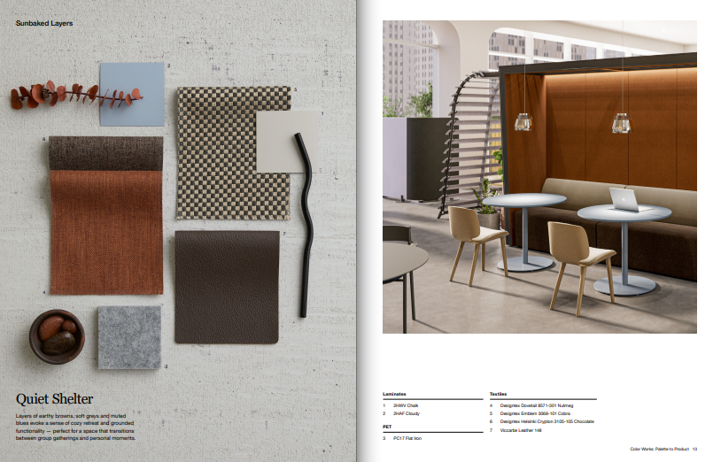
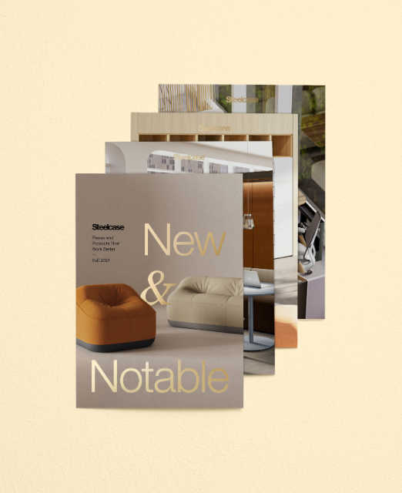
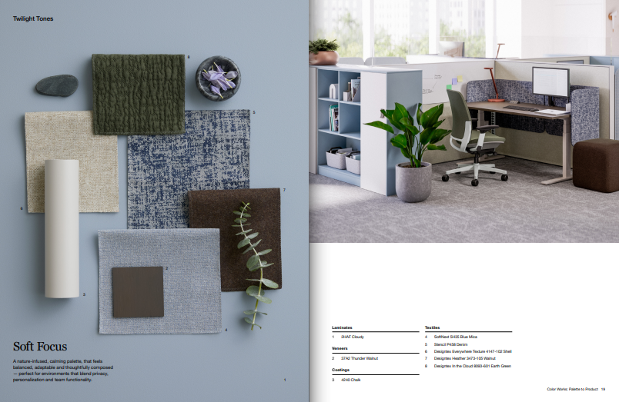
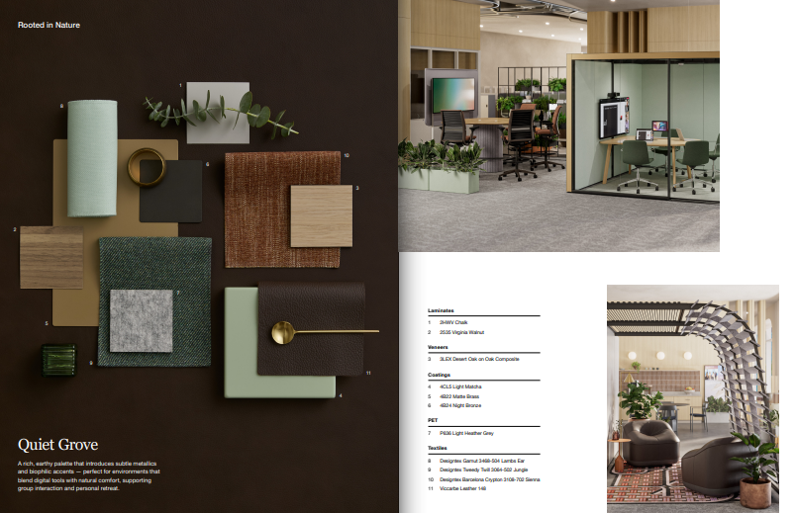
Physical Marketing Materials
The Inspiration Guide and the New & Notable Card Deck are available to order through Steelcase Marketing Resources.
Both tools feature the same applications but give you flexibility in how you use them.
Want to share everything? Present the Inspiration Guide.
Want to highlight specific palettes that best fit your customer or project? Bring a few cards from the Card Deck that best suit your needs.
Item number: 25-0000150
Item number: 25-0000148

Slide 22
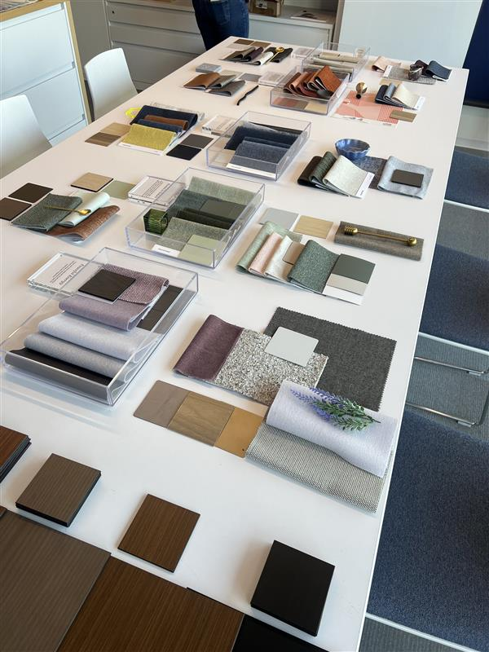
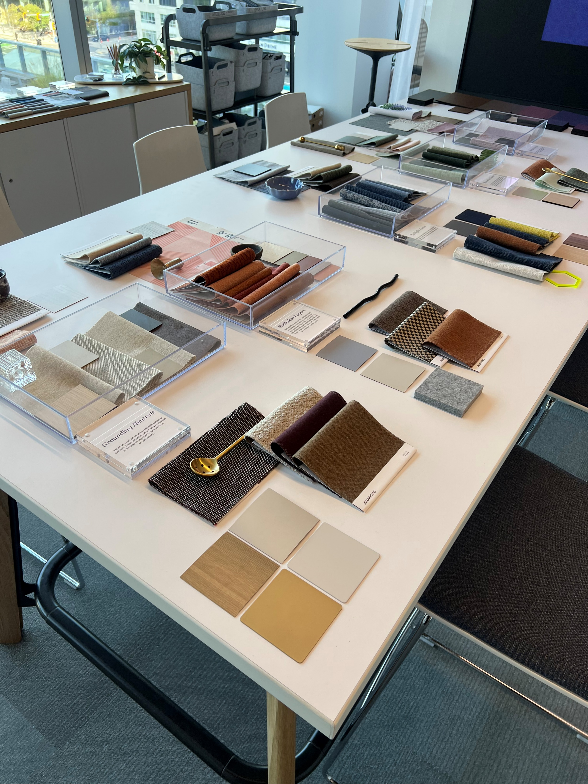
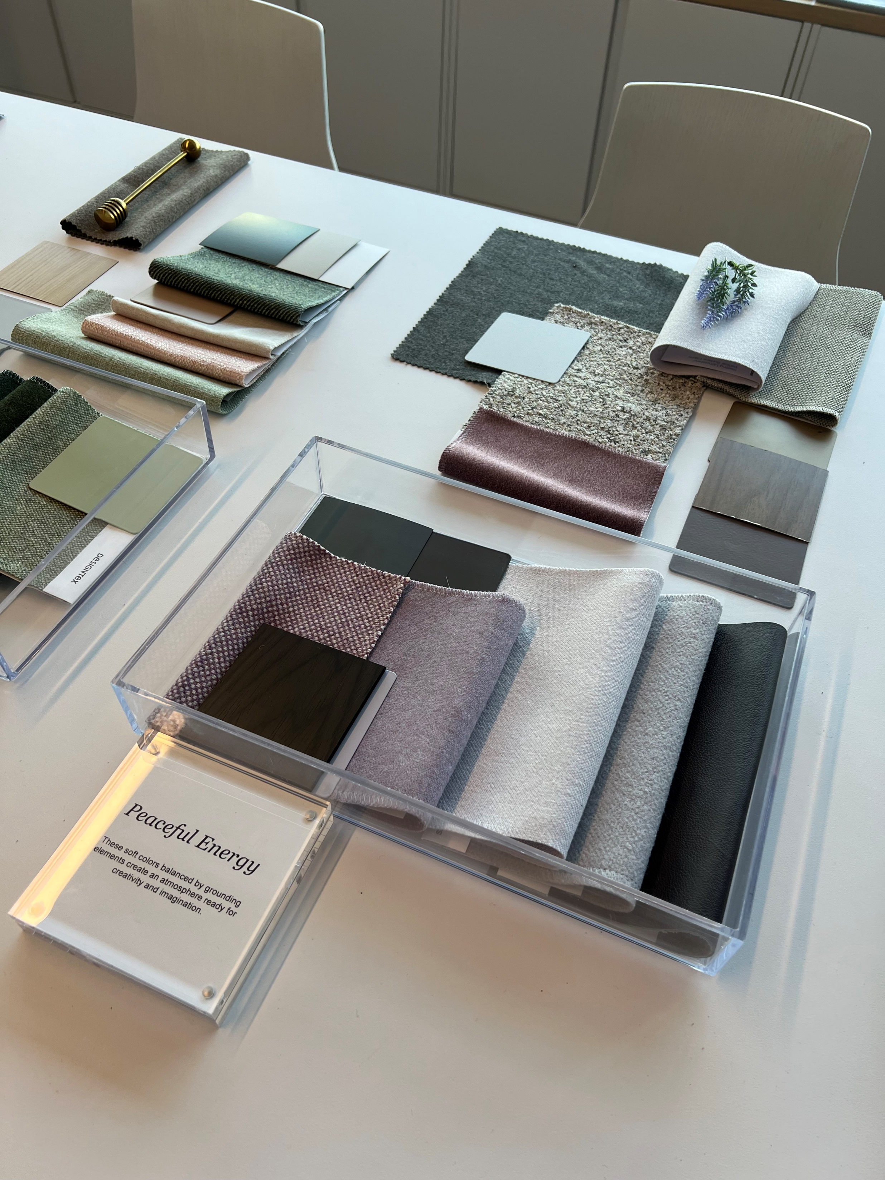
Tabletop Display Example

Slide 23


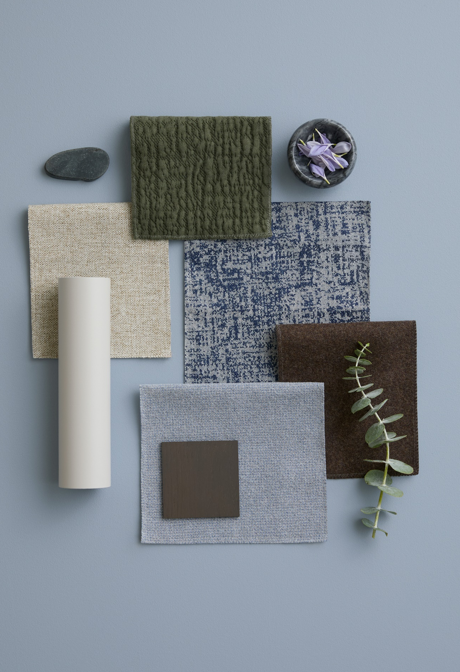
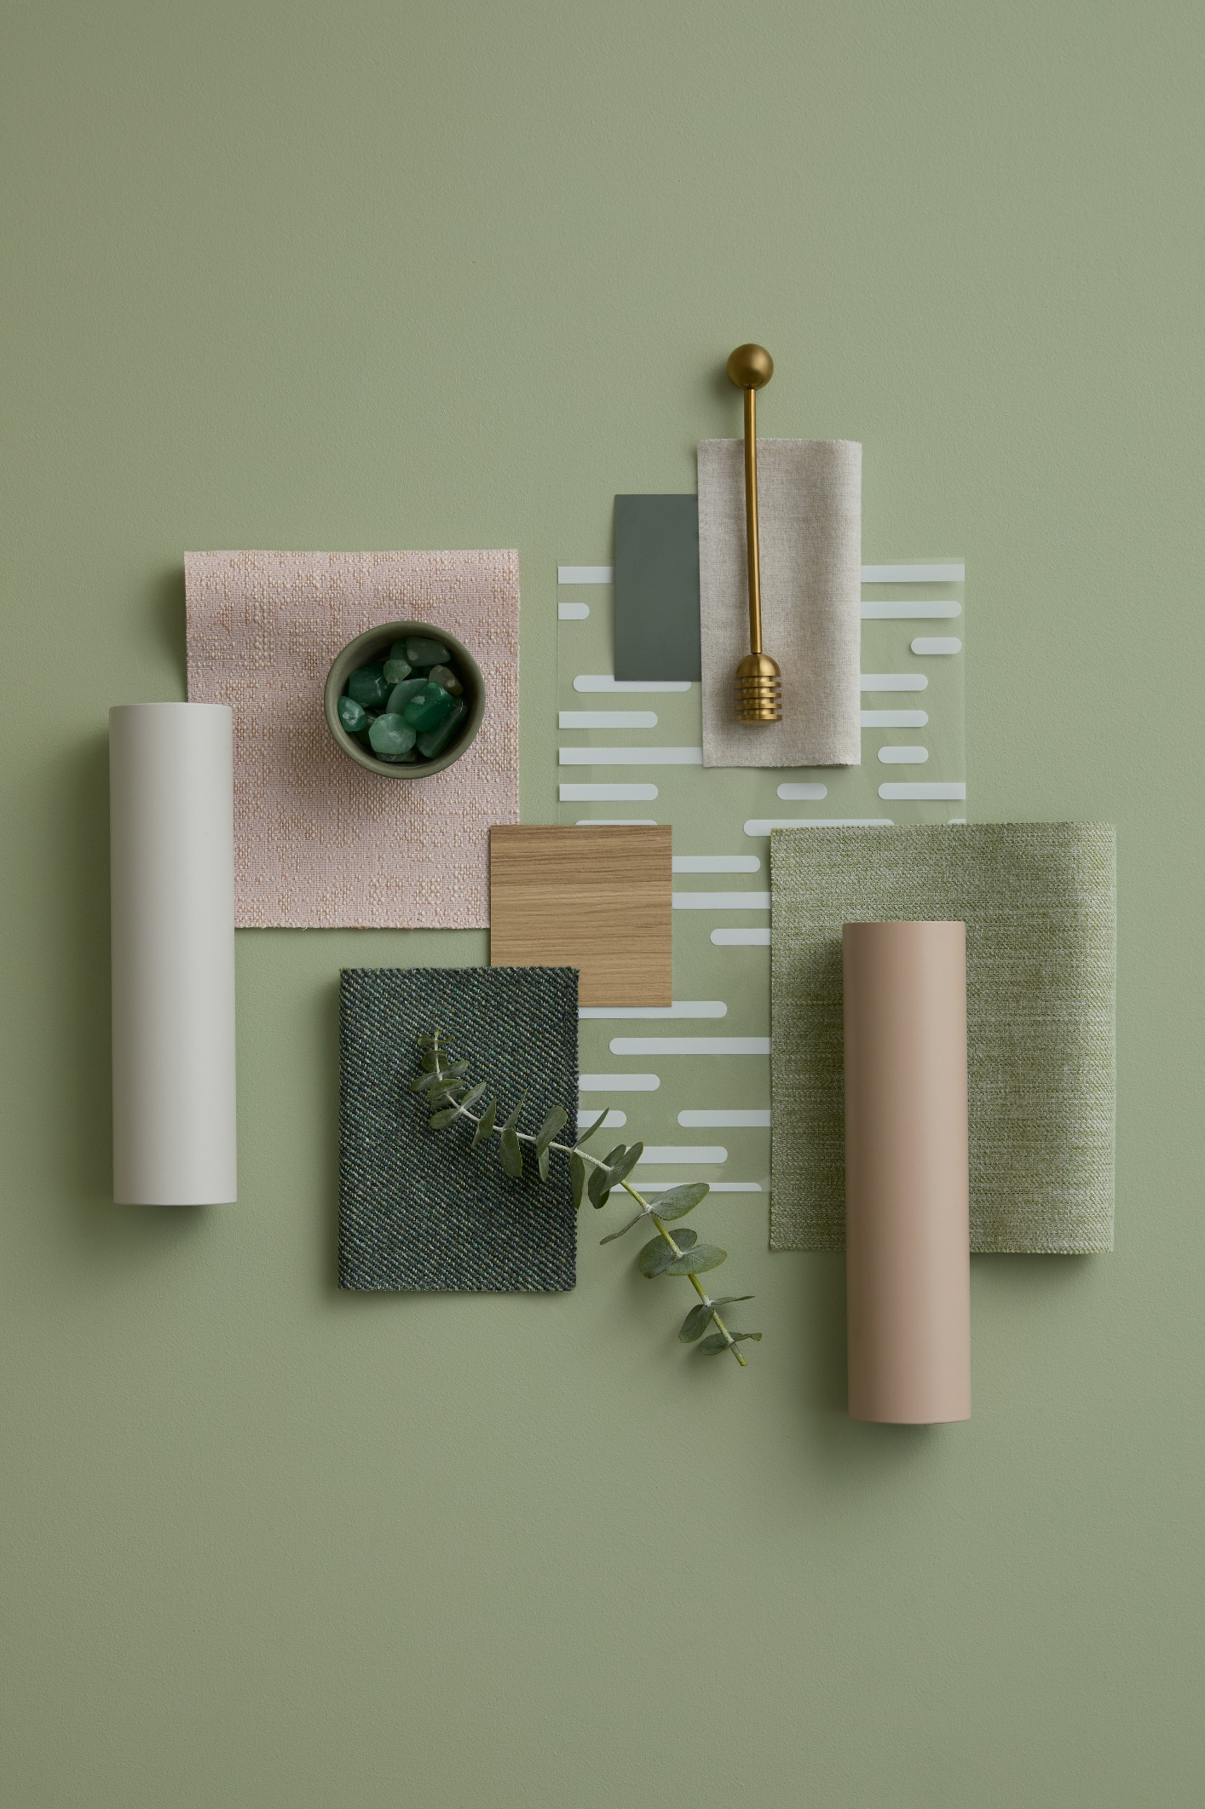

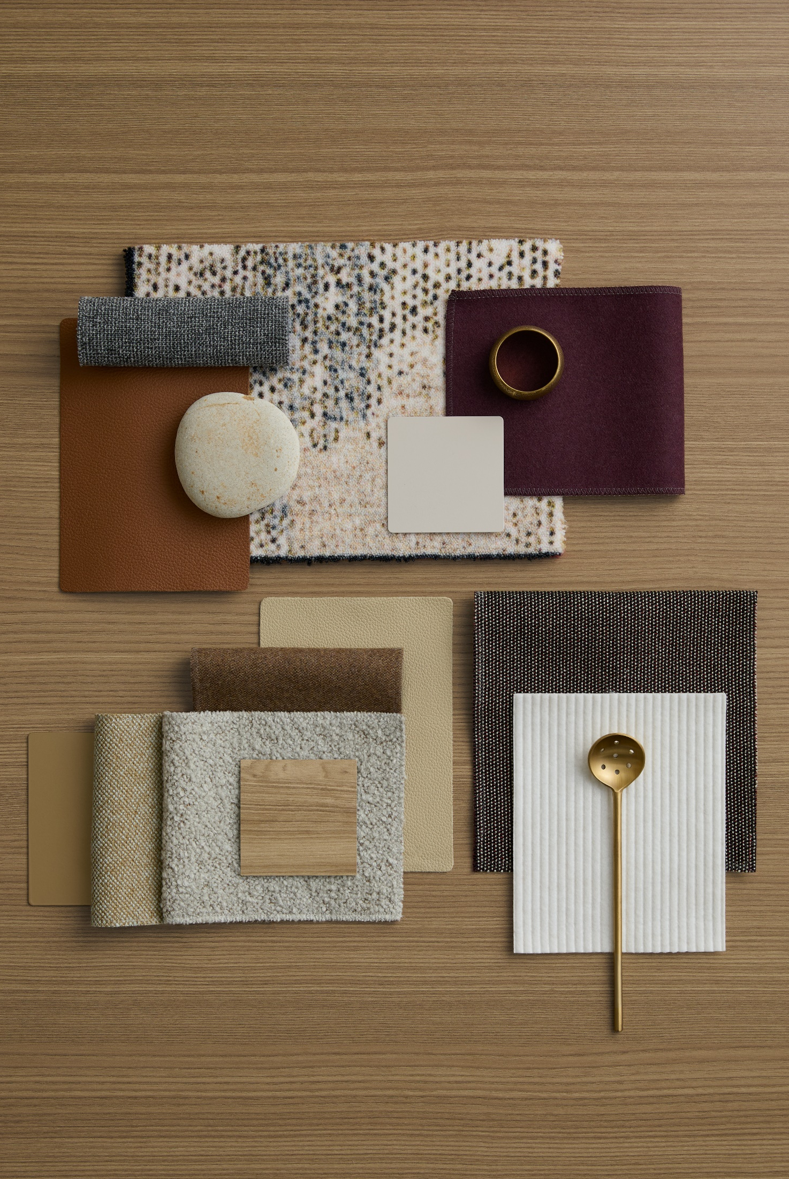



Palette Order
Connected Comfort
Quiet Shelter
Soft Focus
Curated Calm
Grounded Clarity
Display Setup Instructions:
Organize by Color Chapter: Begin by identifying the color chapters. These should be placed in a vertical line through the center of the display.
Pair Application Palettes: For each color chapter, place the corresponding surface material palettes on either side—left and right. These palettes should reflect the finishes and materials that complement the central color chapter.
Grounding Neutrals
Sunbaked Layers
Twilight Tones
Rooted in Nature
Peaceful Energy
Welcoming Focus
Soft Sync
Interactive Energy
Quiet Grove
Notes:
AU

Slide 24
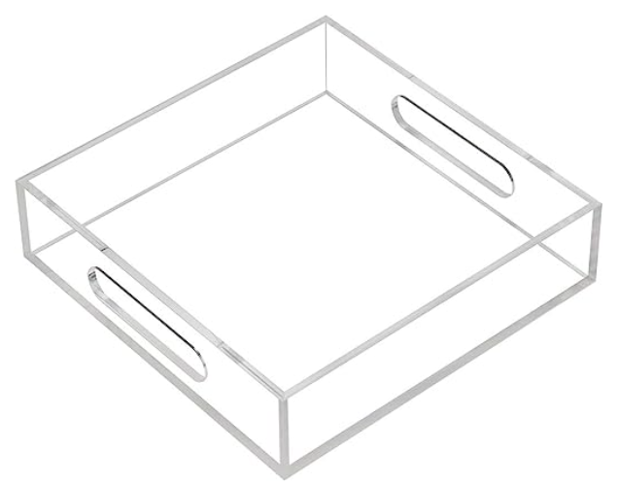
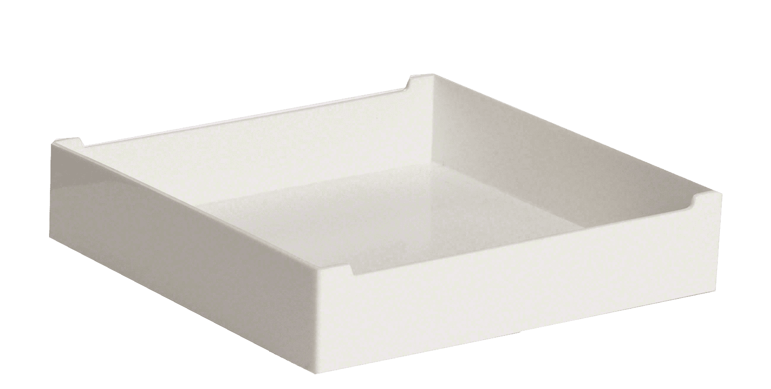
Palette Organization + Color Tray Recommendations
Group by Palette
Use one tray per palette to keep materials grouped and easy to reference. A clear acrylic 8“ x 8" tray can be ordered through Amazon. Steelcase SOTO Personal Boxes are another great option.
Follow a Consistent Layout
Arrange samples in a logical order—such as by application type (e.g., upholstery, laminate, paint) or by visual hierarchy (light to dark, warm to cool).
Label Clearly
Include a label or tag on each tray with the palette name or color chapter to avoid mix-ups.

Slide 25
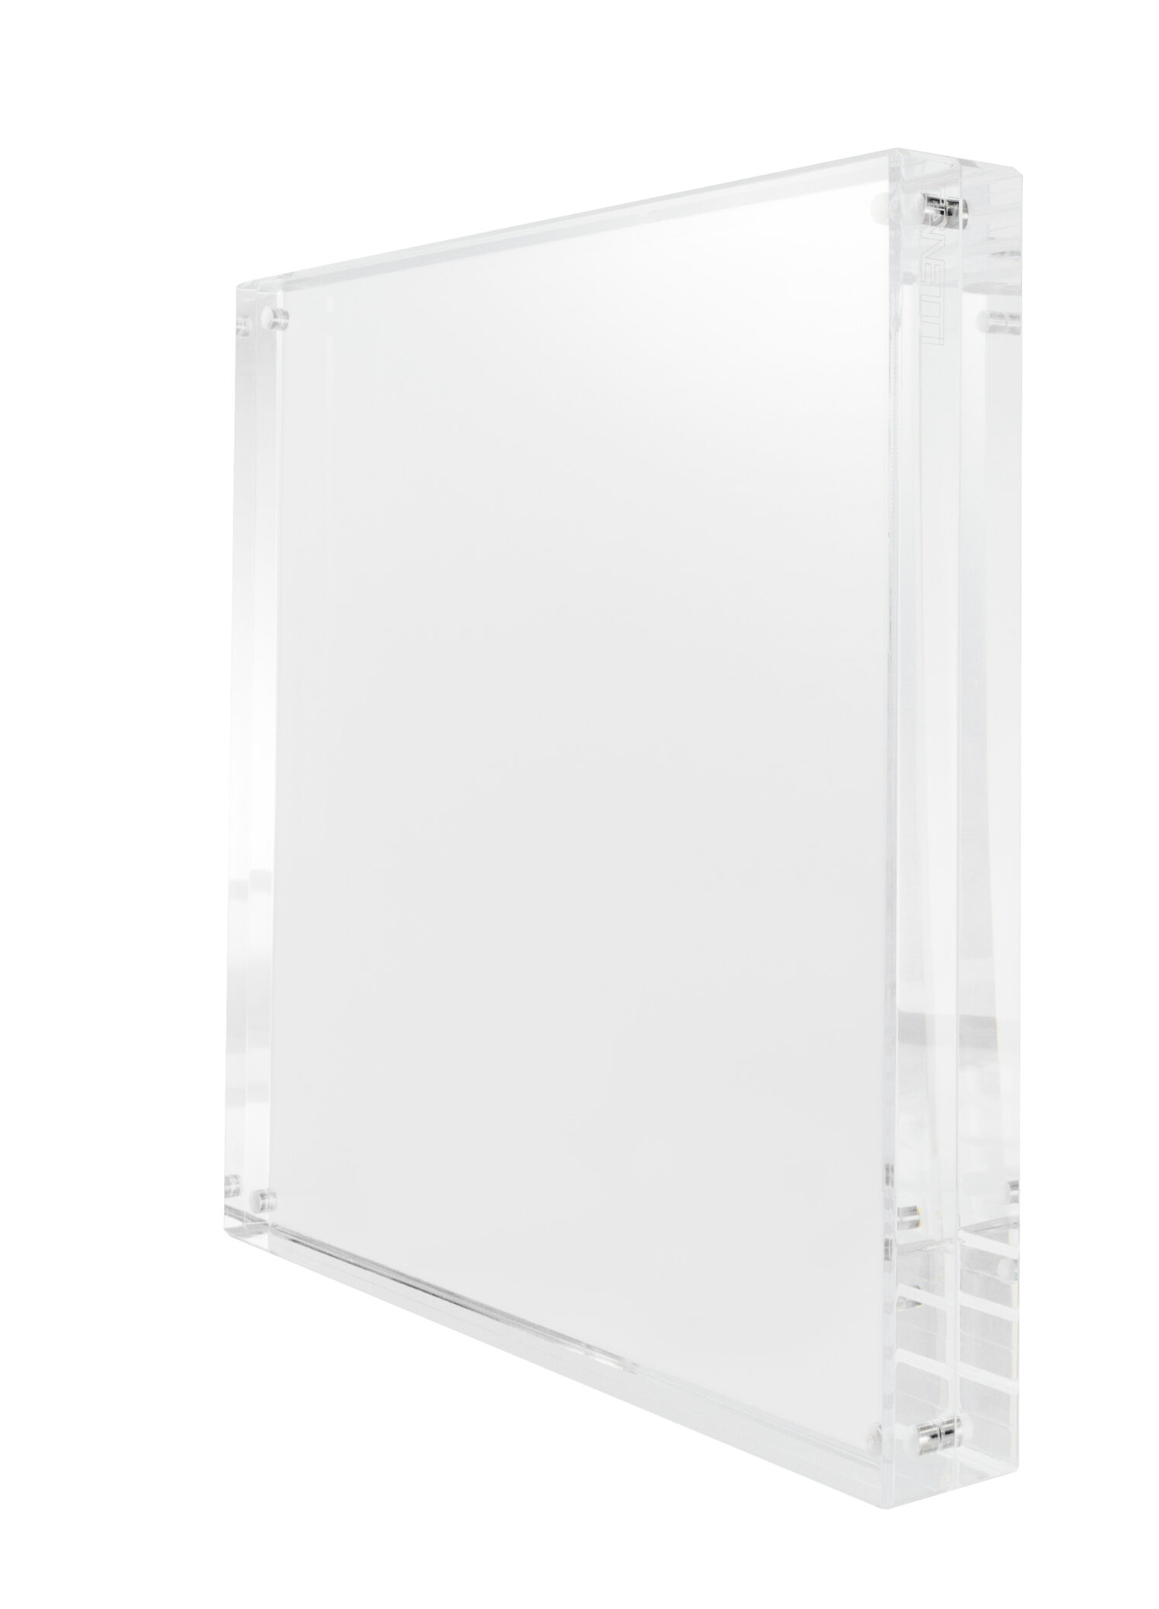
Labels
Create a label for each palette to ensure clear identification and easy reference.
Use clear acrylic magnetic frames to display the labels. These frames provide a clean, modern look and allow for easy updates or swaps.
Place the frame in front of or beside each tray so the label is visible without obstructing the samples.
Labels should include:
Palette name
Optional: brief description or color theme

Slide 26
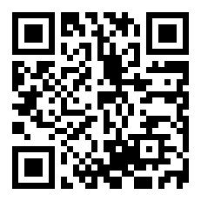
Material Type | Description | Where to Order
Laminate | 2HWV Chalk | Steelcase Marketing Resources
Laminate | Formica Natural Ash 8843 | Formica
Textile, Designtex | Designtex Cozy Texture 3063-101 Sand | Designtex
Textile, Designtex | Designtex Heather 3473-405 Midnight | Designtex
Textile, Designtex | Designtex Heather 3473-604 Concord | Designtex
Textile, Designtex | Designtex Woolish 3973-701 Pink Salt | Designtex
Laminate | 2HWV Chalk | Steelcase Marketing Resources
Leather | Café L211 Chocolate Mousse | Steelcase Marketing Resources
Paint | 4240 Chalk | Steelcase Marketing Resources
Paint | 4B22 Matte Brass | Steelcase Marketing Resources
Paint | 4B23 Burnished Bronze | Steelcase Marketing Resources
Paint | 7225 Sand | Steelcase Marketing Resources
Textile | Brisa BR04 Truffle | Steelcase Marketing Resources
Textile | Brisa BR30 Bone | Steelcase Marketing Resources
Textile | Dovetail 5H42 Sandstone | Steelcase Marketing Resources
Textile | Remx RE06 Linen Beige | Steelcase Marketing Resources
Textile | Stand In 5625 Powder | Steelcase Marketing Resources
Textile | Steelcut Trio TR03 Cassonade Beige | Steelcase Marketing Resources
Textile, Designtex | Designtex Lambert 3623-801 Fog | Designtex
Textile, Designtex | Designtex Micro Tweed 8250-302 Bear | Designtex
Textile, Designtex | Designtex Mohair Plus 3575-102 Pumice | Designtex
Veneer | 3LEX Desert Oak on Oak Composite | Steelcase Marketing Resources
Laminate | Formica 5786 Ashwood Oak | Formica
Laminate | 2HWV Chalk | Steelcase Marketing Resources
Laminate | 2TH2 Fawn Cypress | Steelcase Marketing Resources
Laminate | 2759 Warm White | Steelcase Marketing Resources
Leather | Antic Cuir Leather 142 | Viccarbe
Leather | Viccarbe Leather Anticcuir 126 | Viccarbe
Paint | 4B22 Matte Brass | Steelcase Marketing Resources
Paint | 4240 Chalk | Steelcase Marketing Resources
Rug | Moooi Crisp Dawn Awakens In Light | Mooi
Textile | Intermix Opaque KR16 Bronze | Steelcase Marketing Resources
Textile, Designtex | Designtex Arne 4141-804 Mid Grey | Designtex
Textile, Designtex | Designtex Heather 3473-604 Concord | Designtex
Textile, Designtex | Designtex Heather 3473-307 Walrus | Designtex
Textile, Designtex | Designtex Lambert 3623-801 Fog | Designtex
Textile, Designtex | Designtex Wannabe Rib 5622-106 Cream | Designtex
Textile, Designtex | Designtex Woolish 3973-101 Sandstone | Designtex
To access the Excel version of this list for all palettes, please refer to the Fall 2025 New + Notable Palettes Sample Ordering Guide by clicking the link or scanning the QR code below.
Connected Comfort
Grounding Neutrals
Welcoming Focus

Slide 27
To access the Excel version of this list for all palettes, please refer to the Fall 2025 New + Notable Palettes Sample Ordering Guide by clicking the link or scanning the QR code below.
Quiet Shelter
Material Type | Description | Where to Order
Laminate | 2HWV Chalk | Steelcase Marketing Resources
Laminate | 2HAF Cloudy | Steelcase Marketing Resources
Leather | Viccarbe Leather 148 | Viccarbe
PET | PC17 Flat Iron | Steelcase Marketing Resources
Textile, Designtex | Designtex Dovetail 8571-301 Nutmeg | Designtex
Textile, Designtex | Designtex Emblem 3068-101 Cobra | Designtex
Textile, Designtex | Designtex Helsinki Crypton 3105-105 Chocolate | Designtex
Laminate | Formica Natural Ash 8843 | Formica
Leather | Café L213 Chai | Steelcase Marketing Resources
Paint | 1ATG Rose Quartz | Steelcase Marketing Resources
Paint | 4B23 Burnished Bronze | Steelcase Marketing Resources
Paint | 4B25 Matte Copper | Steelcase Marketing Resources
Paint | 4CL6 Terra | Steelcase Marketing Resources
Paint | 4CL7 Sandstone | Steelcase Marketing Resources
Textile | Dovetail 5H44 Terra | Steelcase Marketing Resources
Textile | Dovetail 8571-301 Nutmeg | Steelcase Marketing Resources
Textile | SoftNext 5H37 Burnt Umber | Steelcase Marketing Resources
Textile, Designtex | Designtex Barcelona Crypton 3018-702 Sienna | Designtex
Textile, Designtex | Designtex Heather 3473-452 Rust | Designtex
Textile, Designtex | Designtex Helsinki Crypton 3105-105 Chocolate | Designtex
Textile, Designtex | Designtex In The Cloud 8093-302 Spice | Designtex
Textile, Designtex | Designtex Salsa 8150-401 Petal | Designtex
Laminate | 2730 Arctic White | Steelcase Marketing Resources
Laminate | 2TH2 Fawn Cypress | Steelcase Marketing Resources
Laminate | Formica 8843 Natural Ash | Formica
Plastic | 6697 Fog | Steelcase Marketing Resources
Textile | Billiard Multi Use 5H18 Teak | Steelcase Marketing Resources
Textile, Designtex | Designtex Custom Graphic Ribbon #E7CDB9 / #CB865F | Designtex
Textile, Designtex | Designtex Heather 3473-251 Champagne | Designtex
Textile, Designtex | Designtex Mateo 3895-402 Dark Blue | Designtex
Textile, Designtex | Designtex Micro Tweed 8250-754 Denim | Designtex
Sunbaked Layers
Soft Sync

Slide 28
Material Type | List of Samples | Where to Order
Laminate | 2HWV Chalk | Steelcase Marketing Resources
Laminate | 2HAF Cloudy | Steelcase Marketing Resources
Paint | 4240 Chalk | Steelcase Marketing Resources
Textile | SoftNext 5H35 Blue Mica | Steelcase Marketing Resources
Textile | Stencil P458 Denim | Steelcase Marketing Resources
Textile, Designtex | Designtex Everywhere Texture 4147-102 Shell | Designtex
Textile, Designtex | Designtex Heather 3473-105 Walnut | Designtex
Textile, Designtex | Designtex In the Cloud 8093-601 Earth Green | Designtex
Veneer | Veneer Thunder Walnut 37A2 | Steelcase Marketing Resources
Laminate | Formica Natural Ash 8843 | Formica
Laminate | Laminate Cloudy 2HAF | Steelcase Marketing Resources
Laminate | Laminate Satin Stone 24H3 | Steelcase Marketing Resources
Leather | Café L214 Blueberry Tart | Steelcase Marketing Resources
Paint | 4B26 Smoked Mica | Steelcase Marketing Resources
Plastic | 6336 Jazz | Steelcase Marketing Resources
Textile | Dovetail 5H50 Darkest Grey | Steelcase Marketing Resources
Textile | Intermix Baltic KR18 | Steelcase Marketing Resources
Textile | SoftNext Blue Mica 5H23 | Steelcase Marketing Resources
Textile | Stencil Denim P458 | Steelcase Marketing Resources
Textile, Designtex | Designtex Barcelona Crypton 3108-403 Midnight | Designtex
Textile, Designtex | Designtex Habitat 3069-801 Mineral | Designtex
Textile, Designtex | Designtex Heather 3473-407 Mid Blue | Designtex
Textile, Designtex | Designtex Micro Tweed 8250-757 Ballpoint | Designtex
Textile, Designtex | Designtex Road Trip 8408-402 Canal | Designtex
Textile, Designtex | Designtex Tweedy Twill 3064-802 Zebra | Designtex
Veneer | Veneer Thunder Walnut 37A2 | Steelcase Marketing Resources
Laminate | Formica 8843 Natural Ash | Formica
Laminate | 24H3 Satin Stone | Steelcase Marketing Resources
Laminate | 2535 Virginia Walnut | Steelcase Marketing Resources
Plastic | 6336 Jazz | Steelcase Marketing Resources
Textile | Intermix KR18 Baltic | Steelcase Marketing Resources
Textile | Stencil P464 Orchid | Steelcase Marketing Resources
Textile, Designtex | Designtex Barcelona Crypton 3108-403 Midnight | Designtex
Textile, Designtex | Designtex Dovetail 8571-301 Nutmeg | Designtex
Textile, Designtex | Designtex Everywhere Texture 4147-504 Loden | Designtex
Textile, Designtex | Designtex Road Trip 8408-402 Canal | Designtex
Textile, Designtex | Designtex Tiny Boucle 3926-201 Sunbeam | Designtex
To access the Excel version of this list for all palettes, please refer to the Fall 2025 New + Notable Palettes Sample Ordering Guide by clicking the link or scanning the QR code below.
Soft Focus
Twilight Tones
Interactive Energy

Slide 29
Curated Calm
Material Type | List of Samples | Where to Order
Custom Film | CDP Glass Stripes 06 | Designtex
Laminate | 2HWV Chalk | Steelcase Marketing Resources
Laminate | 2HAE Dark Olivine | Steelcase Marketing Resources
Laminate | 2TH2 Fawn Cypress | Steelcase Marketing Resources
Laminate | Formica 8843 Natural Ash | Formica
Paint | 4CL5 Light Matcha | Steelcase Marketing Resources
Paint | 4CL7 Sandstone | Steelcase Marketing Resources
Textile | Dovetail 5H45 Honeydew | Steelcase Marketing Resources
Textile, Designtex | Designtex Brushed Flannel 3797-101 Creme | Designtex
Textile, Designtex | Designtex Distressed Texture 3935-301 Peony | Designtex
Textile, Designtex | Designtex Tweedy Twill 3064-502 Jungle | Designtex
Laminate | 2HAE Dark Olivine | Steelcase Marketing Resources
Paint | 4CL1 Dark Olivine | Steelcase Marketing Resources
Paint | 4CL5 Light Matcha | Steelcase Marketing Resources
Textile | Brisa BR07 Sage | Steelcase Marketing Resources
Textile | Cogent: Connect 5SD2 Peacock | Steelcase Marketing Resources
Textile | Dovetail 5H45 Honeydew | Steelcase Marketing Resources
Textile | SoftNext 5H36 Jade | Steelcase Marketing Resources
Textile | Stand In Olivine | Steelcase Marketing Resources
Textile, Designtex | Designtex Heather 3473-505 Hunter | Designtex
Textile, Designtex | Designtex Heather 3473-506 Kelp | Designtex
Textile, Designtex | Designtex Micro Tweed 8250-601 Ivy | Designtex
Textile, Designtex | Designtex Spree 8221-701 Sprout | Designtex
Veneer | 3LAX Graphite on Oak Composite | Steelcase Marketing Resources
Laminate | 2HWV Chalk | Steelcase Marketing Resources
Laminate | 2535 Virginia Walnut | Steelcase Marketing Resources
Leather | Viccarbe Leather 148 | Viccarbe
Paint | 4CL5 Light Matcha | Steelcase Marketing Resources
Paint | 4B22 Matte Brass | Steelcase Marketing Resources
Paint | 4B24 Night Bronze | Steelcase Marketing Resources
PET | P636 Light Heather Grey | Steelcase Marketing Resources
Textile, Designtex | Designtex Barcelona Crypton 3108-702 Sienna | Designtex
Textile, Designtex | Designtex Gamut 3468-504 Lambs Ear | Designtex
Textile, Designtex | Designtex Tweedy Twill 3064-502 Jungle | Designtex
Veneer | 3LEX Desert Oak on Oak Composite | Steelcase Marketing Resources
To access the Excel version of this list for all palettes, please refer to the Fall 2025 New + Notable Palettes Sample Ordering Guide by clicking the link or scanning the QR code below.
Rooted in Nature
Quiet Grove

Slide 30
Grounded Clarity
Material Type | List of Samples | Where to Order
Laminate | 2535 Virginia Walnut | Steelcase Marketing Resources
Paint | 7243 Seagull | Steelcase Marketing Resources
Paint | 4CL8 Smokey Plum | Steelcase Marketing Resources
Paint | 4B22 Matte Brass | Steelcase Marketing Resources
Textile | Billiard Multi-Use 5H21 Gunmetal | Steelcase Marketing Resources
Textile | Intermix Opaque KR14 Seagull | Steelcase Marketing Resources
Textile | Dovetail 5H49 Aura | Steelcase Marketing Resources
Textile, Designtex | Designtex Lounge 3162-601 Lilac | Designtex
Textile, Designtex | Designtex Speckle Boucle 3014-101 Pebble | Designtex
Laminate | 24H4 Satin Mocha | Steelcase Marketing Resources
Leather | Café L209 Earl Grey | Steelcase Marketing Resources
Paint | 4238 Mocha | Steelcase Marketing Resources
Paint | 4CL3 Aura | Steelcase Marketing Resources
Paint | 4CL8 Smokey Plum | Steelcase Marketing Resources
Textile | Bo Peep 5G84 Gravel | Steelcase Marketing Resources
Textile | Brisa BR06 Ash | Steelcase Marketing Resources
Textile | Brisa BR12 Abyss | Steelcase Marketing Resources
Textile | Dovetail 4H59 Aura | Steelcase Marketing Resources
Textile, Designtex | Designtex Checker 8360-851 Orchid | Designtex
Textile, Designtex | Designtex Heather 3473-601 Thistle | Designtex
Textile, Designtex | Designtex Micro Tweek 8250-851 Thistle | Designtex
Textile, Designtex | Designtex Mirco Tweed 8250-852 Fig | Designtex
Textile, Designtex | Designtex Wonder 9501-907 | Designtex
Veneer | 3LHX Espresso on Walnut Composite | Steelcase Marketing Resources
To access the Excel version of this list for all palettes, please refer to the Fall 2025 New + Notable Palettes Sample Ordering Guide by clicking the link or scanning the QR code below.
Peaceful Energy

