Slide 1
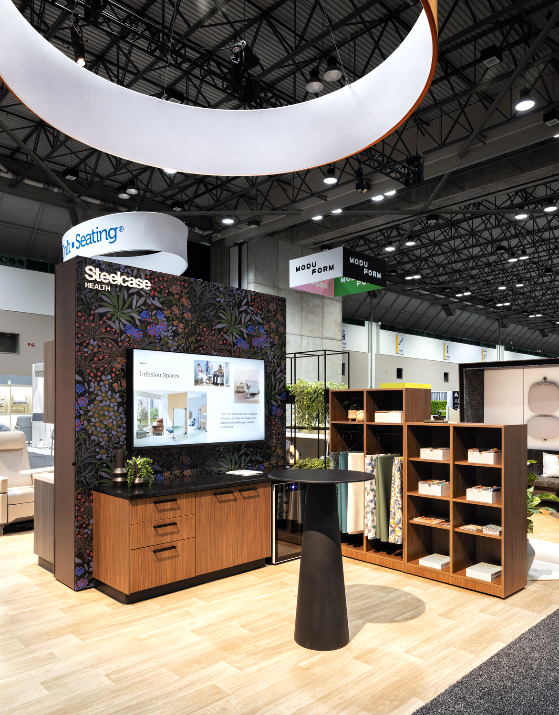
Healthcare Design Conference and Expo 2025
Post Event Summary

Slide 2
Dealer Community of Practice Meeting

Slide 3

Healthcare Dealer Community of Practice
October 25 - Circadia in Kansas City
100+ participants from 26 dealers joined Steelcase Healthcare sales and marketing teams
Focus: Collaboration, relationship building, and strategies to win in healthcare
Interested in future COP events or quarterly calls? Contact lwareck@steelcase.com

Slide 4
Healthcare Design Exhibit Presence Overview

Slide 5
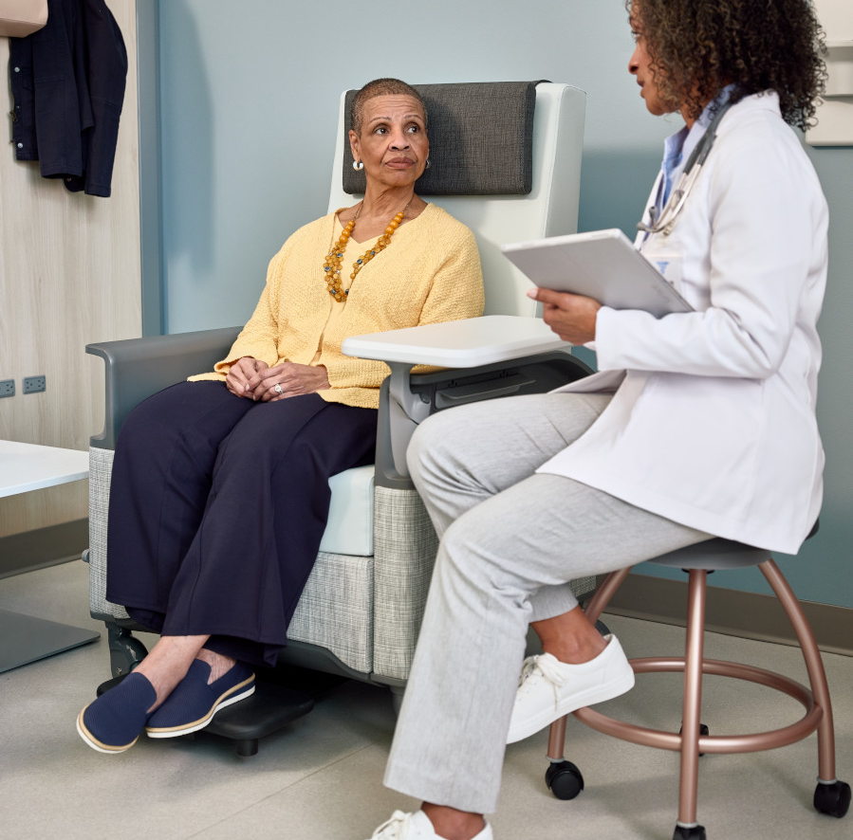
Supporting the Work of Care
At Steelcase Health, we believe that experiences of care begin with more caring spaces. More than ever, we understand that intentional, human-centered design can have a positive effect on healthcare experiences and outcomes for everyone involved. And ensuring better health outcomes for patients and families start with the belief that people whose jobs are about taking good care of others deserve spaces that take care of them, too.

Slide 6
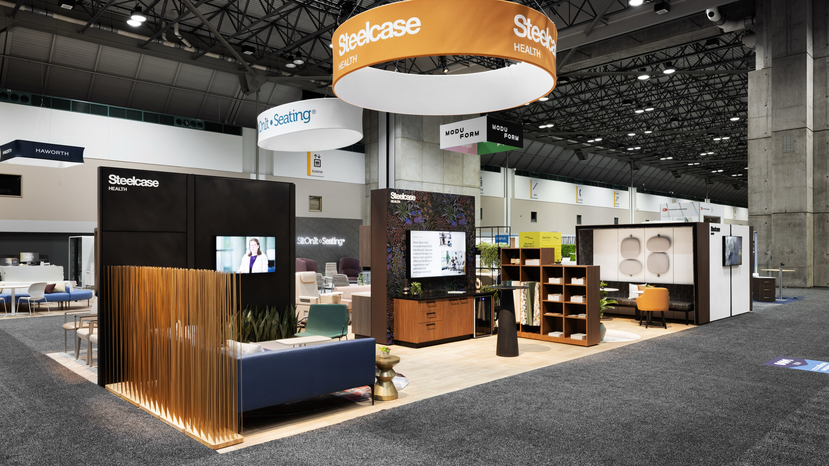

Slide 7
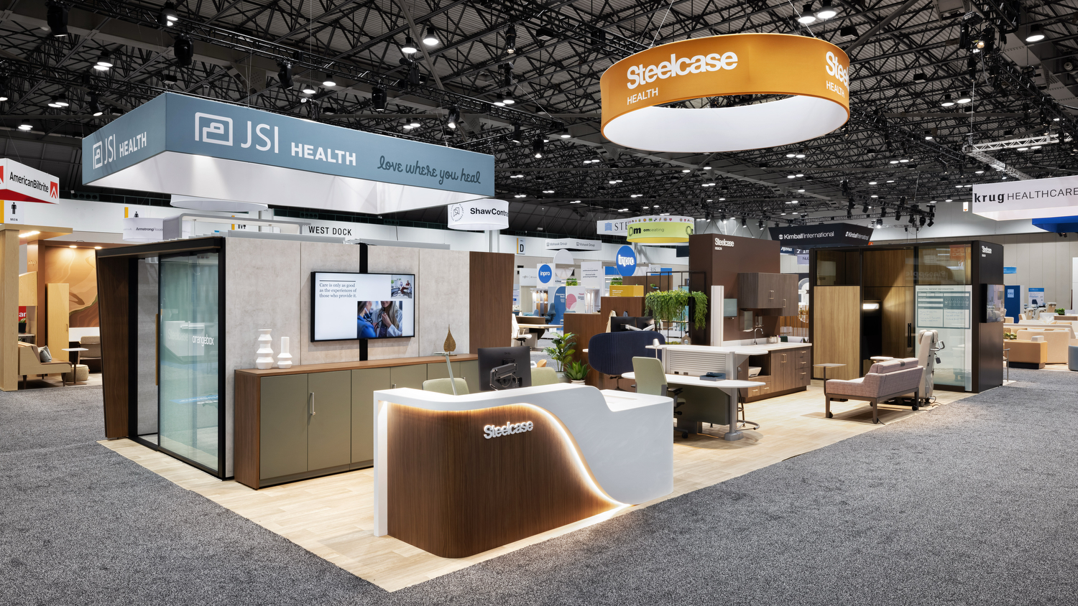

Slide 8
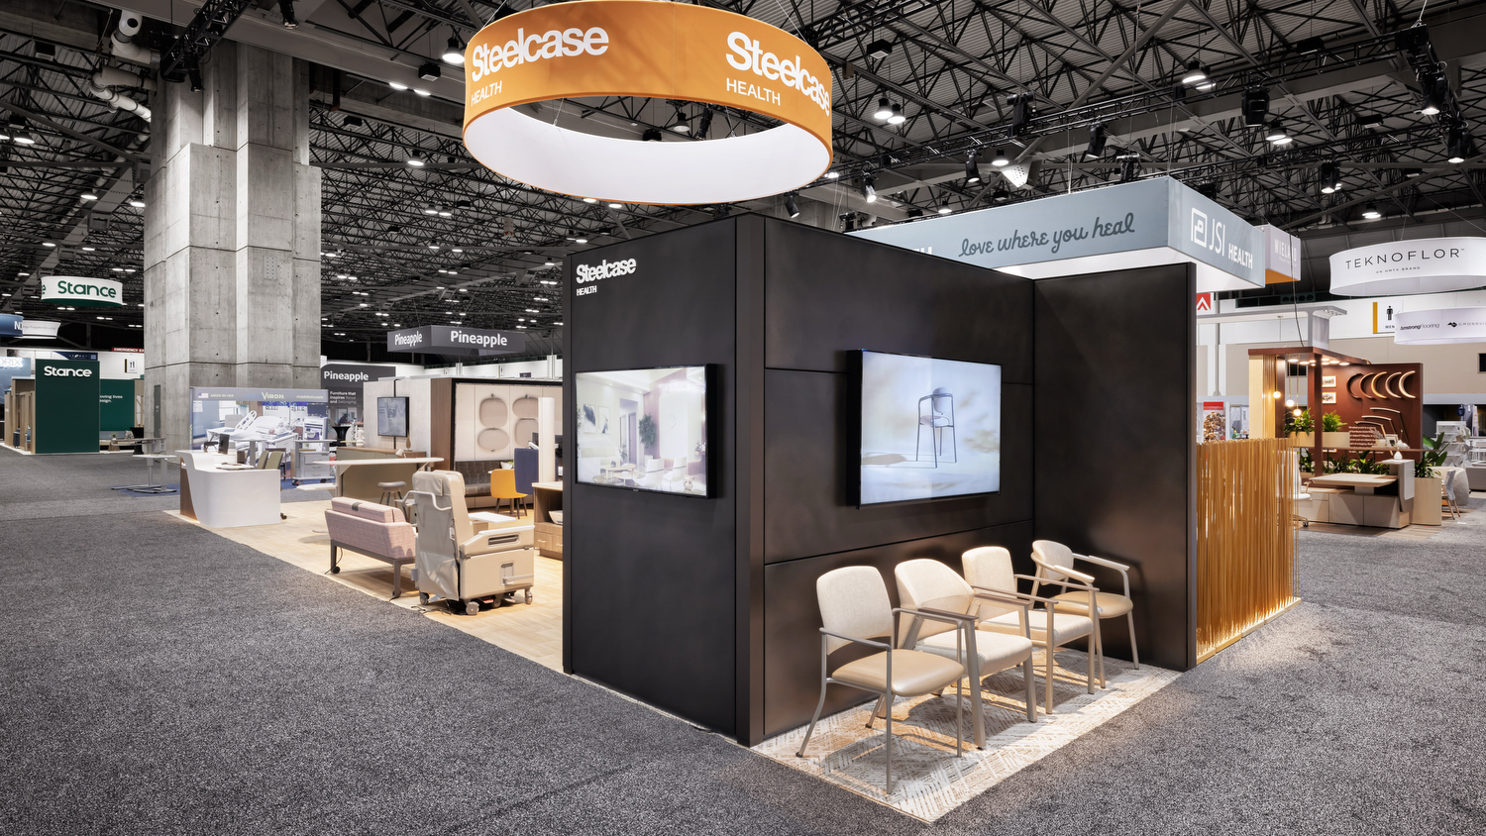

Slide 9
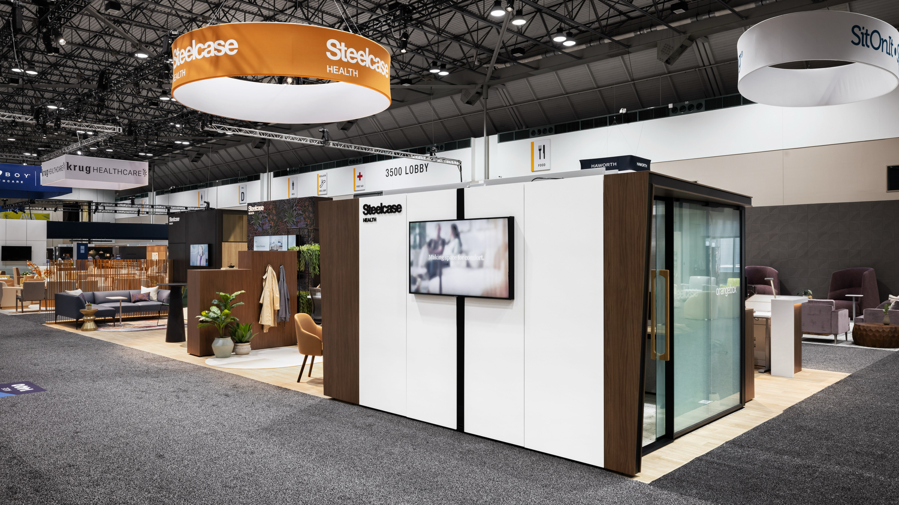

Slide 10
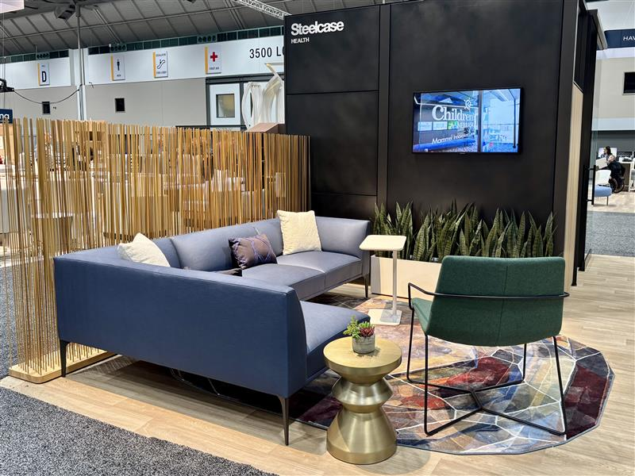
Featured Zone: Waiting
Highlights:
Inclusive seating with multiple widths creates a welcoming environment for all. Space is defined by Extremis Sticks, offering subtle boundaries while maintaining clear sightlines for staff. Biophilic elements, such as planters, add natural warmth and a welcoming atmosphere. The new West Elm Health Mesa Sectional introduces coated materials, highlighting our expanded textile options.
Featured Products:
West Elm Health Mesa Sectional
West Elm Health Slope Bariatric Chair
West Elm Nolan Table
Extremis Sticks
Moooi Rug
Coalesse Lagunitas Personal Table
Notes:
Specifications:
Extremis Sticks, Straight
150CM, Natural Wood
No extra weight
Base: Rubber
West Elm Mesa Lounge, Left Hand Chaise
Inner/Outer Upholstery: Designtex- 3809 Rise- 404 True Blue
Smooth Paint: Antique Bronze
Regard Planters, 11”D X 33”W
Paint: 4242 Milk Smooth
No shelf bracket
Moooi Rug, Crystal Brown
Soft Yard
West Elm Health Bariatric Slope Chair With Arms, Metal Legs
Back/ Seat: Designtex- 4147 Everywhere Texture- 511 Spruce
Base Finish: 4B29 Cast Iron
With Arms
Without Seam
West Elm Nolan Side Table, 14”W X 14”D X 17”H
Finish: Burnished Brass

Slide 11
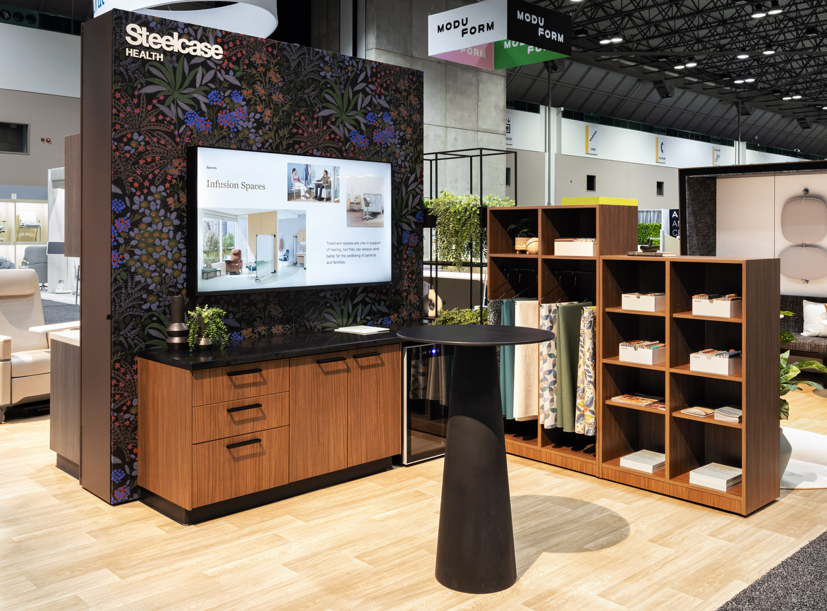
Featured Zone: Hospitality and Surface Materials
Highlights:
Convey Casework brings flexibility and a hospitality-inspired feel to healthcare spaces. Its modular design creates welcoming environments for patients and visitors while meeting clinical requirements. Warm finishes and thoughtful details add comfort, and Designtex wall coverings integrate biophilic elements to enhance a warm, inviting atmosphere.
Featured Products:
Convey Modular Casework
Moooi Container Table
WorkValet Storage
Designtex Wall Covering
Designtex Fabrics
Notes:
Specifications:
Moooi Container Table
Size: 70D Container Round
Top Finish HPL Black
Bar Height
Classic Foot
No Bodhi
Convey, Doors/Drawers
23”D X 32.5”H X 24”W
Case Finish: Walnut Heights 2TH7
Solid Surface: Corian Grade C, Deep Night Sky
No Back Splash
Customer Supplied Pull: Doug Mockett DP183 Series Rectangle Drawer Pull, Matte Black
WorkValet Locker Double Wide 2 Door
Parametric
Depth: 18.875
Width 36”W
Height: 67.3125
Case Finish: Walnut Heights 2TH7
No Door, No Hinge, Full Front, No Lock, No Pull, With Coat Rod, No Back Panel
WorkValet Locker Double Wide 4 Door
Parametric
Depth: 18.875
Width 36”W
Height: 54.81250
Case Finish: Walnut Heights 2TH7
No Door, No Hinge, Full Front, No Lock, No Pull, One Adjustable Shelf, No Hook, No Back Panel
Designtex Digital Studio, Wallcovering
Pattern: Liliana

Slide 12
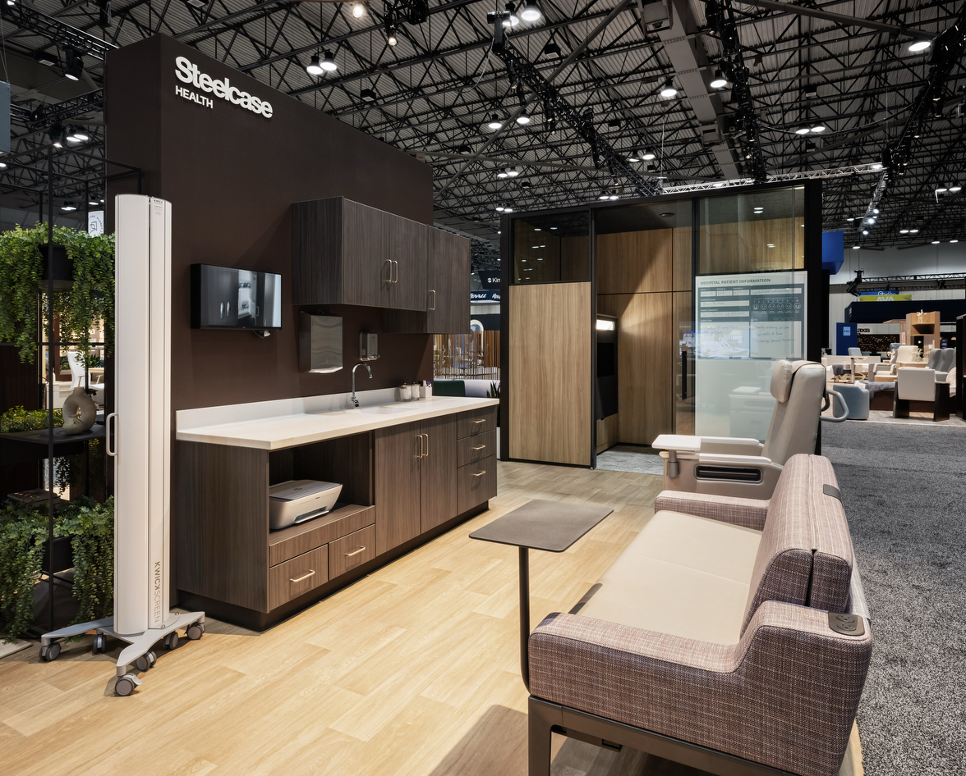
Featured Zone: Patient Care
Highlights: Reducing burnout and turnover begins with improving the experience of clinicians and staff. The built environment supports engagement and seamless collaboration through flexible spaces, comfortable furniture, and integrated technology. Polyvision’s patient board offers a hygienic, customizable surface, while Convey’s rail system adapts over time with lighting and storage for organized care. The surround sleeper maximizes space and comfort for families, with integrated power and mobile tablets for convenience and connection.
Featured Products:
Convey Modular Casework
Surround Sleeper
Empath Recliner
Polyvison Splash Surface + Patient Board
Kwickscreen Pro
Notes:
Specifications:
KwickScreen Pro
Height- 190CM
Print: White Opaque
Stock Artwork: Botanical Print BOT05 Lavender
Surround Lounge, 66” W
Back width: 55”
Softer seat
With sleep surface
Frame: 4238 Mocha
Back/ Arms: Designtex- Wayside 3062- Mulberry 601
Seat: Designtex- Glimmer 3006, Enoki 101
Short Left + Right Arm
Right Arm, 2 Power
2 front locking casters + 2 no lock rear casters
With tablet rail
Surround Tablet
Tablet Finish: 6527 Merle
Tablet Arm Finish: 7360 Merle
Empath Recliner, 23”W
Trendelenburg
Fully Upholstered, LSF folding arm
Back/Seat/Arms/Pillow Finish: Designtex- Glimmer 3006, Enoki 101
Arm Cap: *Special, Corian- Glacier White
Rounded corner
Softer seat
Right facing table
Dual recline
With directional steering
With push bar
With IV pole holder
No drainage bag
With heat and massage
With pull-out footrest
Convey Modular Casework, Wall Suspended
Upper Cabinets, 15”D, 24”W X 30”H, 24”H X 35”W
D Pull: 9211 Nickel
Base Cabinets- 24”D, 32.5”H X 24”W (drawer), 32.5”H X 30”H (printer), 32.5”H X 36”W (sink)
D Pull: 9211 Nickel
Base/ Upper Cabinets/ End Conditions:
2HSN: Storm Noce
With back splash
Sink 8252, Solid Surface 2973 Linen
Polyvision, Everwall Skin
37”W X 76”H
Substrate: Ceramic Steel
Graphic: Brush Stroke + Patient Board
Color: Sea Salt

Slide 13
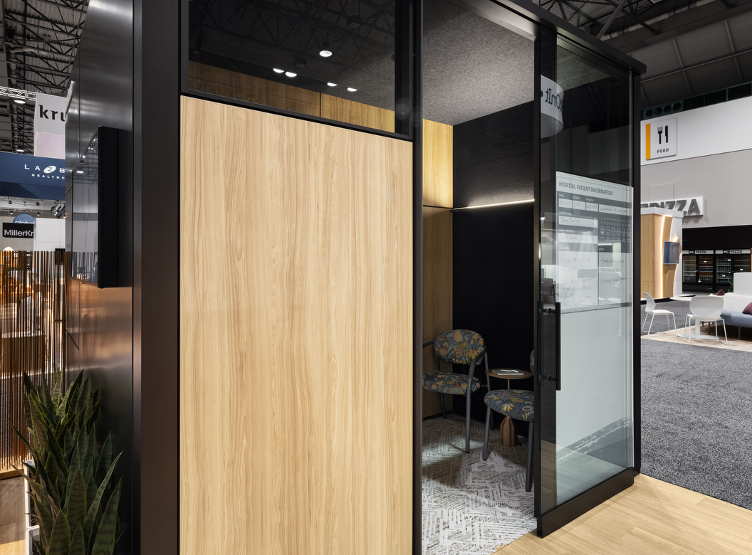
Featured Zone: Ocular View
Zone Details:
Ocular View, a collaboration between Steelcase and Logitech, delivers lifelike, immersive virtual interactions for patients and physicians. Everwall modular walls provide visual and acoustic privacy with a lightweight, adaptable frame that ensures ADA accessibility. Completing the thoughtful design are the Viccarbe Burin Table for personal items and supportive Radia Seating for comfort.
Featured Products:
Ocular View
Radia chairs
Viccarbe Burin Table
Everwall Modular Wall System
Notes:
Specifications:
Radia Chair, Armless, 21” W
Seat/Back: Designtex, Blossom 9416- Charcoal 151
Frame: 4B26 Smoked Mica
Radia Chair, With Arms, 21” W
Seat/Back: Designtex, Blossom 9416- Charcoal 151
Arm Cap: 6527 Merle, Contour
Frame: 4B26 Smoked Mica
Viccarbe Burin Table, 14”D X 14”W X 22”H
Color: Bronze
Everwall
Trim, Cornice, Junctions, Paint: 4B24 Night Bronze
Skins: Designtex- J278 Hush- 810 Onyx, 1ATT Cast Shadow, 2TH2 Fawn Cypress
Door Frame, Slider, Single- 40” W X 108” H, Right hand
Door Hardware: 4710 Low Gloss Black, push/pull handle
Ocular View Digital Counterpart 53”
Laminate: 2TH2 Fawn Cypress
Expressed Toe Kick

Slide 14
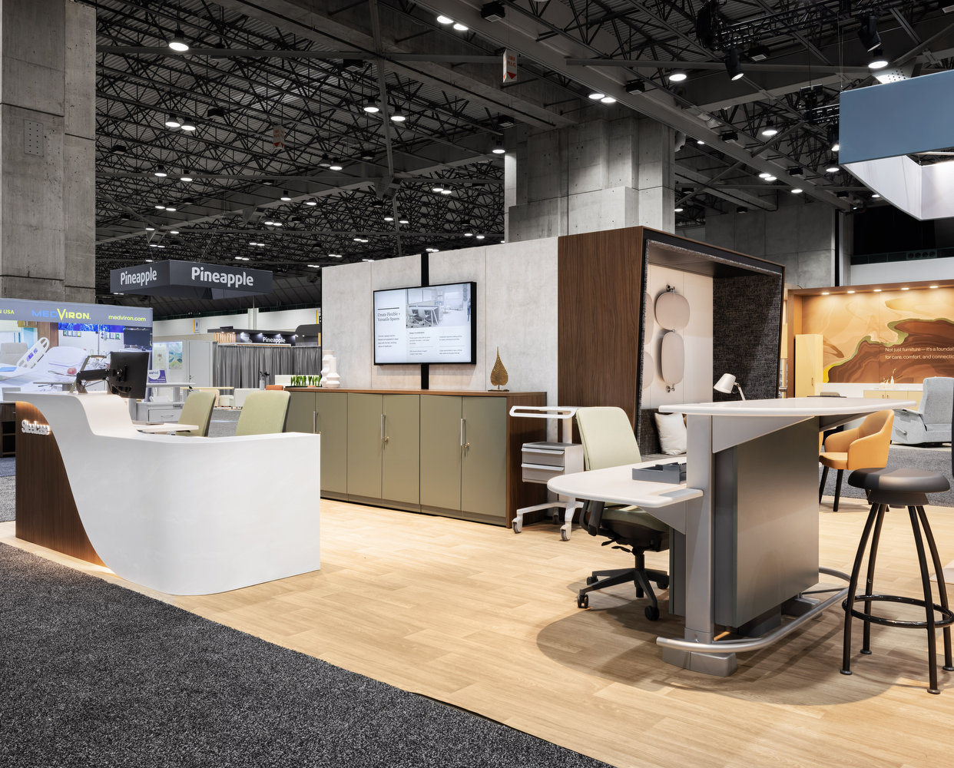
Featured Zone: Clinician Work
Highlights: Clinicians need ergonomic, flexible tools to stay focused despite interruptions and inefficiencies. This nurse station delivers a custom millwork look with modular adaptability. Integrated emergency power enhances functionality. Height-adjustable desks, monitor arms, and task lighting offer comfort and control. Pocket carts support mobility, while the Sync workstation with footrest promotes posture adjustments. ADA-accessible counters guide patients intuitively to staff.
Featured Products:
Montage Panels + E-Power Specials
Third-Party Millwork Façade
Verge Stool
Sync Workstation
Amia Task Seating
Universal Storage + File Surround
Universal Surfaces
Migration Height Adjustable Desk
Pocket Cart
Notes:
Specifications:
Verge Stool, 4 Leg Base, 31”H
Frame: 4B20 Obsidian
Sync, Double Sided Base 72”W, 42”H Upper, 28”H Lower
Tile/ Laminate Edge: 2HAE Dark Olivine
Frame: Platinum Metallic
Surface: Corian Price Group C- Venaro White
Amia Task Seating, Sewn
Upholstery: Designtex- Press 8000- Grove 652
Height width pivot depth arms
Plastic: 6527 Merle
Soft casters
Amia Task Seating, Sewn, Upholstered Back
Upholstery: Designtex- Press 8000- Lichen 651
Height width pivot depth arms
Plastic: 6527 Merle
Soft casters
Montage Panels
Painted Skins: 4242 Milk Smooth
Junctions/ Trim/ Base: 4242 Milk Smooth
Receptacles: 6009 Arctic White
*Panels to accommodate E-Power specials (special frame, tile, + power components)
StudioCraft Façade, Millwork to Modular Solution
Solid Surface Group C- Venaro White
Wilsonart Walnut Heights Laminate
Migration Height Adjustable Desk, 2 Stage, 23”D X 40”W
T-Leg
Top Surface: 24h1- Satin White
Edge Finish: 6009 Arctic White
Base Finish: 4799 Platinum Metallic
Square corner, rectangle column, no overhang, no cable tray
Cable Riser: 4799 Platinum Metallic
Chain Finish: 6053 Seagull
Universal Worksurface, 24”D X 42”W
Top Surface: 24H1 Satin White
Edge Finish- 6009 Arctic White
No power access
No scallop
No grommet
½” cord drop
Dash Mini Task Light
C-clamp
4CL1 Dark Olivine
LED Intro Single Arm Task Light
Finish: 4142 Platinum Gloss
Universal File Surround, 18”D X 108”W X 40”H
Top/ End Panel Finish: 2TH7 Walnut Heights
Edge Finish: 6T07 Walnut Heights
Long Grain
No back panel
Universal Storage, 18”D X 36”W X 40”H
Proud Steel Front
Paint: 4CL1 Dark Olivine
Key Random
No Top
Bar Pull: Silver
CF Series Intro Monitor Arm
Paint: 7018 Pewter
C-clamp
CF Plus Monitor Arm
Paint: 7018 Pewter
Slatwall Bracket
Pocket Cart, 22”W X 22 ½” D, Adjustable Height, 2 Bin Unit
Finish: 7243 Seagull

Slide 15
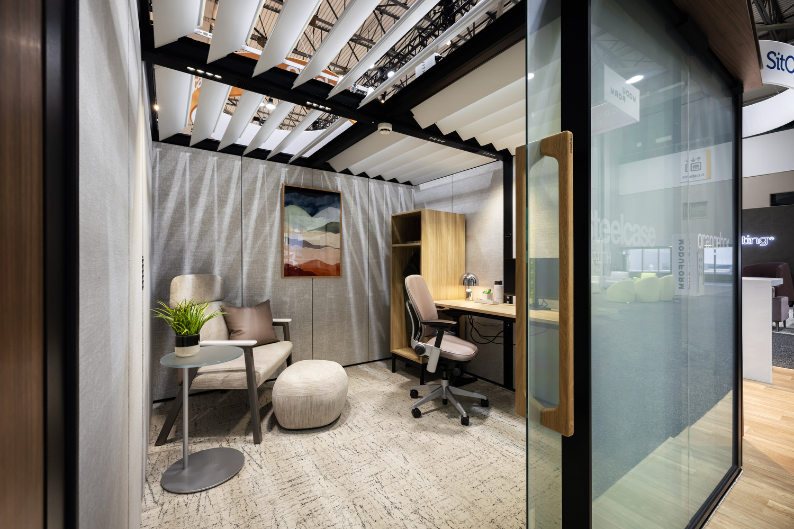
Featured Zone: Quiet Respite
Zone Details:
Clinicians need spaces that support quick recovery from stress. Campers & Dens offer flexible zones for rest, focus, or collaboration, with varying levels of privacy and control. Features like Vitrm (KwickSwitch) for instant privacy, Embold seating with ottomans, adjustable desks, and personal storage help create restorative environments tailored to clinician needs..
Featured Products:
Embold Bariatric Chair
Coalesse Jean Nouvel Ottoman
WorkValet
Leap Chair
West Elm Work Sutton Height Adjustable Desk
Orangebox Capers + Dens
Vitrm (KwickSwitch)
CF Series Intro Single Monitor Arm
Tom Dixon Bell Desk Lamp
Notes:
Specifications:
Leap Chair, Upholstered, Sewn
Plastic Finish: 6249 Platinum Solid
Upholstery: Designtex- Rise 3809- Rutabaga 602
Hard Casters
With Lumbar
No Headrest
CF Series Intro Single Monitor Arm
Arm Finish: 0835 Black
C-Clamp Bracket
Jean Nouvel Ottoman
Upholstery: Designtex- Mexico City Crypton 3107- Pewter 801
Desktop Powerstrip
Power Configuration: 2 Power, 2 USB C 45W
Power Finish: 6000 Black
Power Mount: C-Clamp
Utility Power: 1 Utility, 1 Female Plug, Tray
Standard Nema 5-15 3 Prong
6’ Standard Cord, Black
Embold Chair, Single Seat, Bariatric, 32”W
Seat Finish/ Inner Back: Designtex- Mexico City Crypton 3107- Pewter 801
Outer Back: Upholstery: Designtex- Rise 3809- Rutabaga 602
Frame Finish: 4238 Mocha
Arm Cap: Overhang
Arm Cap Finish: Grade A Glacier White Corian
With high back
Bracket Finish: 7360 Merle
Work Valet, Leg Base
Width: 20.12500
Depth: 24”
Base Finish: Black
Work Valet, Single Locker, 1 Wide Door, Leg Base
Parametric
Depth: 24”
Width: 20.12500
Height: 66.50
Case Finish: 2TH2 Fawn Cypress
No door, no hinge, no lock, no pull, no adjustable shelf
Interior Configuration: with coat hooks
No back panel
*Exploring sloped top special
Bell Rechargeable Desk Lamp
Color: Silver
West Elm Sutton, Height Adjustable Desk, Extended, 58”W X 23”D
Top Surface/ Edge Finish: 2TH2 Fawn Cypress
Square corner
Foot/ Leg Ring Finish: 4710 Low Gloss Black
With cable tray
With active touch controller
No under worksurface power
Campers + Dens
Interior Skin Upholstery: Stencil- Orchid P464
Cabin Skin Upholstery: Stencil- Cracked Pepper P457
Exterior Skin Laminate: Cement 2UH4, Satin White 2UH1
Cabin Laminate: Walnut Heights 2TH7
Kink Laminate: Walnut Heights 2TH7
Pillow Upholstery:
Designtex- Rise 3809- Rutabaga 602

Slide 16
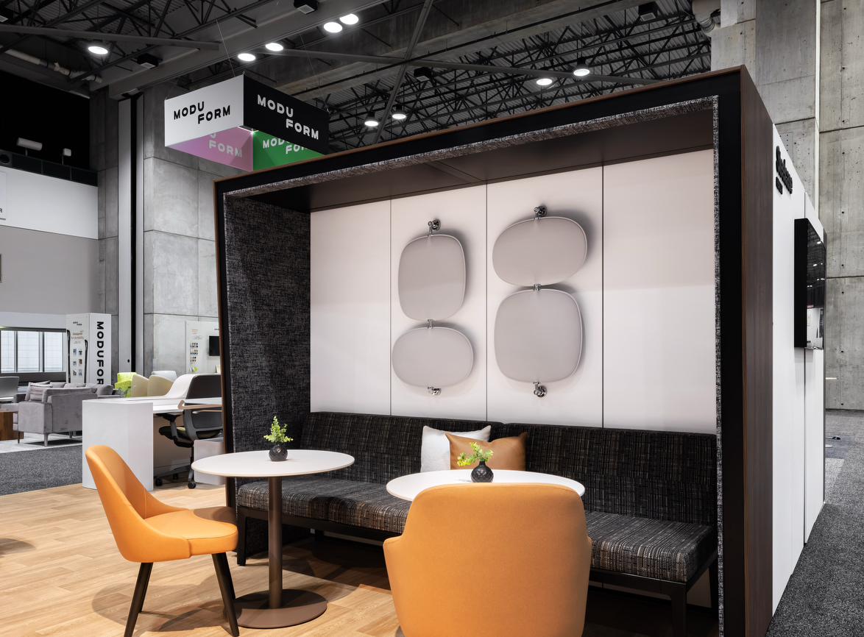
Featured Zone: Social Respite
Highlights:
Campers + Dens Cabin provides a flexible touchdown space near care zones, supporting rest and workflow. Regard seating with Montara tables and West Elm Health Sterling chairs creates a welcoming, clinically relevant spot to pause or connect. SnowSound Perline Wall Panels improve acoustic comfort for a more restorative experience.
Featured Products:
West Elm Health Collection Sterling Chairs
Regard Lounge
Coalesse Montara Tables
Orangebox Campers + Dens
SnowSound Wall Panels
Notes:
Specifications:
Coalesse Montara Work-Height Table, Round, 30”W X 28 ½”H
Base Finish: 4238 Mocha
Top Finish 24H1 Satin White
Edge Finish: 6009 Arctic White
Regard Single Sided Unit, 27 ½”D X 55”W
Frame: 7207 Black
Back/ Seat Upholstery: Designtex- Jumper 3878- Finch 803
No screen attachment
Regard Single Sided Unit, 27 ½”D X 44”W
Frame: 7207 Black
Back/ Seat Upholstery: Designtex- Jumper 3878- Finch 803
No screen attachment
West Elm Health Collection, Sterling Chair, Metal Leg W/ Arms
Non-contrasting color scheme
Back/Seat Finish: Designtex- Ethos 8060- Umber 301
Base Finish: 7207 Black
West Elm Work Sterling Chair, Guest 4 Legs, Armless
Non-contrasting
Back/Seat Finish: Designtex- Ethos 8060- Umber 301
Wood leg: Rift Cut Low Sheen VP03 Black Oak
*Non-health version for a side-by-side customer comparison
Pillow Upholstery:
Designtex- Habitat 3069- Snow 101
Designtex- Tour 3072- Bronze 114
SnowSound, Perline Wall Panels
Oval, Cool White

Slide 17
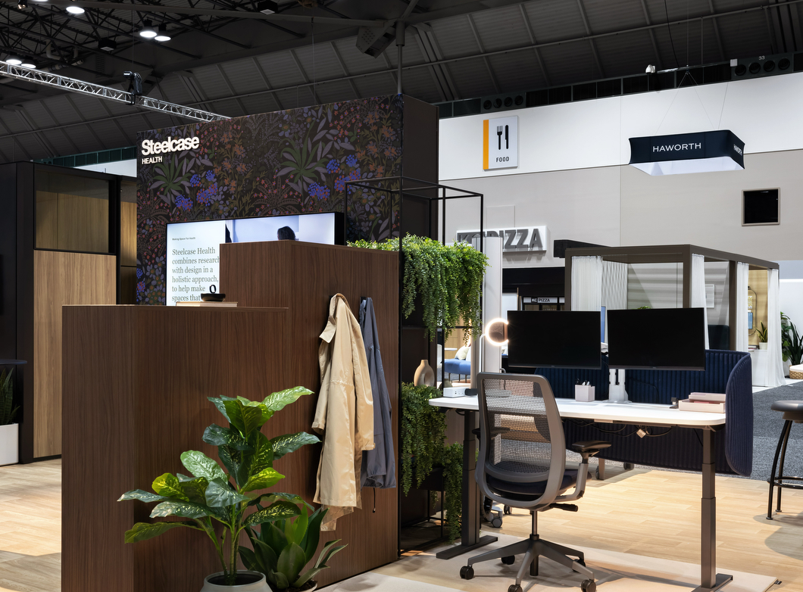
Featured Zone: Administrative
Highlights:
Administrative spaces are vital to healthcare delivery. This environment combines ergonomic features and essential tools to support productivity and well-being. Height-adjustable desks, task seating, and easy access to lighting, monitor arms, power, and storage give clinicians control and comfort, while soft elements like plants and rugs create a welcoming atmosphere. Featured Products:
WorkValet
Steelcase Series 2 Task Chair
Migration Heigh-adjustable Desk
Soffio Screen
Eclipse Light
CF Series Monitor Arm
Desktop Powerstrip
Color Dial Rug
Notes:
Specifications:
WorkValet Locker Double Wide 2 Door
Parametric
Depth: 18.875
Width 36”W
Height: 67.3125
Case Finish: Walnut Heights 2TH7
No Door, No Hinge, Full Front, No Lock, No Pull, With Coat Rod, No Back Panel
WorkValet Locker Double Wide 4 Door
Parametric
Depth: 18.875
Width 36”W
Height: 54.81250
Case Finish: Walnut Heights 2TH7
No Door, No Hinge, Full Front, No Lock, No Pull, One Adjustable Shelf, No Hook, No Back Panel
Steelcase Series 2 Task Chair, Air Back
Air Back Plastic: 6295 Black
Seat Finish: Designtex- Everywhere Texture 4147- Twilight 411
Sewn Seat
Color Scheme: Sterling Dark
Base Finish: Texture Paint 7250- Sterling Dark Solid
No headrest, no coat hanger
Arm type: height, width, pivot, depth
Hard Casters
CF Series, Intro Dual Monitor Arm
Arm Finish: Pearl Snow ZW01
Bracket: Dual C-Clamp
Desktop Powerstrip
Power Configuration: 3 Power, 1 USB A+C
Power Finish: 6009 Arctic White
Power Mount: C-Clamp
Standard NEMA 5-15 3 Prong Plug
8’ standard power cord, black
Migration Desk, Organic, Extended, Intro, 29”D X 64”W
Size: Modular
Leg Type: T-Leg
Bow Front
Top Surface: Satin White 24H1
Edge Finish: Arctic White 6009
Rectangle Column
No Overhang
Base finish: Smooth Paint 4243 Merle Smooth
No cable tray
Soffio Screen, 68”W
Surface Finish: Designtex-Billiard Panel 4116- Navy 405
Steelcase Eclipse Light
Light Finish: ZW01 Pearl Snow
Color Dial Arc Sand Rug
Color: 180X300 Low Pile Polyamide

Slide 18
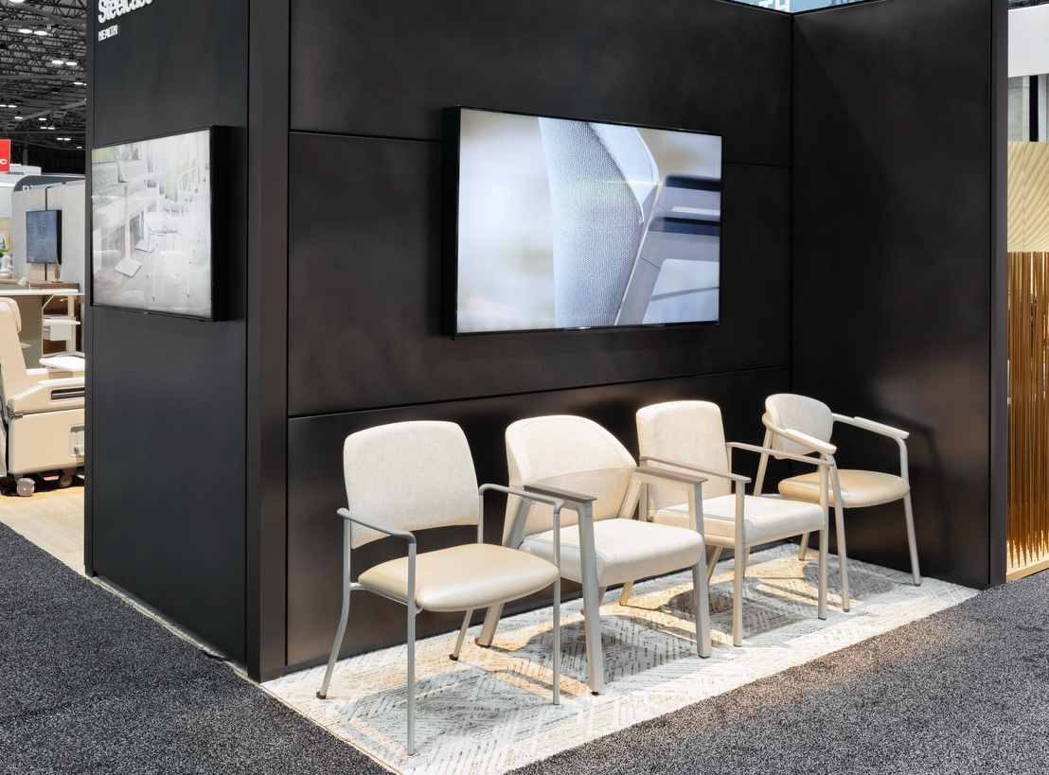
Featured Zone: Healthcare Seating Display
Highlights:
With better design, healthcare seating can become less institutional and a lot more comfortable, appealing and inviting — while still meeting crucial demands for safety, durability and cleanability. Featured Products:
Sorrel
Aspekt
Embold
Radia
Notes:
Specifications:
Aspekt Chair, Straight Arm
Frame: 4750 Champagne Metallic
Arm Cap: 6059 Sterling Dark Solid
Seat/ Back: Designtex- Grenoble 3113- Pewter 102
Wall saver leg
Convex Back
No moisture barrier
Embold, 21”W single seat
Frame: 4750 Champagne Metallic
Arm Cap: 6527 Merle, overhang
Seat/ Back: Designtex- Grenoble 3113- Pewter 102
With wallsaver glides
No high back
With moisture barrier
Radia, 21”W single chair with arms
Frame: 4750 Champagne Metallic
Arm Cap: Corian Antarctica
Seat: Designtex- Metallo 3889- Pebble 103
Back: Designtex- Grenoble 3113- Pewter 102
No moisture barrier
West Elm Health- Slope Bariatric Chair
Frame: 4750 Champagne Metallic
Arm Cap: 6527 Merle, overhang
Upholstery: Designtex- Grenoble 3113- Pewter 102
Without seam
With arm
Glides: Natural
Sorrel Chair- 22”W stacking with arms
Frame: 4750 Champagne Metallic
Arm Cap: 6160 Grey
Back: Designtex- Grenoble 3113- Pewter 102
Seat: Designtex- Metallo 3889- 103 Pebble
Wall saver leg
No leg guards
Thick seat
Hard glides

Slide 19
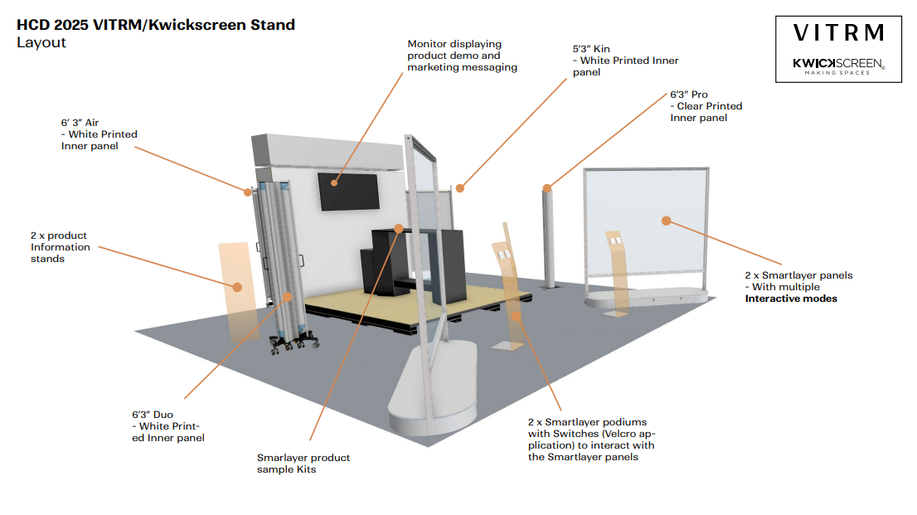
KwickScreen/Vitrm Exhibit Space
Partner Details:
KwickScreen and Vitrm are specialized Steelcase partners that creates portable, retractable partition screens and retrofittable privacy film for healthcare environments.
Retractable and mobile screens allow for instant visual and physical separation space reconfiguration
Vitrm (KwickSwitch) provides privacy at the flip of a switch.

Slide 20
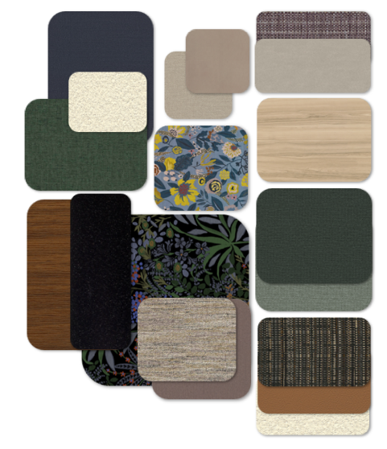
Healthcare Design Conference 2025
Connecting Color in Healthcare
In response to evolving trends in healthcare interiors, our finish selections reflect a strategic shift toward deeper, more emotionally engaging palettes that evoke warmth, richness, and a sense of comfort. This design direction mirrors broader industry movements seen across major tradeshows and the competitive landscape, signaling a shift toward more emotionally resonant environments.
Our selections are grounded in biophilic design principles, incorporating nature-inspired hues and materials to foster calm, connection, and a sense of restoration. By integrating darker finishes, we’re leaning into a more elevated hospitality aesthetic—bringing a sense of luxury and intentionality to environments that support healing and well-being.
An emotionally resonant space doesn’t just look good—it feels good, and that feeling can have a real impact on patient outcomes and staff well-being.

Slide 21
Speaking Session

Slide 22
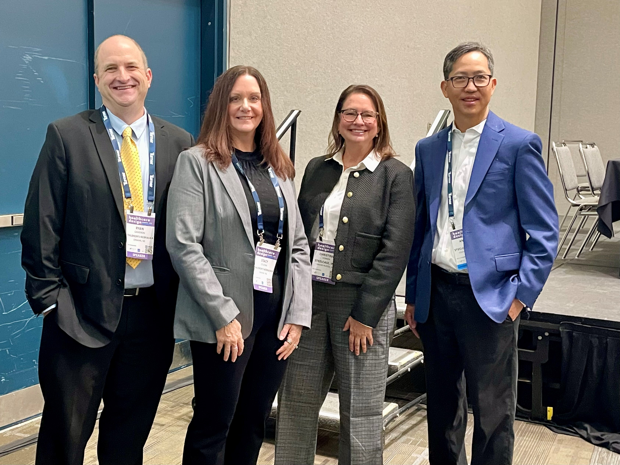
Knowledge Sharing Session
Enhancing Pediatric Telehealth with Immersive, Extended Reality Pod
Immersive technologies are creating new opportunities to enhance telehealth. Children’s Nebraska is exploring extended reality pods to improve patient experience. This session shares research on immersive and hybrid care, space reimagination, and insights from a behavioral health pilot. Attendees will learn patient and family feedback, future plans for specialties like dermatology, and how extended reality pods offer a cost-effective telehealth solution while mitigating risks in coding and billing.
Presenters:
Ryan Cameron, Children’s Nebraska
Stacy Zoucha, Children's Nebraska
Andrew Kim, Steelcase
Christina Vernon, Steelcase

