Slide 1

Steelcase® Roam™
Take Teamwork Anywhere.
Presenter’s Name
Company Name
xxx.xxx.xxxx / name@companyurl.com
COMPANY LOGO
Notes:
READ BEFORE PRESENTING – Update slide and turn text white or delete slide content noted in red before presenting
We’d like to introduce Roam, a revolutionary way for teams to create and collaborate. Roam by Steelcase is a new system of mobile stands and wall mounts co-developed with Microsoft to support the Surface Hub 2S. Giving you the power to take teamwork anywhere! Today we’ll show you how.

Slide 2
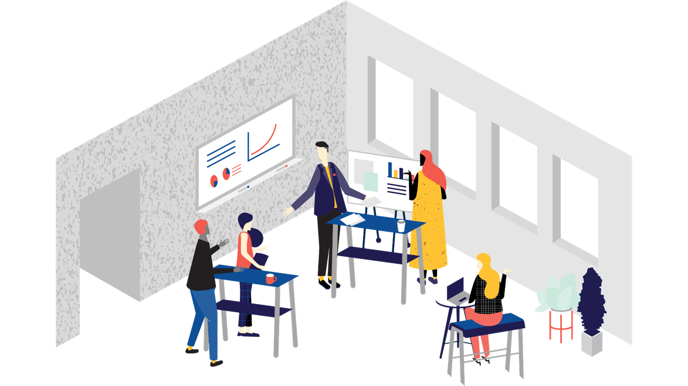
Collaboration Research
Collaboration is Critical
Notes:
Everybody knows collaboration fuels innovation — you can’t create good ideas without it. Leaders recognize this and are expecting teams to step up.

Slide 3
Collaboration Research
Collaboration is Critical But Stifled.
Notes:
While many people truly want to collaborate and are trying hard, they face some very real barriers.

Slide 4
Collaboration Research
6 Countries Globally
2019 Active Collaboration Study
3,000+ Participants
Notes:
In 2019, Steelcase conducted a research study to learn more about how people want to collaborate.
The 2019 Steelcase Active Collaboration Study revealed some of the biggest issues workers face are the spaces they work in and the technology that’s available to them.
That study illuminated 4 principle barriers to collaboration that I want to share.
Additional Info
Sample includes 3,060 office workers across wide range of industries and job functions, at firms of 500+ employees, who collaborate in their jobs at least 10% of the time. Six markets include France (12%), Germany (18%), Japan (16%), UK (19%), US (19%), Australia (17%).

Slide 5

Collaboration Research
Access to People
73% of employees are unable to get access to the right people.
Notes:
The first barrier people identified, is the inability to gather the right stakeholders to make a decision. In today’s global market, the right people are often distributed, making collaboration hard.

Slide 6
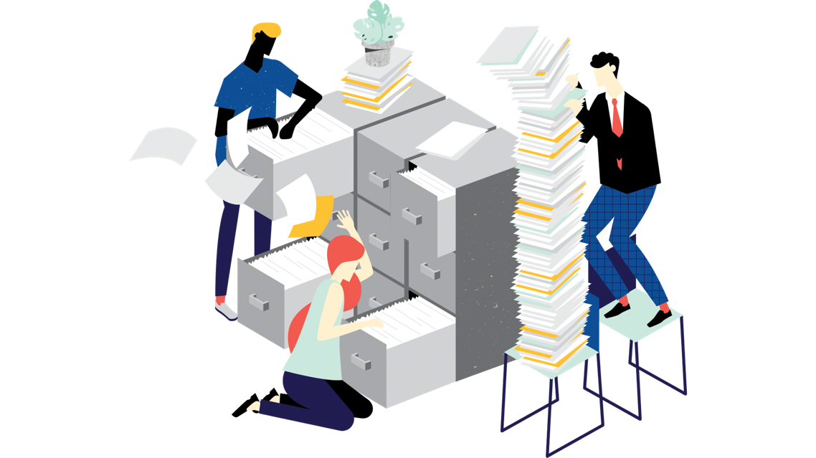
Collaboration Research
Access to Information
70% of employees are unable to access the information needed in real time.
Notes:
The second barrier is access to information. Respondents identified that they’re often slowed by not having access to the same information as their colleagues during collaborative sessions.

Slide 7
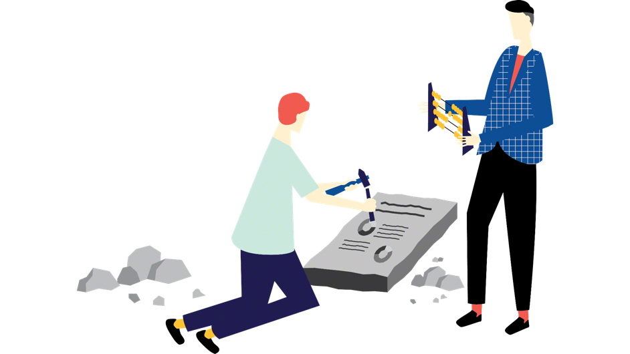
Collaboration Research
Outdated Technology
66% of employees said their technologies and software are not compatible.
Notes:
Third was outdated technology. Workers are often brining their technology to a meeting and compatibility between personal devices and displays often delays collaboration and creativity.

Slide 8
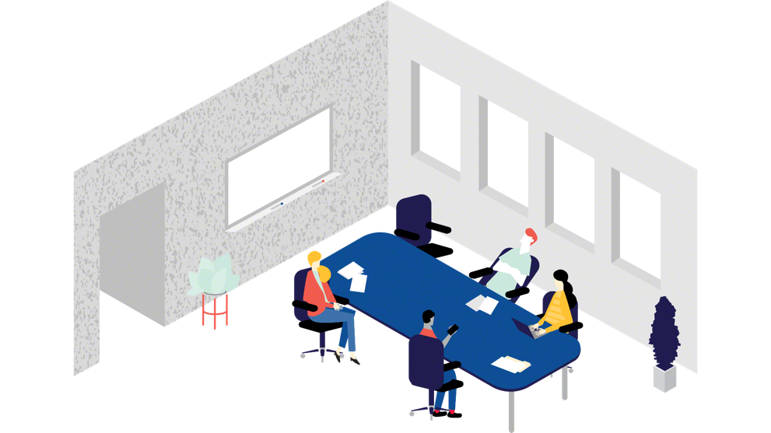
Collaboration Research
Meeting Room Constraints
72% of employees want to be able to move, but only 53% are able to.
Notes:
And Finally, we discovered that space can also be a barrier to collaboration. Teams want the ability to move around and get active, but furniture and devices often don’t support this desire.
Steelcase and Microsoft used this research and these barriers to re-envision what collaboration might look like if these barriers were removed. And we envision it looking something like this: NEXT SLIDE IS THE VIDEO.

Slide 9
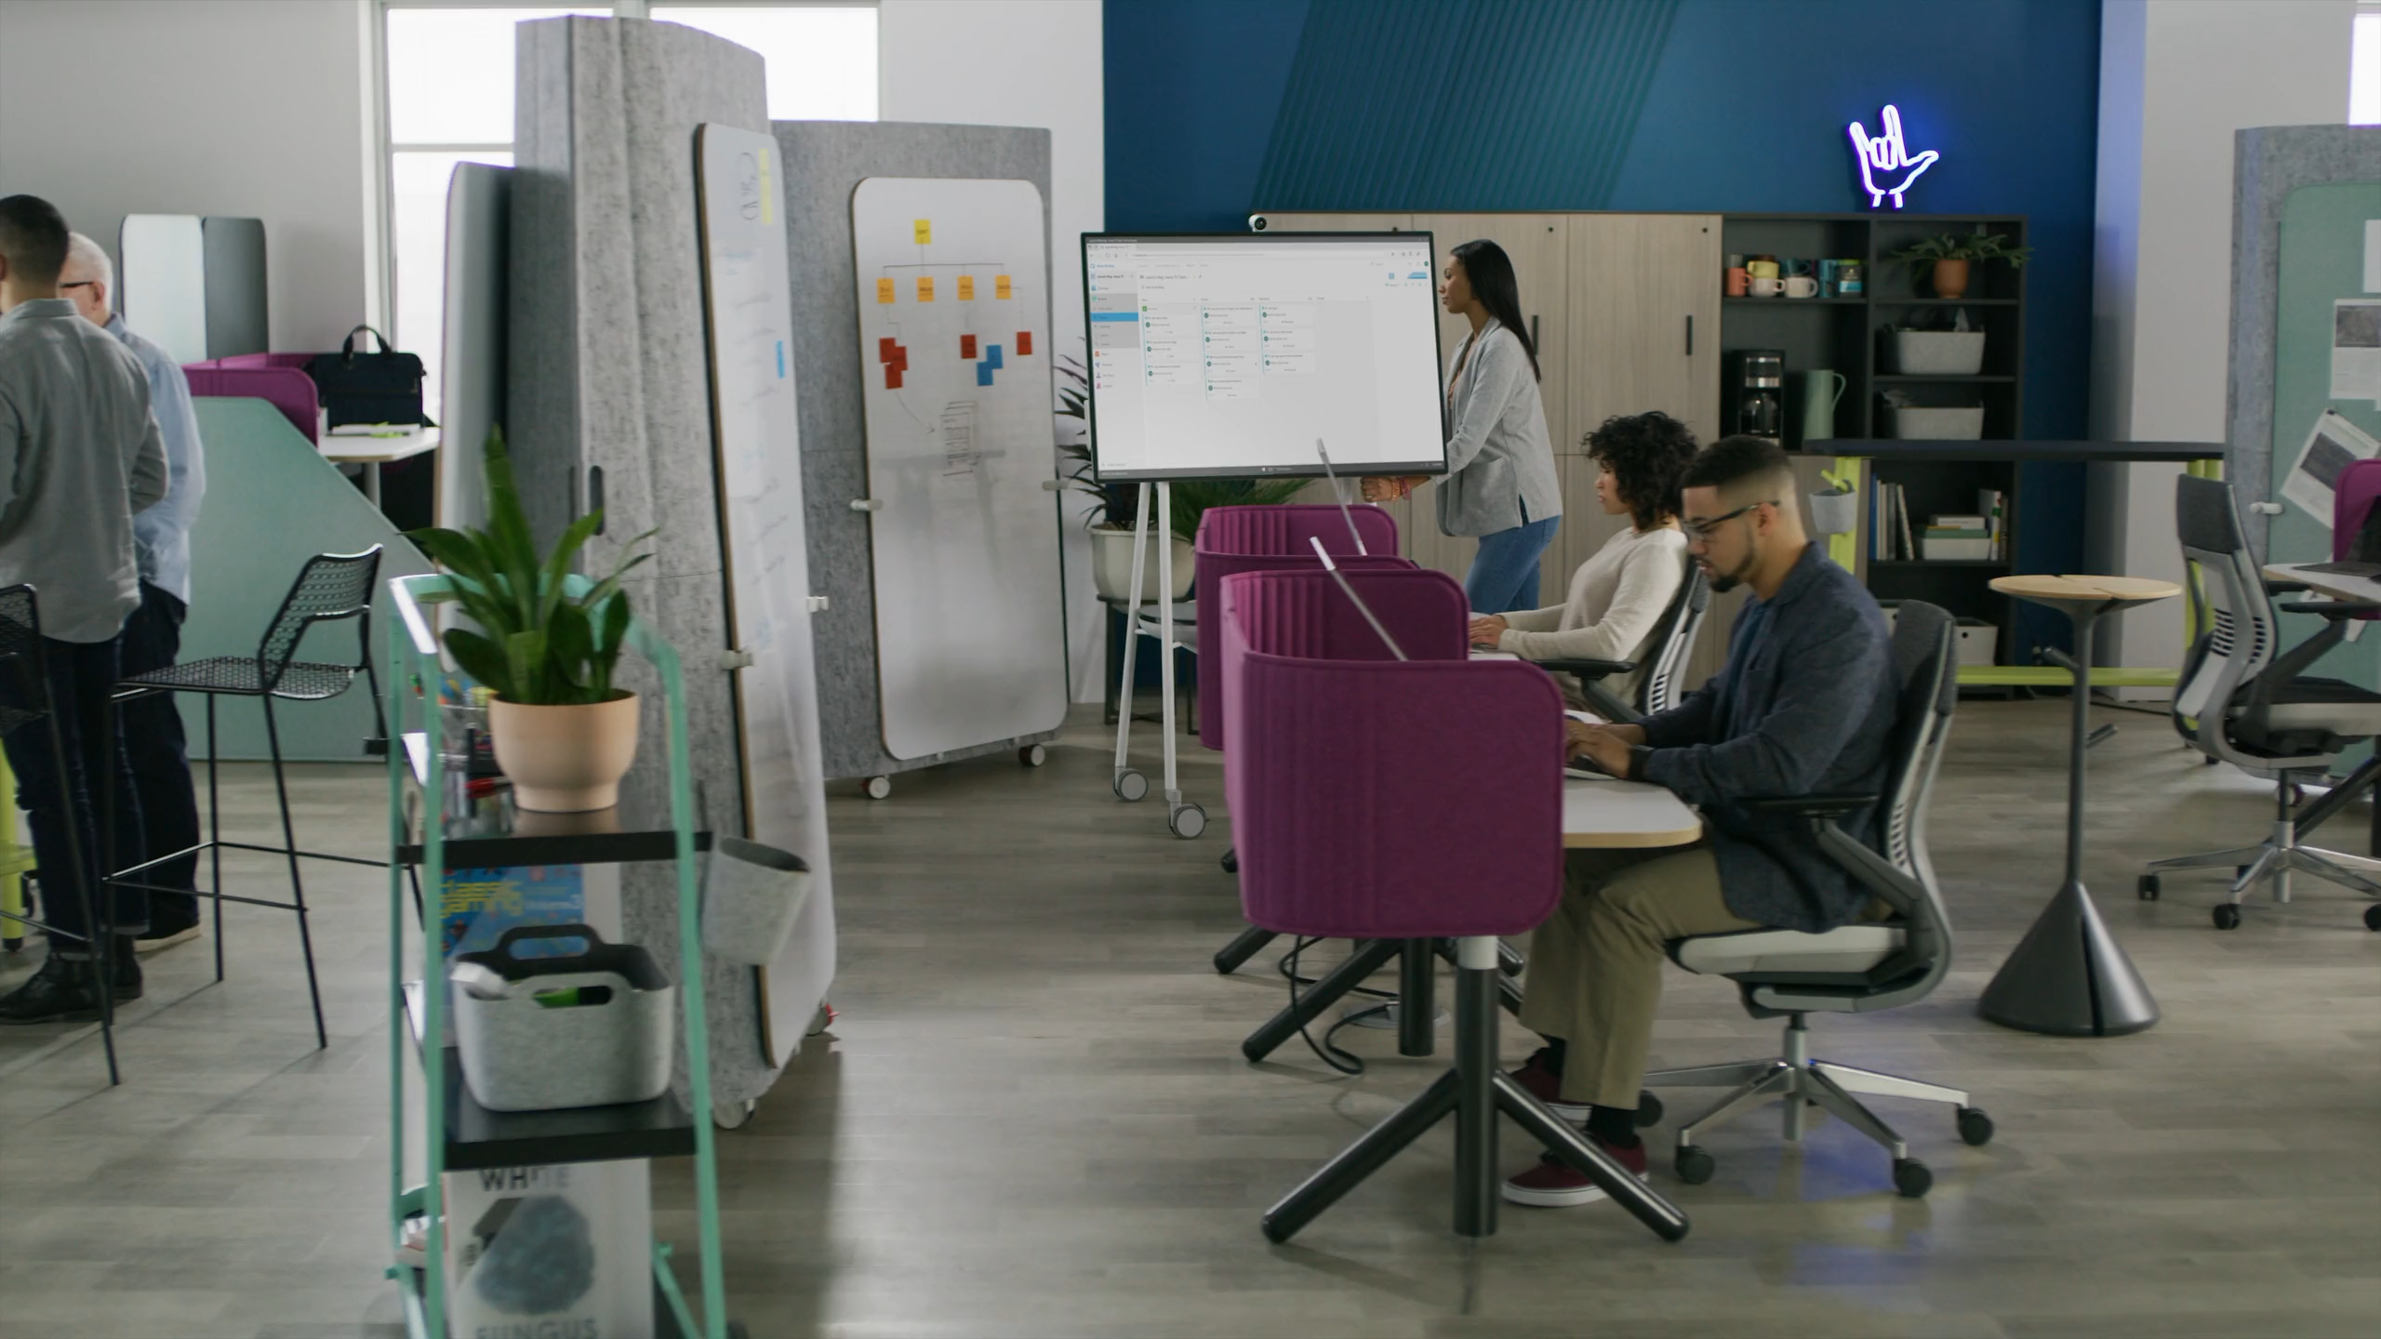
Notes:
CLICK TO PLAY VIDEO

Slide 10
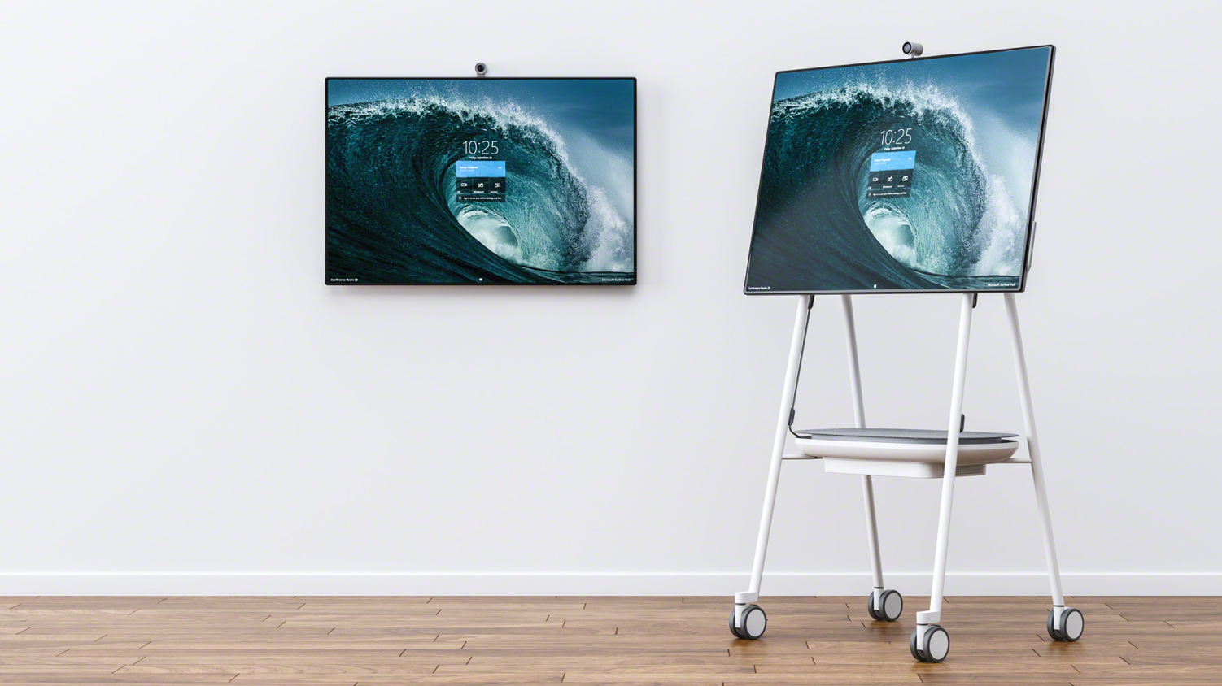

Notes:
This is Roam. A new system of mobile stands and wall mounts that allows teams the freedom to collaborate anywhere their ideas take them. Roam is the only mobile stand with a built in APC mobile charge battery, allowing you to truly unplug.
OR...
Introducing Steelcase® Roam™ and Microsoft Surface Hub 2.
Collaboration just got easier.
Microsoft Surface Hub 2S is a next generation, all-in-one collaboration device built for teamwork that can turn any space into a collaborative space. The sleek slim design allows it to go into any size room using the Steelcase Roam Mobile Stand or easy-to-hang wall mounts.
Now Collaboration can happen:

Slide 11
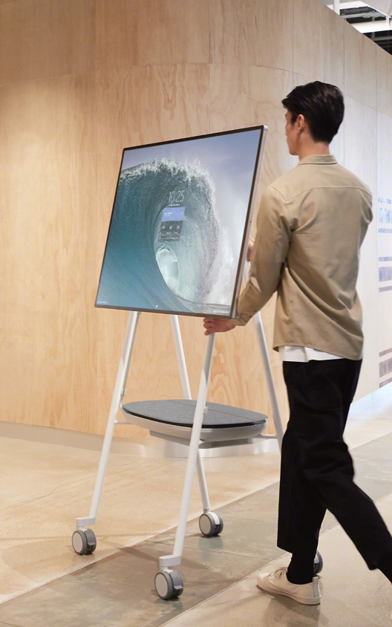
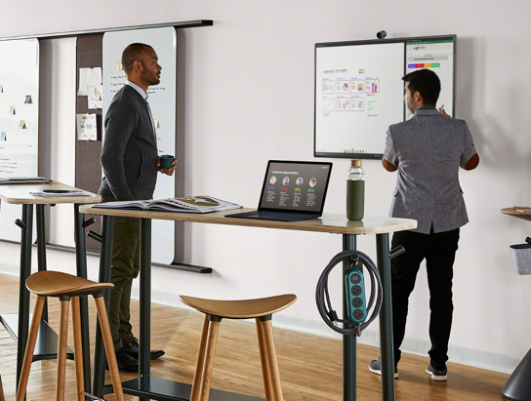
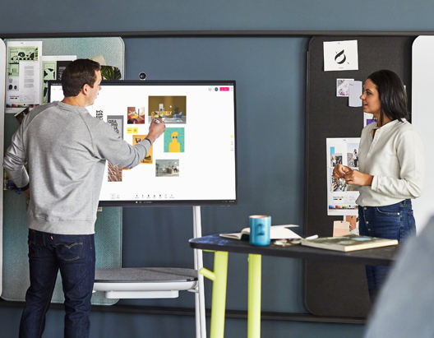
Steelcase Roam
Collaborate Anywhere
Notes:
Anywhere
Steelcase Roam enables teams to collaborate anywhere with a mobile stand that can be moved with one hand. Its small footprint allows it to fit in all kinds of spaces, from enclaves or huddle rooms, to enclosed rooms or open social spaces. Used for remote collaboration, your distant teammate can actually move around with you and participate more fully.

Slide 12
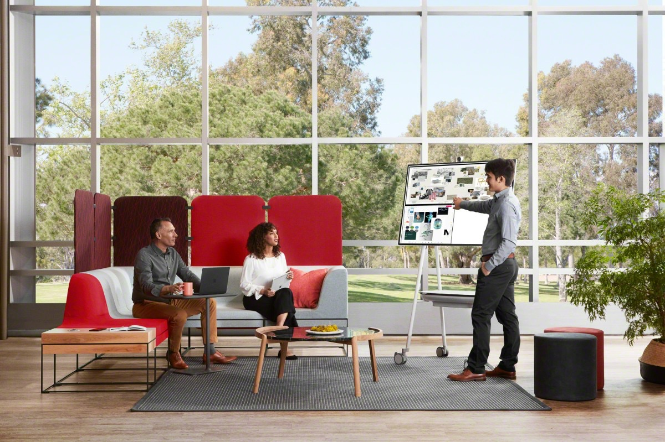
Steelcase Roam
Collaborate Anytime
Notes:
Anytime
Great ideas can’t always be scheduled. When they pop up, you want to keep them moving. Surface Hub 2S and Steelcase Roam let you collaborate in planned sessions or spontaneously, whenever good ideas strike.

Slide 13
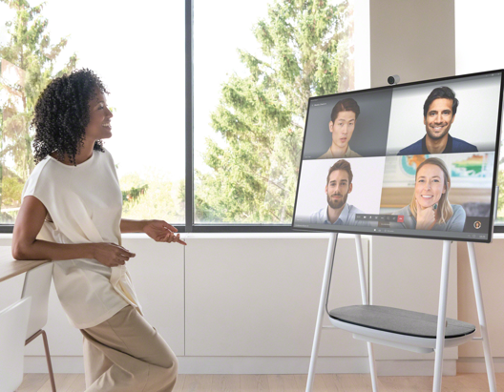
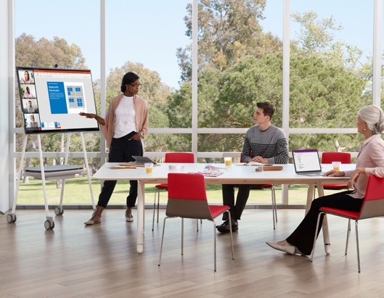
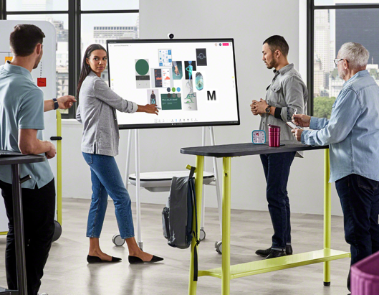
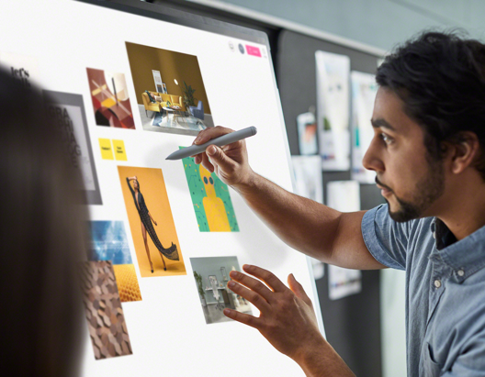
Steelcase Roam
Collaborate Any Way
Notes:
Anyway
Collaboration takes multiple forms, all of which are important to innovation:
Informative - keeping you in the loop Evaluative - getting feedback Generative - co-creating something new
Generative collaboration is the most difficult and elusive. “Eureka!” moments require a different approach. The right set of tools and environment can help teams do the mental heavy-lifting required to come up with new ideas.

Slide 14
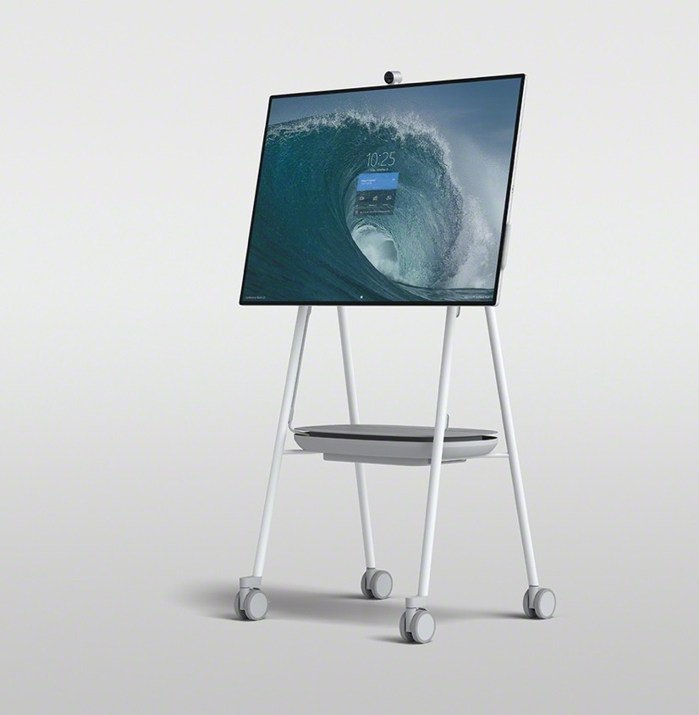
Steelcase Roam Mobile Stand
Notes:
Let me tell you a bit more about Steelcase Roam, starting with the Mobile stand.

Slide 15
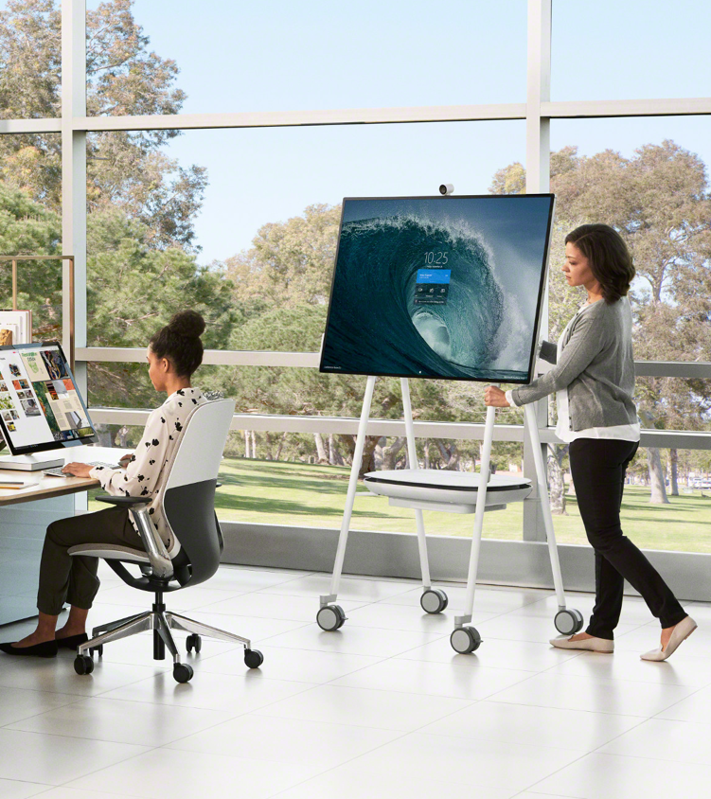
Steelcase Roam Mobile Stand
Innovative Mobility
Notes:
Roam moves easily on smooth rolling casters for easy on-the-go transitions throughout a workspace, from a conference room to private office to casual spaces and beyond.

Slide 16
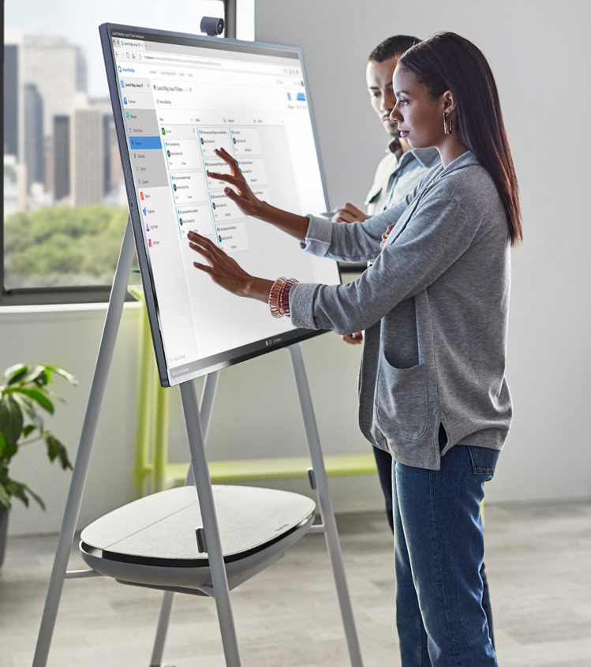
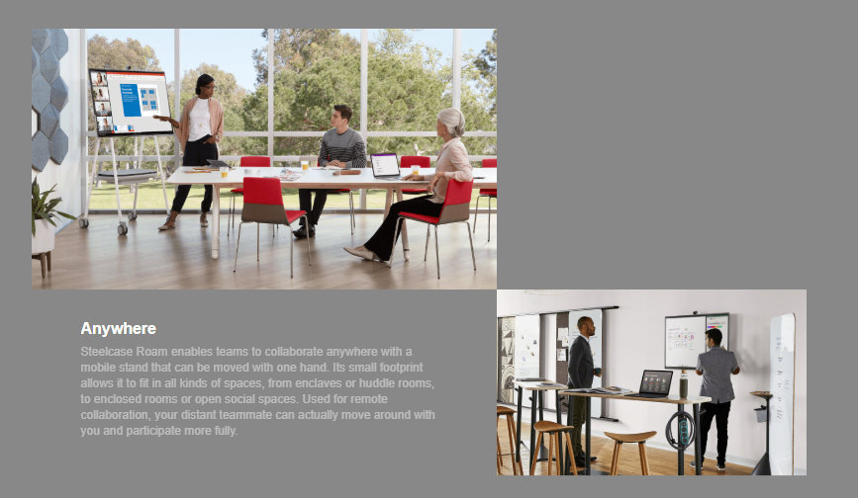
Steelcase Roam Mobile Stand
Approachable Design
Notes:
With a minimal design, Roam integrates seamlessly into any workspace. The stand is a familiar easel-style design, making it stylish and approachable for collaboration anywhere.

Slide 17
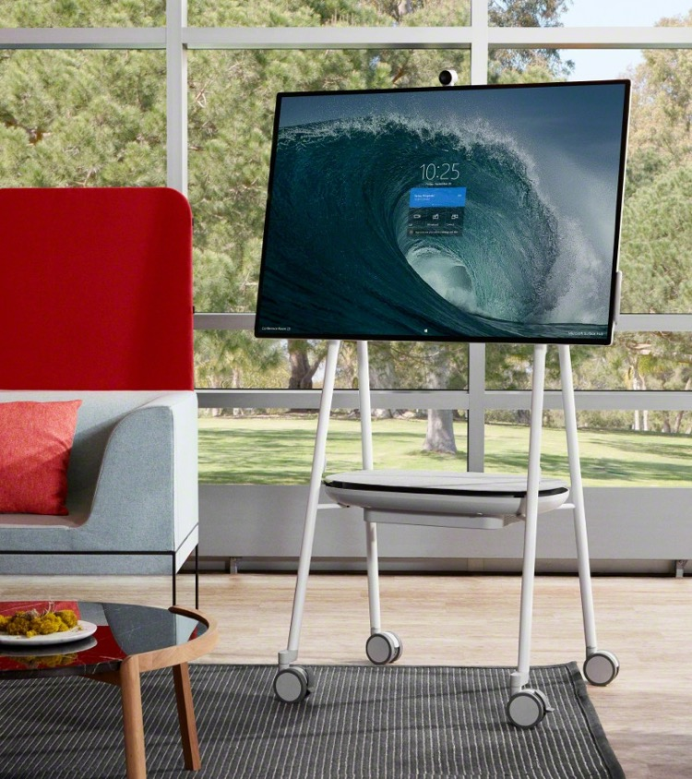
Steelcase Roam Mobile Stand
Thoughtful Integration
Notes:
Roam was created to perfectly complement Surface Hub 2S for collaboration anywhere, with an industry exclusive storage tray that can hold an optional APC Charge battery and a smart cord management system designed for untethered use.

Slide 18
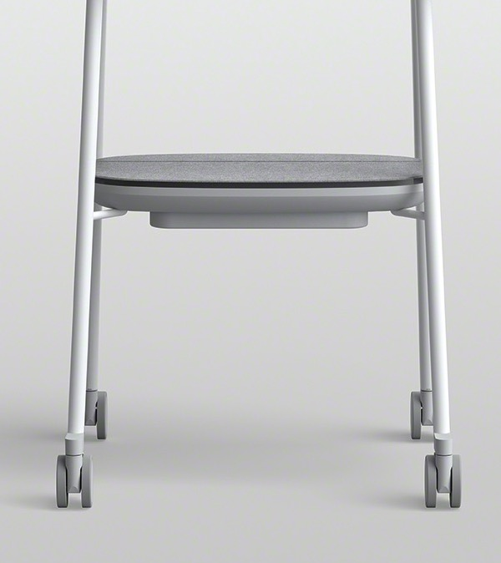
Steelcase Roam Mobile Stand
APC™ Charge
Mobile Battery.
Notes:
Speaking of the battery, the APC Charge battery is a an innovation from our partner Schneider Electric.
The APC Charge empowers true mobility to support your creative flow. Unplug, stay connected and never lose creative momentum as you move between space.
APC Charge Additional Info:
Optional Battery
Manufactured by Schneider APC
Availability Late September Delays: Japan, UAE

Slide 19
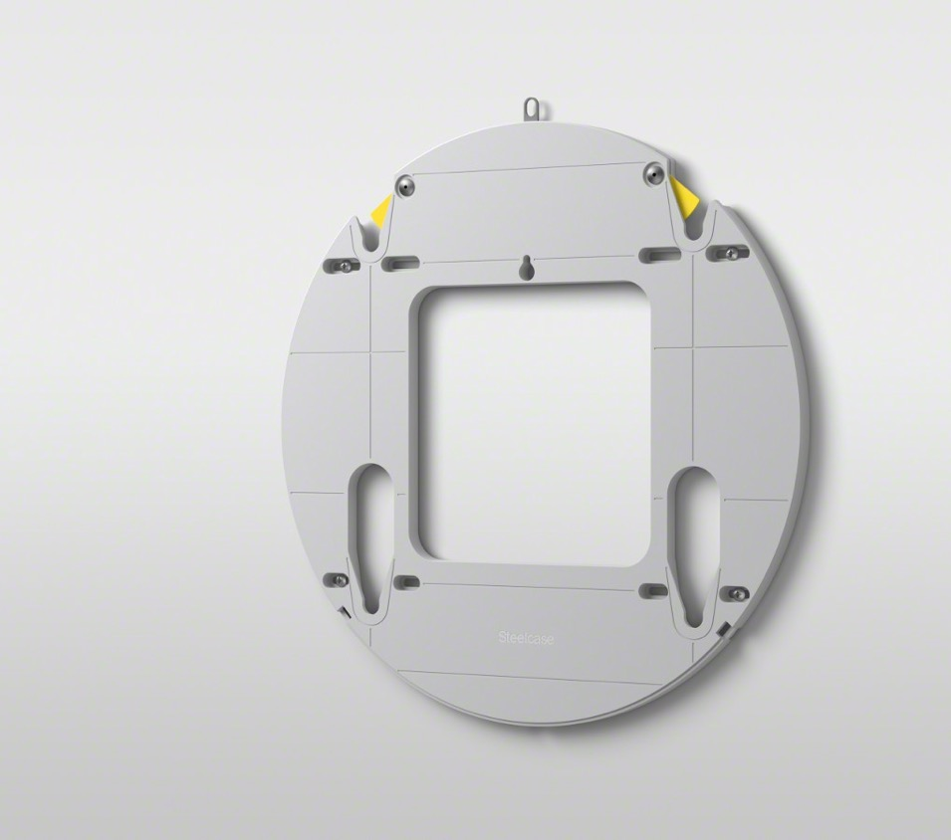
Steelcase Roam Wall Mount
Notes:
We also know that customers and organizations will want to mount the Surface Hub 2S. So in addition to the mobile stand, we also designed an incredibly thoughtful wall mounting system.

Slide 20
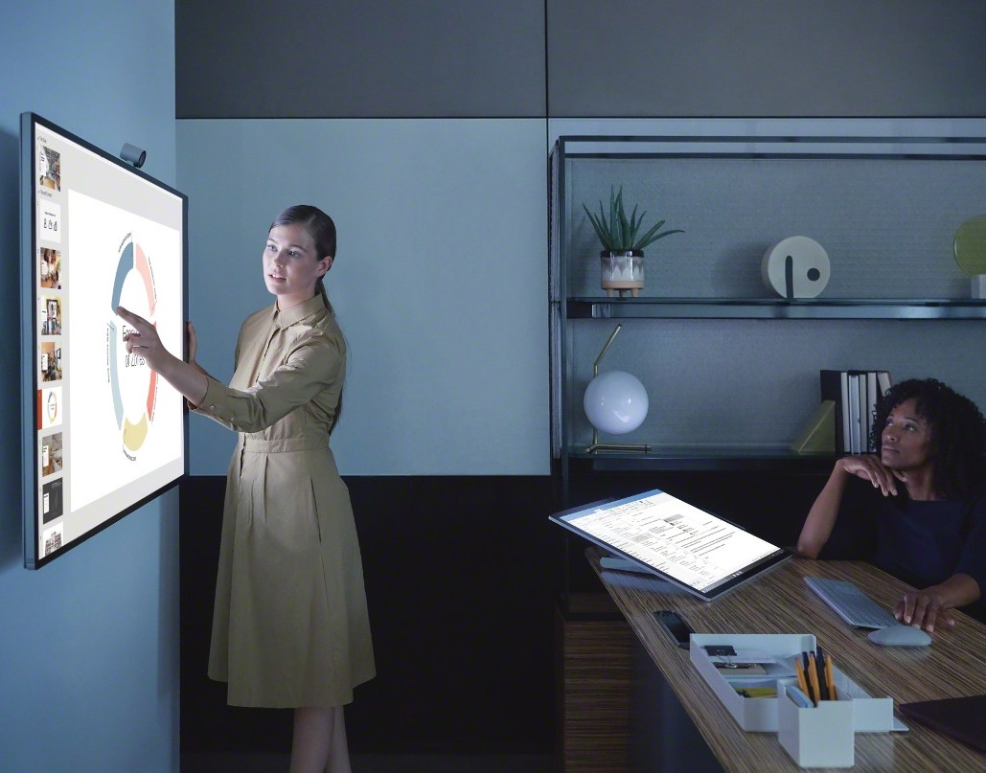
Steelcase Roam Wall Mount
Roam in Smaller Spaces
Notes:
The Wall mount is incredibly easy-to-install and makes any space more flexible with the integration of the Surface Hub 2S. From smaller huddle spaces and conference rooms to private offices.

Slide 21
Make any place a teamwork space.
Notes:
Give teams the freedom to collaborate wherever their ideas take them. Your workflow doesn’t have to be limited by the spaces available or a scheduled meeting time.
Let’s determine how Roam can enhance collaboration for your organization.
DISCUSSION – presenter to talk about the organization’s deployment plans (quantities, locations, space types) and how Roam can enable them to get the most out of their investment.
Visit Steelcase.com to learn more about how Microsoft Surface Hub 2S and Steelcase Roam activate teams to generate better ideas faster.

Slide 22
Notes:
Thank you!

