Slide 1
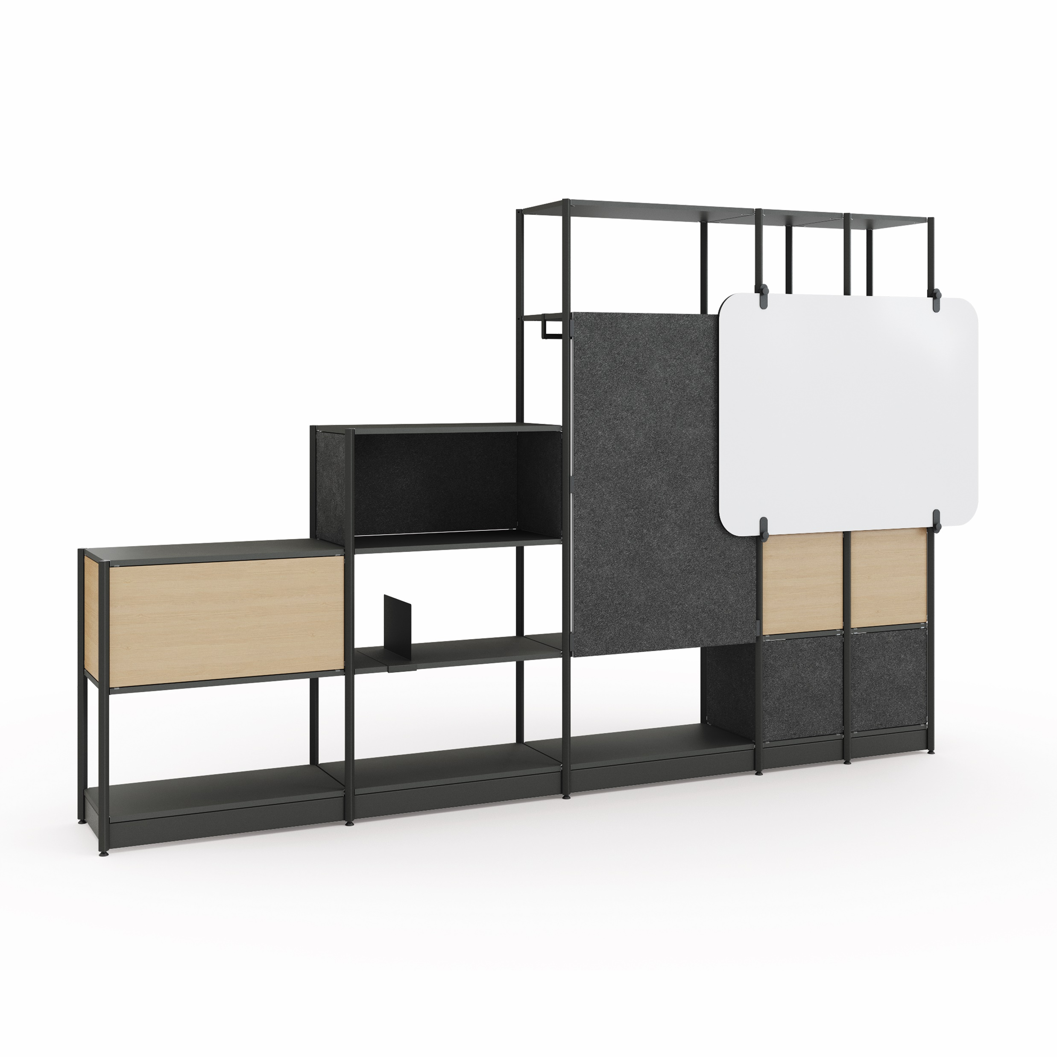
Flex Active Frame
Jan 2022
Products & Material Color Theme Template

Slide 2
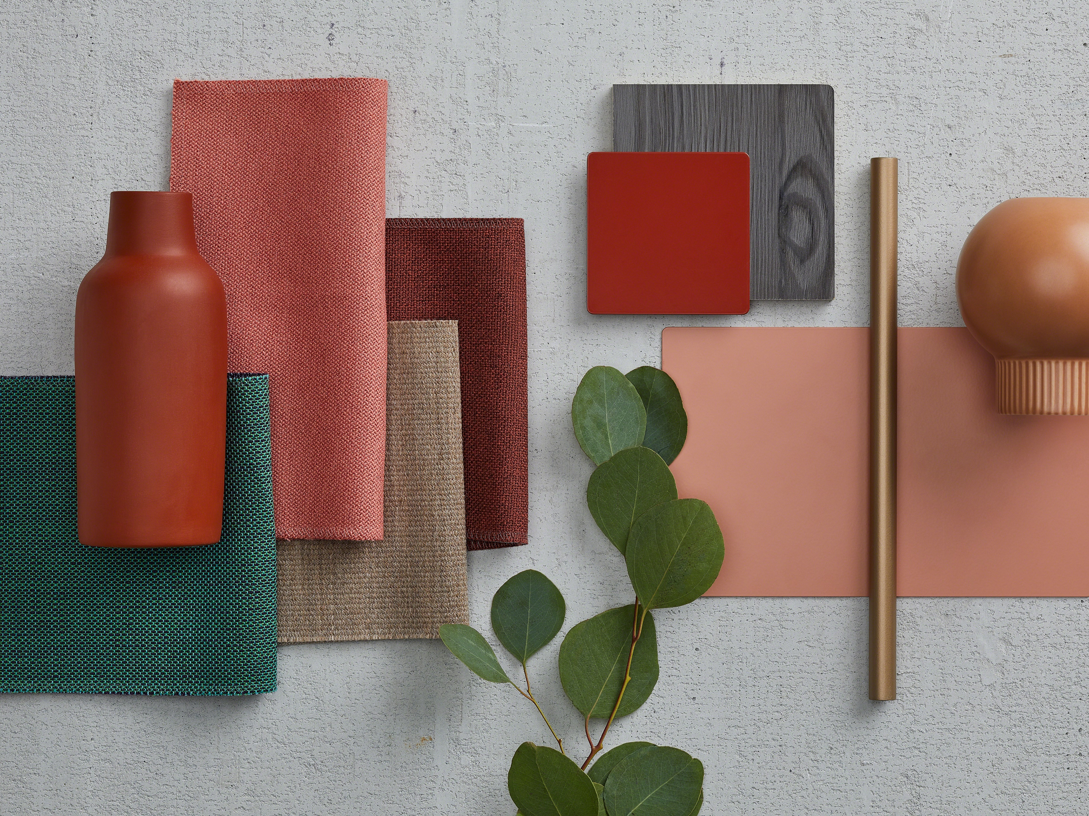
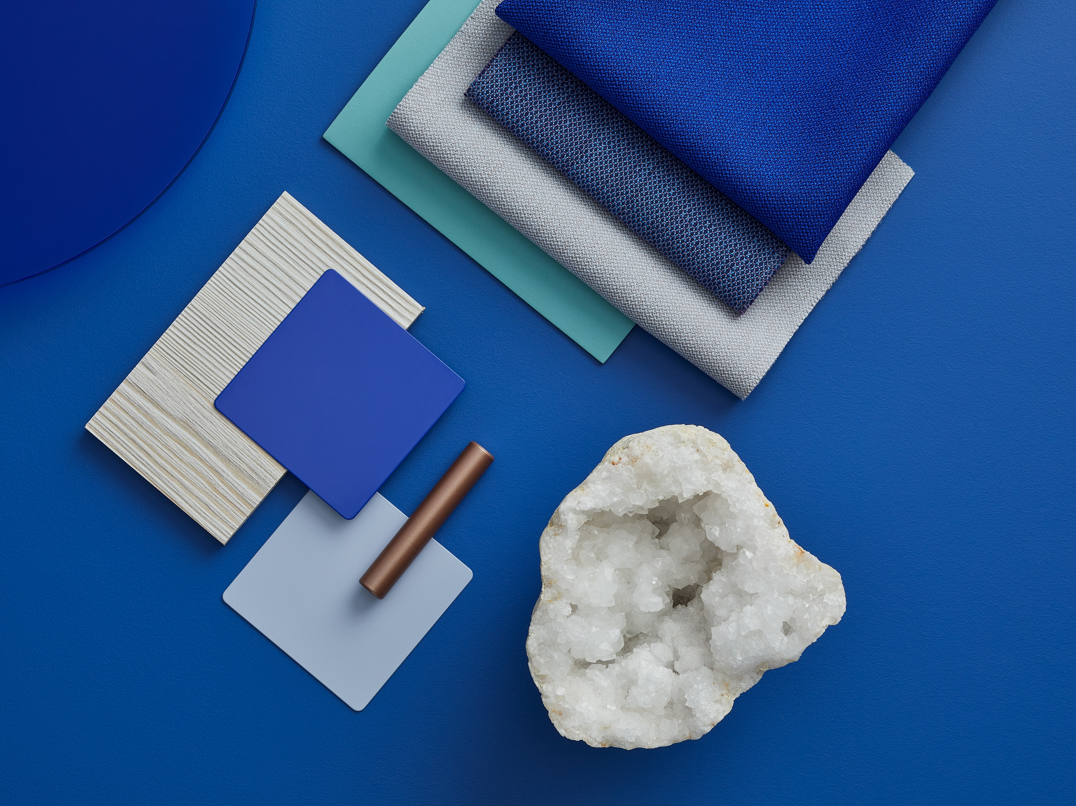
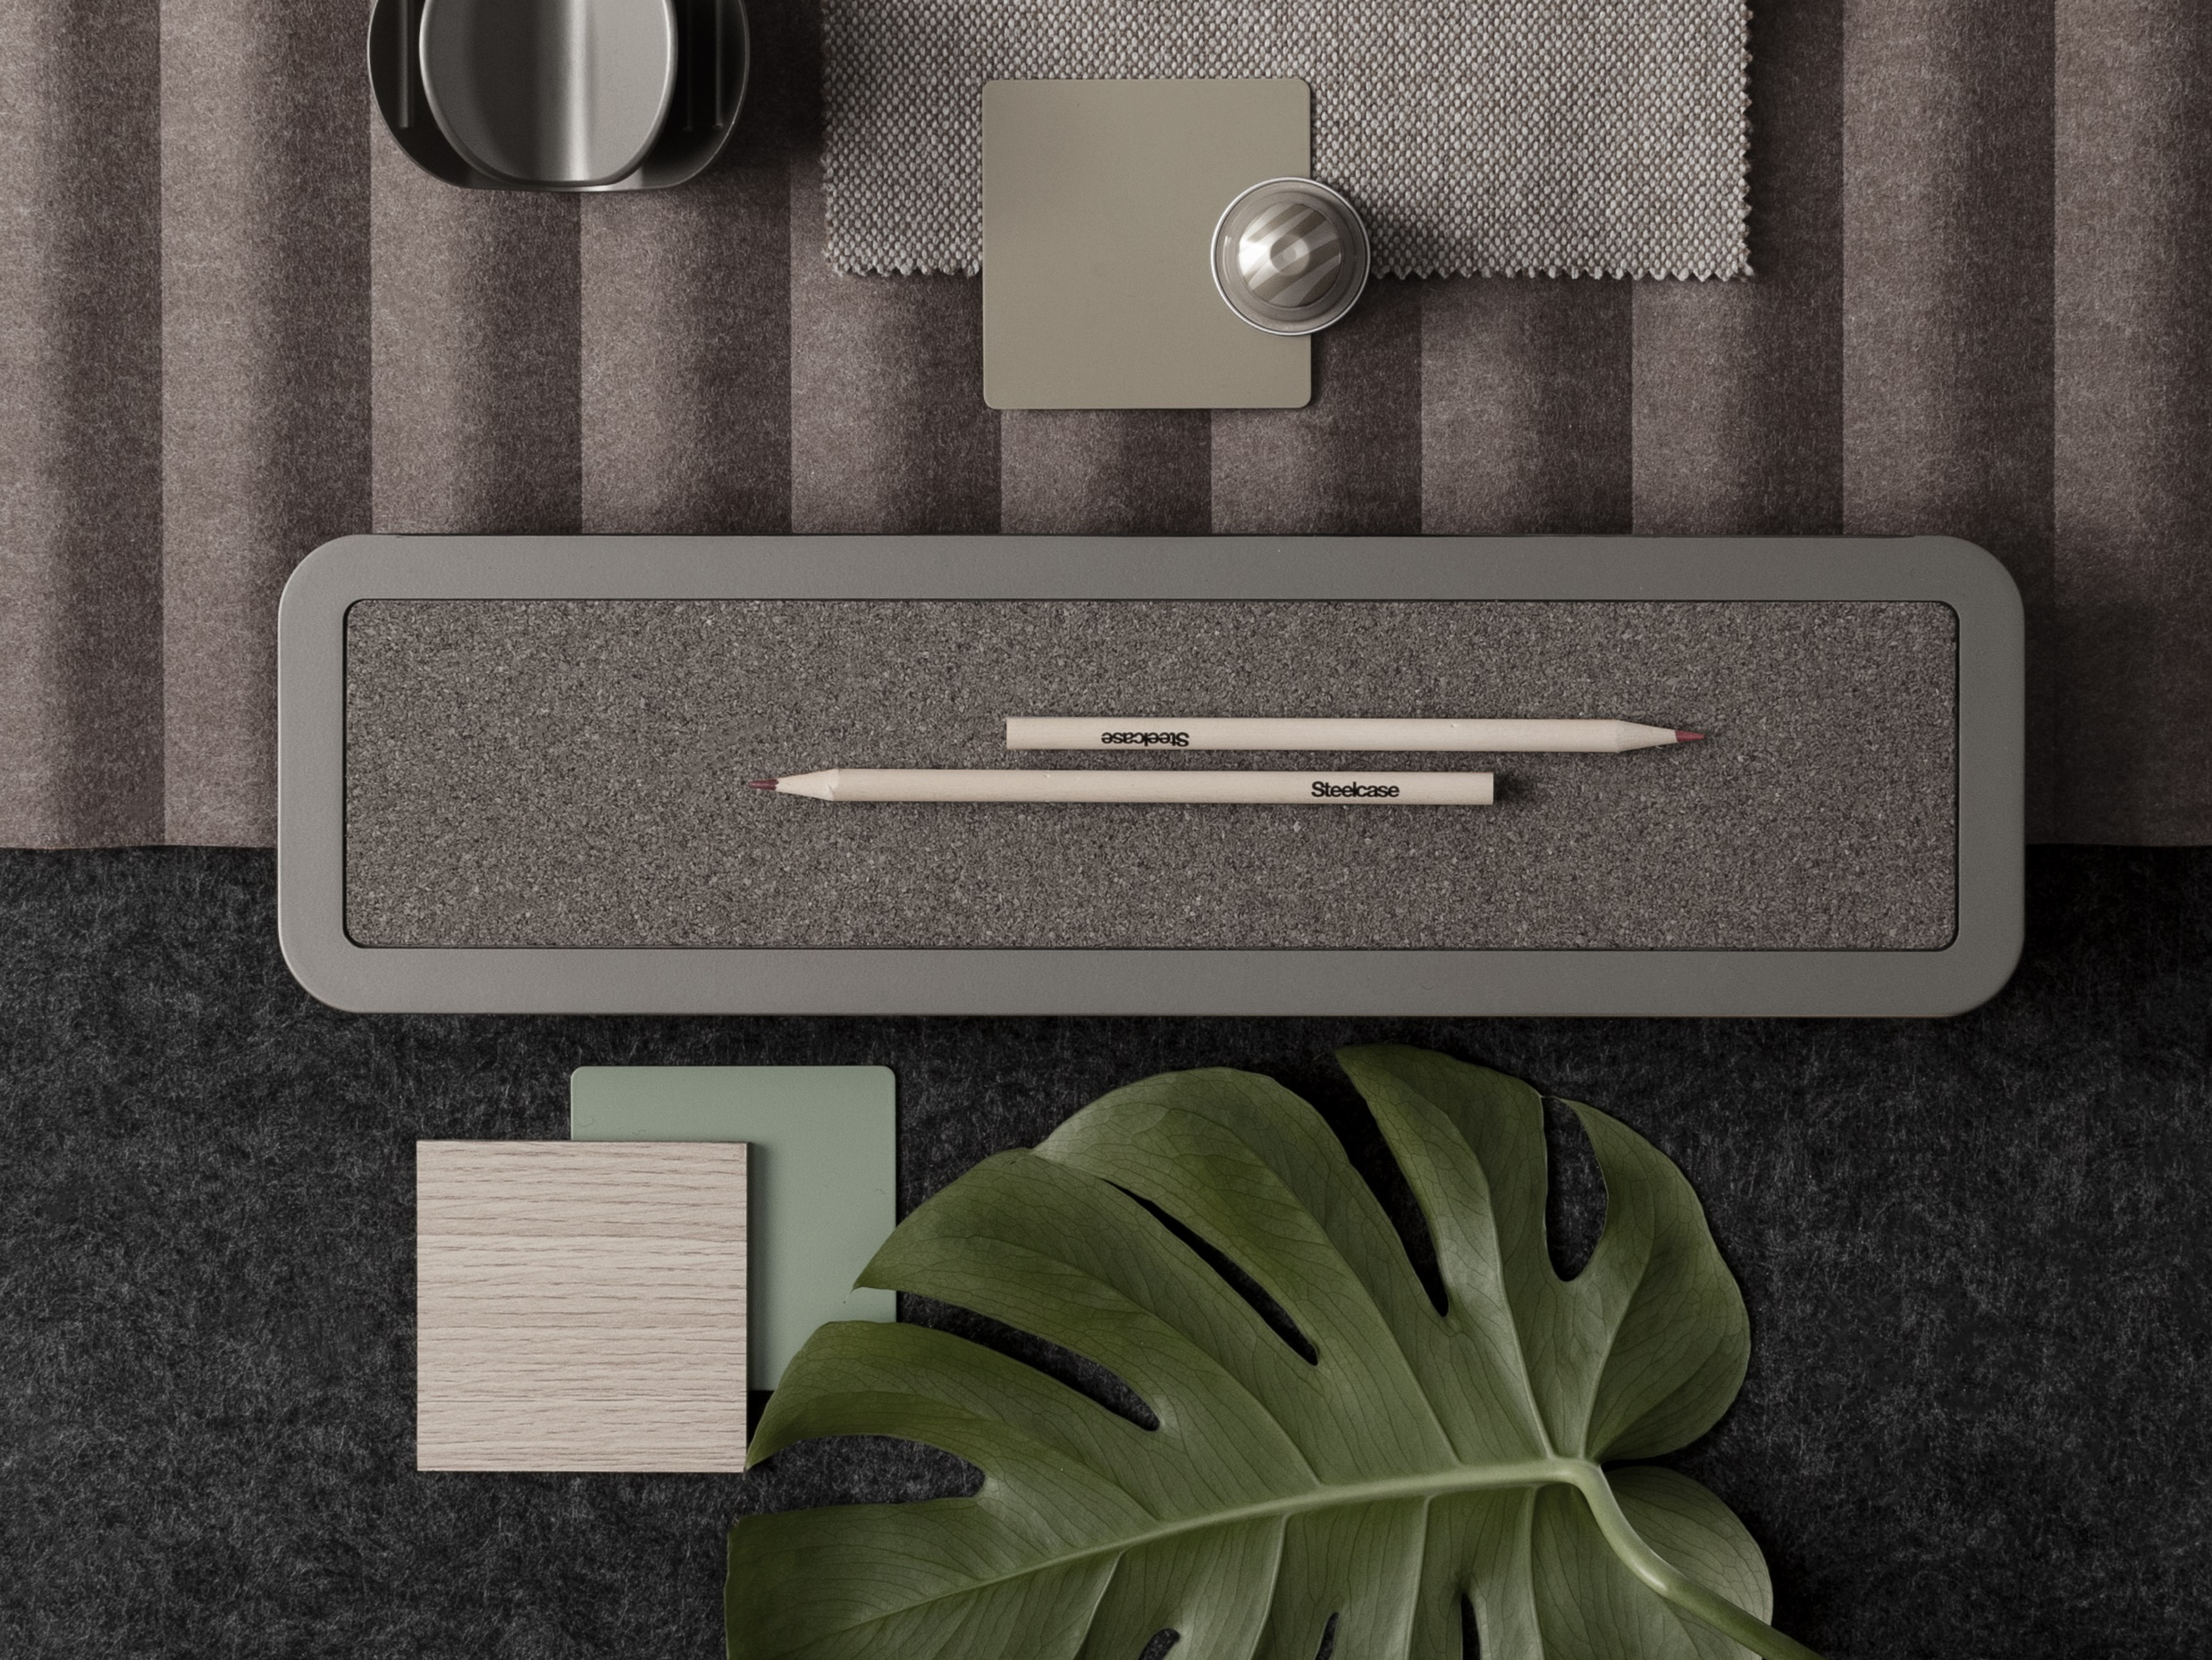
Theme Overview
Warm
Cool Tones
Neutral Tones
[Key in your title]
Generally thought of as bolder tones, red, orange, and yellow grab the attention of passersby. In essence, they captivate and intrigue individuals. It’s not uncommon for warm shades to make people feel alive and uplifted. These hues have a way of breathing life into everything they touch.
[Key in your title]
Cool Colors tend to have a calming effect. At one end of the spectrum, they are cold, impersonal, antiseptic colors. At the other end, cool colors are comforting and nurturing. Blue, green, and the neutrals white, gray, and silver are examples.
[Key in your title]
The neutral colors of black, white, silver, gray, and brown make good backgrounds, serve to unify diverse color palettes, and often stand alone as the only or primary focus of a design. Neutral colors help to put the focus on other colors or serve to tone down colors that might otherwise be overpowering on their own.

Slide 3
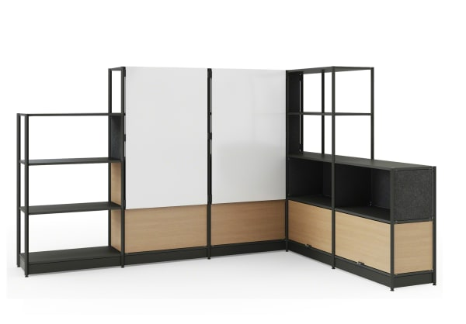
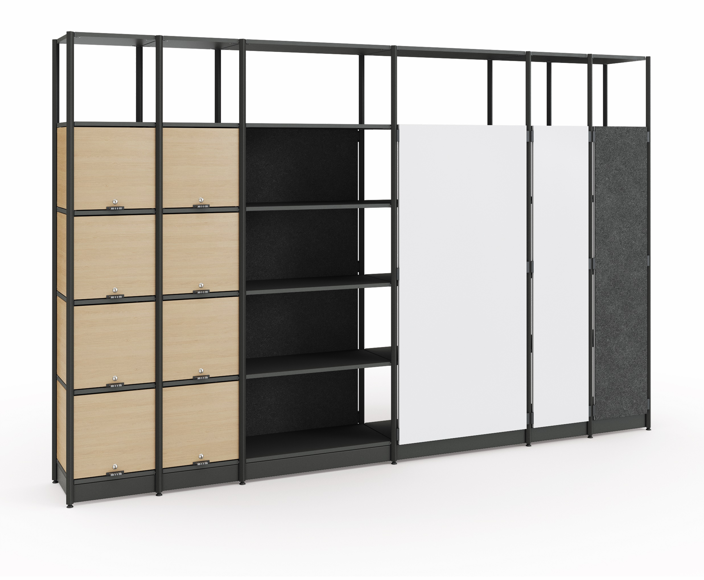
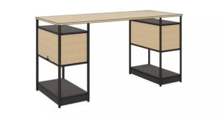
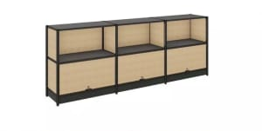
Flex Active Frame
Storage
White Board
White Board
Shelve/Door
Laminate Color
Accents
PET Color Accents
Frame
Paint Color Accents
Frame
Paint Color
Accents
Shelve/Door
Laminate Color
Accents
PET Color Accents
Pre-Configured Unit
Pre-Configured Unit
Shelve/Door
Laminate Color
Accents
PET Color Accents
Shelve/Door
Laminate Color
Accents
PET Color Accents
Frame
Paint Color
Accents
Frame
Paint Color
Accents
Pre-Configured Unit
Pre-Configured Unit
*Pre-configuration unit shown are for visual purpose. More options available

Slide 4
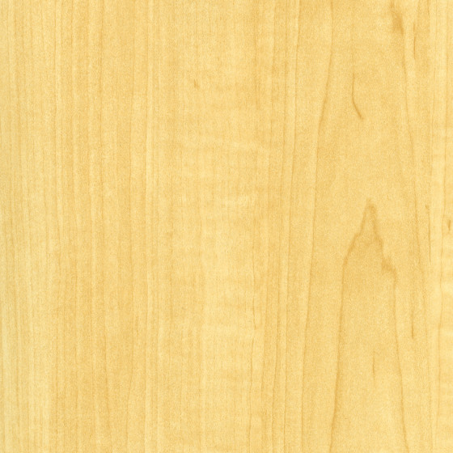
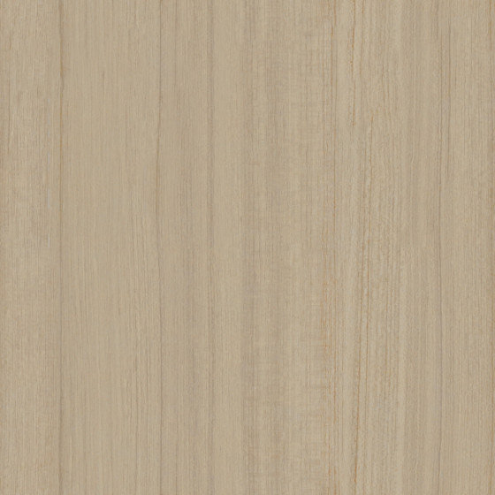
Flex Active Frame
Pre-Configured Unit
Laminate Color Accents
Leg
PRICE GROUP 1
PRICE GROUP 2
Wood Grain Laminate
Smooth paint color accents
White Board
160: Maple
2LWE: Warm Elm
2LAT: Acacia
2LGO: Grey Oak
2L40:
Graphite Walnut
25L8: Clear
Walnut
1ATR: Blush
1ATK: Citrine
4AQ9: Scarlet
Solid Laminate
AW01: Arctic
White
2L83: Seagull
2LMG: Merle
Shelve/Door
Laminate Color
Accents
PET Color Accents
Plastic Edgeband
Frame
Paint Color
Accents
6237: Maple
6LWE: Warm Elm
6213: Acacia
6LGO: Grey Oak
6231:
Graphite Walnut
6245: Clear
Walnut
6009: Arctic
White
6053: Seagull
6LSL: Silver
6527: Merle
PET Color Accents
No warm tone available
Warm Tones

Slide 5
Flex Active Frame
Pre-Configured Unit
Laminate Color Accents
Structure
PRICE GROUP 1
PRICE GROUP 2
Wood Grain Laminate
Smooth paint color accents
White Board
160: Maple
2LWE: Warm Elm
2LAT: Acacia
2LGO: Grey Oak
2L40:
Graphite Walnut
25L8: Clear
Walnut
1ATB: Cloud
1ATJ: Sea Salt
1ATH: Olivine
4EE9: Electric Indigo
Solid Laminate
AW01: Arctic
White
2L83: Seagull
2LSL: Silver
2LMG: Merle
Shelve/Door
Laminate Color
Accents
PET Color Accents
Plastic Edgeband
Frame
Paint Color
Accents
6237: Maple
6LWE: Warm Elm
6213: Acacia
6LGO: Grey Oak
6231:
Graphite Walnut
6245: Clear
Walnut
6009: Arctic
White
6053: Seagull
6LSL: Silver
6527: Merle
PET Color Accents
PET
1904:Sea Salt
1907: Denim
Cool Tones

Slide 6
Flex Active Frame
Pre-Configured Unit
Laminate Color Accents
Structure
PRICE GROUP 1
PRICE GROUP 1
Wood Grain Laminate
Gloss color accents
White Board
160: Maple
2LWE: Warm Elm
2LAT: Acacia
2LGO: Grey Oak
2L40:
Graphite Walnut
25L8: Clear
Walnut
4140: Arctic White
Solid Laminate
Smooth paint color accents
AW01: Arctic
White
2L83: Seagull
2LSL: Silver
2LMG: Merle
BK: Black
Shelve/Door
Laminate Color
Accents
PET Color Accents
Plastic Edgeband
Texture paint color accents
Frame
Paint Color
Accents
6237: Maple
6LWE: Warm Elm
6213: Acacia
6LGO: Grey Oak
6231:
Graphite Walnut
6245: Clear
Walnut
6009: Arctic
White
7360: Merle
PRICE GROUP 3
6LSL: Silver
6527: Merle
Smooth Metallic
6053: Seagull
PET Color Accents
PET
4B22: Matte Brass
4B23: Burnished
Bronze
BZ11: Silver
1902: Flax
1912: Mild Grey
1911: Dark Gray
Neutral Tones

Slide 7
Flex Active Frame
Pre-Configured Unit
Laminate Color Accents
Leg
PRICE GROUP 1
PRICE GROUP 2
Wood Grain Laminate
Smooth paint color accents
160: Maple
2LWE: Warm Elm
2LAT: Acacia
2LGO: Grey Oak
2L40:
Graphite Walnut
25L8: Clear
Walnut
1ATR: Blush
1ATK: Citrine
4AQ9: Scarlet
Solid Laminate
White Board
Shelve/Door
Laminate Color
Accents
PET Color Accents
AW01: Arctic
White
2L83: Seagull
2LMG: Merle
Plastic Edgeband
Frame
Paint Color
Accents
6237: Maple
6LWE: Warm Elm
6213: Acacia
6LGO: Grey Oak
6231:
Graphite Walnut
6245: Clear
Walnut
6009: Arctic
White
6053: Seagull
6LSL: Silver
6527: Merle
PET Color Accents
No warm tone available
Warm Tones

Slide 8
Flex Active Frame
Pre-Configured Unit
Laminate Color Accents
Structure
PRICE GROUP 1
PRICE GROUP 2
Wood Grain Laminate
Smooth paint color accents
160: Maple
2LWE: Warm Elm
2LAT: Acacia
2LGO: Grey Oak
2L40:
Graphite Walnut
25L8: Clear
Walnut
1ATB: Cloud
1ATJ: Sea Salt
1ATH: Olivine
4EE9: Electric Indigo
Solid Laminate
White Board
Shelve/Door
Laminate Color
Accents
PET Color Accents
AW01: Arctic
White
2L83: Seagull
2LSL: Silver
2LMG: Merle
Plastic Edgeband
Frame
Paint Color
Accents
6237: Maple
6LWE: Warm Elm
6213: Acacia
6LGO: Grey Oak
6231:
Graphite Walnut
6245: Clear
Walnut
6009: Arctic
White
6053: Seagull
6LSL: Silver
6527: Merle
PET Color Accents
PET
1904:Sea Salt
1907: Denim
Cool Tones

Slide 9
Flex Active Frame
Pre-Configured Unit
Laminate Color Accents
Structure
PRICE GROUP 1
PRICE GROUP 1
Wood Grain Laminate
Gloss color accents
160: Maple
2LWE: Warm Elm
2LAT: Acacia
2LGO: Grey Oak
2L40:
Graphite Walnut
25L8: Clear
Walnut
4140: Arctic White
Solid Laminate
Smooth paint color accents
White Board
Shelve/Door
Laminate Color
Accents
PET Color Accents
BK: Black
AW01: Arctic
White
2L83: Seagull
2LSL: Silver
2LMG: Merle
Plastic Edgeband
Texture paint color accents
Frame
Paint Color
Accents
6237: Maple
6LWE: Warm Elm
6213: Acacia
6LGO: Grey Oak
6231:
Graphite Walnut
6245: Clear
Walnut
6009: Arctic
White
7360: Merle
PRICE GROUP 3
6LSL: Silver
6527: Merle
Smooth Metallic
6053: Seagull
PET Color Accents
PET
4B22: Matte Brass
4B23: Burnished
Bronze
BZ11: Silver
1902: Flax
1912: Mild Grey
1911: Dark Gray
Neutral Tones

Slide 10
Flex Active Frame
Pre-Configured Unit
Laminate Color Accents
Leg
PRICE GROUP 1
PRICE GROUP 2
Wood Grain Laminate
Smooth paint color accents
Shelve/Door
Laminate Color
Accents
PET Color Accents
160: Maple
2LWE: Warm Elm
2LAT: Acacia
2LGO: Grey Oak
2L40:
Graphite Walnut
25L8: Clear
Walnut
1ATR: Blush
1ATK: Citrine
4AQ9: Scarlet
Solid Laminate
Frame
Paint Color
Accents
AW01: Arctic
White
2L83: Seagull
2LMG: Merle
Plastic Edgeband
6237: Maple
6LWE: Warm Elm
6213: Acacia
6LGO: Grey Oak
6231:
Graphite Walnut
6245: Clear
Walnut
6009: Arctic
White
6053: Seagull
6LSL: Silver
6527: Merle
Warm Tones

Slide 11
Flex Active Frame
Pre-Configured Unit
Laminate Color Accents
Structure
PRICE GROUP 1
PRICE GROUP 2
Wood Grain Laminate
Smooth paint color accents
Shelve/Door
Laminate Color
Accents
PET Color Accents
160: Maple
2LWE: Warm Elm
2LAT: Acacia
2LGO: Grey Oak
2L40:
Graphite Walnut
25L8: Clear
Walnut
1ATB: Cloud
1ATJ: Sea Salt
1ATH: Olivine
4EE9: Electric Indigo
Solid Laminate
Frame
Paint Color
Accents
AW01: Arctic
White
2L83: Seagull
2LSL: Silver
2LMG: Merle
Plastic Edgeband
6237: Maple
6LWE: Warm Elm
6213: Acacia
6LGO: Grey Oak
6231:
Graphite Walnut
6245: Clear
Walnut
6009: Arctic
White
6053: Seagull
6LSL: Silver
6527: Merle
Cool Tones

Slide 12
Flex Active Frame
Pre-Configured Unit
Laminate Color Accents
Structure
PRICE GROUP 1
PRICE GROUP 1
Wood Grain Laminate
Gloss color accents
Shelve/Door
Laminate Color
Accents
PET Color Accents
160: Maple
2LWE: Warm Elm
2LAT: Acacia
2LGO: Grey Oak
2L40:
Graphite Walnut
25L8: Clear
Walnut
4140: Arctic White
Solid Laminate
Smooth paint color accents
Frame
Paint Color
Accents
AW01: Arctic
White
2L83: Seagull
2LSL: Silver
2LMG: Merle
BK: Black
Plastic Edgeband
Texture paint color accents
6237: Maple
6LWE: Warm Elm
6213: Acacia
6LGO: Grey Oak
6231:
Graphite Walnut
6245: Clear
Walnut
6009: Arctic
White
7360: Merle
PRICE GROUP 3
6LSL: Silver
6527: Merle
Smooth Metallic
6053: Seagull
PET Color Accents
PET
4B22: Matte Brass
4B23: Burnished
Bronze
BZ11: Silver
1902: Flax
1912: Mild Grey
1911: Dark Gray
Neutral Tones

Slide 13
Flex Active Frame
Pre-Configured Unit
Laminate Color Accents
Leg
PRICE GROUP 1
PRICE GROUP 2
Wood Grain Laminate
Smooth paint color accents
Shelve/Door
Laminate Color
Accents
PET Color Accents
160: Maple
2LWE: Warm Elm
2LAT: Acacia
2LGO: Grey Oak
2L40:
Graphite Walnut
25L8: Clear
Walnut
1ATR: Blush
1ATK: Citrine
4AQ9: Scarlet
Solid Laminate
Frame
Paint Color
Accents
AW01: Arctic
White
2L83: Seagull
2LMG: Merle
Plastic Edgeband
6237: Maple
6LWE: Warm Elm
6213: Acacia
6LGO: Grey Oak
6231:
Graphite Walnut
6245: Clear
Walnut
6009: Arctic
White
6053: Seagull
6LSL: Silver
6527: Merle
Warm Tones

Slide 14
Flex Active Frame
Pre-Configured Unit
Laminate Color Accents
Structure
PRICE GROUP 1
PRICE GROUP 2
Wood Grain Laminate
Smooth paint color accents
Shelve/Door
Laminate Color
Accents
PET Color Accents
160: Maple
2LWE: Warm Elm
2LAT: Acacia
2LGO: Grey Oak
2L40:
Graphite Walnut
25L8: Clear
Walnut
1ATB: Cloud
1ATJ: Sea Salt
1ATH: Olivine
4EE9: Electric Indigo
Solid Laminate
Frame
Paint Color
Accents
AW01: Arctic
White
2L83: Seagull
2LSL: Silver
2LMG: Merle
Plastic Edgeband
6237: Maple
6LWE: Warm Elm
6213: Acacia
6LGO: Grey Oak
6231:
Graphite Walnut
6245: Clear
Walnut
6009: Arctic
White
6053: Seagull
6LSL: Silver
6527: Merle
Cool Tones

Slide 15
Flex Active Frame
Pre-Configured Unit
Laminate Color Accents
Structure
PRICE GROUP 1
PRICE GROUP 1
Wood Grain Laminate
Gloss color accents
Shelve/Door
Laminate Color
Accents
PET Color Accents
160: Maple
2LWE: Warm Elm
2LAT: Acacia
2LGO: Grey Oak
2L40:
Graphite Walnut
25L8: Clear
Walnut
4140: Arctic White
Solid Laminate
Smooth paint color accents
Frame
Paint Color
Accents
BK: Black
AW01: Arctic
White
2L83: Seagull
2LSL: Silver
2LMG: Merle
Plastic Edgeband
Texture paint color accents
6237: Maple
6LWE: Warm Elm
6213: Acacia
6LGO: Grey Oak
6231:
Graphite Walnut
6245: Clear
Walnut
6009: Arctic
White
7360: Merle
PRICE GROUP 3
6LSL: Silver
6527: Merle
Smooth Metallic
6053: Seagull
PET Color Accents
PET
4B22: Matte Brass
4B23: Burnished
Bronze
BZ11: Silver
1902: Flax
1912: Mild Grey
1911: Dark Gray
Neutral Tones

Slide 16
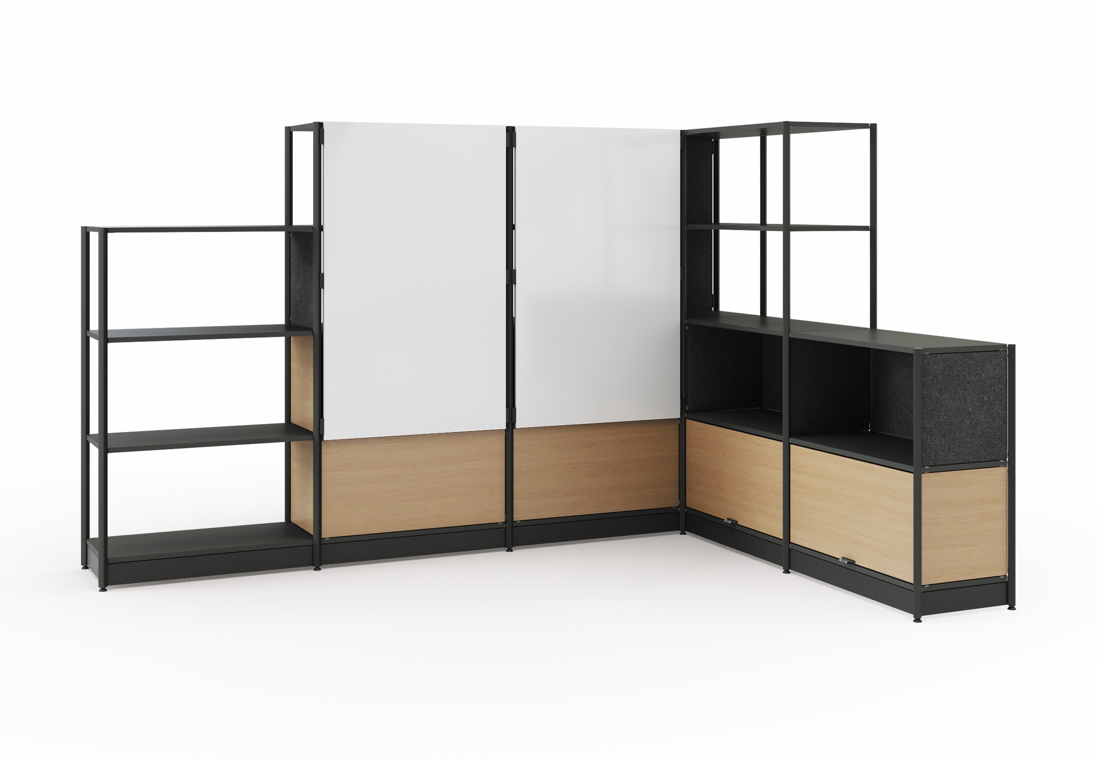
Flex Active Frame
Pre-Configured Unit
WARM TONES
[Key in your title]
Generally thought of as bolder tones, red, orange, and yellow grab the attention of passersby. In essence, they captivate and intrigue individuals. It’s not uncommon for warm shades to make people feel alive and uplifted. These hues have a way of breathing life into everything they touch.
White Board
Shelve/Door
Laminate Color Accents
PET Color Accents
Frame
Paint Color Accents
Wood Grain Laminate
Paint
160: Maple
4AQ9: Scarlet
Warm Tones
Mix and match your proposed color matching

Slide 17
Product Name
Specifications
COOL TONES
[Key in your title]
Cool Colors tend to have a calming effect. At one end of the spectrum, they are cold, impersonal, antiseptic colors. At the other end, cool colors are comforting and nurturing. Blue, green, and the neutrals white, gray, and silver are examples.
White Board
Shelve/Door
Laminate Color Accents
PET Color Accents
Frame
Paint Color Accents
Wood Grain Laminate
Paint
Insert here
Insert here
key in here
key in here
Cool Tones
Mix and match your proposed color matching

