Slide 1
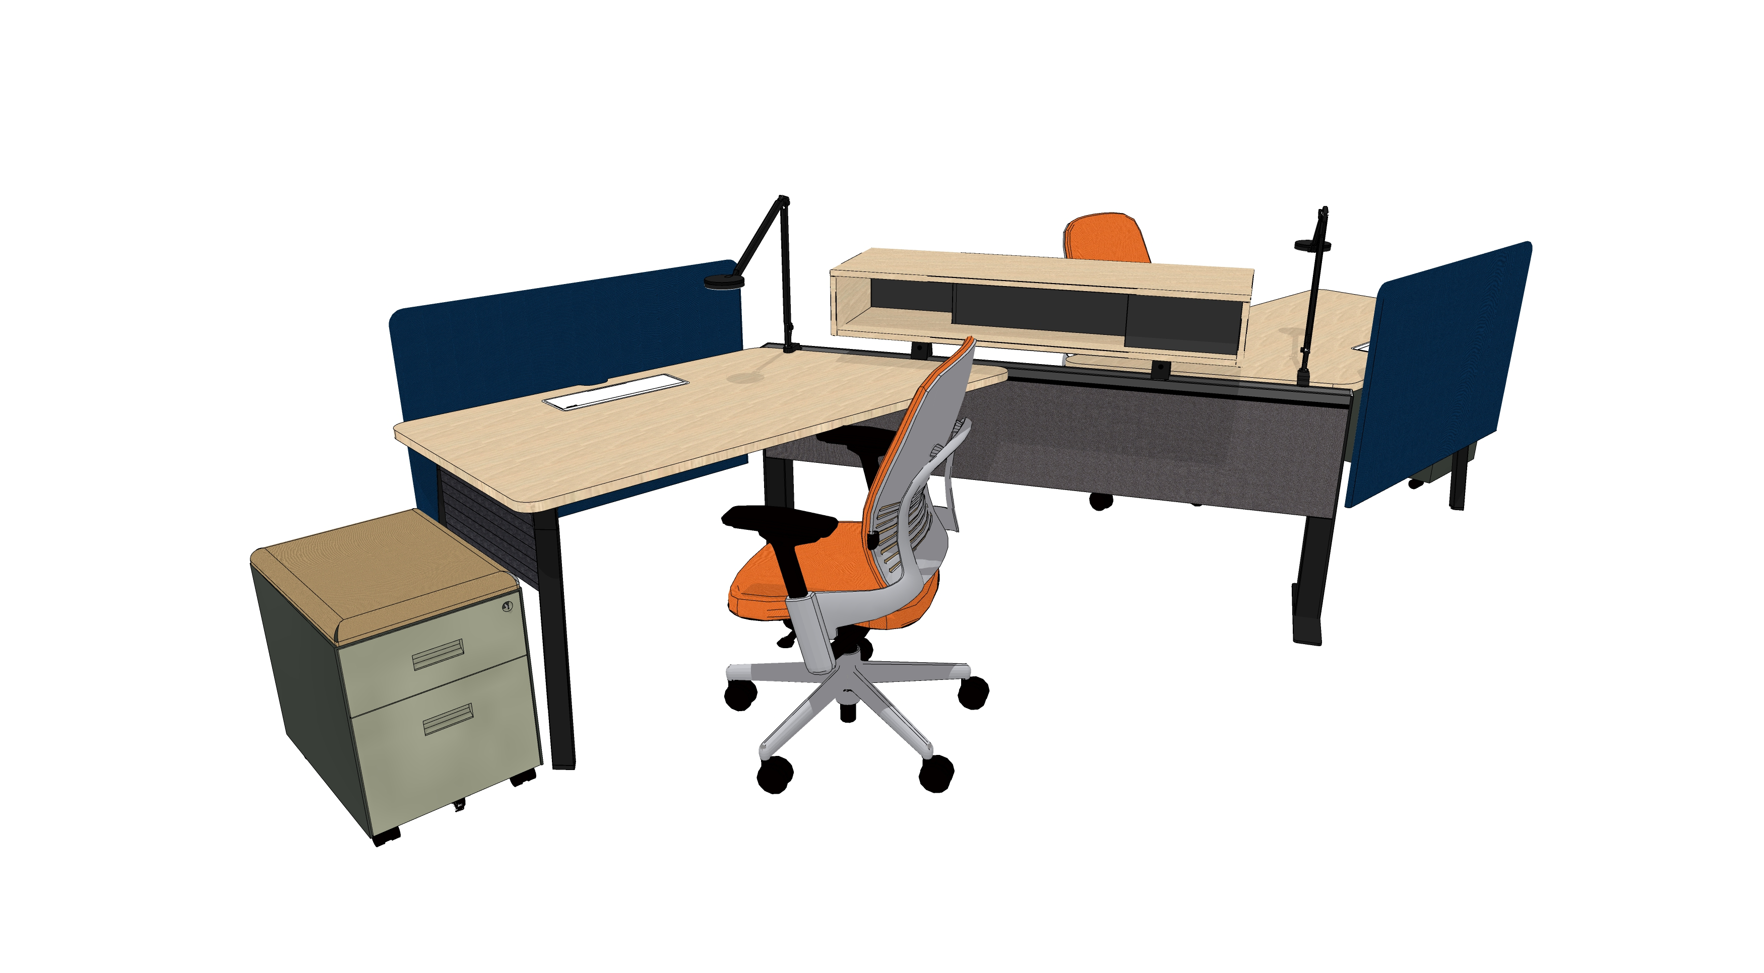
Diversal
Jan 2022
Products & Material Color Theme Template

Slide 2
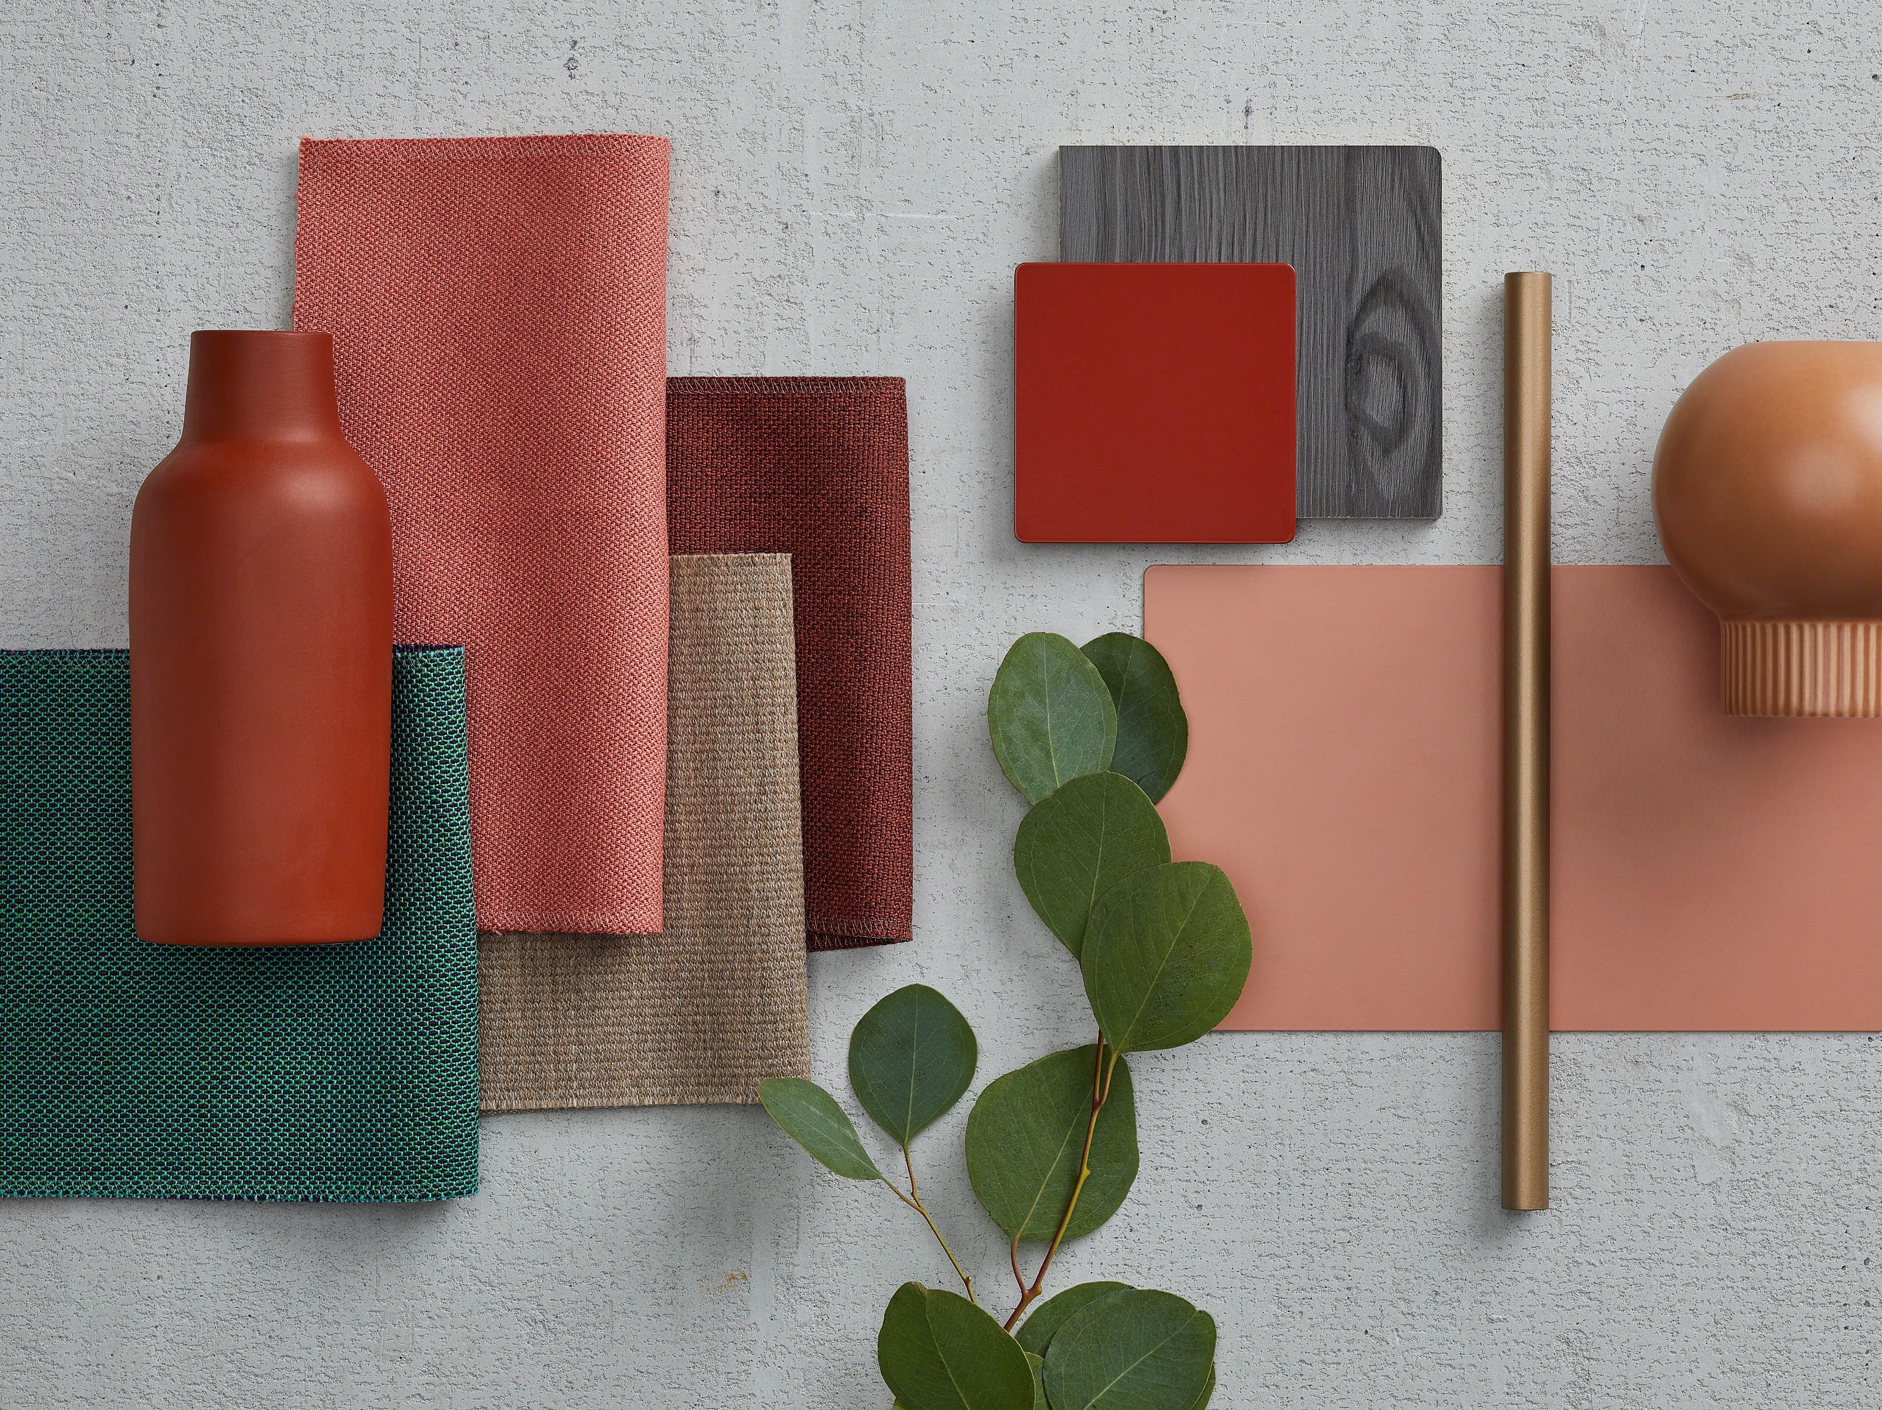
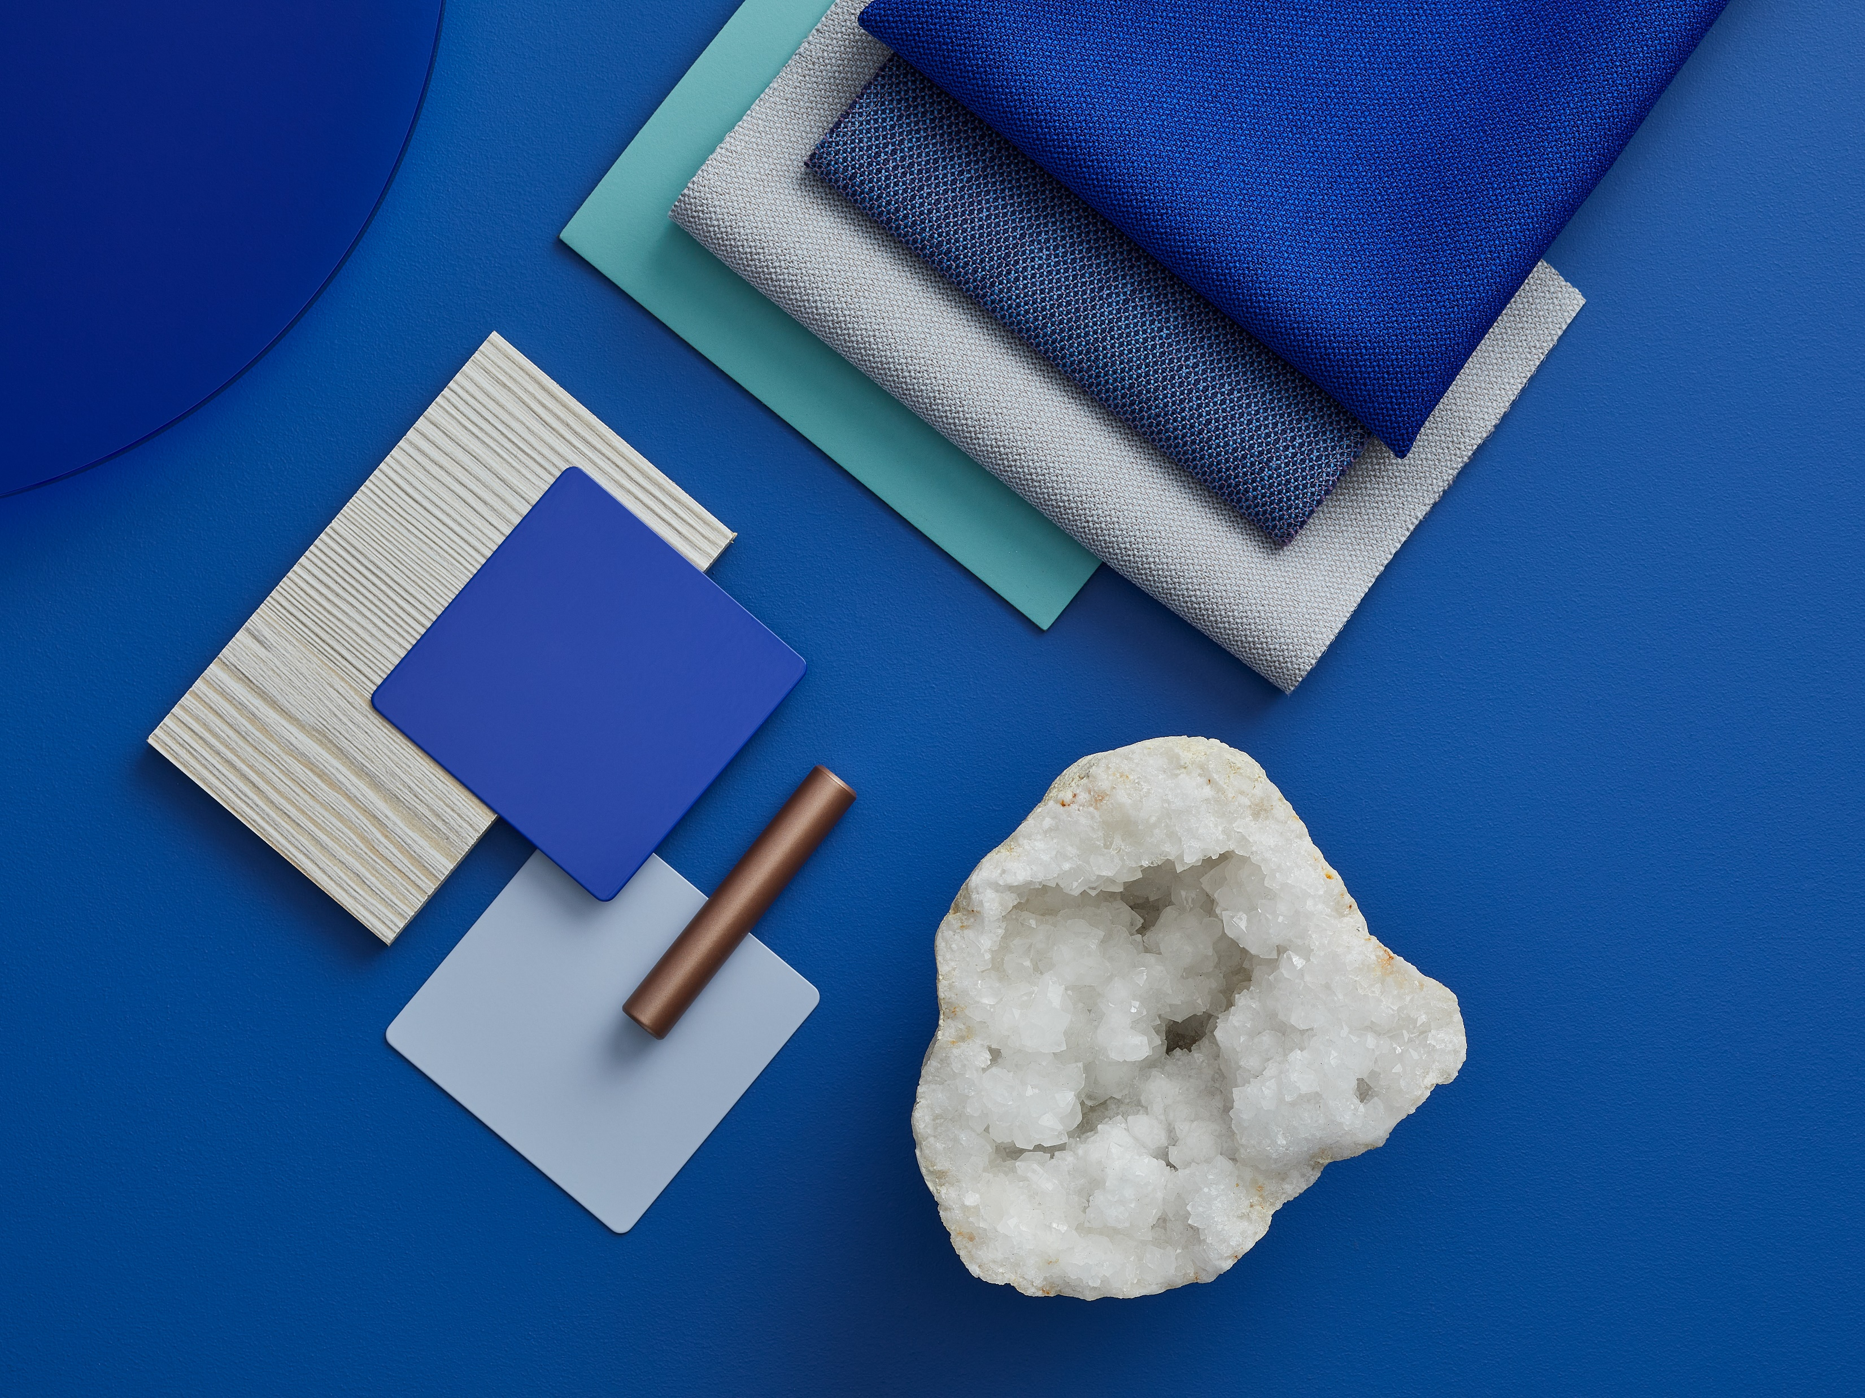
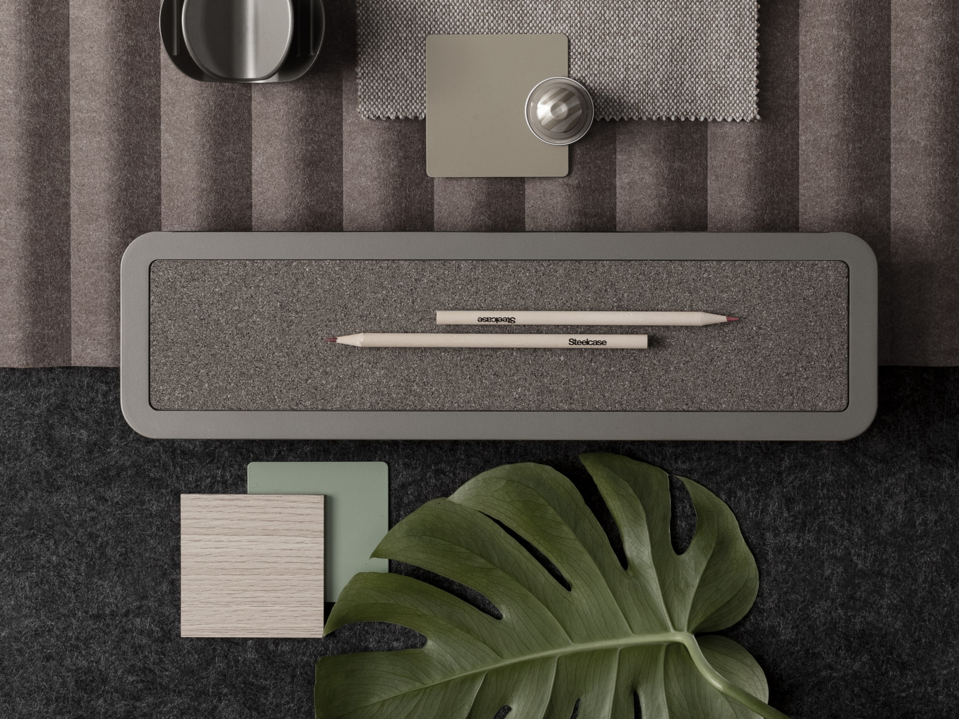
Theme Overview
Warm
Cool Tones
Neutral Tones
[Key in your title]
Generally thought of as bolder tones, red, orange, and yellow grab the attention of passersby. In essence, they captivate and intrigue individuals. It’s not uncommon for warm shades to make people feel alive and uplifted. These hues have a way of breathing life into everything they touch.
[Key in your title]
Cool Colors tend to have a calming effect. At one end of the spectrum, they are cold, impersonal, antiseptic colors. At the other end, cool colors are comforting and nurturing. Blue, green, and the neutrals white, gray, and silver are examples.
[Key in your title]
The neutral colors of black, white, silver, gray, and brown make good backgrounds, serve to unify diverse color palettes, and often stand alone as the only or primary focus of a design. Neutral colors help to put the focus on other colors or serve to tone down colors that might otherwise be overpowering on their own.

Slide 3
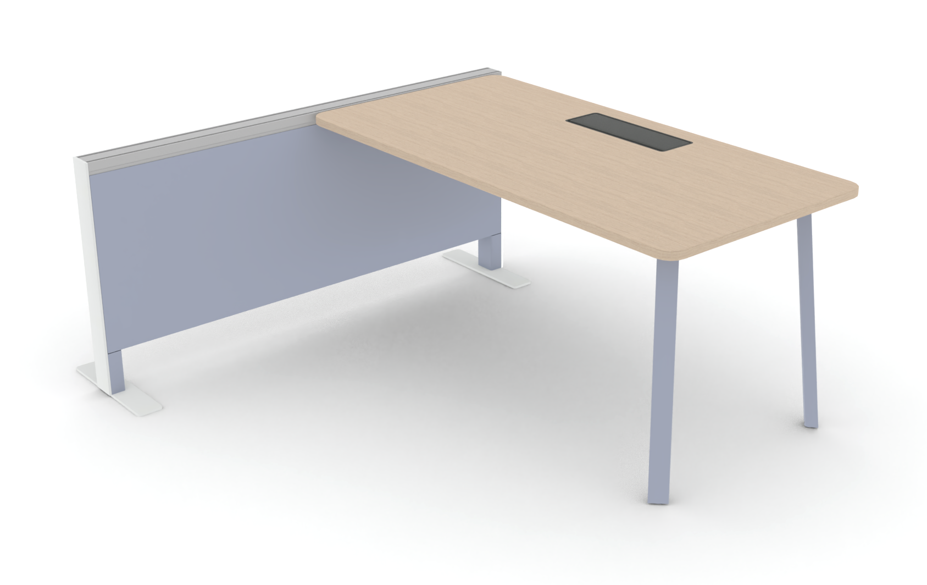
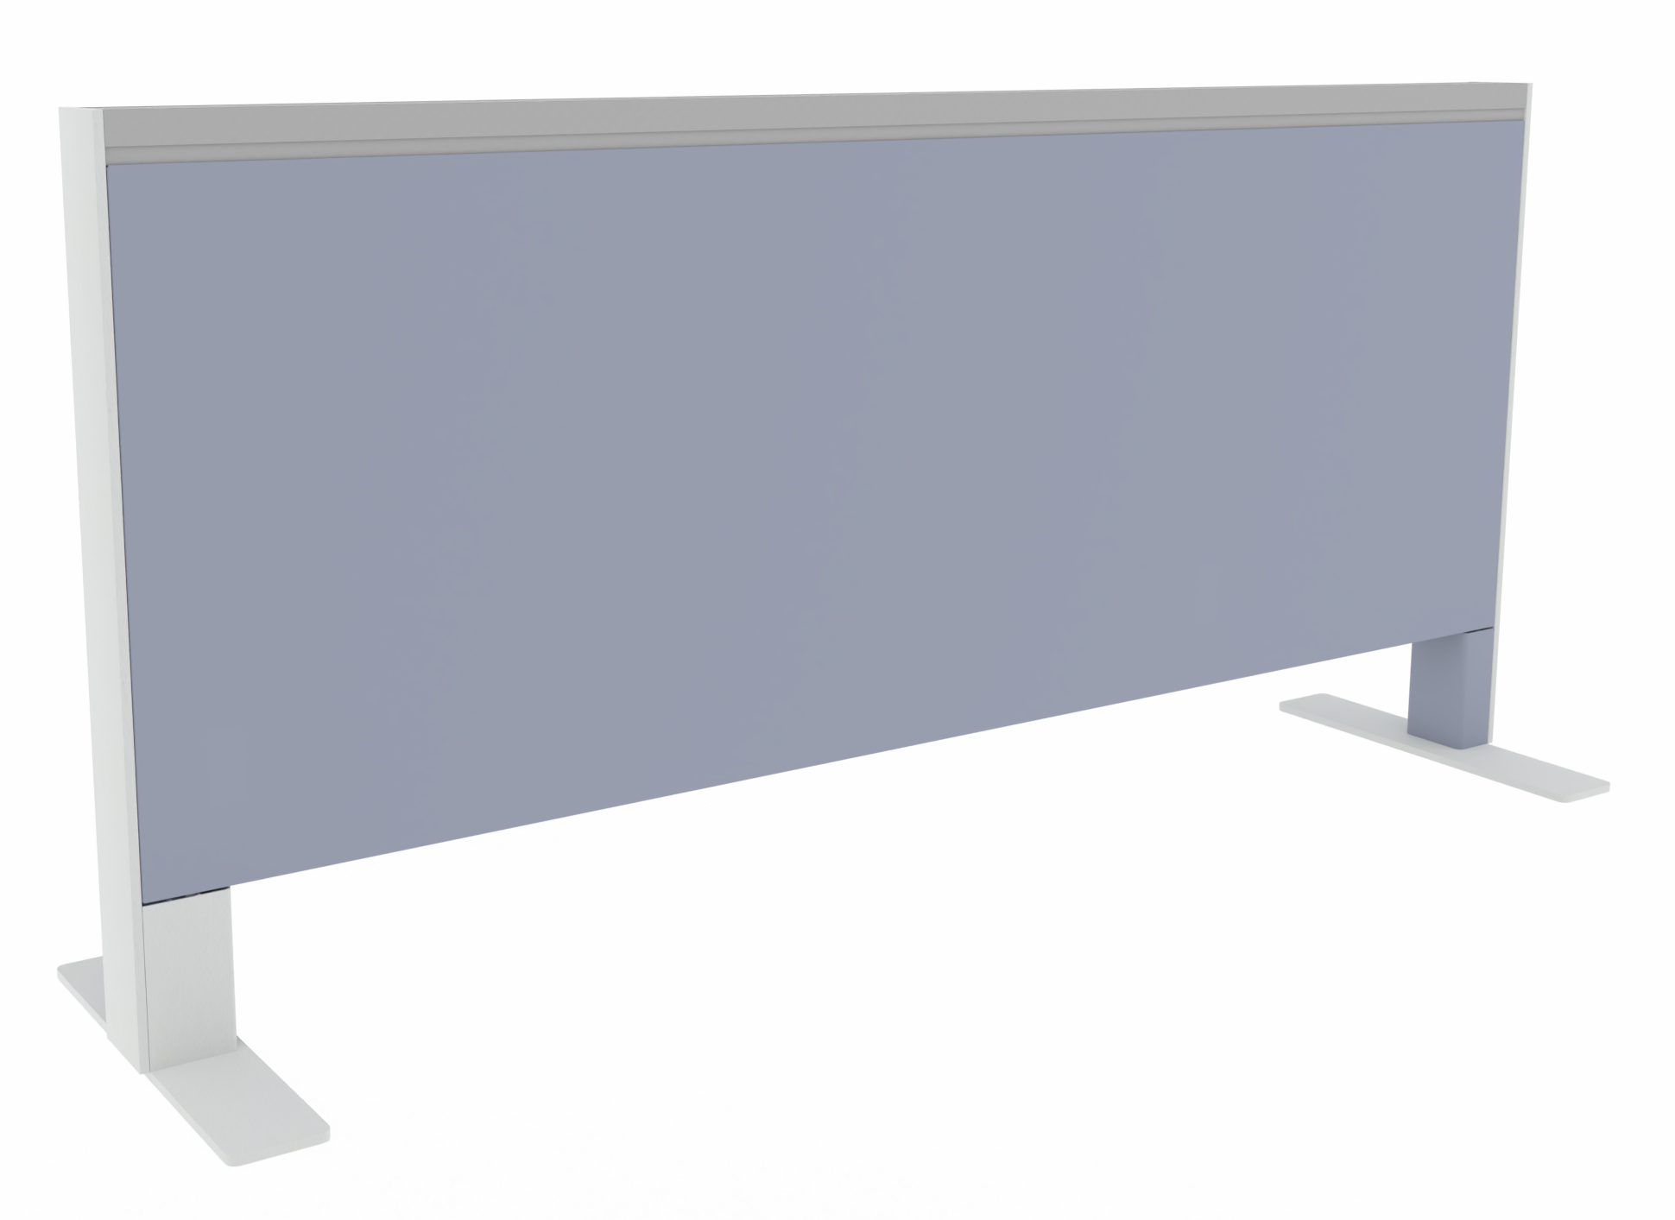
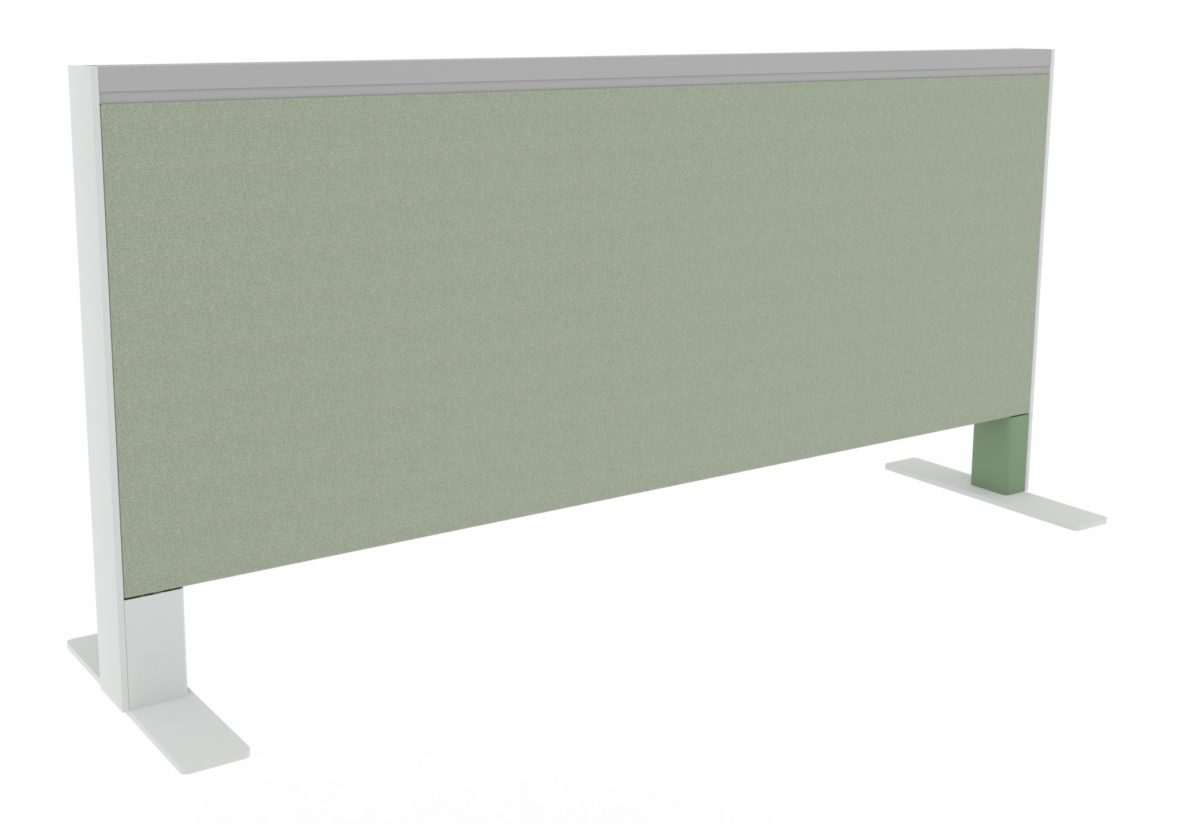
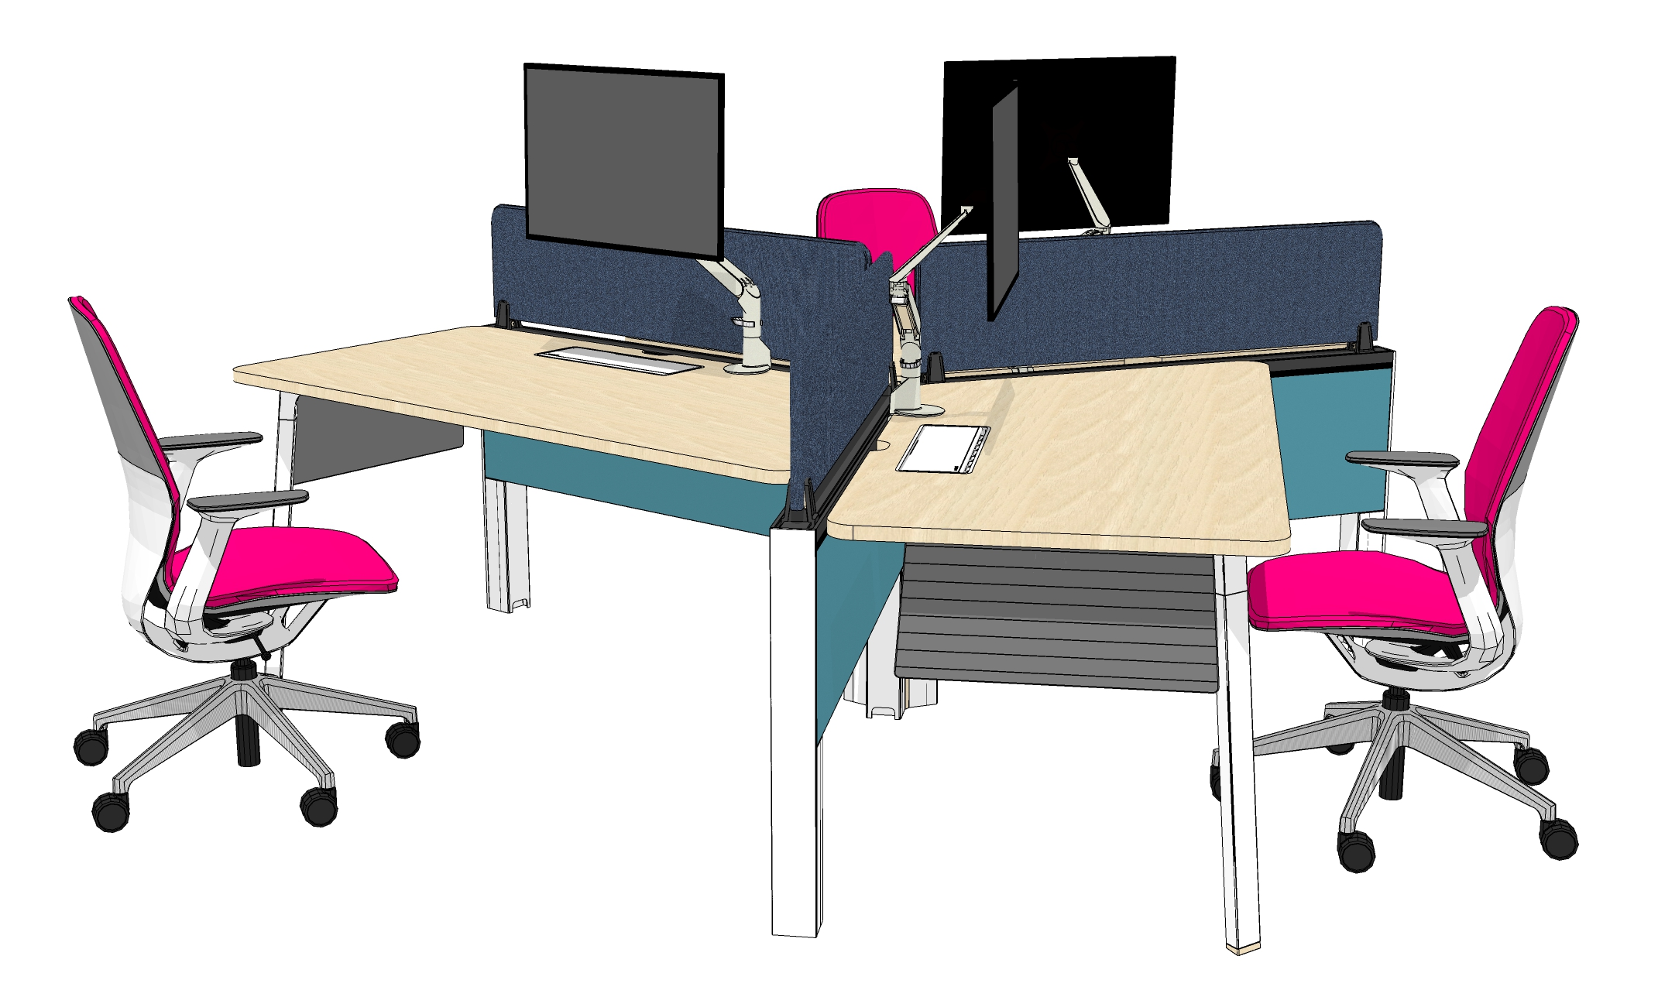
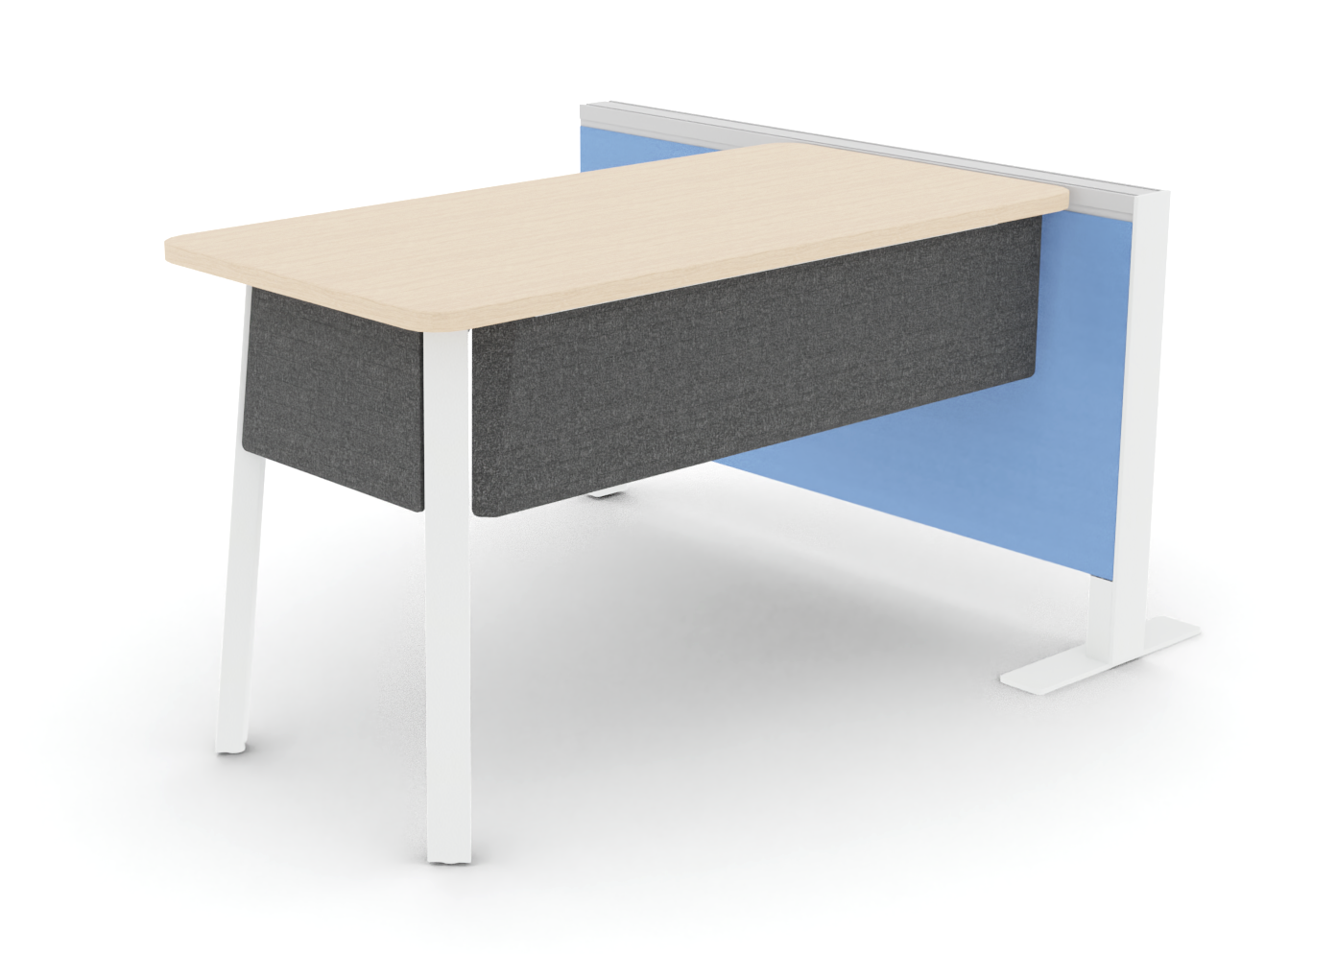
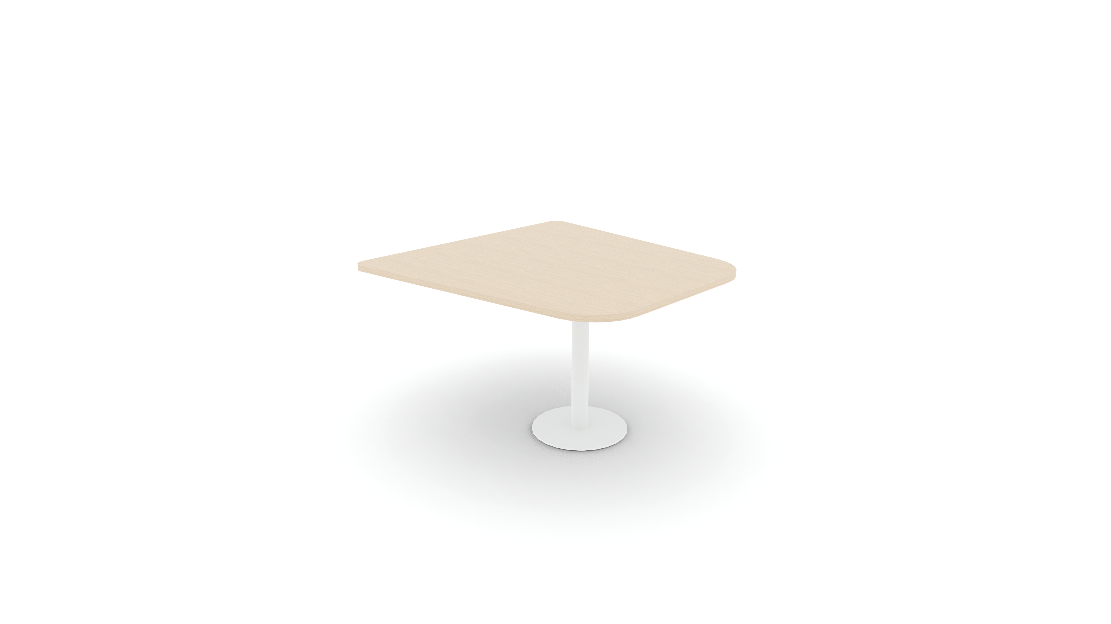
Diversal
System
Desk
Desk
Beam (Metal)
Beam (Fabric)
Collaborative Table
Modesty Panel

Slide 4
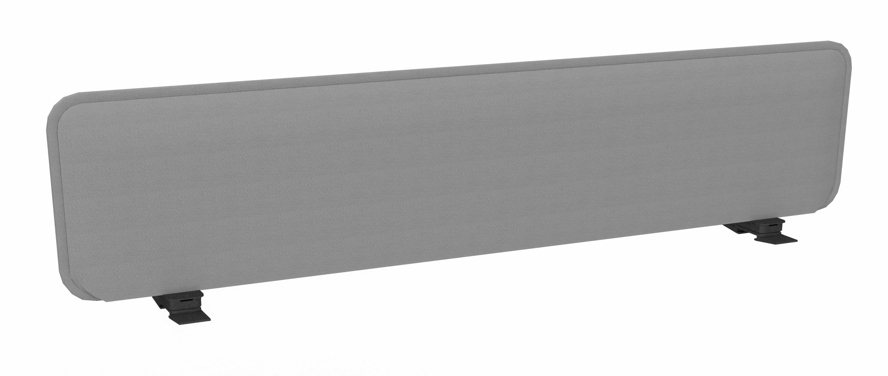
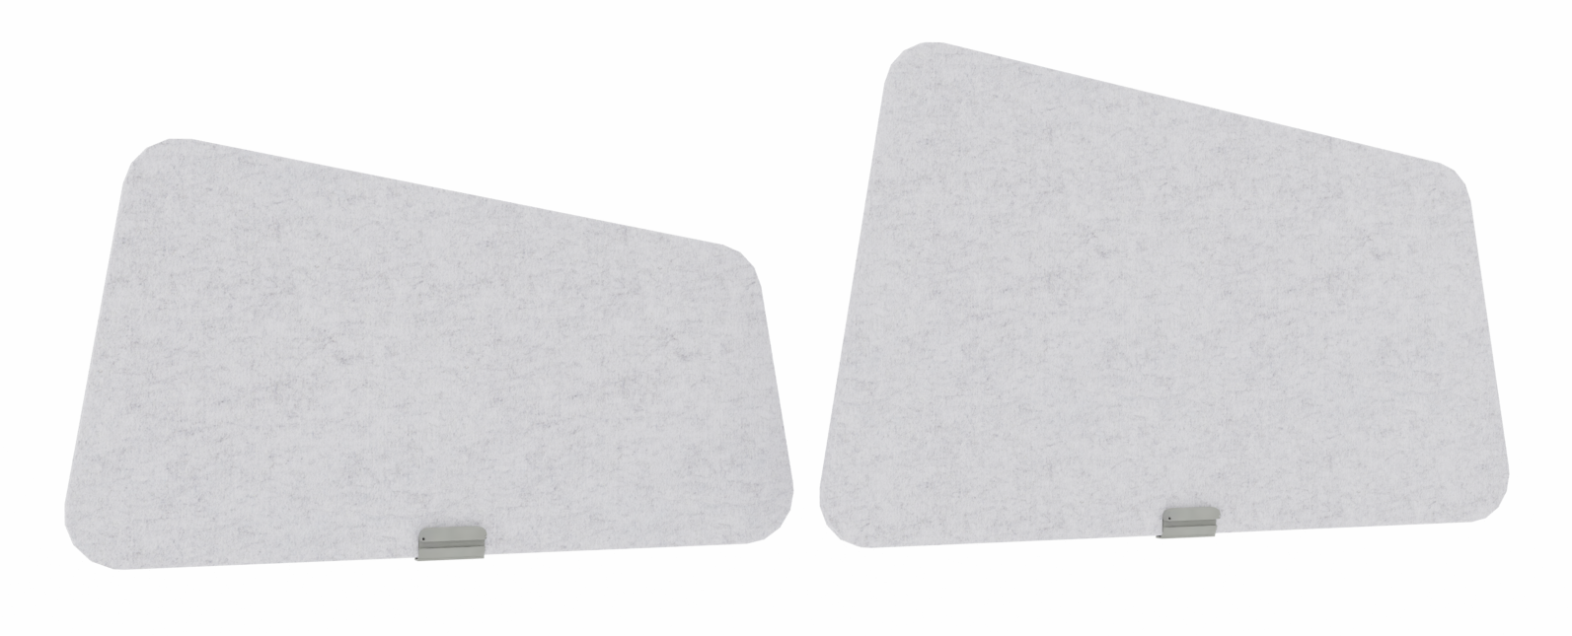
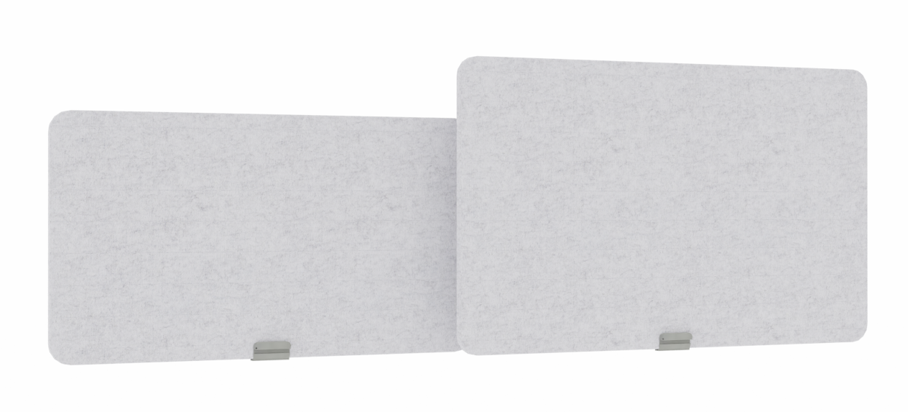
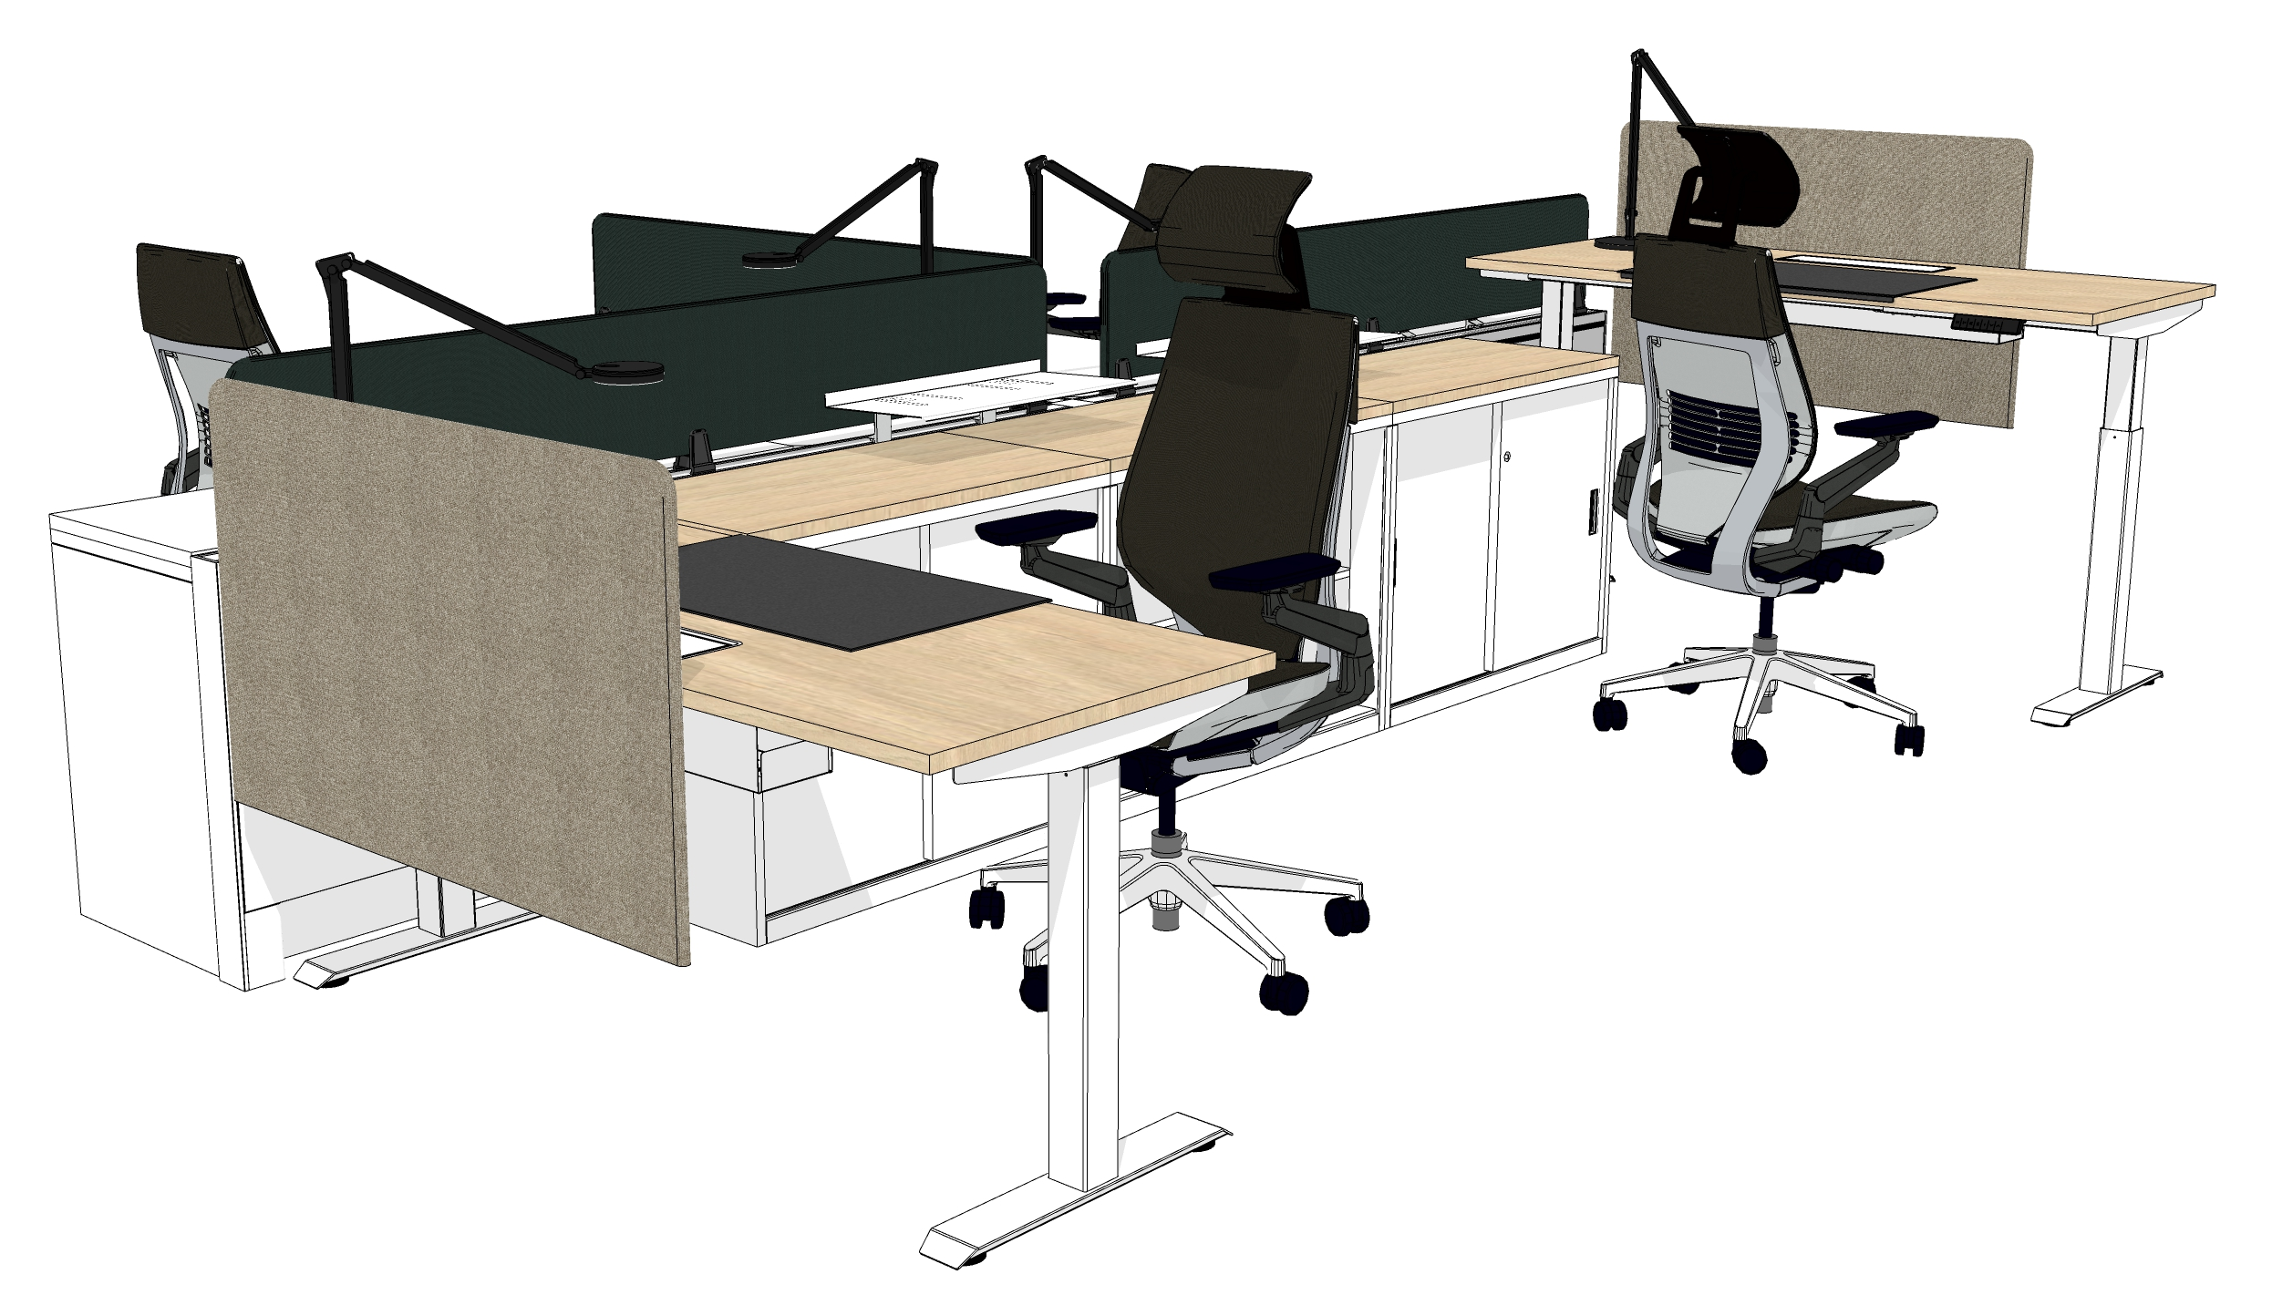
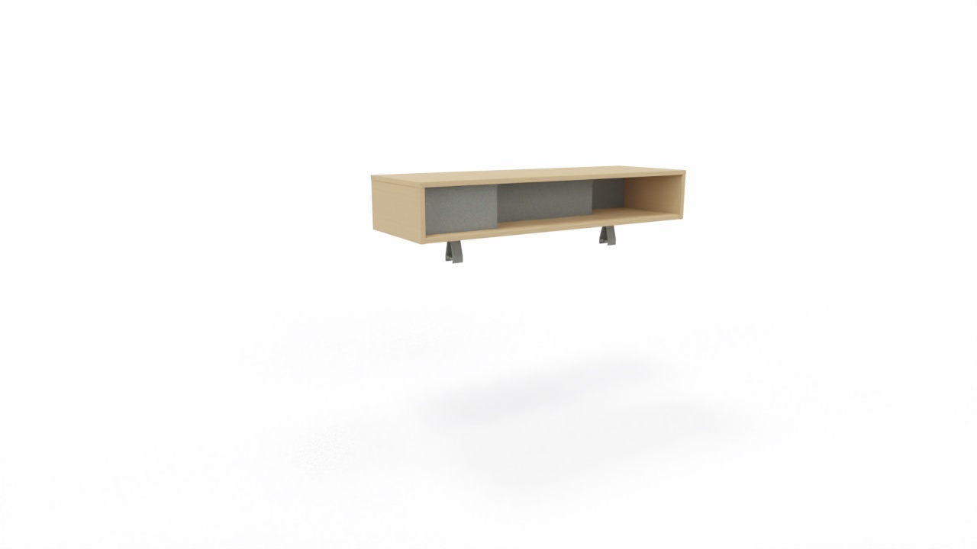
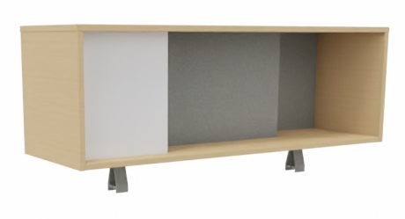
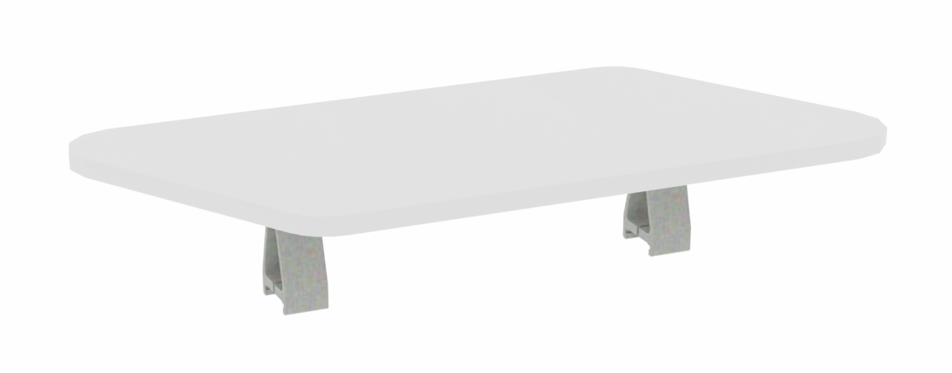
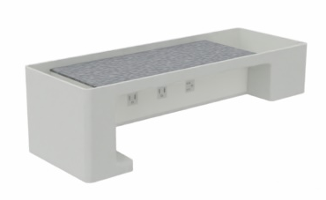
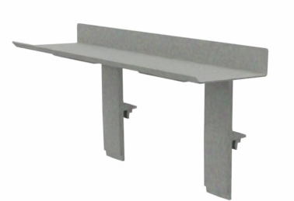
Diversal
System
Accessories
Sarto Center Screen
Frameone Center Screen (Glass)
Sarto Center Screen
Interactive Worktop
Organizer Shelf
Overhead Cabinet
Launch Pad
Soto Shelf

Slide 5
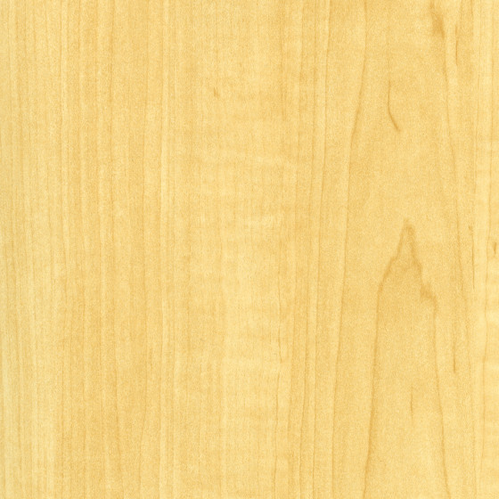
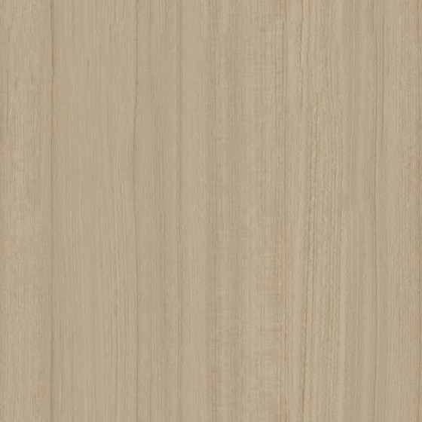
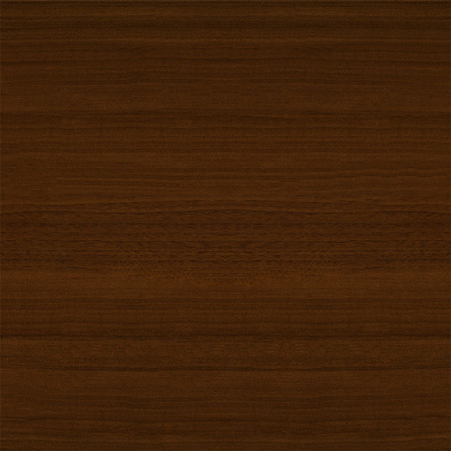
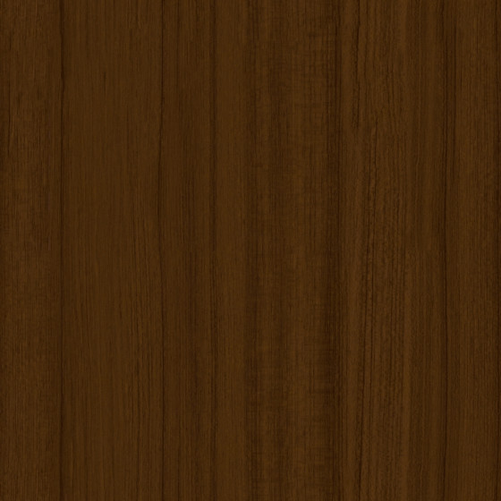





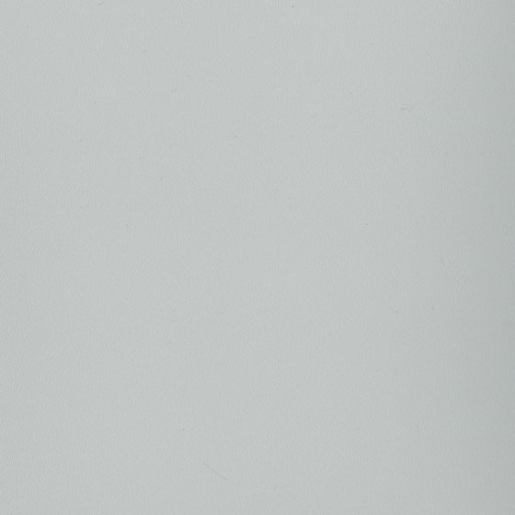

Diversal
Desk
Laminate Color Accents
Leg
PRICE GROUP 1
PRICE GROUP 2
Wood Grain Laminate
Smooth paint color accents
Flipper
Plastic Color Accents
160: Maple
2LAT: Acacia
2L40:
Graphite Walnut
25L8: Clear
Walnut
1ATR: Blush
1ATK: Citrine
4CZ5: Honey
4CZ7: Saffron
4AQ9: Scarlet
4CZ4: Merlot
Worktop
LPL Color Accents
Solid Laminate
AW01: Arctic
White
2L83: Seagull
2LMG: Merle
Plastic Edgeband
Leg
Paint Color Accents
6237: Maple
6213: Acacia
6231:
Graphite Walnut
6245: Clear
Walnut
6009: Arctic
White
6053: Seagull
6527: Merle
Flipper
White
Merle
Warm Tones

Slide 6






Diversal
Desk
Laminate Color Accents
Leg
PRICE GROUP 1
PRICE GROUP 2
Wood Grain Laminate
Smooth paint color accents
Flipper
Plastic Color Accents
160: Maple
2LAT: Acacia
2L40:
Graphite Walnut
25L8: Clear
Walnut
1ATB: Cloud
1ATJ: Sea Salt
1ATH: Olivine
4AQ8: Wasabi
4CZ2: Peacock
4CZ6: Lagoon
4AV3: Blue Jay
Worktop
LPL Color Accents
Solid Laminate
4EE9: Electric Indigo
4CZ1: Aubergine
4CZ3: Jungle
AW01: Arctic
White
2L83: Seagull
2LMG: Merle
Plastic Edgeband
Leg
Paint Color Accents
6237: Maple
6213: Acacia
6231:
Graphite Walnut
6245: Clear
Walnut
6009: Arctic
White
6053: Seagull
6527: Merle
Flipper
White
Merle
Cool Tones

Slide 7




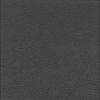


Diversal
Desk
Laminate Color Accents
Leg
PRICE GROUP 1
PRICE GROUP 1
Wood Grain Laminate
Gloss color accents
Flipper
Plastic Color Accents
160: Maple
2LAT: Acacia
2L40:
Graphite Walnut
25L8: Clear
Walnut
4140: Arctic White
Worktop
LPL Color Accents
Solid Laminate
Smooth paint color accents
AW01: Arctic
White
2L83: Seagull
2LMG: Merle
SL: Silver
NI: Nickel
BK: Black
Plastic Edgeband
Texture paint color accents
Leg
Paint Color Accents
6237: Maple
6213: Acacia
6231:
Graphite Walnut
6245: Clear
Walnut
6009: Arctic
White
7241: Arcrtic White
7360: Merle
PRICE GROUP 3
6527: Merle
Smooth Metallic
6053: Seagull
Flipper
4798: Sterling
Metallic
White
Merle
PRICE GROUP 4
Texture Metallic
7246: Midnight
Metallic
Neutral Tones

Slide 8
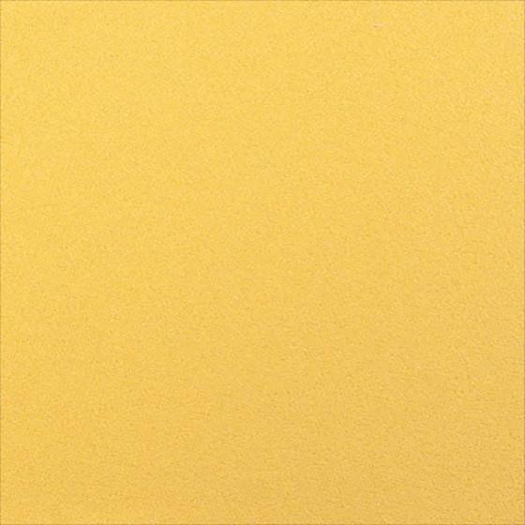
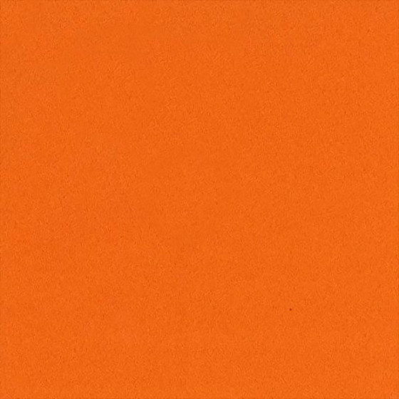
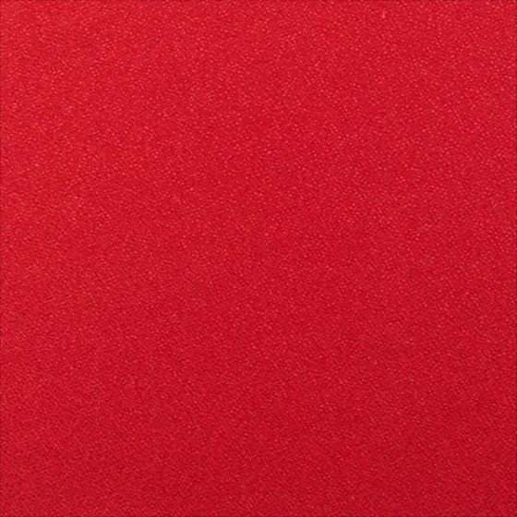
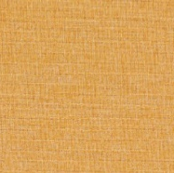
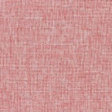
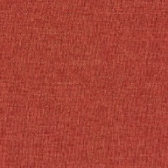
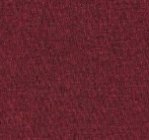
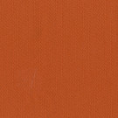
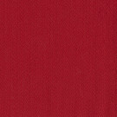
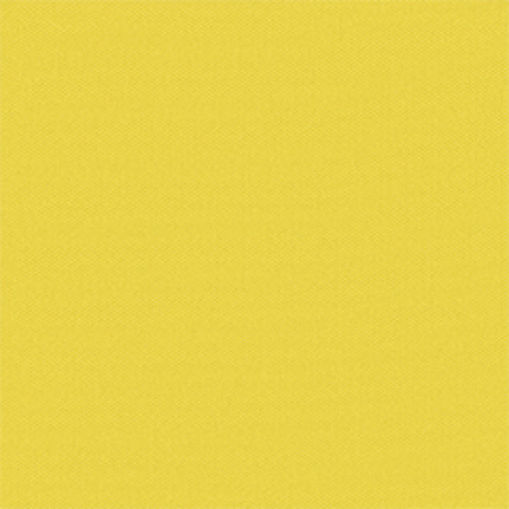

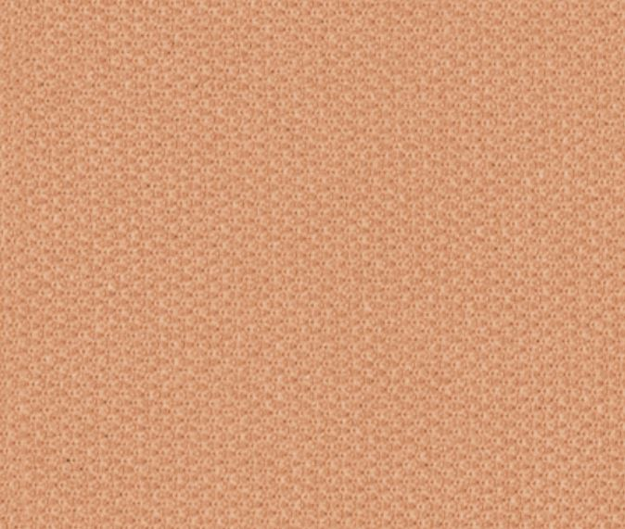
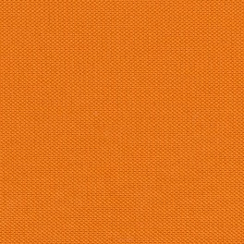

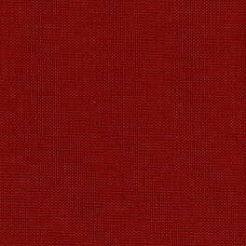
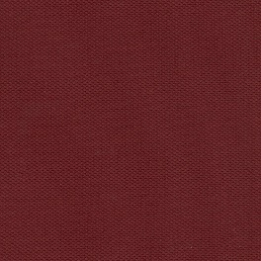
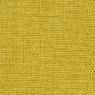
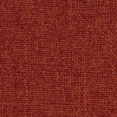
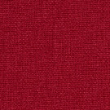
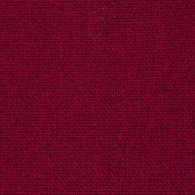
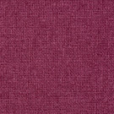

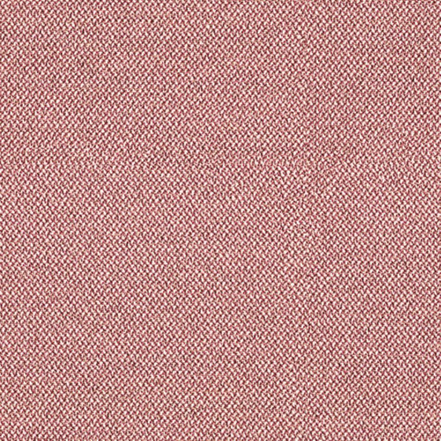
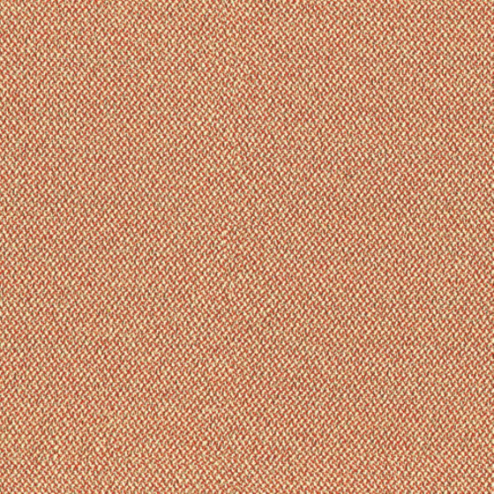
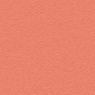

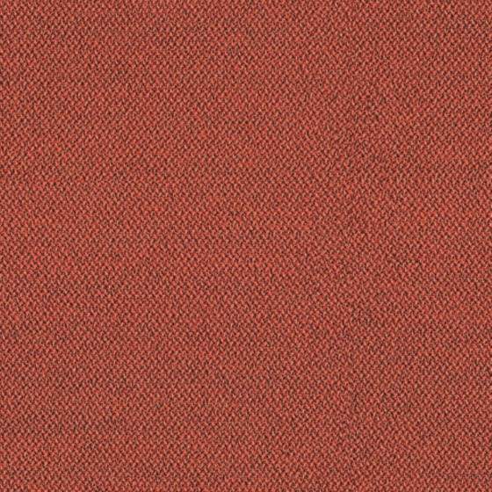
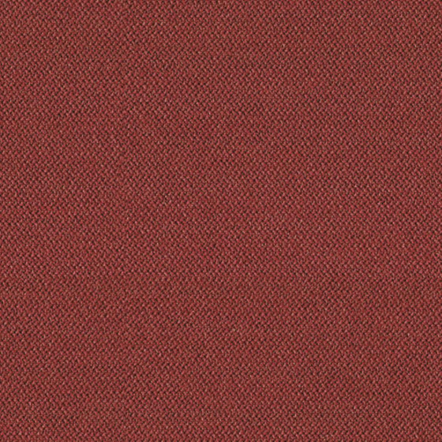
Diversal
Beam (Fabric)
Fabric Color Accents (Skin)
Paint Color Accents (Frame)
PRICE GROUP 1
Omni-R
Smooth paint color accents
Rail
Aluminum Color Accents
J518: Maize
J537: Tangerine
J538:Scarlet
J502: Crimson
1ATR: Blush
1ATK: Citrine
Otto
Skin
Paint Color Accents
Paint Color Accents (End-of-Run, Cable Cover & Stabilizer)
No warm tone available
End-of-Run
Paint Color Accents
K605: Honey
K606: Coral
K607: Saffron
K608: Merlot
PRICE GROUP 2
Aluminum Color Accents
Cable Cover
Paint Color Accents
Buzz 2
Anodized Aluminum Color Accents
Frame
Paint Color Accents
5G55: Pumpkin
5G57: Rouge
8050: Clear Anodize
8051: Dark Anodize
Stabilizer
Paint Color Accents
Cogent Connect
5SD5: Citrine
5S16: Turmeric
5SD6:
Rose Quartz
5SD4: Saffron
5S17: Tangerine
5S18: Scarlet
5S99: Lipstick
Medley
62002:
Mustard Yellow
63017:
Orange Mix
64019: Red
64123:
Cherry Red
64125:
Dark Pink
Era
5EU1: Pink
5ER8: Pink
Lemonade
5ES3: Persimmon
5ET1: Peach
5ET2: Cherry
5ER7: Saffron
5ES0: Scarlet
Warm Tones

Slide 9
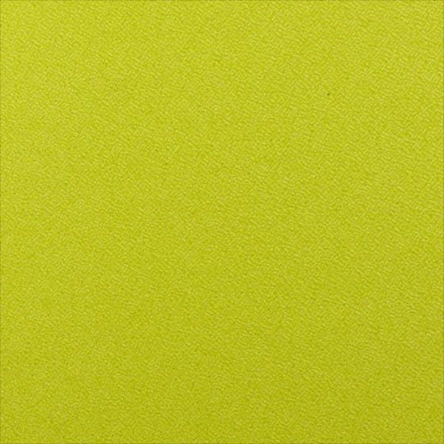





















































Diversal
Beam (Fabric)
Fabric Color Accents (Skin)
Fabric Color Accents (Skin)
PRICE GROUP 1
Omni-R
Era
Rail
Aluminum Color Accents
J543: Wasabi
J541: Blue Jay
J513: Azure Blue
J506: Sapphire
J507: Ink Blue
J515: Hydrangea
K609: Aubergine
5ET3:
Fresh Green
5ET8: Stone
5ES4: Sprout
5EU3: Green Citrine
5ET4: Jade
5ER3:
Pistachio
5ET5: Sky
Otto
Skin
Paint Color Accents
K604: Grass
K603: Olive
K602: Lizard
K601: Peacock
K611: Bluestone
K610: Lagoon
5ES5: Blue Mint
5ET9: Slate
5ET7: Ocean
5EU2: Electric Indigo
5ER2: Blue Nickel
5ER0: Cobalt
End-of-Run
Paint Color Accents
PRICE GROUP 2
Paint Color Accents (Frame)
Cable Cover
Paint Color Accents
Buzz 2
Smooth paint color accents
Frame
Paint Color Accents
5G59: Meadow
5F07: Blue
5F08: Navy
5F05: Burgundy
1ATB: Cloud
1ATJ: Sea Salt
1ATH: Olivine
4EE9: Electric Indigo
Stabilizer
Paint Color Accents
Cogent Connect
Paint Color Accents (End-of-Run, Cable Cover & Stabilizer)
No cool tone available
5SF4: Olivine
5S23: Wasabi
5SD7: Sea Salt
5S21: Blue Jay
5SD3: Lagoon
5SF3: Storm
Cloud
5S18: Connect
Aluminum Color Accents
5SD2: Peacock
5S94: Lizard
5SD0: Royal Blue
5S93: Blueprint
5S95: Sailor
5SD1: Aubergine
Anodized Aluminum Color Accents
Medley
8050: Clear Anodize
8051: Dark Anodize
68002: Apple Green
68005: Khaki
Green
67054: Dark
Green
67006: Sky Blue
66144: Denim
67053: Water Blue
66007: Blue Jean
66010: Blue
66145: Blue Purple
65086: Dark
Purple
65012: Purple
Cool Tones

Slide 10






































Diversal
Beam (Fabric)
Fabric Color Accents (Skin)
Paint Color Accents (Skin, Frame, End-of-Run, Cable Cover & Stabilizer )
PRICE GROUP 1
Omni-R
Gloss color accents
Rail
Aluminum Color Accents
J544: Nickel
J508: Rhino
J535: Coconut
J521: Cloud
J547: Malt
J517: Cork
J509: Cocoa
J501: Ebony
4140: Arctic White
Otto
Smooth paint color accents
Skin
Paint Color Accents
End-of-Run
Paint Color Accents
K612: Smoke
K613: Iron
K614: Ash
K615: Charcoal
SL: Silver
NI: Nickel
BK: Black
PRICE GROUP 2
Texture paint color accents
Cable Cover
Paint Color Accents
Buzz 2
Frame
Paint Color Accents
7241: Arcrtic White
7360: Merle
Stabilizer
Paint Color Accents
5G64: Alpine
5G51: Sable
5F15: Stone
5G65: Tornado
5F17: Black
PRICE GROUP 3
Cogent Connect
Smooth Metallic
5S24: Nickel
5S15: Coconut
5S27: Malt
5S96: Quicksilver
5S28: Root Beer
5S25: Graphite
5S26: Licorice
4798: Sterling
Metallic
Cross Check
PRICE GROUP 4
Texture Metallic
CC14: Platinum
CS15: Basalt
CS10: Otter
CC16: Slate
Black
Medley
7246: Midnight
Metallic
66008: Light Grey
61002: Beige
60003: Grey
61003: Chamois
67002: Khaki
60167: Grey Brown
60004: Pepper
61004: Mocha
60999: Black Pepper
Era
Neutral Tones
5ET6: Cloud
5ER6: Truffle
5ES7: Night Owl
5ER9: Onyx

Slide 11
Diversal
Beam (Metal)
Paint Color Accents (Skin)
Aluminum Color Accents
PRICE GROUP 2
Smooth paint color accents
Anodized Aluminum Color Accents
Rail
Aluminum Color Accents
1ATR: Blush
1ATK: Citrine
4CZ5: Honey
4CZ7: Saffron
4AQ9: Scarlet
4CZ4: Merlot
8050: Clear Anodize
8051: Dark Anodize
Skin
Paint Color Accents
Paint Color Accents (Frame)
Smooth paint color accents
End-of-Run
Paint Color Accents
1ATR: Blush
1ATK: Citrine
Cable Cover
Paint Color Accents
Paint Color Accents (End-of-Run, Cable Cover & Stabilizer)
Frame
Paint Color Accents
No warm tone available
Stabilizer
Paint Color Accents
Warm Tones

Slide 12
Diversal
Beam (Metal)
Paint Color Accents (Skin)
Aluminum Color Accents
PRICE GROUP 2
Smooth paint color accents
Anodized Aluminum Color Accents
Rail
Aluminum Color Accents
1ATB: Cloud
1ATJ: Sea Salt
1ATH: Olivine
4AQ8: Wasabi
4CZ2: Peacock
4CZ6: Lagoon
4AV3: Blue Jay
8050: Clear Anodize
8051: Dark Anodize
Skin
Paint Color Accents
4EE9: Electric Indigo
4CZ1: Aubergine
4CZ3: Jungle
End-of-Run
Paint Color Accents
Paint Color Accents (Frame)
Smooth paint color accents
Cable Cover
Paint Color Accents
Frame
Paint Color Accents
1ATB: Cloud
1ATJ: Sea Salt
1ATH: Olivine
4EE9: Electric Indigo
Stabilizer
Paint Color Accents
Paint Color Accents (End-of-Run, Cable Cover & Stabilizer)
No cool tone available
Cool Tones

Slide 13
Diversal
Beam (Metal)
Paint Color Accents (End-of-Run, Cable Cover & Stabilizer)
Aluminum Color Accents
PRICE GROUP 1
Gloss color accents
Anodized Aluminum Color Accents
Rail
Aluminum Color Accents
4140: Arctic White
8050: Clear Anodize
8051: Dark Anodize
Smooth paint color accents
Skin
Paint Color Accents
End-of-Run
Paint Color Accents
SL: Silver
NI: Nickel
BK: Black
Texture paint color accents
Cable Cover
Paint Color Accents
Frame
Paint Color Accents
7241: Arcrtic White
7360: Merle
Stabilizer
Paint Color Accents
PRICE GROUP 3
Smooth Metallic
4798: Sterling
Metallic
PRICE GROUP 4
Texture Metallic
7246: Midnight
Metallic
Neutral Tones

Slide 14
Diversal
Collaborative Table
Laminate Color Accents
Structure
PRICE GROUP 1
PRICE GROUP 2
Wood Grain Laminate
Smooth paint color accents
Worksurface
Laminate Color Accents
160: Maple
2LAT: Acacia
2L40:
Graphite Walnut
25L8: Clear
Walnut
4AQ9: Scarlet
Solid Laminate
Structure
Paint Color Accents
AW01: Arctic
White
2L83: Seagull
2LMG: Merle
Plastic Edgeband
6237: Maple
6213: Acacia
6231:
Graphite Walnut
6245: Clear
Walnut
6009: Arctic
White
6053: Seagull
6527: Merle
Warm Tones

Slide 15
Diversal
Collaborative Table
Laminate Color Accents
Structure
PRICE GROUP 1
PRICE GROUP 2
Wood Grain Laminate
Smooth paint color accents
Worksurface
Laminate Color Accents
160: Maple
2LAT: Acacia
2L40:
Graphite Walnut
25L8: Clear
Walnut
4AQ8: Wasabi
4AV3: Blue Jay
Solid Laminate
Structure
Paint Color Accents
AW01: Arctic
White
2L83: Seagull
2LMG: Merle
Plastic Edgeband
6237: Maple
6213: Acacia
6231:
Graphite Walnut
6245: Clear
Walnut
6009: Arctic
White
6053: Seagull
6527: Merle
Cool Tones

Slide 16
Diversal
Collaborative Table
Laminate Color Accents
Structure
PRICE GROUP 1
PRICE GROUP 1
Wood Grain Laminate
Gloss color accents
Worksurface
Laminate Color Accents
160: Maple
2LAT: Acacia
2L40:
Graphite Walnut
25L8: Clear
Walnut
4140: Arctic White
Solid Laminate
Smooth paint color accents
Structure
Paint Color Accents
AW01: Arctic
White
2L83: Seagull
2LMG: Merle
SL: Silver
NI: Nickel
BK: Black
Plastic Edgeband
Texture paint color accents
6237: Maple
6213: Acacia
6231:
Graphite Walnut
6245: Clear
Walnut
6009: Arctic
White
7241: Arcrtic White
7360: Merle
PRICE GROUP 3
6527: Merle
Smooth Metallic
6053: Seagull
4798: Sterling
Metallic
PRICE GROUP 4
Texture Metallic
7246: Midnight
Metallic
Neutral Tones

Slide 17



Diversal
Modesty Panel
PET Color Accents
Paint Color Accents
PET color accents
Texture paint color accents
BZ11: Silver
BZ36: Grey
BZ03: Dark Grey
7241: Arcrtic White
7360: Merle
Modesty Panel
PET Color Accents
Neutral Tones

Slide 18





Diversal
Sarto Screen
Fabric Color Accents
PET Color Accents
PRICE GROUP 1
No warm tone available
Omni-R
Structure
J518: Maize
J537: Tangerine
J538:Scarlet
J502: Crimson
Texture paint color accents
Otto
Center Screen
Fabric Color Accents
PET W/ Stripe
PET W/ No Stripe
7360: Merle
K605: Honey
K606: Coral
K607: Saffron
K608: Merlot
Smooth paint color accents
PRICE GROUP 2
Cogent Connect
SL: Silver
5SD5: Citrine
5S16: Turmeric
5SD6:
Rose Quartz
5SD4: Saffron
5S17: Tangerine
5S18: Scarlet
5S99: Lipstick
Medley
62002:
Mustard Yellow
63017:
Orange Mix
64019: Red
64123:
Cherry Red
64125:
Dark Pink
Era
5EU1: Pink
5ER8: Pink
Lemonade
5ES3: Persimmon
5ET1: Peach
5ET2: Cherry
5ER7: Saffron
5ES0: Scarlet
Stencil
P469: Sepia
P459: Chartreuse
P461: Mauvelous
P456: Mulberry
Warm Tones

Slide 19







Diversal
Sarto Screen
Fabric Color Accents
Fabric Color Accents
PRICE GROUP 1
Omni-R
Stencil
J543: Wasabi
J541: Blue Jay
J513: Azure Blue
J506: Sapphire
J507: Ink Blue
J515: Hydrangea
K609: Aubergine
P468: Honeydew
P467: Sea Salt
P462: Bermuda
P458: Denim
Otto
PET Color Accents
Center Screen
Fabric Color Accents
PET W/ Stripe
PET W/ No Stripe
PET With No Stripe
K604: Grass
K603: Olive
K602: Lizard
K601: Peacock
K611: Bluestone
K610: Lagoon
PRICE GROUP 2
Cogent Connect
BZ47: Cloud
1904: Sea Salt
1907: Denim
Structure
5SF4: Olivine
5S23: Wasabi
5SD7: Sea Salt
5S21: Blue Jay
5SD3: Lagoon
5SF3: Storm
Cloud
5S18: Connect
Texture paint color accents
5SD2: Peacock
5S94: Lizard
5SD0: Royal Blue
5S93: Blueprint
5S95: Sailor
5SD1: Aubergine
7360: Merle
Smooth paint color accents
Medley
SL: Silver
68002: Apple Green
68005: Khaki
Green
67054: Dark
Green
67006: Sky Blue
66144: Denim
67053: Water Blue
66007: Blue Jean
66010: Blue
66145: Blue Purple
65086: Dark
Purple
65012: Purple
Era
5ET3:
Fresh Green
5ET8: Stone
5ES4: Sprout
5EU3: Green Citrine
5ET4: Jade
5ER3:
Pistachio
5ET5: Sky
Cool Tones
5ES5: Blue Mint
5ET9: Slate
5ET7: Ocean
5EU2: Electric Indigo
5ER2: Blue Nickel
5ER0: Cobalt

Slide 20








Diversal
Sarto Screen
Fabric Color Accents
PET Color Accents
PRICE GROUP 1
Omni-R
PET With No Stripe
J544: Nickel
J508: Rhino
J535: Coconut
J521: Cloud
J547: Malt
J517: Cork
J509: Cocoa
J501: Ebony
BZ11: Silver
1902: Flax
BZ03: Dark Grey
Otto
PET With Stripe
Center Screen
Fabric Color Accents
PET W/ Stripe
PET W/ No Stripe
K612: Smoke
K613: Iron
K614: Ash
K615: Charcoal
BZ11: Silver
PRICE GROUP 2
Structure
Cogent Connect
Texture paint color accents
5S24: Nickel
5S15: Coconut
5S27: Malt
5S96: Quicksilver
5S28: Root Beer
5S25: Graphite
5S26: Licorice
7360: Merle
Medley
Smooth paint color accents
66008: Light Grey
61002: Beige
60003: Grey
61003: Chamois
67002: Khaki
60167: Grey Brown
60004: Pepper
SL: Silver
61004: Mocha
60999: Black Pepper
Era
5ET6: Cloud
5ER6: Truffle
5ES7: Night Owl
5ER9: Onyx
Stencil
P466: Silk
P465: Parchment
P464: Orchid
P460: Bittersweet
P463: Concrete
P457: Cracked Pepper
P455: Midnight
Neutral Tones

Slide 21

Diversal
PET Light Screen (Landscape)
PET Color Accents
Plastic Color Accents
PET color accents
Plastic color accents
BZ11: Silver
BZ36: Grey
6249: Platinum Solid/Nickel
6527: Merle
Screen
PET Color Accents
Bracket
Plastic Color Accents
Neutral Tones

Slide 22
Diversal
PET Light Screen (Rectangular)
PET Color Accents
Plastic Color Accents
PET color accents
Plastic color accents
BZ11: Silver
BZ36: Grey
6249: Platinum Solid/Nickel
6527: Merle
Screen
PET Color Accents
Bracket
Plastic Color Accents
Neutral Tones

Slide 23
Diversal
Organizer Shelf
Laminate Color Accents
Structure
PRICE GROUP 1
Divider
Wood Grain Laminate
Smooth Paint color accents
Frame
Laminate Color Accents
160: Maple
2LAT: Acacia
2L40:
Graphite Walnut
25L8: Clear
Walnut
4AQ9: Scarlet
Solid Laminate
Divider
Paint Color
Accents
Hook
AW01: Arctic
White
2L83: Seagull
2LMG: Merle
Smooth paint color accents
Hook
Paint Color
Accents
SL: Silver
Texture paint color accents
7360: Merle
Warm Tones

Slide 24
Diversal
Organizer Shelf
Laminate Color Accents
Structure
PRICE GROUP 1
Divider
Wood Grain Laminate
Smooth Paint color accents
Frame
Laminate Color Accents
160: Maple
2LAT: Acacia
2L40:
Graphite Walnut
25L8: Clear
Walnut
4AQ8: Wasabi
4AV3: Blue Jay
Solid Laminate
Divider
Paint Color
Accents
Hook
AW01: Arctic
White
2L83: Seagull
2LMG: Merle
Smooth paint color accents
Hook
Paint Color
Accents
SL: Silver
Texture paint color accents
7360: Merle
Cool Tones

Slide 25
Diversal
Organizer Shelf
Laminate Color Accents
Structure
PRICE GROUP 1
Divider
Wood Grain Laminate
Smooth Paint color accents
Frame
Laminate Color Accents
160: Maple
2LAT: Acacia
2L40:
Graphite Walnut
25L8: Clear
Walnut
SL: Silver
NI: Nickel
Solid Laminate
Texture paint color accents
Divider
Paint Color
Accents
AW01: Arctic
White
2L83: Seagull
2LMG: Merle
7241: Arcrtic White
7360: Merle
Hook
Paint Color
Accents
Hook
Smooth paint color accents
SL: Silver
Texture paint color accents
7360: Merle
Neutral Tones

Slide 26
Diversal
Launchpad
Felt Color Accents
Structure
Felt
Paint color accents
13: Flet Grey
WM: Arcrtic White
Felt
Felt Color Accents
Structure
Paint Color Accents
Neutral Tones

Slide 27
Diversal
Soto Shelf
Structure
Smooth paint color accents
SL: Silver
Texture paint color accents
7241: Arcrtic White
Structure
Paint Color Accents
Neutral Tones

Slide 28
Diversal
Desk
WARM TONES
[Key in your title]
Generally thought of as bolder tones, red, orange, and yellow grab the attention of passersby. In essence, they captivate and intrigue individuals. It’s not uncommon for warm shades to make people feel alive and uplifted. These hues have a way of breathing life into everything they touch.
Flipper​
Plastic Color Accents
Plastic
Merle
Worktop
LPL Color Accents
Wood Grain Laminate
2LAT: Acacia
Warm Tones
Mix and match your proposed color matching

Slide 29
Product Name
Specifications
COOL TONES
[Key in your title]
Cool Colors tend to have a calming effect. At one end of the spectrum, they are cold, impersonal, antiseptic colors. At the other end, cool colors are comforting and nurturing. Blue, green, and the neutrals white, gray, and silver are examples.
Flipper​
Plastic Color Accents
Plastic
Insert here
key in here
Worktop
LPL Color Accents
Wood Grain Laminate
Insert here
key in here
Cool Tones
Mix and match your proposed color matching

