Slide 1

Rethinking learning spaces
An introduction to Steelcase Education

Slide 2
learning is changing

Slide 3
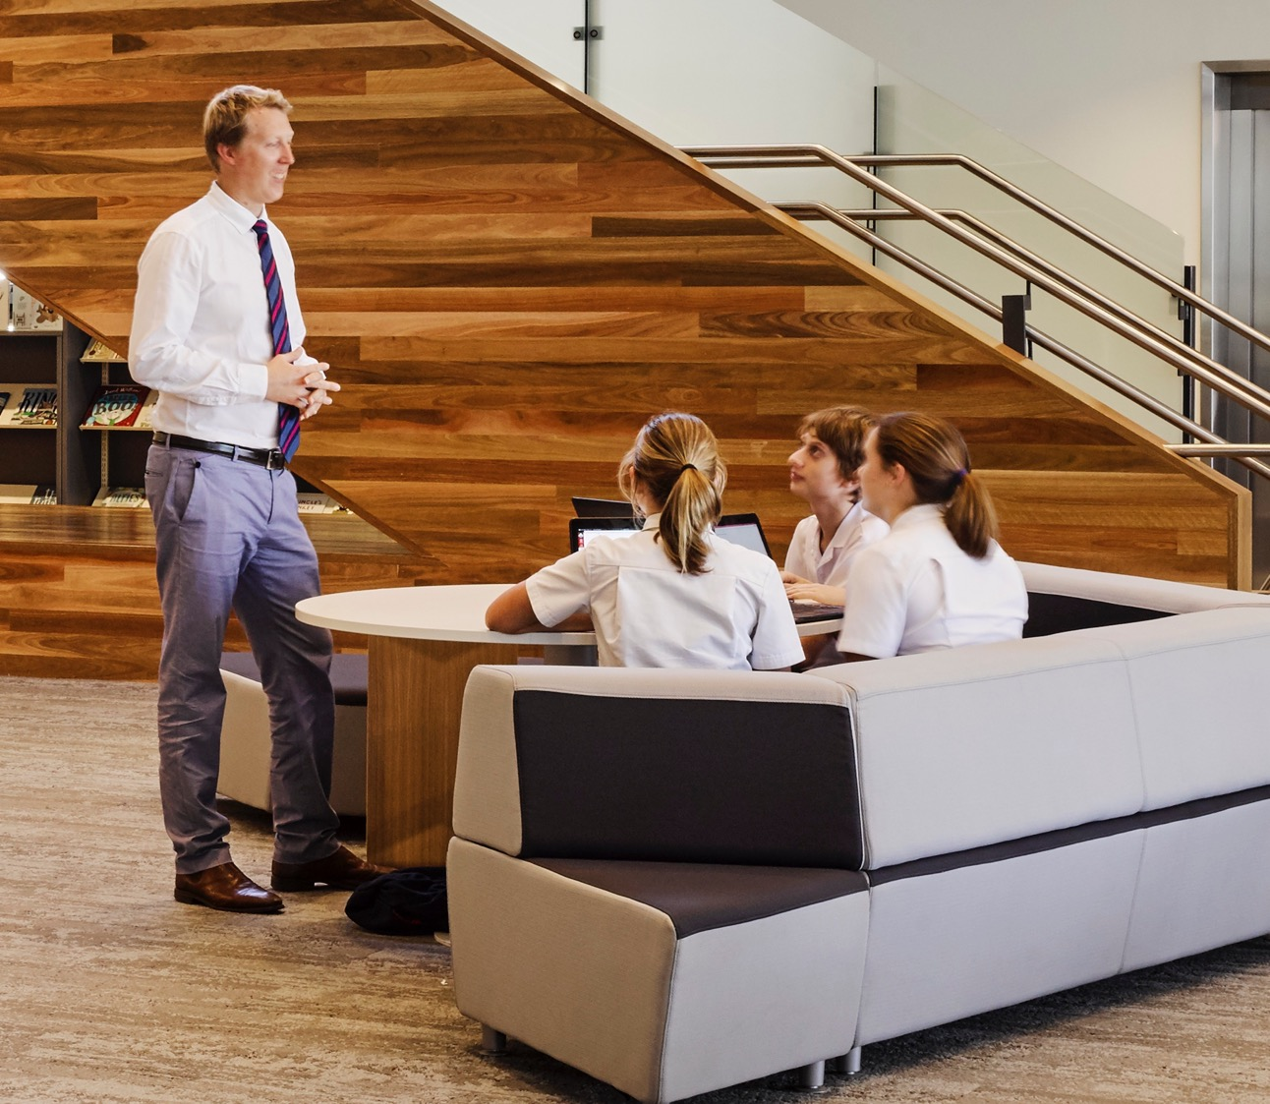
pedagogy has evolved

Slide 4

technology has transformed education

Slide 5

learning spaces need to keep pace

Slide 6
Steelcase Education helps schools, colleges and universities create the most effective, rewarding and inspiring learning environments to meet the evolving needs of students and educators.

Slide 7






our team
Ambroise d’Hauteville
Education Director
Asia Pacific
Jerry Leng
Education Specialist
Dealer China Market
Elizabeth Chan
Regional Education Specialist
SEA
Tengku Hafiz
Regional Education Designer
Asia Pacific
Owen Pescod
Regional Education Specialist
Hong Kong, Macau, Taiwan, South Korea
Xiao Fei Xue
Regional Manager Education
Greater China

Slide 8
we follow a design thinking approach, guided by research
Notes:
Hide this slide and replace with the next one for Australia Market

Slide 9
we follow a design thinking approach, guided by research

Slide 10
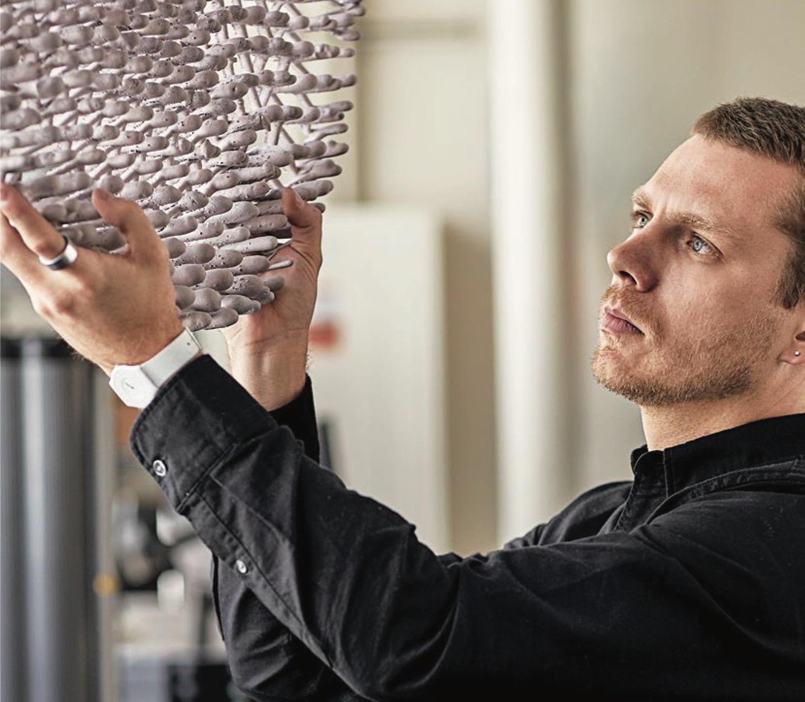
we work in collaboration with experts across fields
Educators Architects Designers Technologists Futurists

Slide 11
we work with progressive institutions around the world
Notes:
Please advise which logos should be updated

Slide 12
Three major themes guide our work in enabling future-ready learning spaces
Learning is active
Learning is everywhere
Learning is transforming

Slide 13

from
Classroom based Lecture style One size fits all Analog

Slide 14
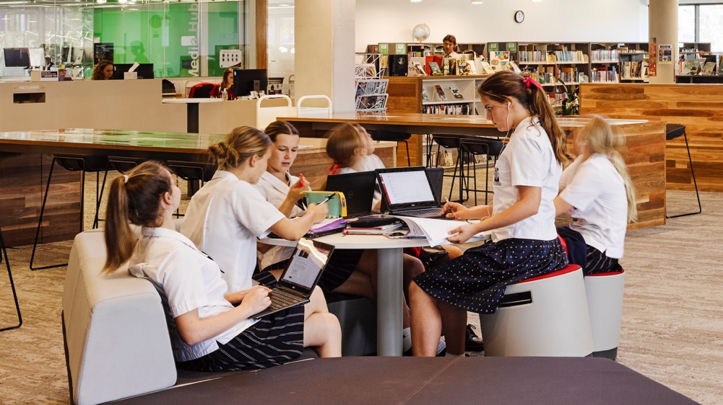
from
to
Classroom based Lecture style One size fits all Analog
Multi-location Interactive Tailored to the individual Blended (analog and digital)

Slide 15
from
to
Classroom based Lecture style One size fits all Analog
Multi-location Interactive Tailored to the individual Blended (analog and digital)
Passive
learning
Active
learning

Slide 16

effective active learning needs a holistic approach
active learning ecosystem
pedagogy
Active
learning
space
technology

Slide 17
pedagogy is the driving force
Active Learning ecosystem
pedagogy
Transition among multiple teaching modes
Peer-to-peer learning
Individual learning
Teacher interactions and ongoing assessment
Professional development to increase adoption of new teaching strategies
Active
learning
space
technology

Slide 18
technology needs thoughtful integration
Active Learning ecosystem
pedagogy
Projection / interaction surfaces for sharing
Access to BYOD and instructional tools
Tools to support anywhere / anytime learning
Analog + digital means to co-create
Designed to support pedagogical strategies
Active
learning
space
technology

Slide 19
space must enable and enhance learning across the campus
Active Learning ecosystem
pedagogy
Visual and physical access
Facilitate social learning
Enable switching among learning modes
Support a range of postures for wellbeing
Integrate institution’s mission / goals
Active
learning
space
technology

Slide 20
effective active learning needs a holistic approach
Active Learning ecosystem
pedagogy
Active
learning
space
technology

Slide 21
Three major themes guide our work in enabling future-ready learning spaces
Learning is active
Learning is everywhere
Learning is transforming

Slide 22
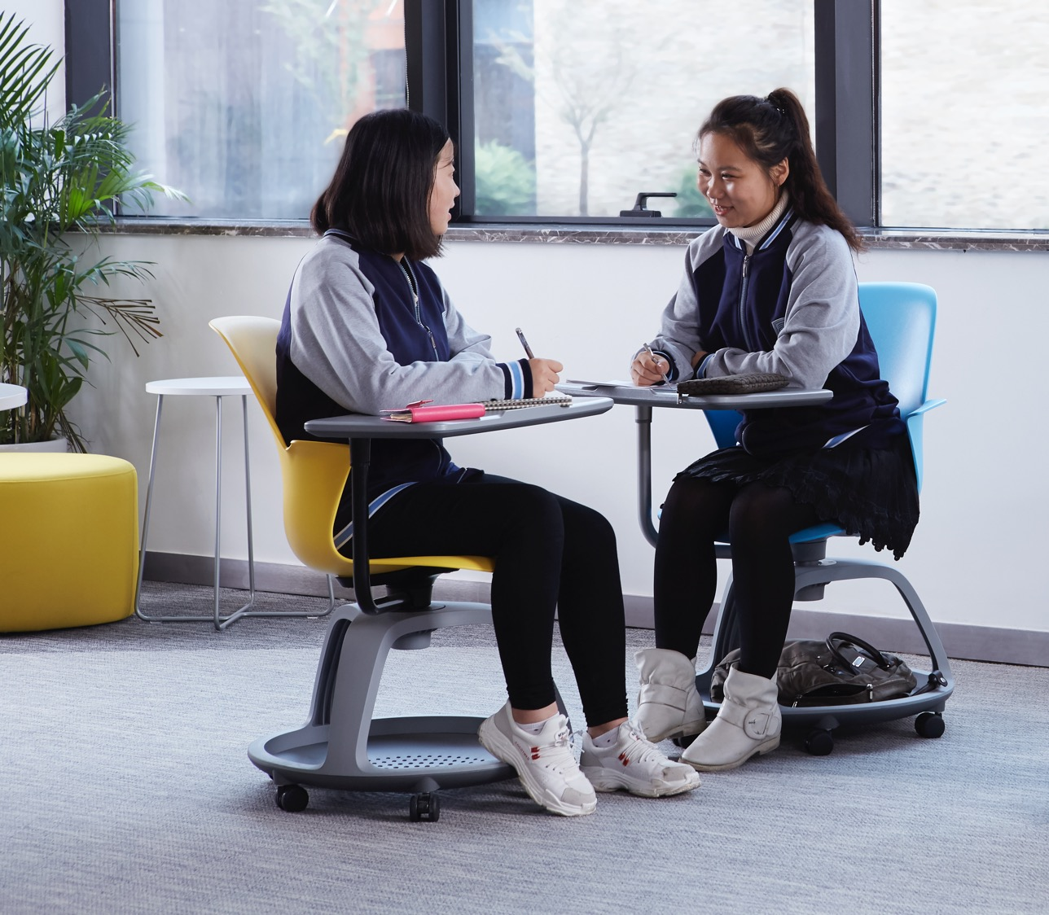

Focus + interaction Individually + in groups
people learn in many ways

Slide 23
learning spaces must support multiple ways of learning
public
Individual work in the presence of others
Open group work with peers or faculty and staff
alone
together
Individual focused work with visual and acoustic privacy
Group work with visual and acoustic privacy
private

Slide 24

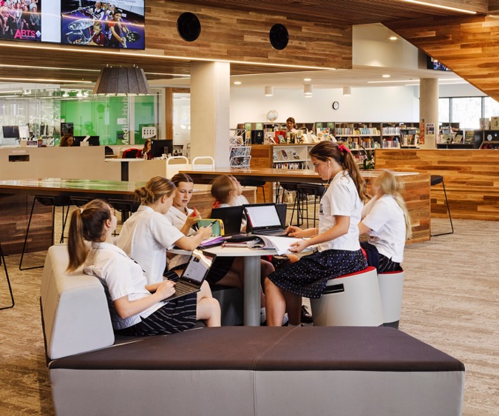
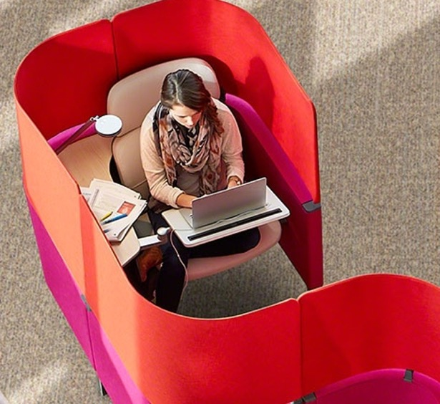
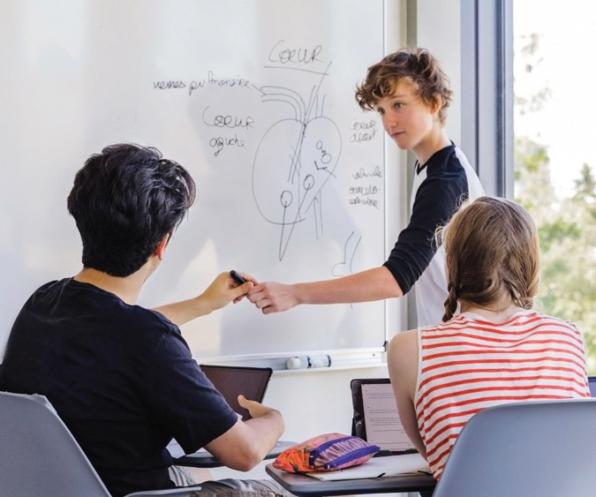
Campuses need a range of spaces that offer choice and control to teachers and learners

Slide 25
Three major themes guide our work in enabling future-ready learning spaces
Learning is active
Learning is everywhere
Learning is transforming

Slide 26

Contemporary educators see the 5Cs as essential skills
Critical thinking
Communication
Creativity
Collaboration
Curiosity

Slide 27

21st century learners increasingly need other key skills
Self agency
Disruptive innovation
Human to computer collaboration

Slide 28
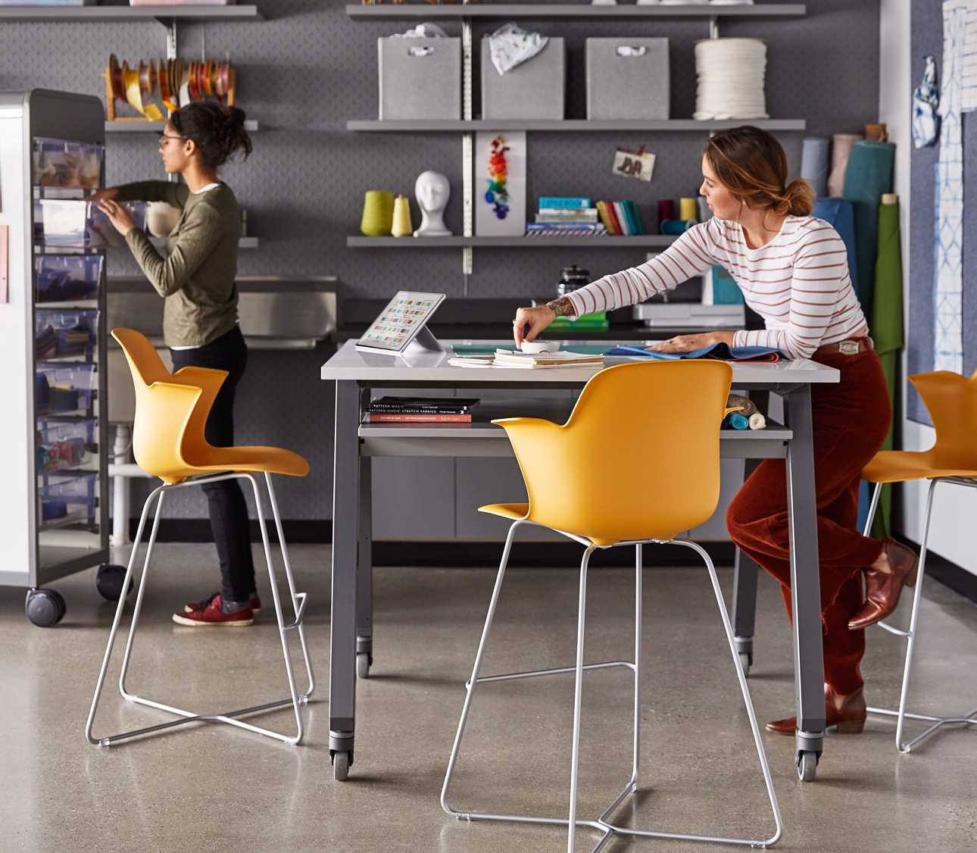
Learning spaces must support 21st century skill building
Fluid and flexible
Integrated with technology
Customizable to learners’ physical, cognitive and emotional needs

Slide 29
Three major themes guide our work in enabling future-ready learning spaces
Learning is active
Active learning needs a holistic approach
Learning is everywhere
Campuses need to offer a diverse range of learning spaces
Learning is transforming
Learning spaces must support 21st century skill building

Slide 30
let’s talk
Owen Pescod | +852 1234 5678 | opescod@steelcase.com | steelcase.asia
Edu team please customize your contact details here and delete this note!

