Slide 1

active
learning spaces
research and trends
Notes:
Welcome and introductions
Note: This presentation is about education trends and research, not SES as an organization. Consider using the SES one-page overview as a handout to accompany this presentation.

Slide 2

We are living in…
“…a period when new technologies and technological systems arise, when the economy is recast and society remade, and when the places where we live and work change to suit new needs.”
Richard Florida
Urban Studies Expert & Author
Notes:
As we frame our conversation today, it’s interesting to consider this quote from Richard Florida. He calls the time we’re living in “The Great Reset” because basically everything has changed. And what’s interesting is that he recognizes that it’s not just about economies, technology etc., but also the critical role that PLACES we work and learn in plays in the new world order, and how it has to change.
Richard Florida calls the time we’re living in “The Great Reset” because basically everything has changed. And what’s interesting is that he recognizes that it’s not just about economies, technology etc, but also the critical role that PLACES we work in plays in the new world order, and how it has to change.
Information for speakers:
We suggest reading this slide as a way to kick off the seminar, and set up why we even need to be talking about a new way of thinking about and designing workplaces. This is a quote from Richard Florida’s book and sets up that the world we are living in is one where everything is changing.

Slide 3

perspective
LEARNING SPACES
LEARNING
LEARNERS
WORLD
Notes:
Speakers notes:
Our perspective about the changing dynamics of the world, learning, learners and learning places throughout campus that we share in this seminar, is based on the same research process that our Workspace Futures team use. We conduct extensive secondary research, as well as review all of the primary research Steelcase has done. We study all of these macro trends and then look for patterns as we synthesize all of the available data. Then we study the implications of this on active learning spaces, and the key issues that are resulting and need to be solved for.
In the study that we’ll be sharing today, we will be giving you an overview of the key education trends and issues as it relates to active learning and space, as well as some ideas we have on how to think about, and design for, the kind of educational environment that organizations need to thrive in this rapidly evolving world. We’ll show you a concept and framework that we have developed in order to support the ideas we believe are relevant and significant when thinking about learning spaces that support increased student success.
We’ll also show you a few thoughtstarters on how these ideas might come to life in a variety of campus settings.
Information for speakers:
It’s important to set up the flow of the seminar – world, learning, learners, learning spaces - by discussing how we conduct secondary research on macro trends and how they are impacting learning and learner behavior. This establishes our credibility and connects the learning space issues with key trends that our audiences are experiencing universally.
Your stories:

Slide 4
the
world
Notes:
Let’s begin by taking a look at the key trends that are impacting us on a global level

Slide 5
THE WORLD
technology
Notes:
Let’s start by looking at global trends with technology

Slide 6
ADOPTION RATE TO REACH 25% OF U.S. POPULATION (IN YEARS)
THE WORLD
electricity 45
telephone 36
radio 31 television 26
pc 16 mobile phone 13
internet 7
ipad 2.5
Source: TechLiberation.com
Notes:
This is a trend we have all experienced. Not only are we adapting to (and adopting) new technologies, the rate at which we are doing so is increasing just as dramatically.
Source: http://techliberation.com/2009/05/28/on-measuring-technology-diffusion-rates/ , from the Census Bureau, Consumer Electronics Association, National Cable and Telecommunications Association

Slide 7
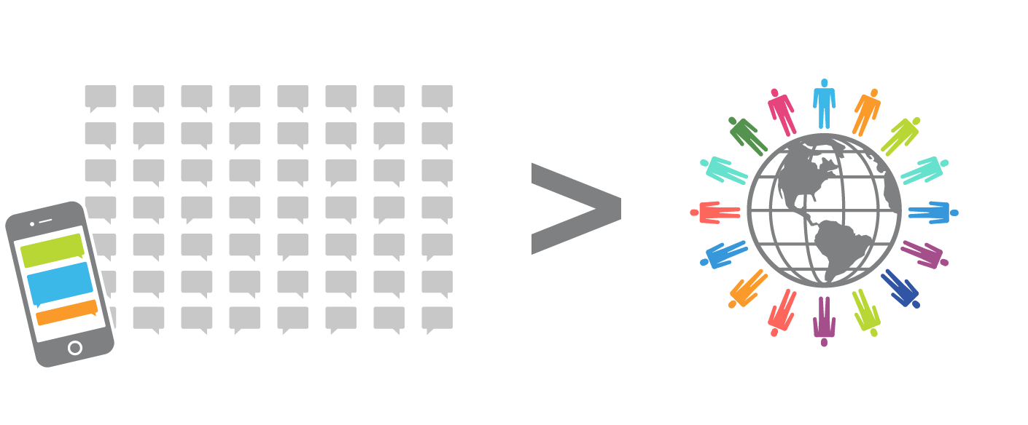
THE WORLD
The number of text messages sent and received every day…
exceeds the world’s population.
Sources: DesignTrend.com, 27 billion messages sent in one day, 2013 and The US Census Bureau, 2013
Notes:
[Read slide]
If you regularly spend time with students, you may not be surprised by this point. The way in which we communicate and the speed at which information is shared has changed and it is prominent.
Information for speakers:
The point behind these next few slides to show how these macro trends impacting society also are driving changes in learning spaces, which we get to later in the presentation.
Sources:
http://www.designntrend.com/articles/4791/20130613/whatsapp-news-27-billion-messages-sent-one-day.htm
http://www.census.gov/popclock/

Slide 8

THE WORLD
One billion+
Facebook users
Source: Facebook Newsroom, 2013
Notes:
As of September 2012, Facebook had one billion users. Social media – and not just Facebook – are no longer limited to students, but has become a way of life.
Source: http://newsroom.fb.com/Key-Facts

Slide 9

THE WORLD
Downloadable texts
are replacing
printed books.
Source: “Digital textbook sales in U.S. Higher Education” Rob Reynolds, Ph.D., Yevgeny Ioffe, Xplana, April 2010
Notes:
Of course, these technological trends are not only impacting society at large, but also the world of education. The iPad was launched in just 2010. Did you ever imagine – even five years ago – that printed textbooks would soon be a thing of the past?
Source:
iPad launch source: http://www.apple.com/pr/library/2010/01/27Apple-Launches-iPad.html

Slide 10
THE WORLD
globalization
Notes:
Next we’ll look at how globalization is impacting the world of education

Slide 11

THE WORLD
The smartest students in China & India…
outnumber the population of North America.
Notes:
In China, the top 25% of the population in terms of IQ outnumbers the total population of North America. As the world becomes increasingly connected, we should consider what this means for the global economy, as well as how we are training students to work in the increasingly interconnected workplace.

Slide 12

THE WORLD
40,000 Chinese undergrads
are enrolled in U.S. colleges.
Source: The Running Battle Against Alien Technologies,
By Michael Totty, The Wall Street Journal, April 25, 2011
Notes:
This interconnected world is also impacting learner demographics. So what does this mean for faculty, campus, recruitment and all of the other factors that typically factor into student life?
Quoted in "The Running Battle Against Alien Technologies," by Michael Totty, The Wall Street Journal, April 25, 2011

Slide 13
THE WORLD
INCREASES IN COLLEGE STUDENTS STUDYING ABROAD
1980
1 million +
2000
nearly 2 million
2007
3 million +
Source: ICOSA, 1-3, 2011, page 38
Notes:
Globalization has also impacted the needs and expectations of learners to gain life experience abroad. Students are moving and more connected than ever.
ICOSA, 1-3, 2011, page 38

Slide 14
If the world had
100 people.
61
THE WORLD
4
8
50
12
1
82
52
13
7
4 would speak Russian or Arabic.
1 would have a college education.
7 would speak Spanish.
13 would be African.
50 males and females.
61 would be Asian.
8 would speak English.
52 would speak other languages.
12 would be European.
82 would be able to read and write.
Notes:
Now consider these stats in terms of the world, globalization and education [read slide]

Slide 15
Does it leverage the benefits of technology to connect learners, instructors and information regardless of place?
How does it prepare learners for a role in the global economy?
Can it accommodate the needs of a global student body?
Does it prepare learners for a multi-cultural learning experience?
THE WORLD
Is your
school ready?
Notes:
Speakers notes:
So is your campus ready for a world that is trending this way? (click to build each bullet point; read them as they come up)
Information for speakers:
Each section ends with a slide that positions key questions to help your audience make the connection between the trends and how the learning spaces need to support those issues. These statements will connect to the learning space concepts that we’ll talk about in the later half of the seminar.

Slide 16
learning
Notes:
Now let’s consider trends in learning.

Slide 17
LEARNING
The amount of
new technical
information is doubling every two years.
Source: emc.com, Worl' Data More Than Doubling Every Two Years—Driving Big Data Opportunity, New IT Roles, 2011
Notes:
To consider trends in learning, we start by looking at the information and content students must learn.
Source:
http://www.emc.com/about/news/press/2011/20110628-01.htm

Slide 18
LEARNING
For students,
half of what they learn in year one
will be outdated in three years.
Source: Britannica.com, Professional Knowledge Increasingly Obsolete, 2008
Notes:
With the rapid expansion of information, it is often difficult to judge what should make it into a lesson plan and what will be outdated within a few years. Often instructors are learning about as rapidly as the students.
Source:
http://www.britannica.com/blogs/2008/12/forecast-6-professional-knowledge-increasingly-obsolete/

Slide 19
LEARNING
We are currently preparing students for jobs that don’t yet exist
Notes:
[read slide, then click to next slide]

Slide 20
LEARNING
We are currently preparing students for jobs that don’t yet exist, using technologies that haven’t been invented
Notes:
[read slide, then click to next slide]

Slide 21
LEARNING
We are currently preparing students for jobs that don’t yet exist, using technologies that haven’t been invented, in order to solve problems we don’t even know are problems yet.
Notes:
This all leads up to the fact that not only is information shifting, but the jobs that require this information and the tools that support it are changing. So how can we adequately prepare students when we cannot predict the future? The answer for many has been to develop students with broader set of skills – often referred to as 21st century skills – using new, learner-centered pedagogies and the shift to active learning.

Slide 22
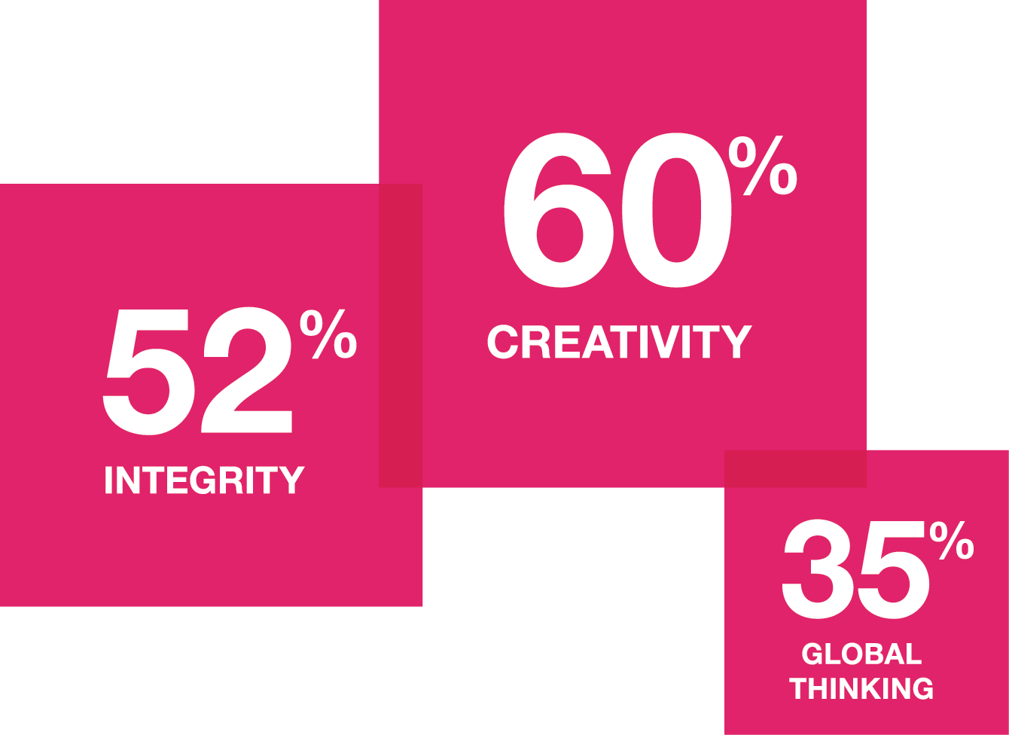
developing 21st century learners
LEARNING
WHAT CORPORATE LEADERS WANT
Source: Capitalizing on Complexity IBM 2010 CEO Study
Notes:
In fact, CEOs in the IBM research ranked creativity as the most important leadership quality, just ahead of integrity and global thinking. Organizations are looking to cultivate creative leaders who can more nimbly lead in complex, global environments and to capitalize on collective intelligence through much more effective collaboration across increasingly global teams.
Sources: CAPITALIZING ON COMPLEXITY, IBM 2010 CEO STUDY
IBM Working Beyond Borders, 2010

Slide 23
LEARNING
Critical thinking
Problem solving
Innovation
Effective communication
Effective collaboration
Self-directed learning
Information and media literate
Globally aware
Civically engaged
Financially and economically literate
employers demand 21st century skills
Notes:
The list of skills that employers are looking for is long. If students don’t learning these skills in school, where and when will they learn them?
Source: *from “Partnership for the 21st century skills”

Slide 24
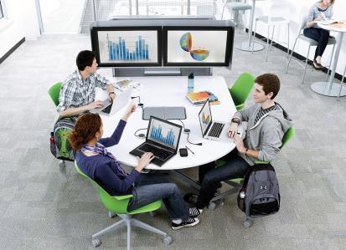
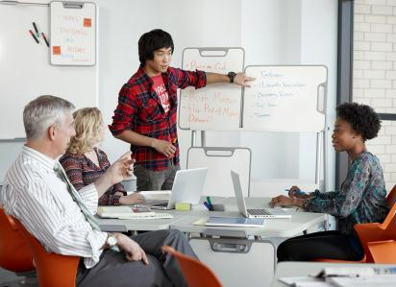

LEARNING
adoption of
new pedagogies
Learner-centered /
constructivist pedagogy
Instructors as guide on the side
Discovery and team- based activities
Notes:
The pedagogy that is being adopted by many educators to develop 21st century work skills is constructivism. Constructivism is the idea that the learner constructs knowledge for himself/herself by making their own discoveries during the learning experience. Thus, learners learn when they construct their own meaning, not when they are being fed information through the one-way sharing of information (i.e. lecture).
Students today expect their learning experiences to speak to who they are and how they learn outside the classroom. They want the opportunity to learn actively through doing vs. listening in hands-on activities that involve familiar contexts and tasks. Instructors respond to students’ tendency toward group activity by giving them opportunities to work collaboratively. According to social constructivist theory, understanding is enhanced when working with others for this reason.
Instructors are increasingly giving students greater responsibility for their own learning, hoping that doing so will help them to develop into lifelong learners. In some cases, learners get to define their own learning goals/problems and ways to resolve it. That is, they own the learning process (in a sense, determine what is learned). The instructor plays more of a side role, monitoring the students’ progress in achieving these goals, providing the proper amount of scaffolding or support to keep the learner on track, and taking steps to encourage them to reflect on both what they are learning and the learning process itself.

Slide 25
various learning preferences
LEARNING
VISUAL IMAGIST Learns through seeing pictures.
AUDITORY ORAL Learns by talking and hearing themselves talk.
MOTOR KINESTHETIC Learns through the use of fine motor muscles.
MOTOR MECHANIC Learns through the use of gross motor muscles.
AUDITORY AURAL Learns by listening to others.
VISUAL VERBALIST Learns through seeing words.
Notes:
Even with constructivist pedagogies in place, not all students are alike and not one approach with work for all students.
Information for speakers:
a learning style is "the complex manner in which, and conditions under which, learners most efficiently and most effectively perceive, process, store, and recall what they are attempting to learn."

Slide 26
several modes of learning and teaching
LEARNING
PROBLEM-BASED LEARNING
An approach to learning focusing on the process of solving a problem and acquiring knowledge. The approach is also inquiry-based when students are active in creating the problem.
PROJECT-BASED LEARNING
An approach to learning focusing on developing a product or creation. The project may or may not be student-centered, problem-based or inquiry-based.
INQUIRY-BASED LEARNING
A student-centered, active learning approach focusing on questioning, critical thinking, and problem solving. It is associated with the idea “involve me and I understand.”
Notes:
Therefore, a variety of approaches have emerged to actively engage ALL students in the learning process, regardless of their learning preference.

Slide 27
LEARNING
Does it prepare learners with 21st century work skills?
Can it accommodate a variety of pedagogies?
Is it flexible enough to support a variety of student learning preferences?
Is your
school ready?
Notes:
Speakers notes:
So let’s pause and think together: Is your campus ready?
(click to build each bullet point; read them as they come up)

Slide 28
learners
Notes:
Next, let’s look at how learners themselves are changing.

Slide 29

the learner has changed
LEARNERS
“Students do not learn in the traditional ways of 50, 30, or even 10 years ago. We need to adapt our campus to their needs and changing times.”
Source: University president quoted in The Cincinnati Post
Notes:
As we know, students are more connected than ever. With social networks, mobile devices and the 24/7 access to information, this generation expects to have information at their fingertips and available immediately. The ways in which they share and receive information has been forever changed.

Slide 30
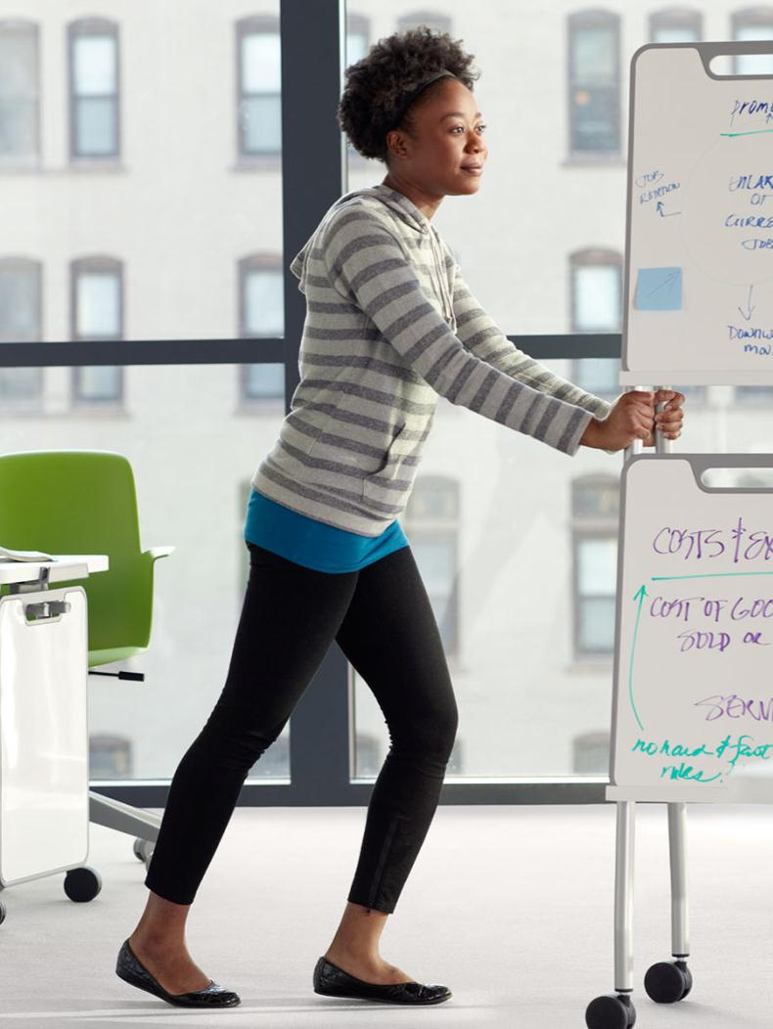
LEARNERS
56%
of US college
students are female.
Source: The Woman’s World 2010: Trends and Statistics, United Nations
Notes:
Learner demographics are changing. Women are graduating from college and professional schools at higher rates.
Source: THE WOMAN’S WORLD 2010: TRENDS AND STATISTICS, UNITED NATIONS

Slide 31
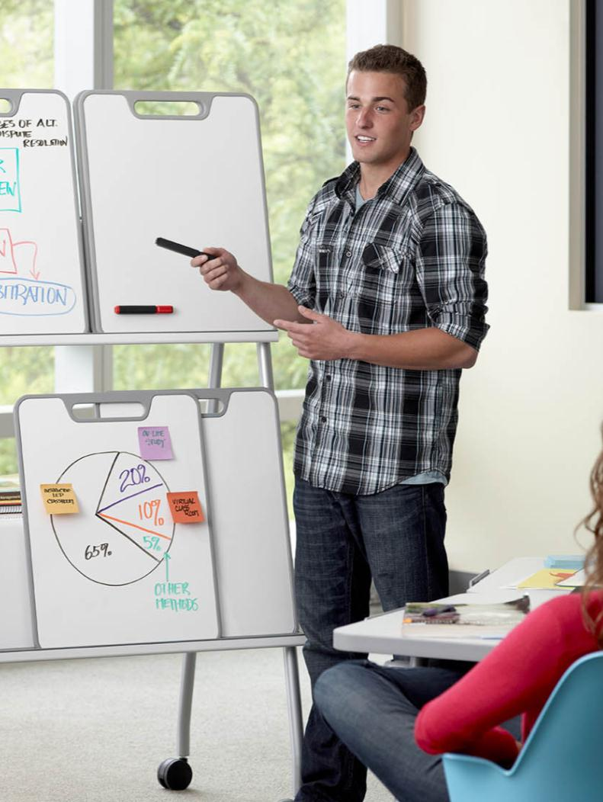
LEARNERS
Today’s learner will
have 10 to 14 jobs. By age 38.
Source: Capstrat, The True About Millenial Workers and Fast Compnay, The Four Year Career, February 2012
Notes:
As much as learner demographics are changing, so are their attitudes toward work. Long-gone are the days when employees find and stay in a job for 20+ years. Today’s workers stay in a job an average of 4.4 years. And 72% say they are willing to sacrifice a higher salary for a more personally and professionally fulfilling career.
In other words, the expectations of this generation has changed and they are looking for different things out of life and a career.
Sources:
Capstrat, The Truth About Millennial Workers, https://www.capstrat.com/elements/downloads/files/millennials-work.pdf.
Fast Company, Four Year Career, by Anya Kamenetz, February 2012. http://www.fastcompany.com/1802731/four-year-career.

Slide 32
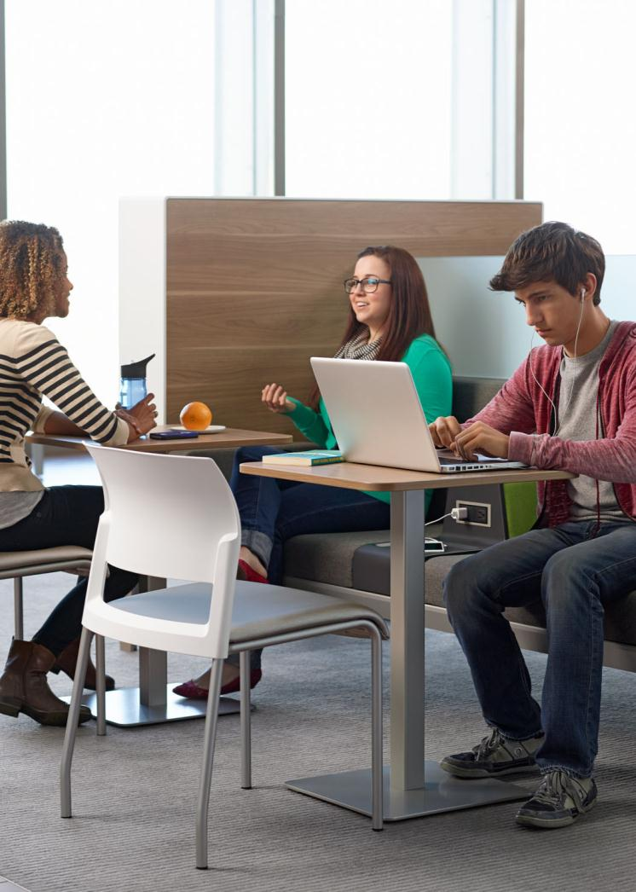
LEARNERS
student
expectations
Engaging learning experiences
Access to technology
Interactive classrooms
Social networks
Sense of community
Choices: to focus, collaborate and socialize how, when and where they want
Notes:
These changing expectations also apply to education. They expect their learning experiences to keep up with the changes they have experienced in the world. They want classrooms that are designed to prepare them for the work skills needed in the 21st century. They want to explore, experiment and to learn by doing vs. sitting back and passively learning. Students today:
-have higher expectations for engaging learning experiences. They are highly active in everything they do. They want their learning experiences to be the same way (i.e. hands-on, experiential & exploratory)
-want their learning experiences to be relevant to their interests and goals and how they learn outside of the classroom. They are adept at using digital, interactive, multimedia technologies.

Slide 33
LEARNERS
Can it embrace learner’s social networks, both virtual and physical?
Can it support learners with a wide range of life experiences?
Is it supporting the changing nature of student expectations?
Is your
school ready?
Notes:
Speakers notes:
(click to build each bullet point; read them as they come up)

Slide 34
learning
spaces
Notes:
Speakers notes:
So let’s look now at the implications of all of these trends and issues on learning spaces.

Slide 35
1
LEARNING PLACES
SHIFT TO LEARNER CENTRIC ENVIRONMENT
2
four learning
place issues
SPACE
OPTIMIZATION
3
ATTRACT +
DEVELOP + RETAIN
4
READINESS TO
SUPPORT TECHNOLOGY
Notes:
When we engage with our clients about how their spaces need to change to support all of the issues we just reviewed, we see a very definite pattern in terms of the learning space issues that they are experiencing. When we consider these in light of everything we’ve just discussed, we see there are 4 key issues that need to be addressed, and we have some thoughts and ideas on how to think about space design in order to support these issues. We’ll highlight some of these for you now.

Slide 36
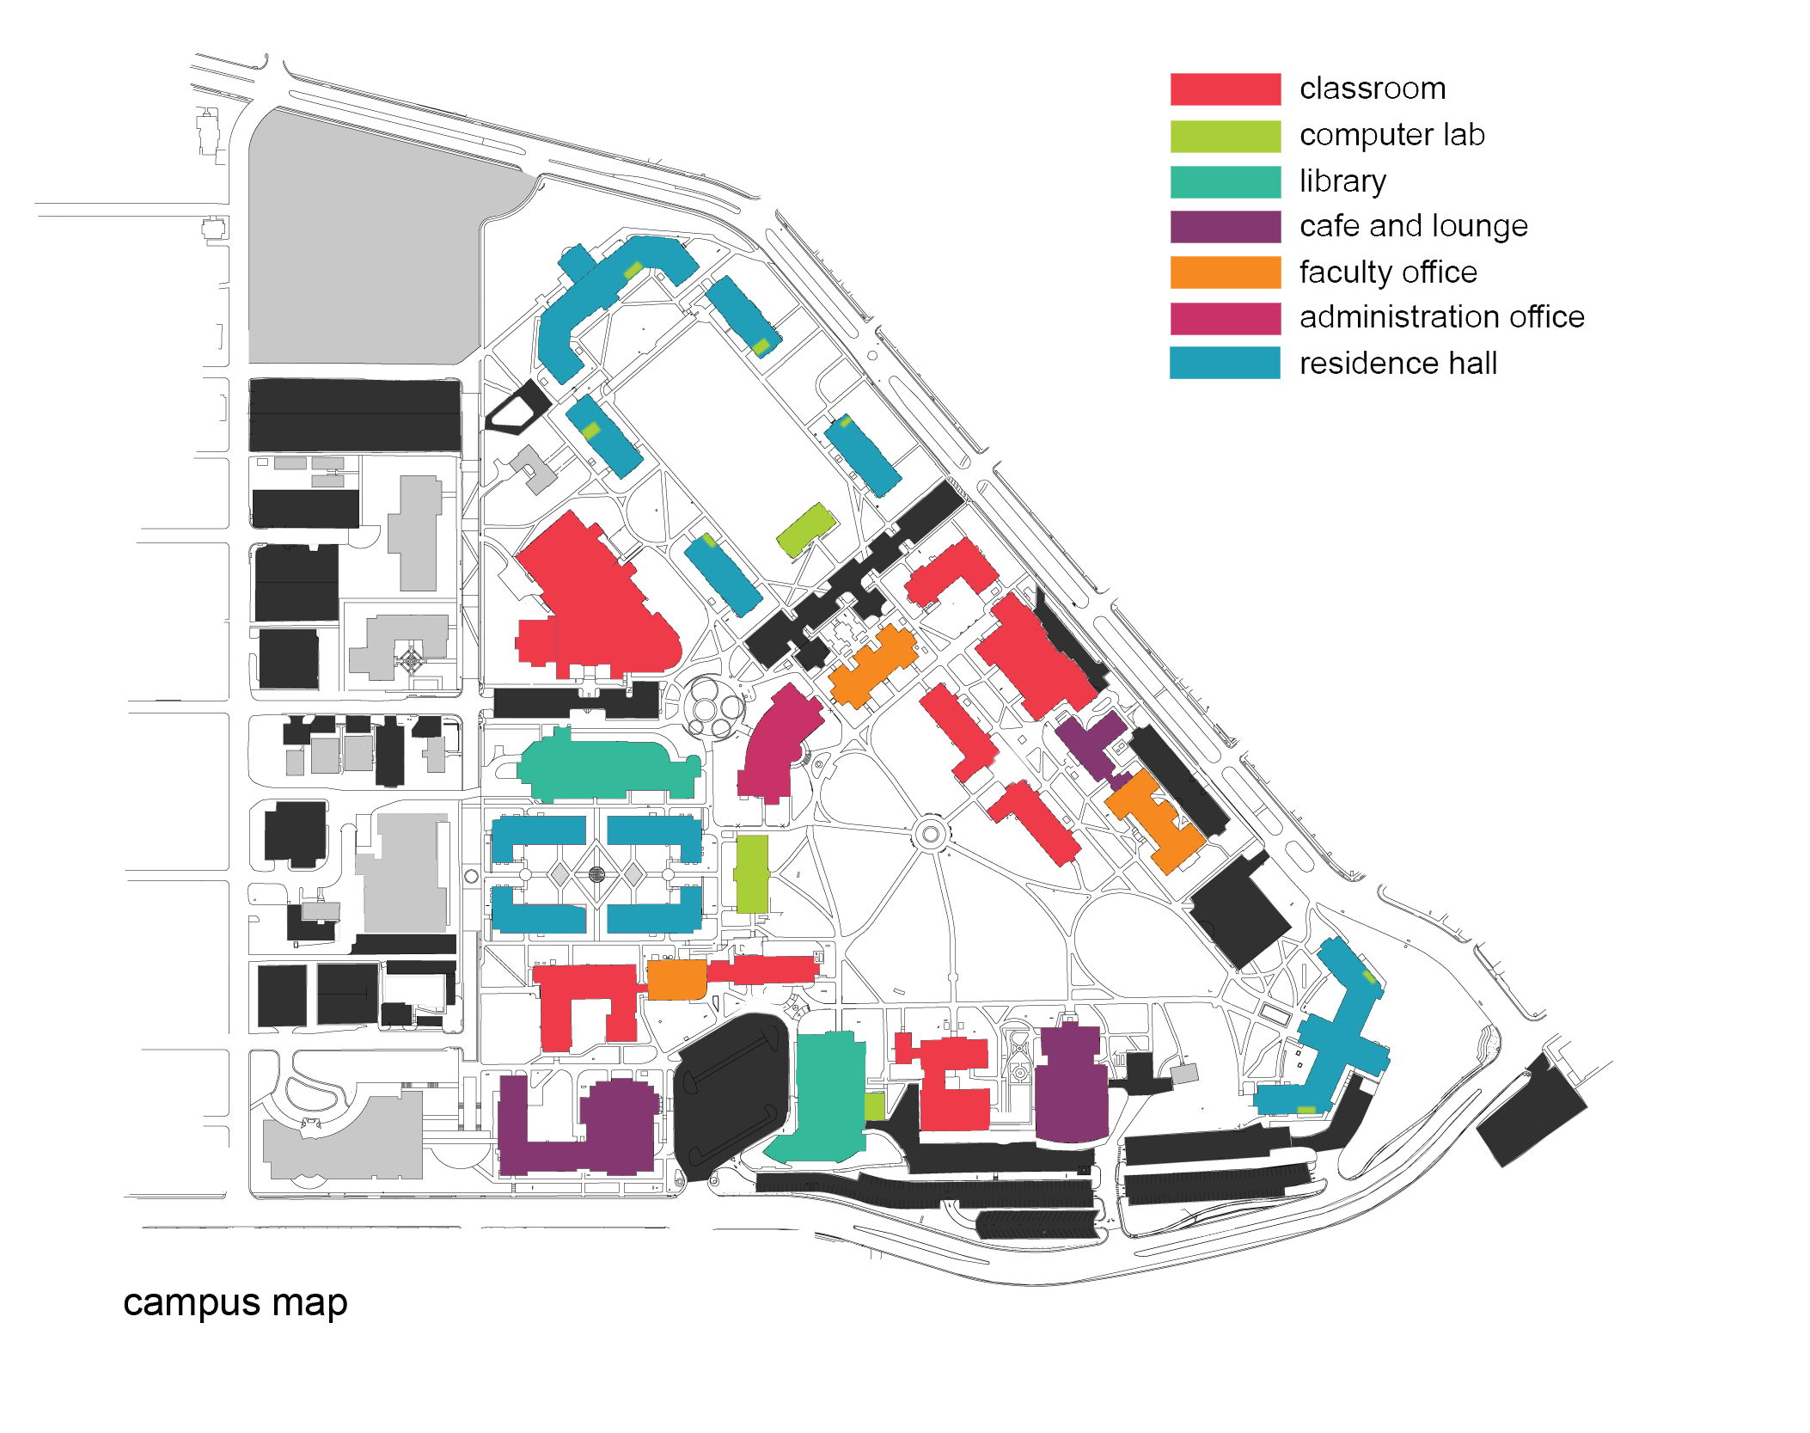
LEARNING PLACES
There’s pressure on every part of the campus to change.
This is a campus wide dilemma.
Notes:
One of the primary issues we have noticed is these changes are not just impacting classrooms, but every part of the campus. This includes both formal and informal learning spaces, from media labs to libraries and in-between spaces. They are all impacted by the changes impacting the world, learning and learners.

Slide 37
1
SHIFT TO LEARNER CENTRIC ENVIRONMENT
LEARNING PLACES
How can the campus be designed to truly enhance active learning?
Steelcase Global HQ
Notes:
Here’s the key question we are asked about how these trends impact space. How can the campus be designed to truly enhance active learning?
We know multiple pedagogies are being employed at every level of education. Many educators are embracing a more active and immersive style of instruction, engaging with students, leveraging technology and exploring new educational strategies. These changes present a challenge to successfully teaching 21st century skills in inadequate facilities. With enrollments on the rise and budgets holding steady or declining, it’s more important than ever to make every space an active learning space.
Properly designed and furnished, every space can take advantage of the opportunities represented by continual change. Learning happens anywhere and can be synchronous or asynchronous, formal or informal. The change from passive to active learning and the tensions created in this process affect teaching and learning strategies, technologies and space. By looking at how individuals learn and by considering information about the learner and learning places, designers can effectively address the spatial needs of today’s students and educators.
These spaces need to ENHANCE learning. Collaboration, movement and flexibility are all ways in which active learning can be achieved. In today’s educational environment, collaborative work is both face to face and distributed, so the tools and spaces that are required are very different from what they’ve been in the past.
Information for speakers:
The word ‘enhanced’ is intentional, as it speaks to a higher level of learning than just providing spaces that can move or have technology. Discussing how to enhance active learning allows us to position products such as media:scape, Node and Verb, and effective applications that we will show at the close of the seminar.
Your stories:
Share success stories you have seen, both formal and informal spaces
Range of spaces from Node classrooms to media:scape libraries
Think about SSI model: informational – everyone has equal access to information, we can all get up, contributed digitally or analog.
Blended learning: what are you seeing to help make blended learning active? Is media:scape with HDVC an opportunity to connect virtually?
Spatially – plan the room so people can get up, move and participate
Social – eye to eye contact is critical
Informative, generative, evaluative

Slide 38

1
SHIFT TO LEARNER CENTRIC ENVIRONMENT
LEARNING PLACES
tipping point for change
100+ years ago
Last 15
Beginning to understand need for change
Constructivist theory takes hold
Last 10
Pockets of pedagogical innovation
Research on the learning environment advances
Last 5
Everyone understands problem-based learning works
Recognition that environments should no longer be a barrier
Notes:
This shift to a learner-centric environment started about 15 years ago, but we have started to see it really take hold with most educational institutions just within the last few years. Schools really want to understand how space can support these other changes they are experiencing to enhance learning and student success.

Slide 39
1
SHIFT TO LEARNER CENTRIC ENVIRONMENT
LEARNING PLACES
Use of collaborative instructional methodologies is increasing:
72%
INCLUDE CLASS DISCUSSIONS
23%
INCLUDE GROUP PROJECTS
46%
FEATURE EXTENSIVE LECTURING
Source: Educause Guide to U.S. Higher Education 2005
Notes:
This is being driven by the changes we see in classrooms. Within classrooms, the use of discussion and group projects is rising, while the use of lecture is declining.
Source: EDUCAUSE Guide to U.S. Higher Education 2005
EDUCAUSE is a nonprofit association whose mission is to advance higher education by promoting the intelligent use of information technology.

Slide 40
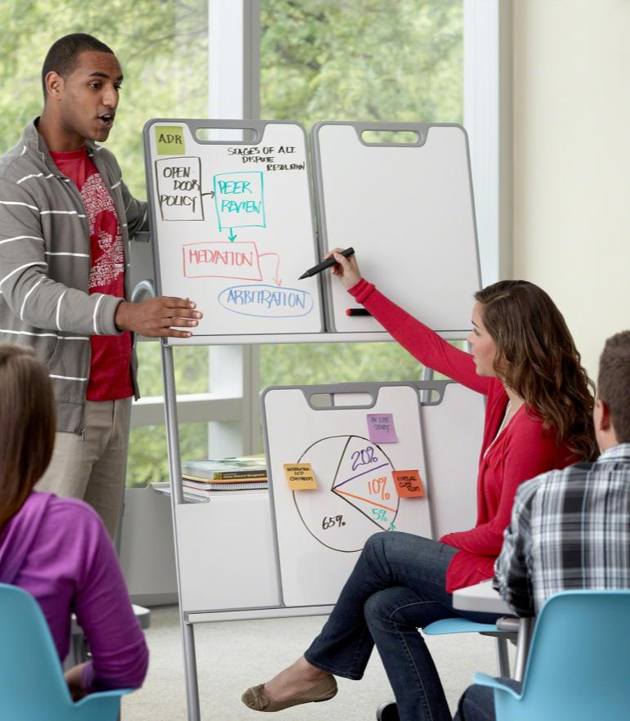
1
SHIFT TO LEARNER CENTRIC ENVIRONMENT
LEARNING PLACES
54%
of college freshmen say they frequently work
with other students
on class assignments.
Source: The American Freshman University of California at Los Angeles
Notes:
We also see these types of work extending beyond the classroom into libraries and in-between spaces, often driven by the assignments students receive in class.
Source: The American Freshman: National Norms for Fall 2009, published by the U. of California at Los Angeles Higher Education Research Institute

Slide 41

1
SHIFT TO LEARNER CENTRIC ENVIRONMENT
LEARNING PLACES
“Collaboration requires a shared space where collaborators can have equal access and interaction.”
Source: Shared Mind- the New Technologies
of Collaboration Michael Schrage
Notes:
To support the types of work students participate in, schools need to reconsider both formal and informal learning spaces designed to support collaboration. Organizations can mistake low-intensity interactions, such as coordination of tasks or exchanging information for collaboration. But collaboration is about people working together for a common purpose, which requires a high level of interdependence and gaining new insights, which requires creativity. Collaboration is all about co-creation and, according to Michael Schrage, a leading thinker on the topic, “requires shared space where collaborators can have equal access and interaction. These shared spaces permit real-time access by all collaborators ...”
Source: SHARED MIND – THE NEW TECHNOLOGIES OF COLLABORATION, MICHAEL SCHRAGE

Slide 42
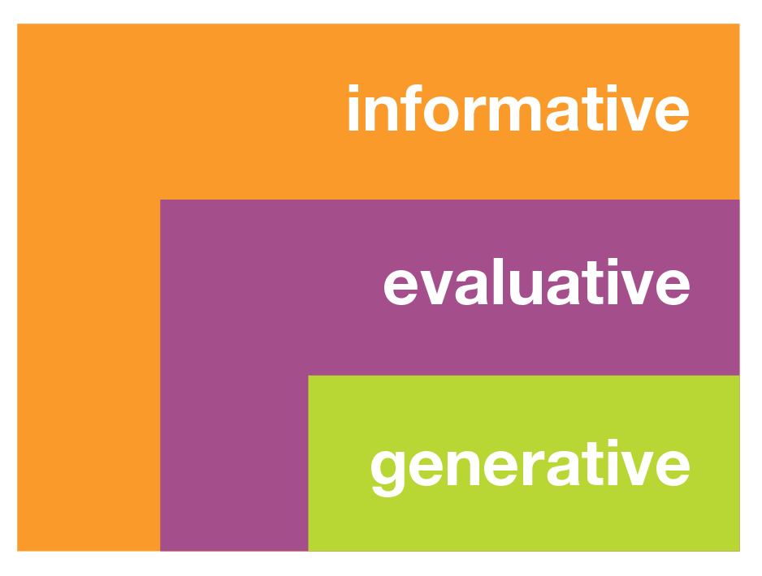
1
SHIFT TO LEARNER CENTRIC ENVIRONMENT
LEARNING PLACES
levels of collaboration
provide updates, share information
review information to make decisions
co-create new solutions
Source: Steelcase WorkSpace Futures
Notes:
Collaboration takes different forms based on the type of work that is at hand. Steelcase WorkSpace Futures did a project to study the different types of collaboration that takes place and identified three distinct types. Informative meetings are those where updates are provided to let others know what’s going on. Evaluative is about reviewing information and making decisions. And generative is about co-creation of new ideas and solutions. So an evaluative session needs a space that allows users to display information and interact with it, for example. Or a space that’s designed for informative sessions might not work at all for an extended period, heads down generative session. Campuses need a range of these spaces to support the different types of collaborative work that students and faculty perform.
Source: Steelcase Workspace Futures
Information for speakers:
One of the reasons we wanted to talk about this is to help correctly position the right media:scape applications. For example, the media:scape team theater is great for informative or evaluative meetings, but if you want to have a co-creation session you might be better to use the off-set or d-shaped tables at stool height, to allow people to change postures throughout the session. So this framework gives you a way to discuss what type of collaboration is taking place and then to determine the best solution for your client.
Your stories:

Slide 43

1
SHIFT TO LEARNER CENTRIC ENVIRONMENT
LEARNING PLACES
The definition of learning places is changing.
Notes:
Classrooms and collaboration spaces are not the only learning spaces that need to reconsider how to incorporate active learning. Learning is happening virtually everywhere. Schools much plan for this in order to truly support learners.

Slide 44

1
SHIFT TO LEARNER CENTRIC ENVIRONMENT
LEARNING PLACES
65%
of students have taken online classes.
Source: CDW-G 21st Century Classroom Report, 2011
Notes:
Consider how spaces must evolve to support learners that are distributed? We have found there are four factors that must be present for active learning to occur: Students must be able to see, to hear, to be comfortable and be connected. When students are connecting virtually, are you still considering these factors as a way to enhance their learning. Learning is no longer occurring inside the box of the classroom. We must consider all learning spaces…whether physical or virtual.
Information for speakers:
Products such as media:scape team theater and kiosk are good solutions to help control the environment of distance learners, especially when distributed groups get together in person.
Source: www.cdwg.com/21stCenturyClassroomReport

Slide 45
1
SHIFT TO LEARNER CENTRIC ENVIRONMENT
LEARNING PLACES
In 2011 160,000 students enrolled in a Massively Open Online Course (MOOC) offered by Stanford.
Source: Inside Higher Ed, 2012
Notes:
Interestingly, research by our WorkSpace Futures team on blended learning environments has found that even when students enroll online, they still seek out social interaction with others in their class. In fact, despite the popularity of MOOCs to open learning to hundreds of thousands of students at once, sites like Coursera have catered to the desire for online students to locate others in their course within close proximity to them for in-person meetings and connections by offering a location service on their website. This speaks to the need for planned in-person educational experiences, regardless of the format of the class. We must consider how we can optimize these experiences to provide the best learning environment possible.
Source:
“Stanford became the first elite institution to offer massively open online courses, or MOOCs. One course in particular, an advanced online class in artificial intelligence, attracted a whopping 160,000 enrollees -- 20,000 of whom stuck with it and completed all the coursework. Read more: http://www.insidehighered.com/news/2012/01/24/stanford-open-course-instructors-spin-profit-company#ixzz20tBffopf Inside Higher Ed

Slide 46
2
SPACE
OPTIMIZATION
LEARNING PLACES
How can space be optimized to support a range of instructor and learner needs?
Steelcase Global HQ
Notes:
Speakers notes:
Here is the key question being asked about real estate. (READ SLIDE)
Real estate is the most costly expense for most organizations, second only to people costs. It has to work harder and smarter than ever before. Whether it’s through reducing the amount of real estate currently owned or getting greater value from what they own, the real estate that an organization owns has to be fully optimized in a way that supports the way students and faculty work now, while also maximizing their investment. In the next few slides we’ll highlight some design considerations that can help to answer this question.

Slide 47
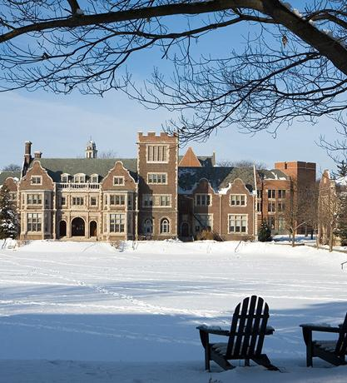
2
SPACE
OPTIMIZATION
LEARNING PLACES
42 ^{years+}
the average “functional age” of school buildings
in the US
Source: 2011 Education Marketplace School
and College Planning and Management
Notes:
Outside of the need for new spaces is the need to refresh our existing spaces. At more than 40 years old, our existing school buildings were designed to support an outdated model of education that existed before the Internet, mobile devices or the pedagogies in place in classrooms today.
Source: 2011 EDUCATION MARKETPLACE; School and College Planning and Management

Slide 48
2
SPACE
OPTIMIZATION
LEARNING PLACES
Space matters.
Learning is strongly affected by the educational climate and the place in which it occurs.
Source: The Impact of Facilities on Recruitment and Retention of Students; David Cain, PhD and Gary Reynolds, PE, APPA 2006
Notes:
Both secondary and Steelcase primary research (AL-POE) tells us that space really does matter. It can significantly impact student engagement factors, which are critical for effective learning.
Source:
The Impact of Facilities on Recruitment and Retention of Students; David Cain, PhD and Gary Reynolds, PE, APPA 2006
SES Active Learning Post-Occupancy Evaluation research tool and findings

Slide 49
2
SPACE
OPTIMIZATION
LEARNING PLACES
Students say facilities are important.
73%
53%
50%
49%
FACILITIES FOR MAJOR
LIBRARY
SOPHISTICATED TECHNOLOGY
LEARNING
SPACES
42%
34%
32%
RESIDENCE HALLS
OPEN SPACES
STUDENT REC
SPACES
Source: The Impact of Facilities on Recruitment and Retention of Students, David Cain, PhD and Gary Reynolds, P.E., APPA 2006
Notes:
Important for schools, students vote with their feet. Students indicate that facilities throughout campus impact their feelings toward a school. This can not only impact the school they choose, but where they decide to spend their time while on campus.
Information for speakers:
This is relevant for K12 as well. While the stats relate to HE, the point is that physical space is important to students and plays a role in their feelings toward a school.
Source:
The Impact of Facilities on Recruitment and Retention of Students, David Cain, PhD and Gary Reynolds, P.E., APPA 2006

Slide 50

2
SPACE
OPTIMIZATION
LEARNING PLACES
Use of space is changing.
Learning alone, together.
Notes:
Additionally, when optimizing real estate, we must consider how students work outside of class. Steelcase observational research in informal learning spaces consistently shows patterns of students studying alone, together. In other words, students seek out the physical and social connections with others, even when they are not directly interacting with them. Spaces should support the desire for students to study alone in the presence of others, without sacrificing space.
Information for speakers:
This conversation sets up a discussion about Regard very well, which is a good solution for the need to study alone, together.

Slide 51
3
ATTRACT + DEVELOP + RETAIN
LEARNING PLACES
How can space positively influence your brand to attract, develop and retain students and instructors?
Accenture
Notes:
Speakers notes:
Here’ s the key question we ask about the issue of Attracting, Develop and Engage. (READ SLIDE)
A school’s image (e.g. brand) – whether in K12 or higher ed – is critical. It’s not always about prestige, but it is about getting and keeping the best students and faculty. Students and parents today have a choices and how your school is perceived is a big part of that. Will budgets on the line, attraction and retention is critical. The same is true for finding faculty that can deliver on your school’s vision. And of course, space must also help to develop students and faculty in the time they are there.
Your stories:

Slide 52
3
ATTRACT + DEVELOP + RETAIN
LEARNING PLACES
Administrators say their #1 priority is attracting and retaining students.
Source: CDW-G 21st-Century Classroom Report, 2011
Notes:
[Read slide] This is an issue that is important and will continue to stay on the minds of administrators. Your spaces can and should be thought of as a strategic tool to help you achieve this priority.
Source:
CDW-G 21st-Century Classroom Report, www.cdwg.com/21stCenturyClassroomReport

Slide 53

3
ATTRACT + DEVELOP + RETAIN
LEARNING PLACES
Brand is critical.
Valuable tool to attract and engage students
Stronger brands equal greater enrollment
Learning spaces help recruit students
Notes:
Administrators are facing a competitive landscape in a time of budget cuts, competing for the highest quality students and faculty. Increased competition for the best students and faculty is causing campus leaders to focus on improving the look and feel of their institution’s brand, starting with their campus facilities.
Brand=Behavior. Strong brands help attract: better students and faculty; more full-pay students; more students who graduate; more donations: more alumni loyalty; more positive media attention.
With this in mind, as yourself: do your learning spaces represent the school’s brand? Do they reflect a focus on improving student learning outcomes? Do they reflect a 21st century learning space?

Slide 54
3
ATTRACT + DEVELOP + RETAIN
LEARNING PLACES
drawing students to campus
89%
of 2011 high school grads surveyed want video campus tours, and to hear about campus life from enrolled students.
Source: 6 Trends in Digital and Mobile Communications for College Admissions in 2011, Cappex.com
Notes:
Students want to see campus. Whether in person or through online tours, experiencing the campus is important to students looking to make a decision on schools.
Source:
6 Trends in Digital and Mobile Communications for College Admissions in 2011, Cappex

Slide 55
4
READINESS TO SUPPORT TECHNOLOGY
LEARNING PLACES
How can schools leverage technology to augment the learning experience?
Steelcase Global HQ
Notes:
Finally, when thinking about active learning spaces, we ask how schools can leverage technology to augment the learning experience.
All too often, we visit classrooms where technology has been placed in the room without consideration for the teaching and learning styles that are needed within the space. Technology should not distract or cause frustration, but enhance engagement in the classroom and other learning spaces. Professional development is often a critical component of successful adoption. However, we must also consider the technology that students bring into the room and how it can be effectively used to enhance learning, rather than made a banned item within the room.

Slide 56
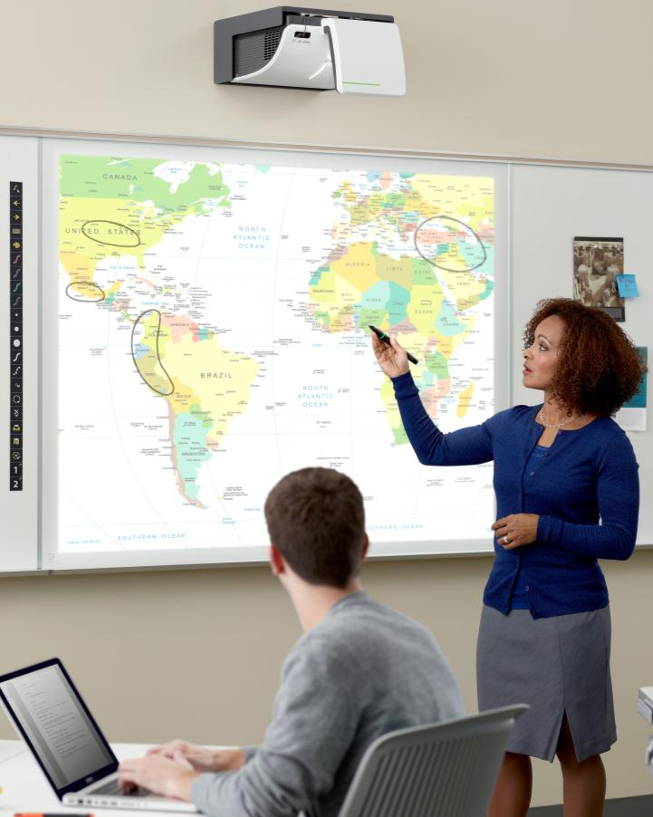
4
READINESS TO SUPPORT TECHNOLOGY
LEARNING PLACES
Disparities remain.
say digital content is essential to the classroom:
72%
66%
students
faculty
only
15%
are using it
Source: CDW-G 21st-Century Classroom Report, 2011
Notes:
The good news is that both students and faculty recognize the importance of technology in the classroom. Unfortunately, this recognition does not translate to actually using the technology in class. What could be holding faculty back?
Information for speakers:
This speaks to the need for professional development, especially related to technology.
Your stories:
Almost everyone has a story about technology that sits in a classroom without being used. Share the best and worst stories…what was the difference between the two?
Source:
CDW-G 21st Century Classroom Report, 2011

Slide 57
4
READINESS TO SUPPORT TECHNOLOGY
LEARNING PLACES
20,000
educational and learning apps
1.5 million
iPads in use in schools
Source: TechCrunch.com, 2012
Notes:
Access to technology and content is not the problem. With a plethora of 1:1 and BYOD programs in schools and universities, technology is prevalent on campus. Also important, the content that is available for learning is expanding rapidly. Between 2011 and 2012 alone, the number of educational apps increased four times over.
Source:
TechCrunch.com, 2012
New Your Times, 2011 (5,400 iPad apps were available in 2011)

Slide 58

4
READINESS TO SUPPORT TECHNOLOGY
LEARNING PLACES
92%
of high school students say technology is an important consideration in the college
selection process.
Source: CDW-G 21st-Century Classroom Report, 2011
Notes:
Not surprisingly, this technology is important to students. As many K12 institutions have led the charge to integrate technology in the classrooms, students go to college expecting to find the same. Schools that are effectively leveraging technology are not only winning students, but helping them learn in ways that are important to them.
Source: CDW-G 21st-Century Classroom Report, www.cdwg.com/21stCenturyClassroomReport

Slide 59
4
READINESS TO SUPPORT TECHNOLOGY
LEARNING PLACES
Is faculty keeping up?
25% of faculty believe professors don’t know how to use technology in the classroom.
Source: CDW-G 21st-Century Classroom Report, 2011
Notes:
Students today are digital natives, comfortable using technology to display, share and present information. Yet many instructors are digital immigrants. Since technology must support the pedagogy used in the classroom, this divide often causes concerns for those who are untrained and uncomfortable when asked to develop instructional design protocols for truly engaging learners.
Source: CDW-G 21st century classroom report, 2011

Slide 60
4
READINESS TO SUPPORT TECHNOLOGY
LEARNING PLACES
technology integration
Improves student performance and teaching effectiveness
Provides accessible learning resources
Enhances the transfer of knowledge
Supports assessment measures
Allows for co-creation + information persistence
Notes:
Technology needs to be integrated but also maintained. Both faculty and students need to be taught to use it.
Mobile devices are already in use as tools for education on many campuses. New interfaces, the ability to connect to wifi and GPS in addition to a variety of cellular networks, and the availability of third-party applications have created a device with nearly infinite possibilities for education, networking and personal productivity on the go; almost every student carries a mobile device, making it a natural choice for content delivery and even field work and data capture.
The grand challenge for colleges and universities is to create a seamless tech-enabled learning environment for faculty and students, one that addresses the use of all learning spaces. Faculty/students must be able to enter these learning spaces with the gear and skills needed to use them effectively.

Slide 61
LEARNING PLACES
Are your learning spaces supporting active learning?
Notes:
So what do you think? Do your learning spaces across campus support active learning? Thinking about all of the things that we have just addressed in terms of the macro trends that we’re experiencing and the way they are impacting learning, do you feel that your learning spaces are ready to support students of today (and tomorrow)?
Your stories:

Slide 62
design
principles
Notes:
At Steelcase, we are constantly reviewing these trends and conducting research to understand them better. From there, we develop design principles and products to solve for the gaps we see in schools today. The following is an overview of these design principles and application to help you imagine how these principles might help you rethink your own active learning spaces.

Slide 63
Is your campus an active learning ecosystem?
Notes:
Speakers notes:
Is your school an active learning ecosystem?
Information for speakers:
It’s important to discuss here that this term is one WE use to describe a concept and a methodology for thinking about what today’s learning spaces needs to be, and do.
Your stories:

Slide 64
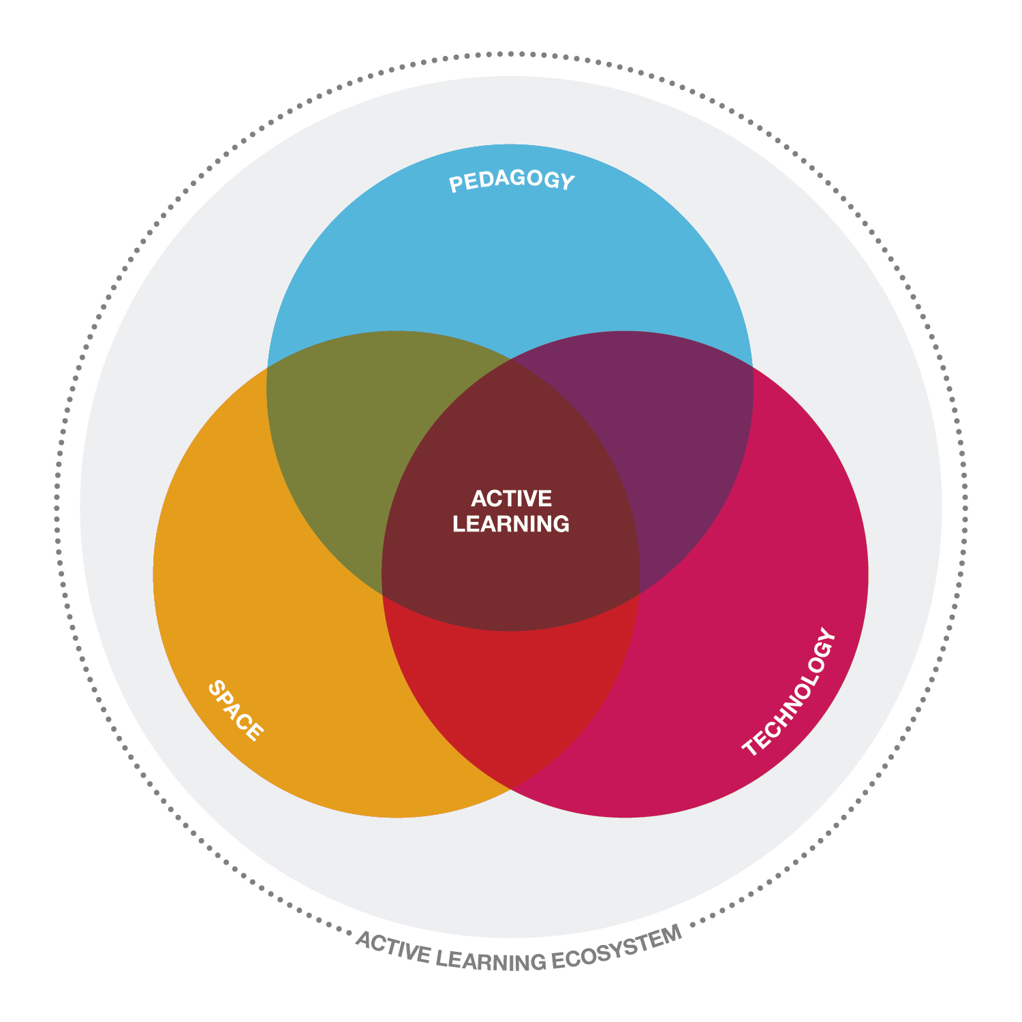
LEARNING PLACES
active learning ecosystem
DESIGN PRINCIPLES
Notes:
Active learning is the guiding principle for all of our work at Steelcase Education Solutions. This diagram illustrates how we think about designing for the active learning ecosystem. This ecosystem suggests pedagogy, technology and space should be all be considered when designing for active learning in all spaces on campus. Pedagogy is purposely placed on top, since it should be the driving force in learning spaces. Then technology and space-related factors should be considered. The three must be considered and planned for together, rather than in isolation.

Slide 65
active learning ecosystem
DESIGN PRINCIPLES
embraces
the complexity of an interconnected world
leverages
the interdependent relationship of pedagogy, technology, and space
provides
an environment of interrelated spaces and solutions that give users choice and control over where and how they learn, through spaces that offer a palette of place, posture and presence
Notes:
In addition to considering the trends we’ve reviewed of the complex change to the world, learning and learners and considering pedagogy, technology and space together, we must also provide students with choice and control over their spaces. Learning spaces that support engaged, active learning do not all look the same.
Place: Users require a range of places for different types of learning.
Posture: The mantra “do no harm” requires a palette of posture.
Presence: Technology and distance learning are driving a palette of presence, whether in-person or connecting via video.

Slide 66
design principles
DESIGN PRINCIPLES
come together
Bring people from multiple buildings and campus together with technology to connect teams distributed around the world.
control and choice
Create a range of spaces and allow people to study in whatever location they learn best; offer a mix of private and public spaces for faculty and students.
amp up or down
Allow faculty and students to choose the amount of sensory stimulation they want at different times.
Notes:
Consider the following when designing these active learning spaces.
Come together: People still need people. Provide connection points for people in space, whether physical or virtual. These connections might be study-related or social.
Choice and control: Provide a range a settings, postures and connection points for students to choose from, depending on the type of work they need to accomplish. One size does not fit all in this case. Allow users to select low-tech, private spaces for solo study and highly connected spaces with HD videoconferencing to connect with distributed group mates or professors when they need it. This range of needs is prevalent on campus. Offering choice and control for users enables them to select the space that is best for them and the work they need to complete.
Amp up or down: Sometimes students want to be socially connected to others, while at other times they need to free themselves from distractions. Plan to support this range of needs throughout campus.

Slide 67
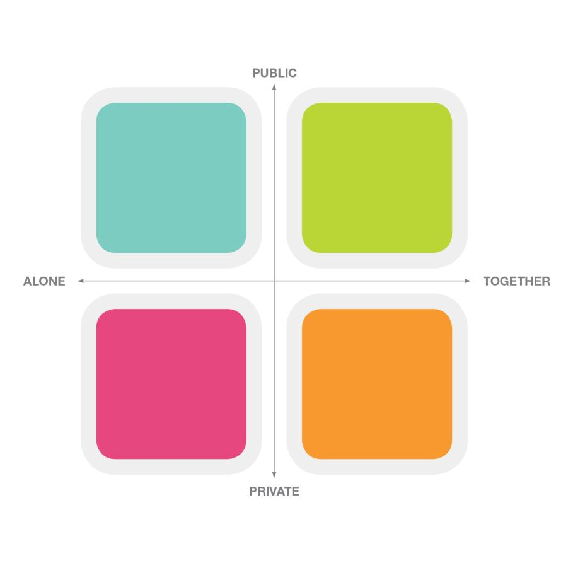
framework for informal learning spaces
DESIGN PRINCIPLES
Plan a range of spaces for a variety of user behaviors and needs
Notes:
To help you think about the range of spaces needed on campus, consider this framework we use for informal learning spaces. We think about informal learning spaces as any place where students lead their own learning – ranging from libraries to cafés or other in-between spaces. This framework structures our thinking about space and behavior when in public or private, when alone or with others. The intent is to thoughtfully provide a range of spaces that support the many needs of learning in these informal spaces.

Slide 68
DESIGN PRINCIPLES
Every space is a learning space.
Notes:
Here are a few applications that incorporate the thinking we have reviewed. These can serve as thoughtstarters for what may be possible on your campus.

Slide 69
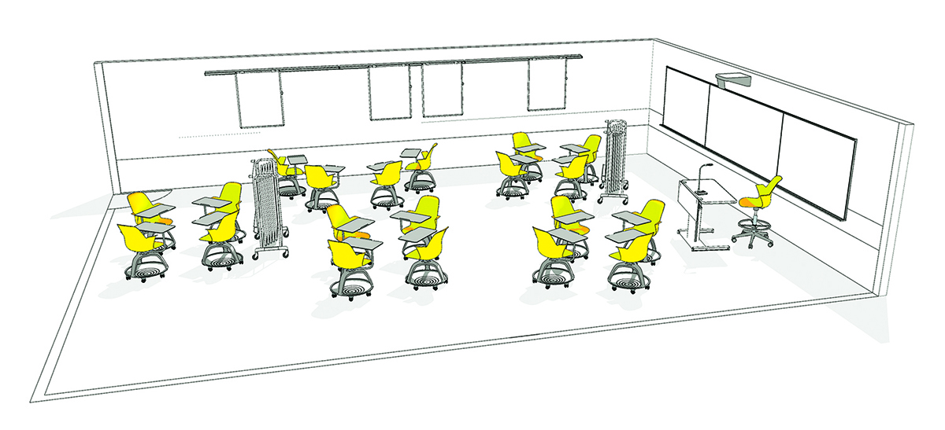
FORMAL LEARNING SPACES
DESIGN PRINCIPLES
Notes:
Real estate is precious. Several classrooms require solutions that support high density, with the added advantages of comfort, flexibility and mobility. This classroom features Node on casters and personal worksurfaces, portable Huddleboards and a height-adjustable instructor table for maximum flexibility and comfort. Node’s swivel seat and mobile casters make it easy for students to have open sightlines to the instructor and other students. Node enables fluid transition between teaching modes.

Slide 70
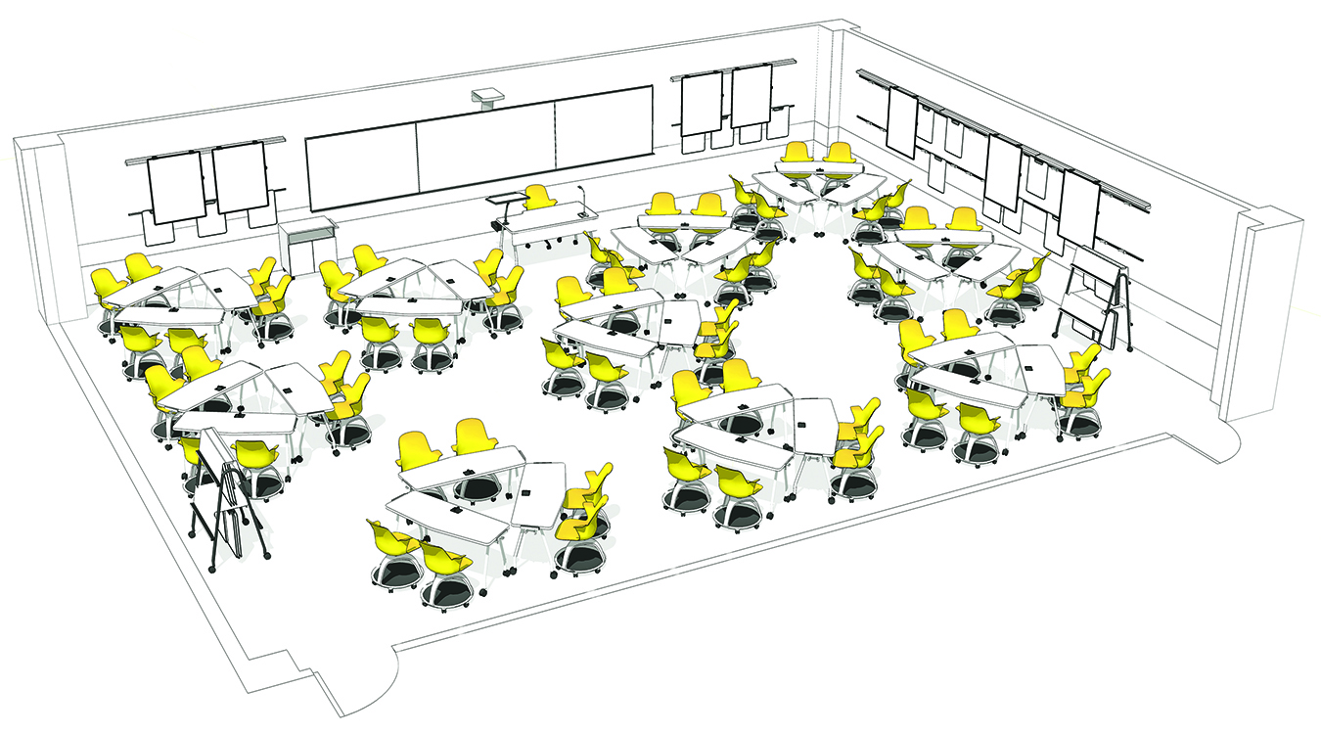
FORMAL LEARNING SPACES
DESIGN PRINCIPLES
Notes:
A large, integrated multi-modal Verb classroom allows students to work together and build community within a large class. Node chairs that can swivel let students easily see others and content throughout the space. Teams of six can easily be configured for group activities while swivel seats allow students to turn to see content and others. As a system, Verb supports multiple pedagogies and learning styles, allowing for fluid transitions between modes. The chevron design allows eye contact to be maintained, even in lecture mode. Team modes are ideal for longer duration projects.

Slide 71
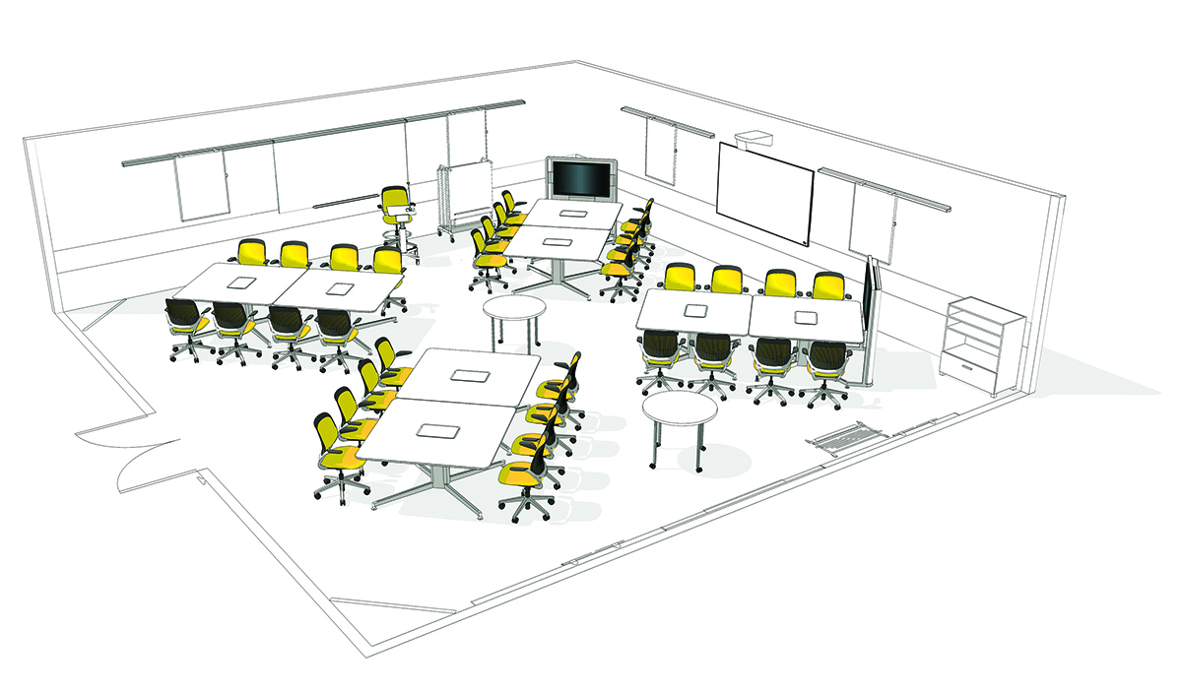
FORMAL LEARNING SPACES
DESIGN PRINCIPLES
Notes:
Combining the innovative LearnLab design with unique media:scape technology creates the opportunity for three distinct modes of sharing digital content: small team co-creation, group sharing and lecture. A media:scape LearnLab supports multiple learning styles and different teaching preferences and offers unprecedented ease in sharing and creating digital content.

Slide 72
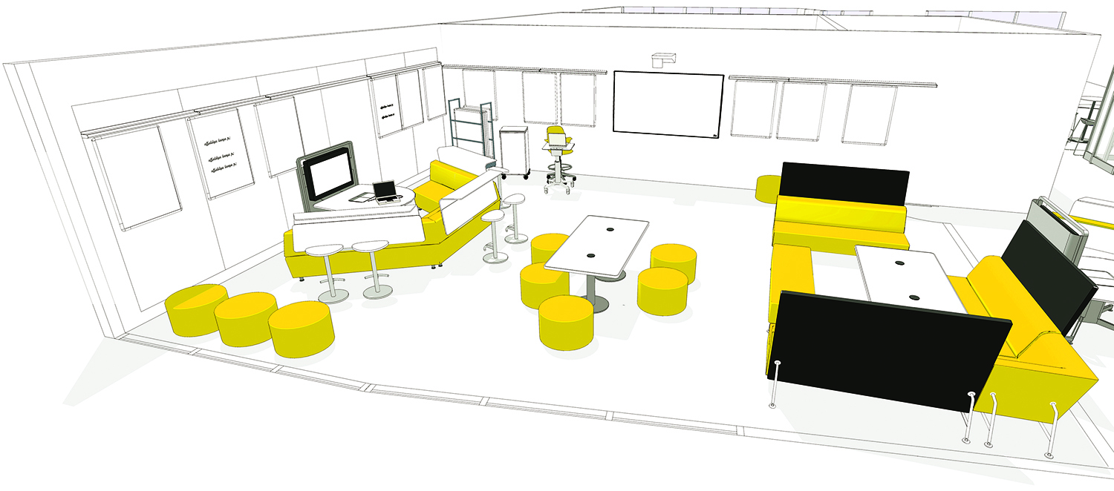
FORMAL LEARNING SPACES
DESIGN PRINCIPLES
Notes:
Active learning typically demands multiple modes of learning and tools within a classroom, often at the same time. This is particularly true at the K12 level. Design multiple zones that support a range of postures and allow students to choose the space that is best for them while allowing access for the instructor to mentor each group. A range of classroom spaces are required to support the many needs of instructors and subject matter.

Slide 73
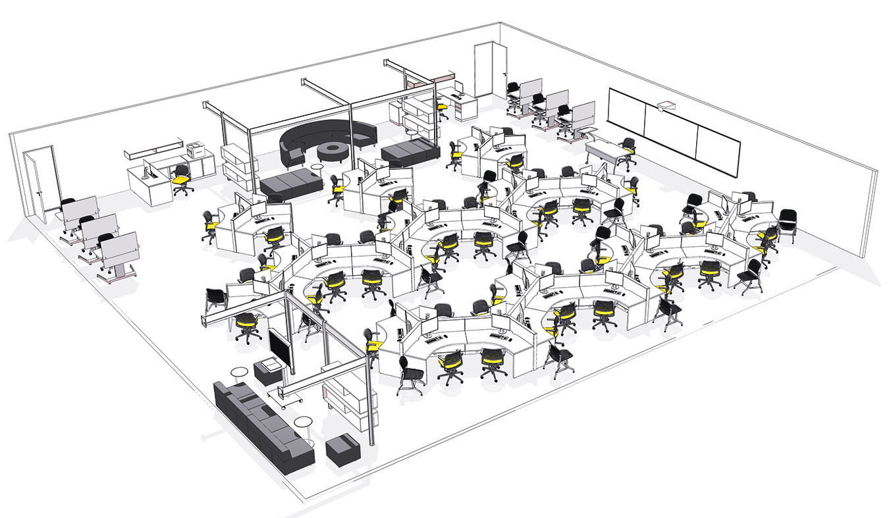
FORMAL LEARNING SPACES
DESIGN PRINCIPLES
Notes:
Designed for both individual and collaborative computer work, media labs let users expand the use of their space as necessary. Students can choose an individual work area or a space for team project work, or they can move easily between the two areas as their work requires. Educators can teach in these spaces and have easy access for assessment.

Slide 74
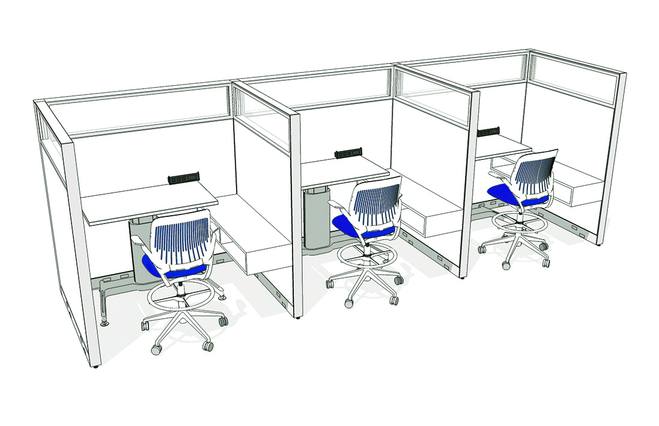
INFORMAL LEARNING SPACES
DESIGN PRINCIPLES
Notes:
Within informal learning spaces, locations for individual work should provide options for short- and long-term stays. Design for posture changes and temporary storage for belongings. Panels with glass panes imply privacy while still providing access to natural light and surroundings. Adjustable height tables allow users to change position over time. Stool-height seating supports new postures for improved wellbeing.

Slide 75
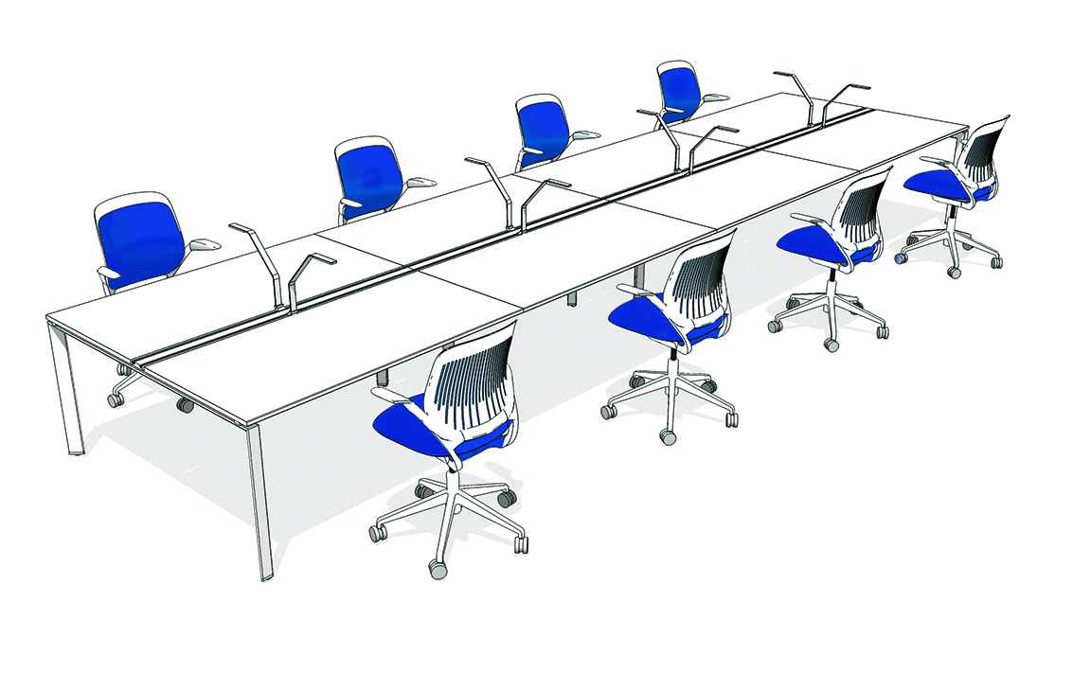
INFORMAL LEARNING SPACES
DESIGN PRINCIPLES
Notes:
Even when focused work is required, students often prefer to study in the presence of others. The FrameOne bench provides students with their own workspace while remaining visually available to others. Soft seating supports a longer stay. Task lighting gives individuals control over their personal setting.

Slide 76
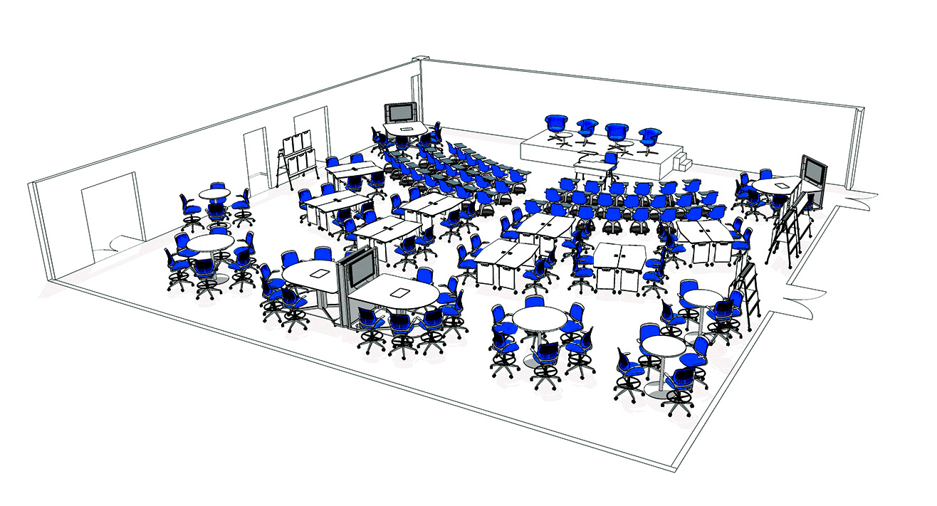
INFORMAL LEARNING SPACES
DESIGN PRINCIPLES
Notes:
Multi-purpose, adaptable spaces are needed to serve a wide variety of functions that may depend on day, week or term. These spaces allow for a rhythm of learning to happen all within one space. A range of settings allow students to engage in multiple activities in one visit. Swivel chairs give control to seated students to orient themselves to activities. Multiple settings allow for digital and analog co-creation.

Slide 77
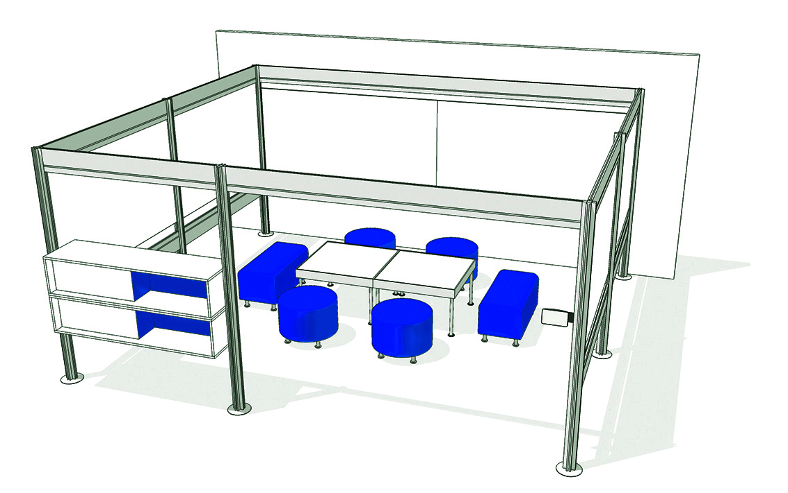
INFORMAL LEARNING SPACES
DESIGN PRINCIPLES
Notes:
Groups often meet to complete assignments in libraries. Provide them with privacy from others and tools to collaborate. Whiteboard surfaces allow teams to brainstorm and collaborate. Post and Beam divides open spaces, providing the privacy groups need from others. Easily movable and low furniture allows students to make the space their own. Room scheduling systems allow groups to reserve a space in advance, avoiding a search for open project space.

Slide 78
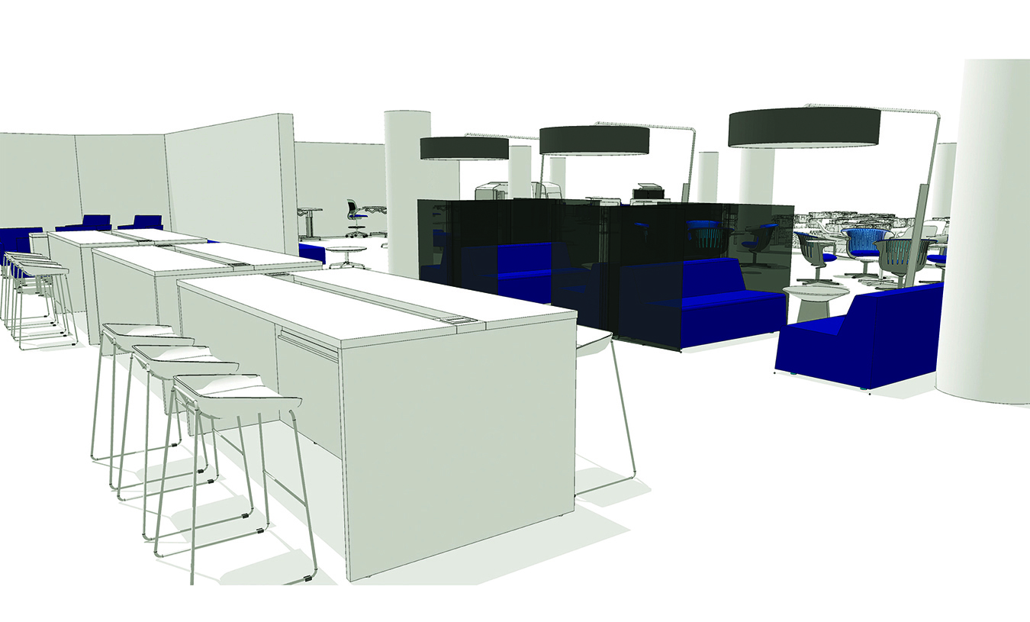
INFORMAL LEARNING SPACES
DESIGN PRINCIPLES
Notes:
From standing-height tables to collaborative seating, this lounge provides students a variety of spaces from which to choose. The Campfire Big Table can be used as a meeting place or a workstation for six people. It comes with a full top or is available with a technology tray and power for a great place to power up and study. The Campfire collection provides
spaces with a wide range of private or open solutions. Here, a more private space offers students a getaway from other, more public lounge spaces.

Slide 79
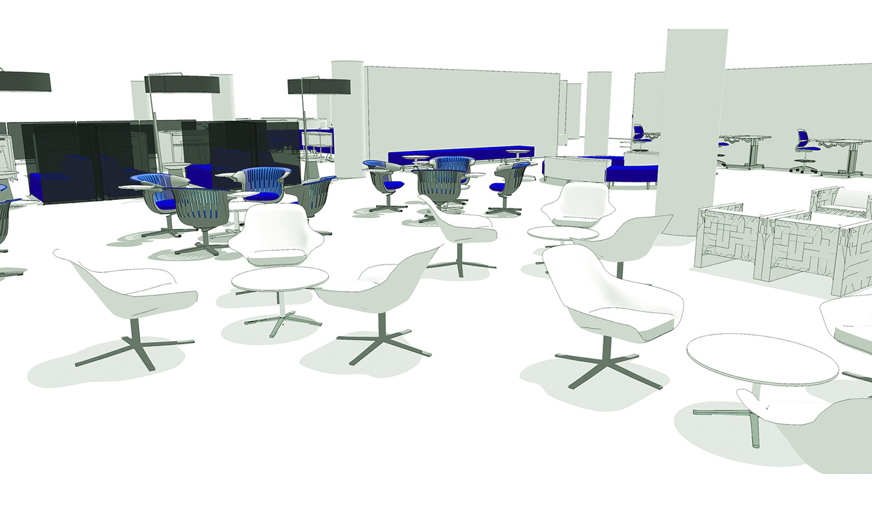
INFORMAL LEARNING SPACES
DESIGN PRINCIPLES
Notes:
This is a highly social lounge space where students can intentionally and by coincidence connect with faculty or fellow students. The Bob lounge chair offers a more modern design,
giving this lounge space a unique style of its own. i2i seating is designed for collaboration, offering students the ability to orient themselves to their fellow collaborators without taking away their focus or sacrificing comfort.

Slide 80
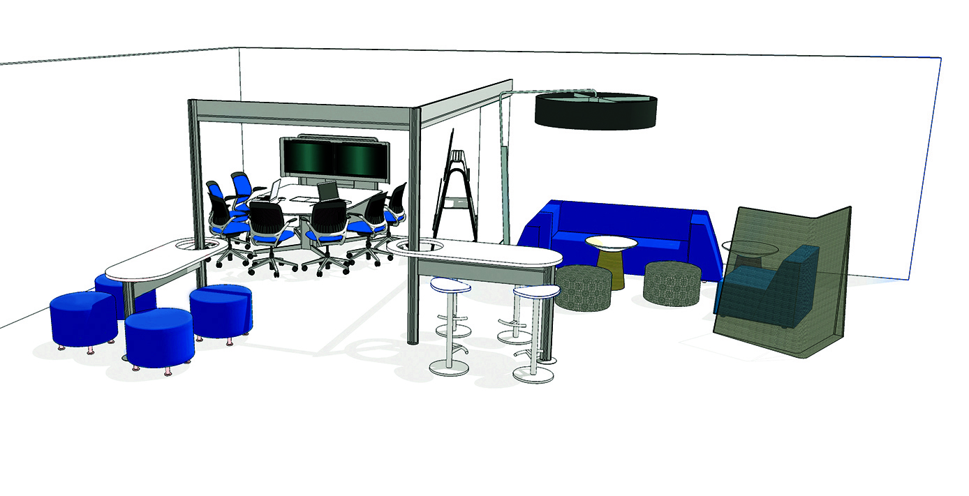
INFORMAL LEARNING SPACES
DESIGN PRINCIPLES
Notes:
Learning expands beyond the four walls of a classroom. Making use of in-between spaces allows every space to become a learning space. Digital display allows for easy sharing of content. Lounge seating allows students to comfortably and informally communicate. Casual seating allows students to work together or alone. Stand-up stations allow students to quickly touch down between classes.

Slide 81
Instead of building schools for 1950, let’s build schools for 2050. Schools designed with the community and for the community. Schools that reflect a dedication to excellence and innovation; schools that are open to all Americans of all ages; that reaffirm the democratic spirit of our great country in the new era of lifelong learning.
Richard Riley, former U.S. Secretary of Education

Slide 82
Classroom research presentation
LearnLab research presentation
Library research presentation
media:scape test drive
next
steps

Slide 83


